Slide 1

Accessory Dwelling Units
Baystate Training Hub
Paul Halfmann, October 22, 2025

Slide 2
Benefits of ADUS
For Property Owners
Additional rental income can help offset maintenance and repair costs
Low-cost housing may allow adult children & other relatives to remain in the community
Long-term options for seniors
Opportunity for caregivers to live close by
Downsize while remaining in their community

Slide 3
Benefits of ADUS
For Renters
Increase the number of affordable housing for smaller households and younger adults
Long-term residents may remain in the community

Slide 4
Benefits of ADUS
For Massachusetts
Increases affordable and diverse housing opportunities
Provides accessible housing for seniors, people with medical needs/disabilities and their care givers
Makes use of existing land, structures & infrastructure
More economical than building a single-family home on a new lot
A more sustainable option
Smaller units use less water & electricity

Slide 5
the Law
Affordable Homes Act was signed August 6, 2024
Revised section 1A (definitions) and section 3 (local zoning prohibitions) of Chapter 40A of the Mass General Laws
Section 1A, Accessory Dwelling Unit: a self-contained housing unit, inclusive of sleeping, cooking and sanitary facilities on the same lot as a principal dwelling, subject to otherwise applicable dimensional and parking requirements, that:
(i) Maintains a separate entrance, either directly from the outside or through an entry hall or corridor shared with the principal dwelling sufficient to meet the requirements of the state building code for safe egress;

Slide 6
the Law
Section 1A, Accessory Dwelling Unit:
(ii) Is not larger in gross floor area than 1/2 the gross floor area of the principal dwelling or 900 square feet, whichever is smaller; and
(iii) Is subject to local additional restrictions
additional size restrictions
restrictions/prohibitions for use as short-term rental, c. 64G s.1
no municipality shall unreasonably restrict the creation or rental of an accessory dwelling unit that is not a short-term rental.

Slide 7
the Law
Ch. 64G, s. 1:
Short-Term Rental: An owner-occupied, tenant-occupied, or non-owner-occupied property, such as an apartment, house, cottage, condominium, or furnished accommodation that is not a hotel, motel, lodging house, or bed and breakfast establishment, where at least one room or unit is rented to an occupant, and all accommodations are reserved in advance.

Slide 8
M.G.L. c. 40A, § 3
Added to section 3 of 40A:
No zoning ordinance or by-law shall prohibit, unreasonably restrict or require a special permit or other discretionary zoning approval for the use of land or structures for a single accessory dwelling unit, or the rental thereof, in a single-family residential zoning district;

Slide 9
M.G.L. c. 40A, § 3
May be subject to reasonable regulations, including, but not limited to, 310 CMR 15.000 et seq., if applicable, site plan review, regulations concerning dimensional setbacks and the bulk and height of structures and may be subject to restrictions and prohibitions on short-term rental, as defined in section 1 of chapter 64G
The use of land or structures for an accessory dwelling unit under this paragraph shall not require owner occupancy of either the accessory dwelling unit or the principal dwelling;

Slide 10
M.G.L. c. 40A, § 3
Not more than 1 additional parking space shall be required for an accessory dwelling unit
No additional parking space shall be required for an accessory dwelling located not more than 0.5 miles from a commuter rail station, subway station, ferry terminal or bus station.

Slide 11
M.G.L. c. 40A, § 3
For more than 1 accessory dwelling unit, or rental thereof, in a single-family residential zoning district there shall be a special permit for the use of land or structures for an accessory dwelling unit.
The Executive Office of Housing and Livable Communities has issued guidelines and promulgated regulations.

Slide 12
Municipality’s Authority
May impose reasonable restrictions and requirements
Site Plan Review
Title 5 Requirements
Dimensional Setbacks, Bulk & Height of Structures
Short-term Rentals

Slide 13
Municipality’s Authority
May NOT
Require owner occupancy for the ADU or the principal dwelling
Require a special permit or other discretionary zoning approval for the use or rental of an ADU
Require more than 1 parking space for an ADU located outside 0.5 miles from a commuter rail station, subway station, ferry terminal or bus station
Require any parking for an ADU located within 0.5 miles from a commuter rail station, subway station, ferry terminal or bus station

Slide 14
Executive Office of Housing and Livable Communities (EOHLC)
760 CMR 71.00: PROTECTED USE ACCESSORY DWELLING UNITS, Promulgated January 31, 2025
Purpose
Encourage the production of accessory dwelling units throughout the Commonwealth
Goal of increasing the production of housing to address statewide, local, and individual housing needs for households
Balance municipal interests in regulating the use and construction of ADUs while empowering property owners to add much needed housing

Slide 15
EOHLC Regulations
Definitions
ADU definition mirrors statute
Protected Use ADU - An attached or detached ADU that is located, or is proposed to be located, on a Lot in a Single-family Residential Zoning District and is protected by M.G.L. c. 40A, § 3, provided that only one ADU on a lot may qualify as a Protected Use ADU. An ADU that is nonconforming to Zoning shall still qualify as a Protected Use ADU if it otherwise meets this definition.

Slide 16
EOHLC Regulations
Definitions
Site Plan Review - A process established by local ordinance or by-law by which a Municipal board or authority may review and impose terms and conditions on, the appearance and layout of a proposed use of land or structures prior to the issuance of a building permit.
Transit Station - A Subway Station, Commuter Rail Station, Ferry Terminal, or Bus Station
Unreasonable Regulation - Zoning restrictions and Municipal regulations that are unreasonable pursuant to 760 CMR 71.03(3)(b).

Slide 17
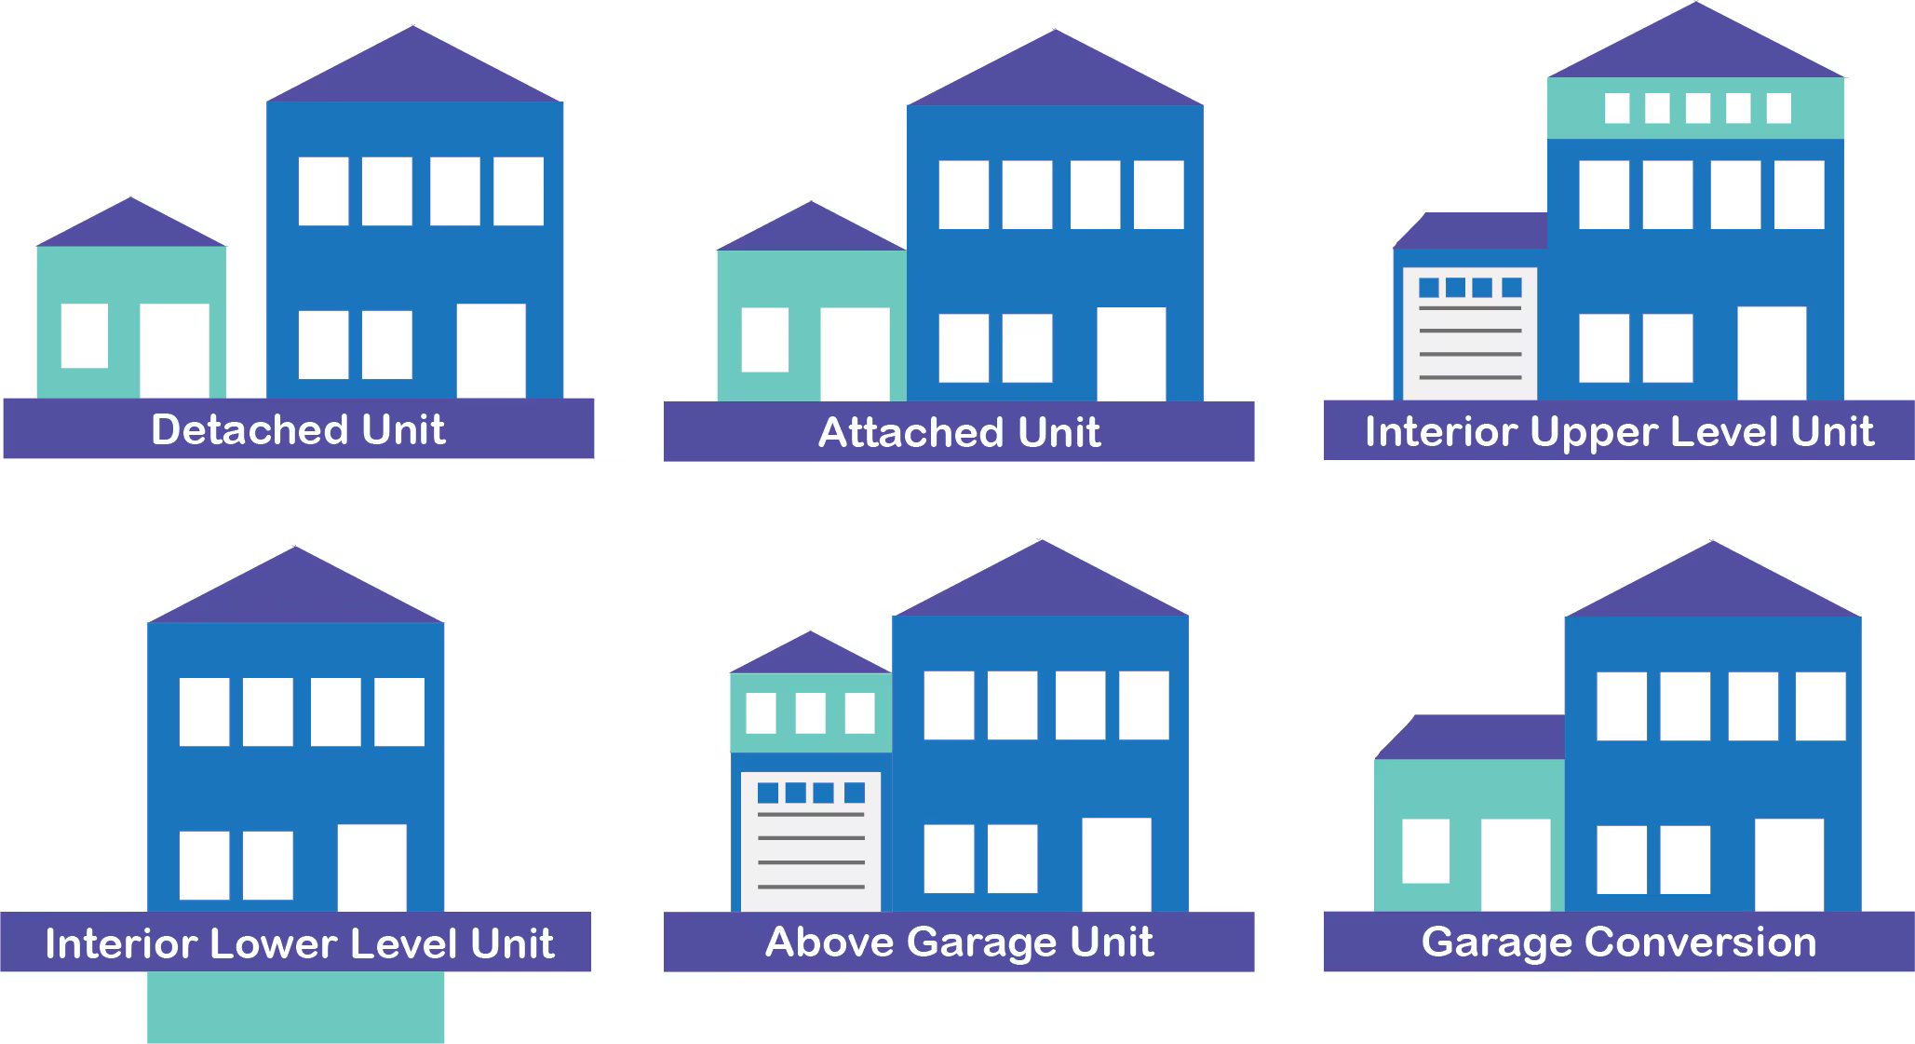
EOHLC Regulations

Slide 18
EOHLC Regulations
71.03 Regulation of Protected Use ADUs
Municipalities shall not prohibit, impose a Prohibited Regulation or Unreasonable Regulation. Municipalities may reasonably regulate a Protected Use ADU, subject to the limitations under 760 CMR 71.00 Prohibited Regulation or Unreasonable Regulation, or, except as provided under 760 CMR 71.03(5) and 760 CMR 71.03(6).
Prohibited Regulation - Municipality shall not subject the use of land or structures
Owner-Occupancy
Minimum Parking Requirements
Use & Occupancy Restrictions
Unit Caps & Density
Relationship to Principal Dwelling
Notes:
Caps & Density for the entire community

Slide 19
EOHLC Regulations
71.03 Regulation of Protected Use ADUs
Unreasonable Regulation.
A Municipality may reasonably regulate and restrict Protected Use ADUs provided that any restriction or regulation imposed by a Municipality shall be unreasonable if the regulation or restriction, when applicable to a Protected Use ADU:
Does not serve a legitimate Municipal interest sought to be achieved by local Zoning;
Serves a legitimate Municipal interest sought to be achieved by local Zoning but its application to a Protected Use ADU does not rationally relate to the legitimate Municipal interest; or

Slide 20
EOHLC Regulations
71.03 Unreasonable restriction/regulation
Serves a legitimate municipal interest sought to be achieved by local zoning and its application to a Protected Use ADU rationally relates to the interest, but compliance with the regulation or restriction will
Result in complete nullification of the use or development of a Protected Use ADU;
Impose excessive costs on the use or development of a Protected Use ADU without significant gain in advancing the municipality’s legitimate interest; or
Substantially diminish or interfere with the use or development of a Protected Use ADU without appreciably advancing the municipality's legitimate interest

Slide 21
EOHLC Regulations
71.03 Unreasonable restriction/regulation
Municipalities shall apply the analysis articulated in 760 CMR 71.03(3)(a) to establish and apply reasonable Zoning or general ordinances or by-laws, or Municipal regulations for Protected Use ADUs, but in no case shall a restriction or regulation be found reasonable where it exceeds the limitations, or is inconsistent with provisions, described below, as applicable:
Design standard
Would not be applied to a Single-Family Residential Dwelling
Is so restrictive, excessive, burdensome, or arbitrary that it prohibits, renders infeasible, or unreasonably increases the costs of use or construction

Slide 22
EOHLC Regulations
Restrictions/regulations shall be considered unreasonable when
Dimensional standards
Dimensional setbacks, lot size, lot coverage, open space, and the bulk and height of structures that are more restrictive than what is required for a Single-Family Residential Dwelling
Utilities, safety & emergency access
Any requirements that are more restrictive than state requirements, including the Fire Code
Environmental regulation
For the protection of public health, safety, welfare and the environment pursuant to Title 5, 310 CMR 15.000 that is more restrictive than for a Single-Family Residential Dwelling

Slide 23
EOHLC Regulations
Restrictions/regulations shall be considered unreasonable when
Site plan review
Any requirement under Site Plan Review concerning the Protected Use ADU that is not clear and objective or imposes terms and conditions that are unreasonable or inconsistent with an as-of-right process as defined in M.G.L. c. 40A, § 1A.
Impact analysis & studies
Any requirement for any impact analysis, study, report, or impact fee that is not required for the development of a Single-family Residential Dwelling in the Single-family Residential Zoning District in which the Protected Use ADU is located.

Slide 24
EOHLC Regulations
Restrictions/regulations shall be considered unreasonable when
Modular dwelling units
Any requirement that prohibits, regulates or restricts a Modular Dwelling Unit from being used as a Protected Use ADU that is more restrictive than the Massachusetts State Building Code
Historic Districts
Municipalities may establish Design Standards and Dimensional Standards for Protected Use ADUs located in an Historic District that are more restrictive or different from what is required for a Single-family Residential Dwelling, or Principal Dwelling, in the Single-family Residential Zoning District; provided, however, that such standards are not unreasonable pursuant to 760 CMR 71.03(3)(a).

Slide 25
EOHLC Regulations
Restrictions/regulations shall be considered unreasonable when
Pre-existing Nonconforming Structures.
A Municipality may not prohibit the development of a Protected Use ADU in an existing structure or Principal Dwelling, or Lot due to nonconformance, that could be used for, or converted into, a Protected Use ADU in conformance with the Building Code, 760 CMR 71.00, and state law.
Short-Term rentals.
Municipalities may establish restrictions and prohibitions

Slide 26
EOHLC Regulations
Enforceability of Restrictions and Regulations on Pre-Existing ADUs
A municipality shall not enforce any Prohibited Regulation or Unreasonable Regulation that was imposed as a condition for the approval of the use of land or structures for a Protected Use ADU prior to the effective date of 760 CMR 71.00
Special Permits for Multiple ADUs on the Same Lot.
Zoning shall require a Special Permit in a Single-Family Residential Zoning District for the use of land or structures for an ADU, or rental thereof, on a Lot on which a Protected Use ADU is already located

Slide 27
EOHLC Regulations
Annual updates
Municipalities shall collect and maintain, at a minimum, data related to their permitting of ADUs, in a format specified by EOHLC
The number of approved ADU permit applications, separately tabulated for attached and detached ADUs;
The number of denied ADU permit applications;
The number of occupancy permits issued for any ADU; and
Other data or information as may be further provided for in EOHLC guidelines
Annual report
Municipalities shall annually submit a report to EOHLC not later than March 31 containing the data collected for the prior calendar year on a form as prescribed by EOHLC

Slide 28
Manufactured Housing
Section 32Q. As used in sections thirty-two A to thirty-two P, inclusive, the words ''manufactured home'' shall mean a structure, built in conformance to the National Manufactured Home Construction and Safety Standards which is transportable in one or more sections, which in the traveling mode, is eight body feet or more in width or forty body feet or more in length, or, when erected on site, is three hundred twenty or more square feet, and which is built on a permanent chassis and designed to be used as a dwelling unit with or without a permanent foundation when connected to the required utilities, and includes the plumbing, heating, air conditioning, and electrical systems contained therein.

Slide 29
DEP Title 5 Guidance
DEP released a guidance document regarding regulatory requirements for ADUs, which stated:
“The addition of an ADU to an existing Facility meets the definition of New Construction if it increases the design flow to the Facility’s septic system (calculated at 110 gpd/bedroom) regardless of whether sanitary sewage from the ADU is discharged to the existing septic system, or to a newly proposed septic system serving only the ADU. This is because both the ADU and the existing principal dwelling will be located on the same Facility and both septic systems are deemed to be one septic system serving the Facility in accordance with the definition of On-site System in 310 CMR 15.002 (a system or series of systems).”

Slide 30
Closing
This is a zoning law
No exemption in the statute or regulation from Housing, Building, Electric, Fire, Plumbing, Title 5 or any other regulations related to residential property
For inspection purposes, they are to comply with 105 CMR 410.000 requirements and any other applicable regulations under the authority of the board of health

Slide 31
References
Section 1A, Chapter 40A, https://www.mass.gov/info-details/mass-general-laws-c40a-ss-1a
Section 3, Chapter 40A, https://malegislature.gov/Laws/GeneralLaws/PartI/TitleVII/Chapter40A/Section3
MDEP, Mass.gov/dep
Guidance on Title 5 (310 CMR 15.000) Compliance for Accessory Dwelling Units
Frequently Asked Questions (FAQ) Related to Guidance on Title 5 (310 CMR 15.000) Compliance for Accessory Dwelling Units
MDPH Housing Regulations, https://www.mass.gov/regulations/105-CMR-41000-minimum-standards-of-fitness-for-human-habitation-state-sanitary-code-chapter-ii

Slide 32

Questions?
Paul Halfmann, MPH, RD
halfmannphc@gmail.com
508.340.6590

