Slide 1
Mosquito Control in Bristol County Information and Education
Priscilla Matton, M.S.- Superintendent
Bristol County Mosquito Control Project
38R Forest Street
Attleboro, MA 02703

Slide 2
BCMCP Activities
Mosquito Viral Surveillance: Cooperative program with the MA Department of Public Health to monitor for Eastern Equine Encephalitis and West Nile Virus in the adult mosquito populations. We use a variety of trap types depending on the environment and the species of mosquitoes wanted.
Spring and Summer Larviciding: To reduce the emergence of adult mosquitoes in areas where mosquito larvae are present.
Catch Basin Treatment: To stop mosquito emergence from water-filled catch basins and storm drains especially for WNV vectors.

Slide 3
BCMCP Activities cont.
Ground-Based Adulticiding: Truck based ultra-low volume (ULV) adulticiding to control both nuisance and vector mosquitoes.
Water Management: A year-round endeavor to clean and maintain mosquito drainage ditches in areas to reduce standing water conducive to mosquito larvae.
Public Outreach: Providing important information to the residents of the county with respect to personal protection against mosquito bites, mosquito breeding prevention on one’s property and mosquito data.

Slide 4
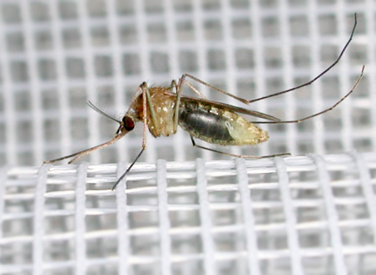
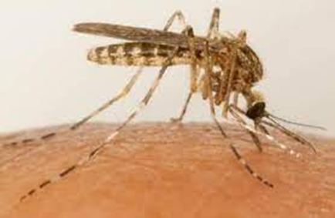
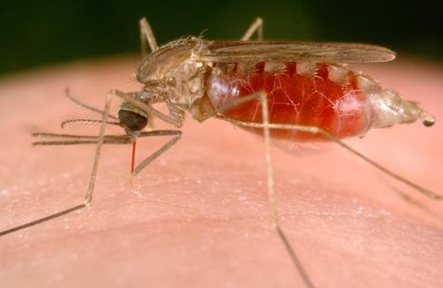
Massachusetts Mosquitoes
There are 53 species in the state
Only the females bite, and not all our species bite people
The overwintering stage is species specific; eggs, larvae, or adult females may overwinter

Slide 5
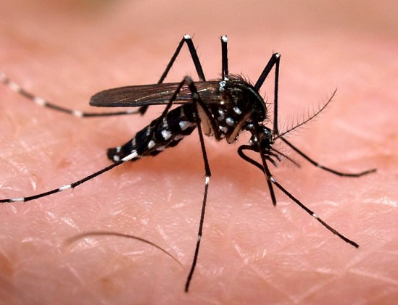
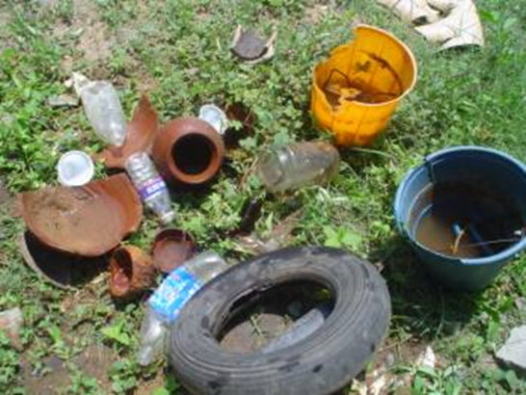
Aedes albopictus- Asian Tiger Mosquito
Invasive - tree hole mosquito
Prefers small – medium containers
ATM eggs are desiccation-resistant
ATM is an aggressive daytime feeder of mammals
Bridge vector potential
EEE, WNV, Dengue, Zika & Chikunguyna
Localized population on the South Coast and along RI border

Slide 6
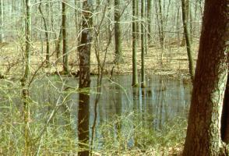
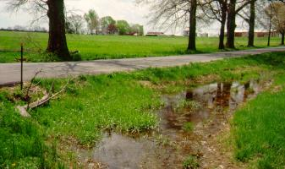
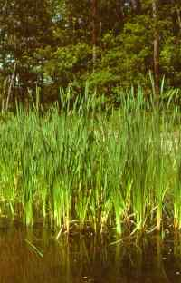
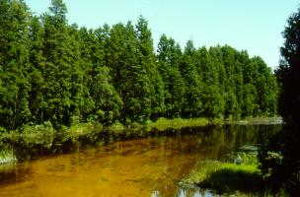
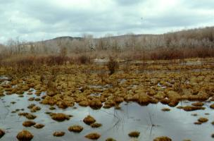
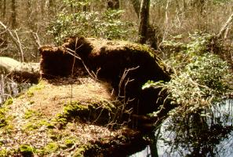
Summer floodwater in ditch
Cattail marsh
Spring woodland pool
Extensively flooded freshwater
marsh extending into swamp
Cedar Swamp Crypts

Slide 7
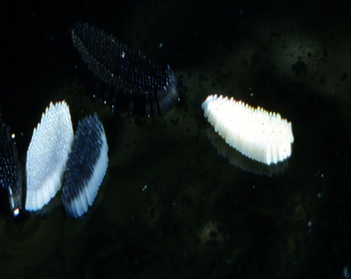
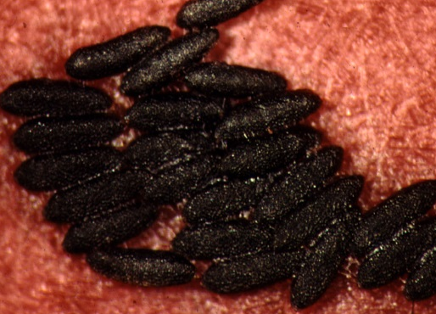
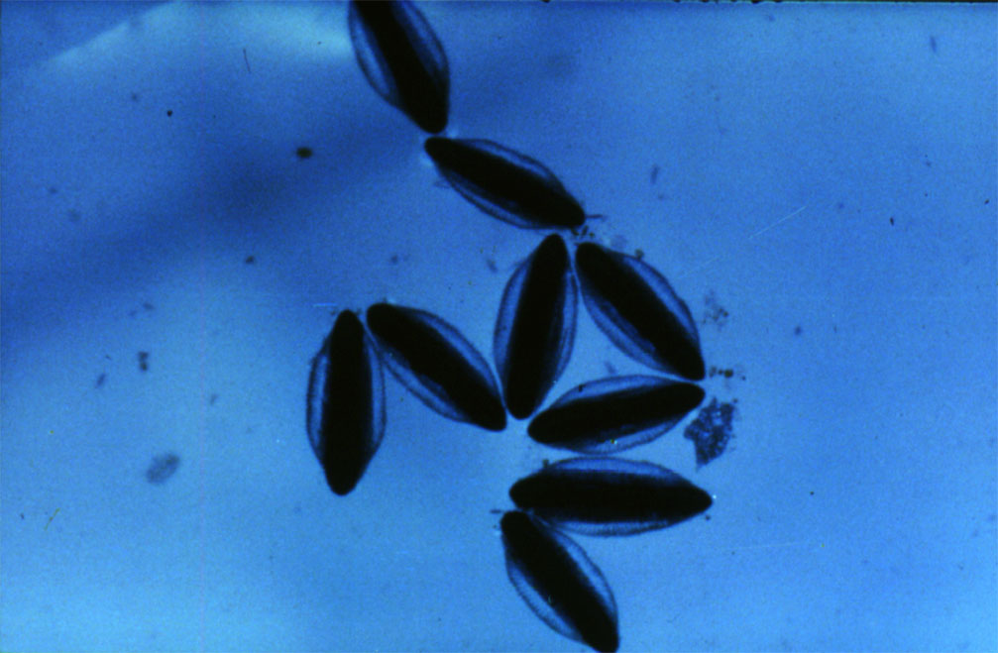
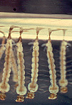
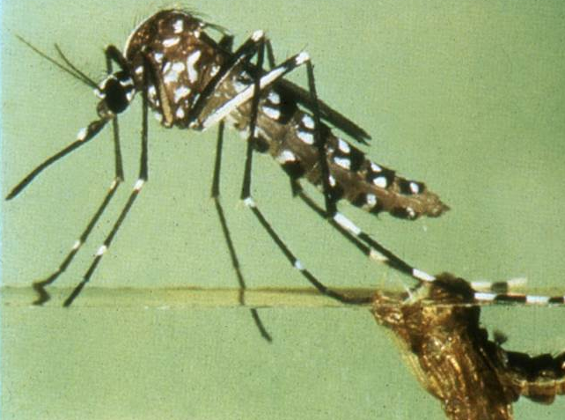
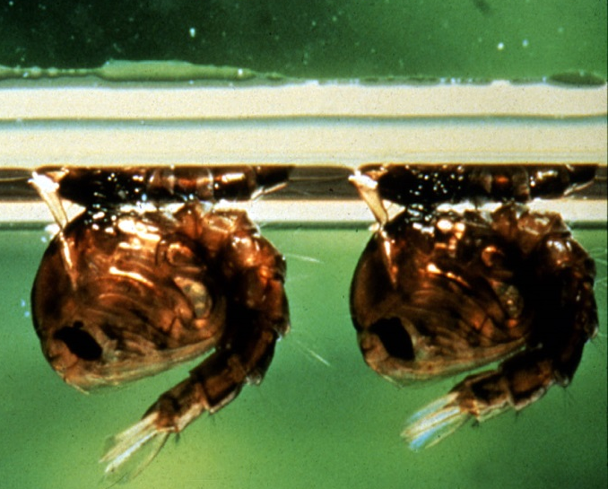
Life Cycle of a Mosquito
EGGS
ADULT
PUPAE
LARVAE

Slide 8
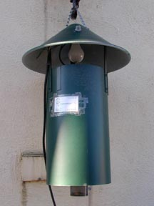
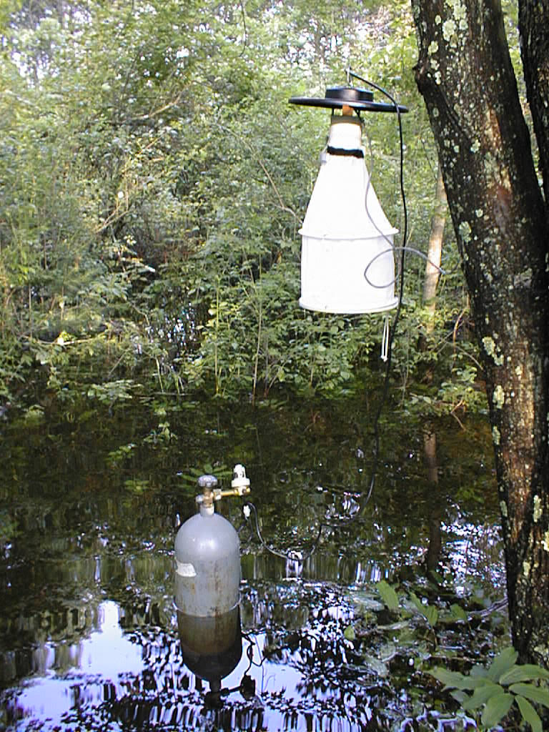
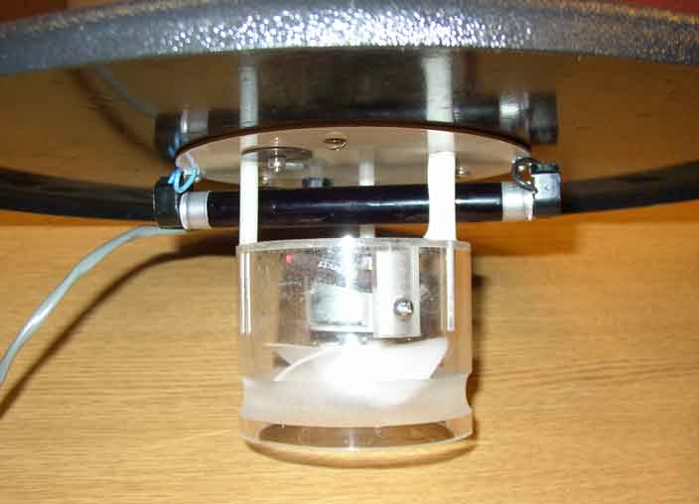
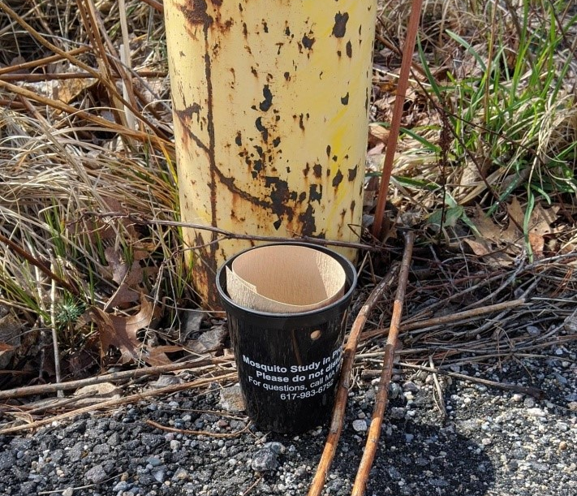
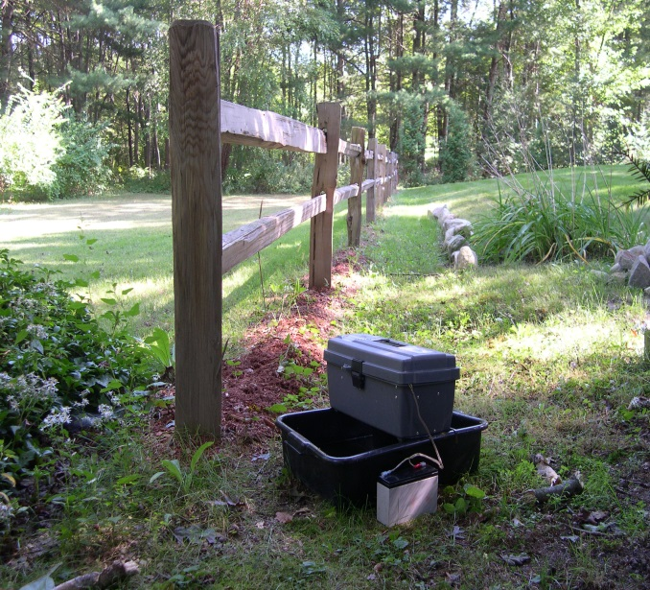
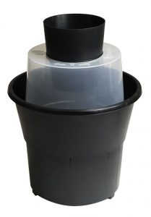
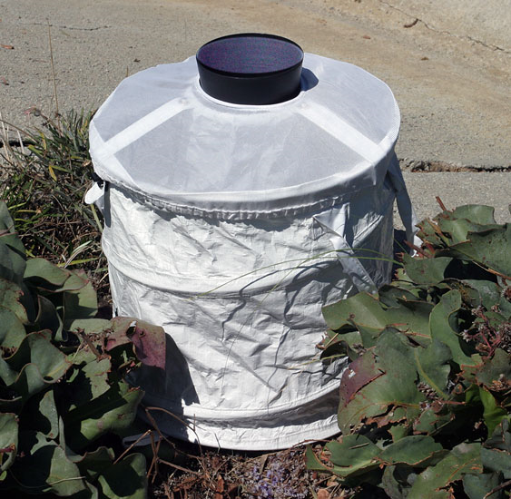
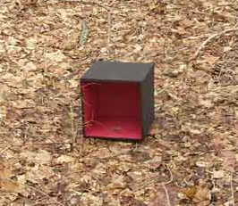
Surveillance
The Cornerstone to Integrated Mosquito Management
NJ Light Trap
Ovi Cup
UV light
CDC Light Trap
Gravid Trap
GAT trap
Resting Boxes
BG Sentinel

Slide 9
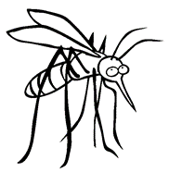

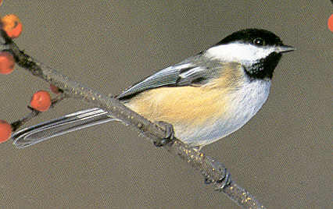

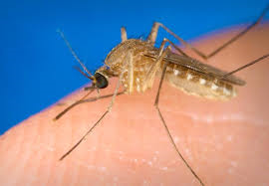
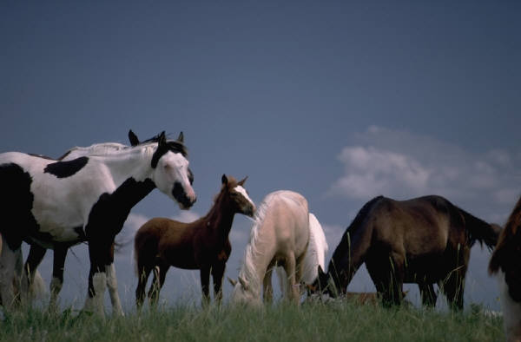
WNV & EEE Virus Cycle
Incidental infections
Birds- Reservoir Host
Bridge Vectors
Incidental infections
Mosquito Vector
Not spread person-to-person, not spread from horses to people

Slide 10
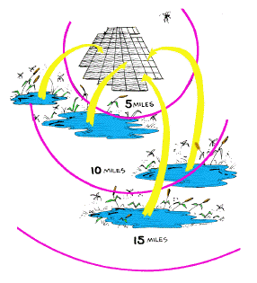
How far does a mosquito fly?

Slide 11
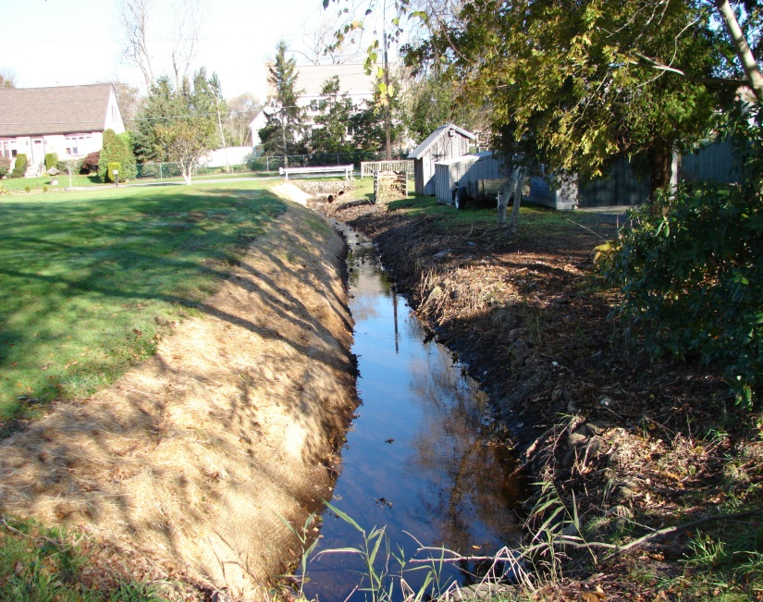
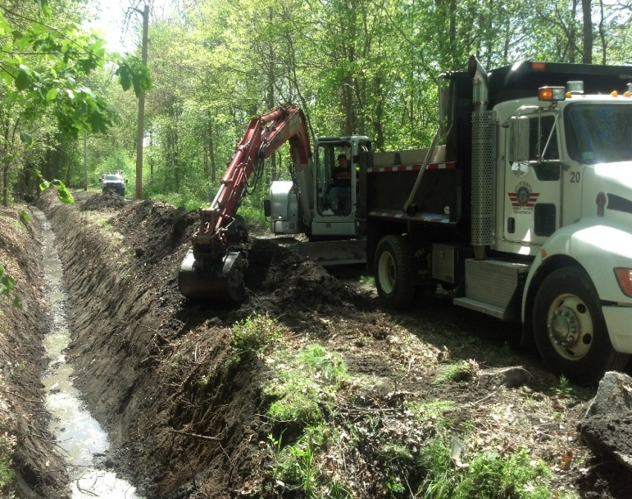
Water management
Our goal is to remove debris, silt and vegetation from drainage ditches throughout our service area to improve water flow, thus eliminating standing water conducive to larval development.
Performed by hand or mechanized (with excavator )
We use erosion control materials and re-seed to stabilized soils
Cleaning out or rebuilding culverts
Marsh restoration

Slide 12
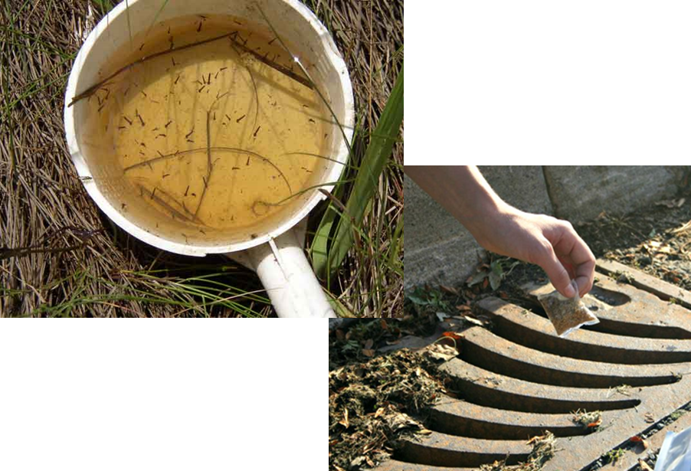
Larvicide
How: Fixed-wing airplane, helicopter or hand
Where: Wetlands, standing water & catch basins
When: Larvae are present & water will remain for complete lifecycle
Who: BCMCP
Products: B.t.i & B. sphaericus products- VectoBac 12AS, VectoLex FG, VectoLex WSP, & FourStar CRG
Opt-out: 333 CMR 13.03- online form (BCMCP or SRMCB website)
Marking the boundaries or areas to be excluded at least every 50 feet using marking methods approved by the Dept which clearly defines the area of exclusion.
Requests for exclusion shall not be honored if: (a) The request is not made in accordance with 333 CMR 13.03; (b) The Commissioner of Public Health has certified that the application is to be made to protect the Public Health; etc.

Slide 13
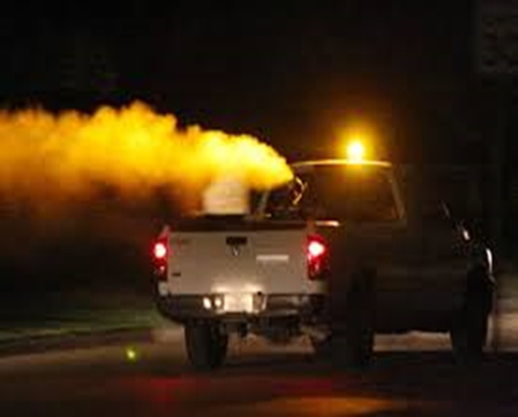
Truck-based ULV Adulticide
How: Pick-up truck
Guidelines:
Small droplet size
Low application rate ~0.64 oz/acre
Truck speed: 5-15 mph
Not less than 50-55°F
Winds < 10 mph
Made between Dusk & Dawn
Where: All 20 towns
When: Surveillance says:
Adults are present/Residential Request
EEE or WNV detections
Abundance of disease vector species
Time of year
Who: BCMCP
Products: Duet Dual Action ULV- Pyrethroid
Opt-out: 333 CMR 13.03- online form
(BCMCP or SRMCB website)
Marking the boundaries or areas to be excluded at least every 50 feet using marking methods approved by the Dept. which clearly defines the area of exclusion.
Requests for exclusion shall not be honored if: (a) The request is not made in accordance with 333 CMR 13.03; (b) The Commissioner of Public Health has certified that the application is to be made to protect the Public Health; etc.

Slide 14
How to make a spray request
call (508) 823-5253 (8am- 2pm)
fax (508) 828-1868
e-mail a spray request to: RequestBristolMCP@comcast.net
Please include last name and full address including zip code.
Please note that a request is for one application and not for the whole season

Slide 15
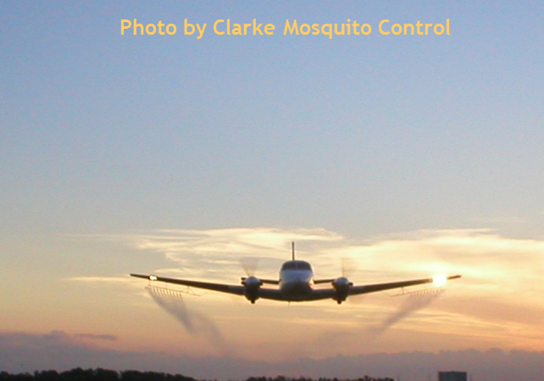
State sponsored Aerial ULV Adulticide
How: Fixed-wing airplane contractor
Where: Surveillance dictates
When: Surveillance dictates
Who: SRMCB/MA DPH
Products: MDAR w/ consultation from DPH, DEP, DFG & MAG
Anvil 10 + 10 ULV
Opt-out: Acts 2000- Chapter 120 Sec 2- Amendment to Ch 252
Municipalities to opt out of spraying conducted by SRMCB
(a); Alternative mosquito management plan approved by the executive office
(b); Public Selectman/Council meeting with public comment
MA Arbovirus Surveillance & Response Plan

Slide 16
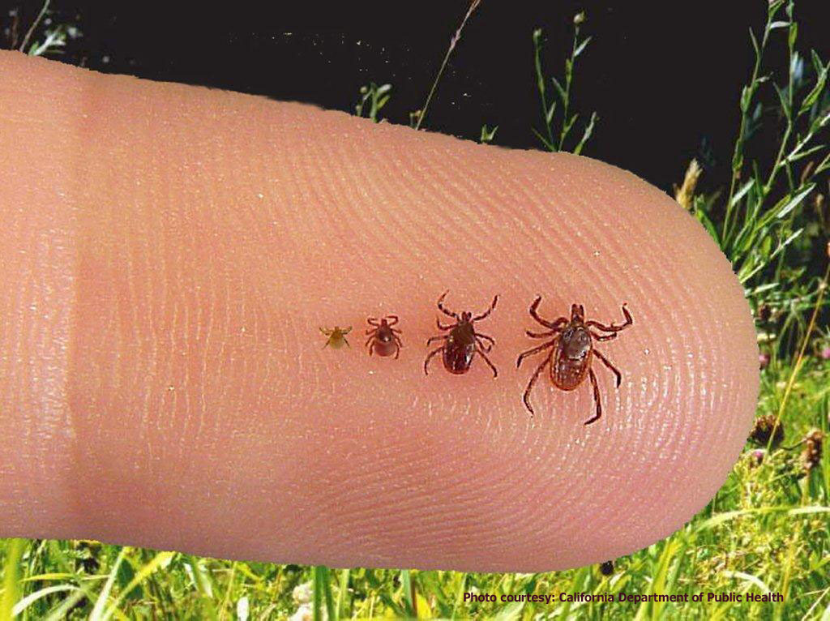
Beware of Ticks!
Active year-round
Won’t jump or drop from trees or brush
Will wait for you to come into contact
Stay on the trails, do not walk into the brush
Separate yard from woods with a clear line
Perform tick checks
Larvae as small as a poppyseed

Slide 17
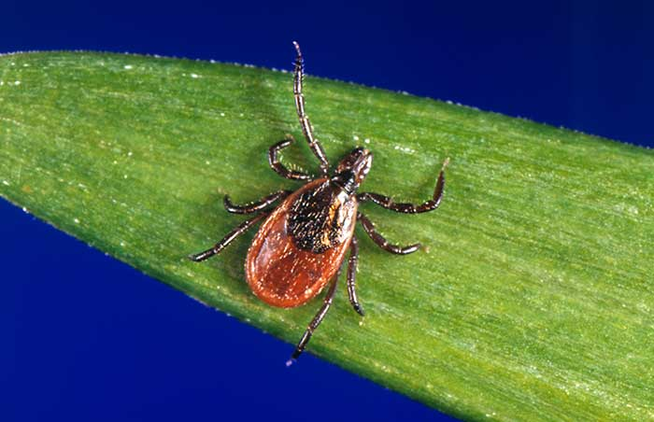
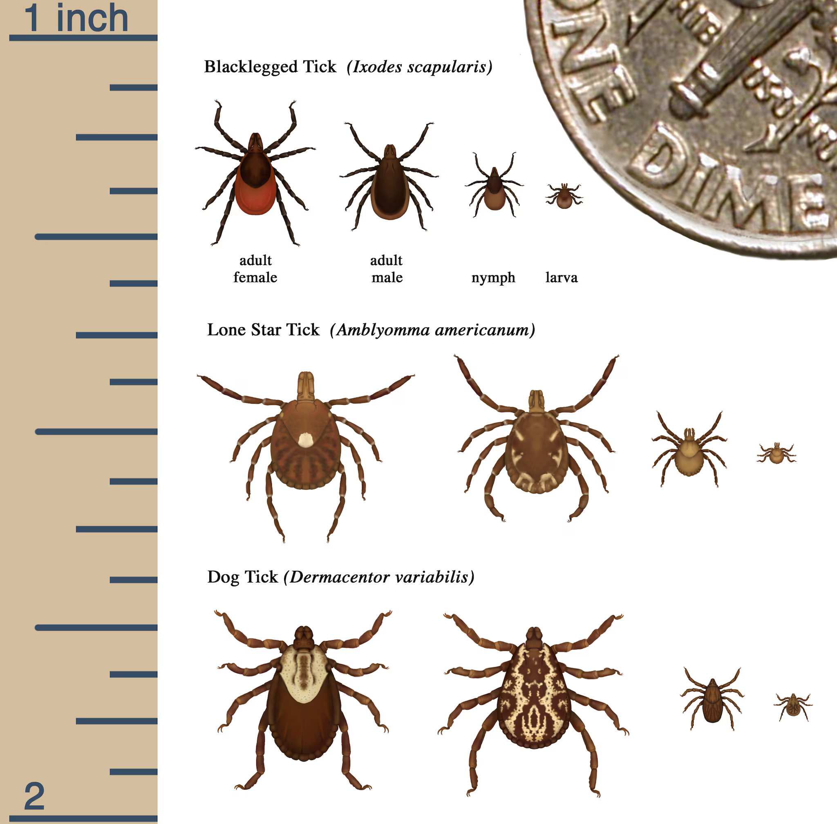
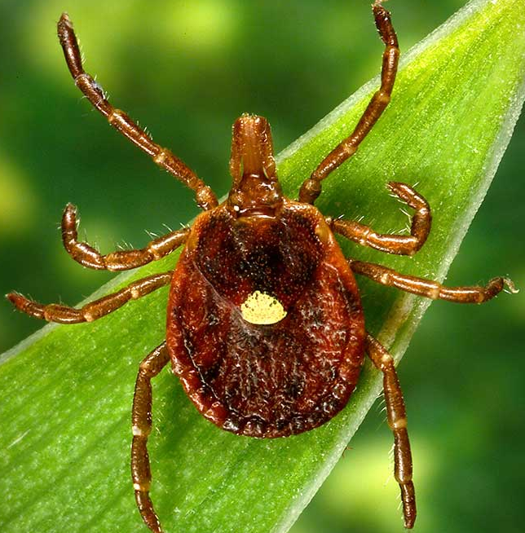
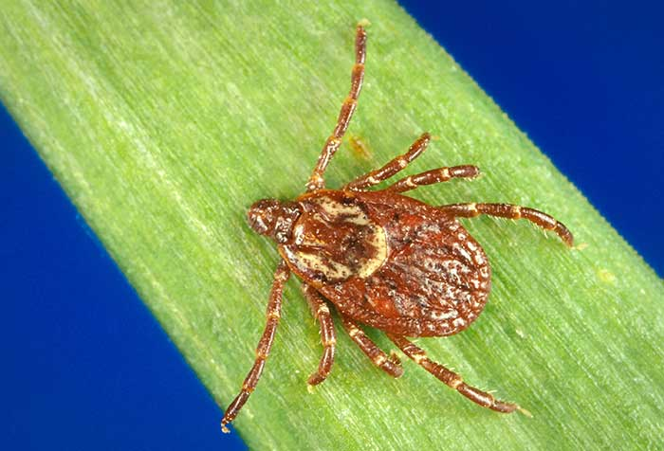

Slide 18
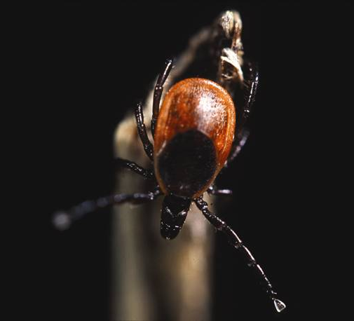
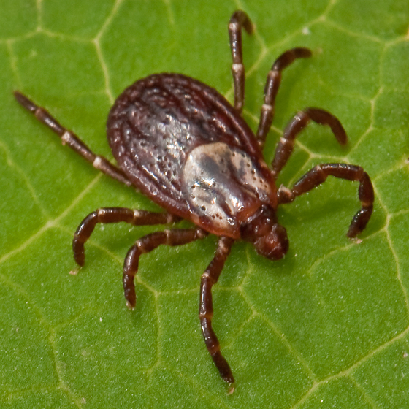
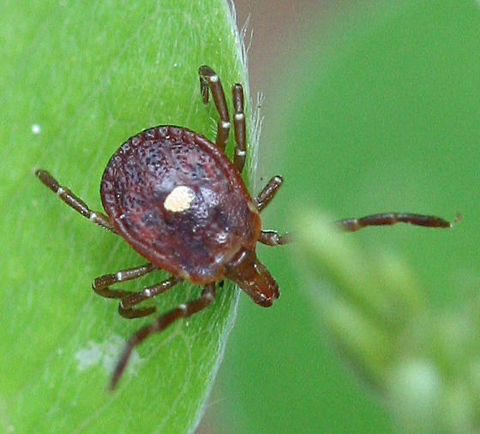
10 Known diseases in Massachusetts
photo credit: Michael Patnuade, Ph. D.
photo credit: Roy Cohutta
photo credit: Lynette Elliott

Slide 19
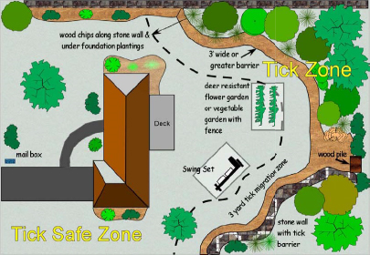
Deer ticks:
forest edge
shrubby vegetation
82% are
~10 ft from treeline
Tick Management Handbook- Kirby Stafford, CT Agricultural Experiment Station

Slide 20
How to avoid mosquito and tick bites!
5 D’s of Protection
Dusk
Dawn
Dress
DEET
Drain

Slide 21
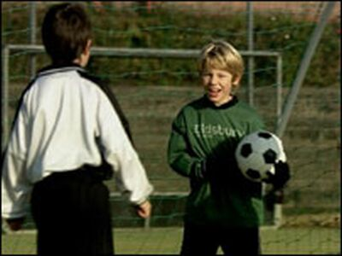
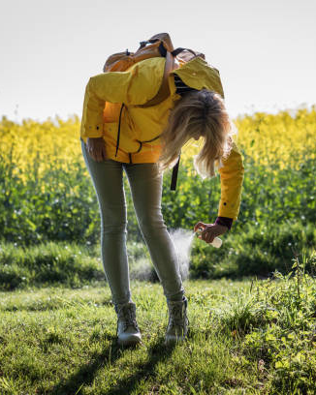
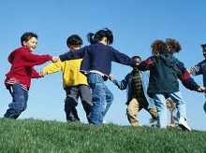
Protecting Yourself
Avoid outdoor activities at Dusk and Dawn
Dress
Wear long sleeves and pants when outdoors

Slide 22
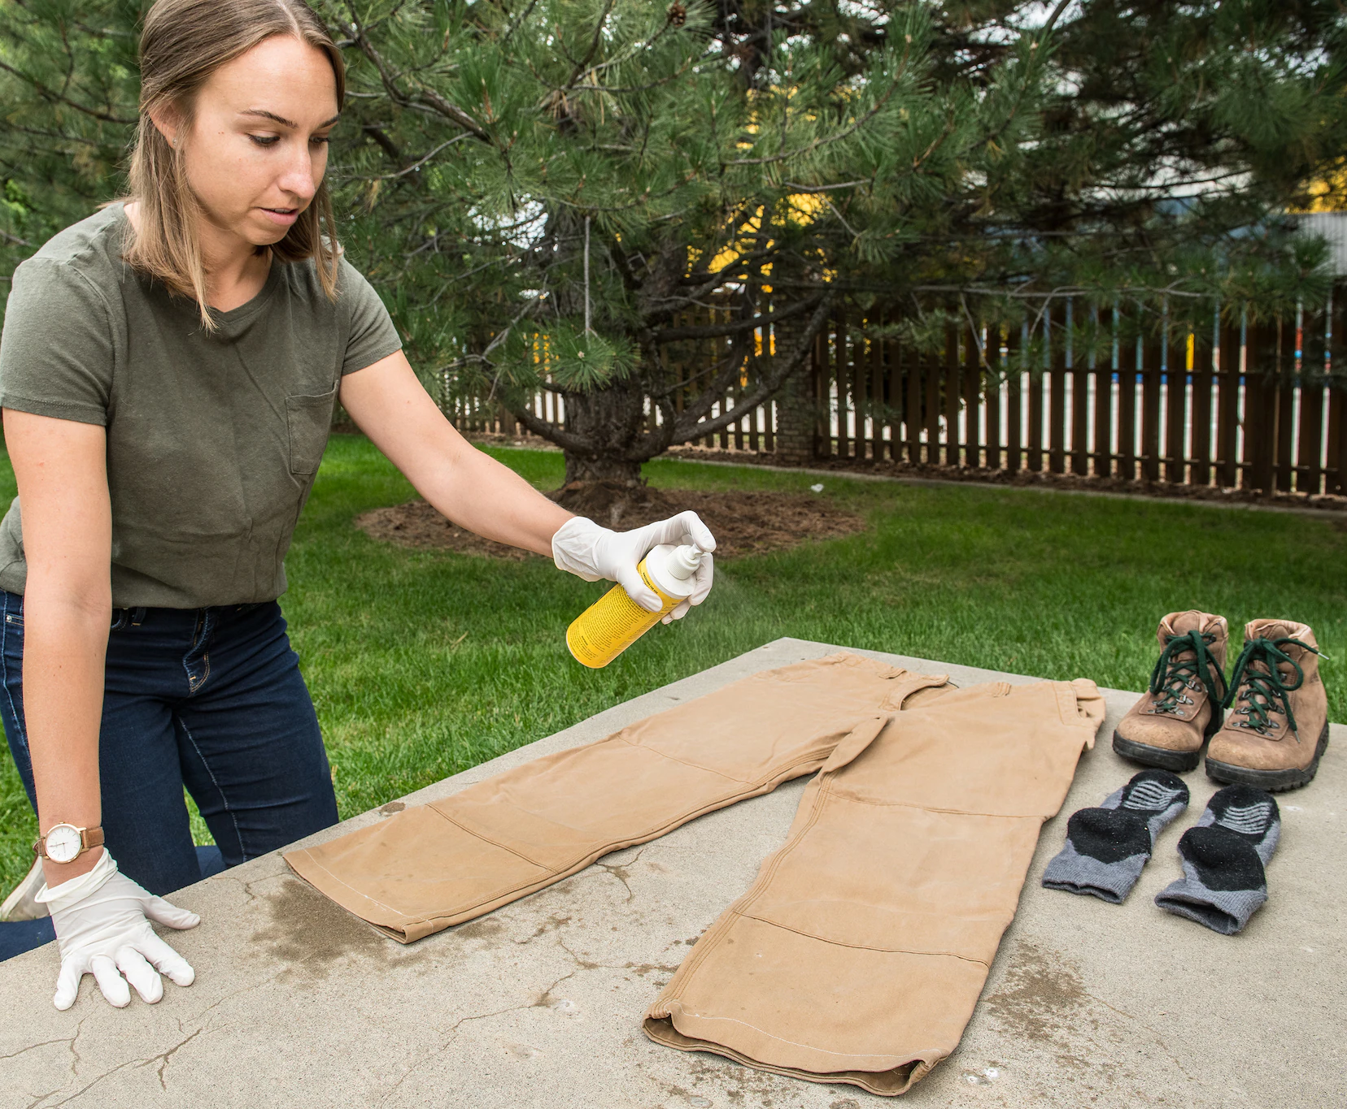
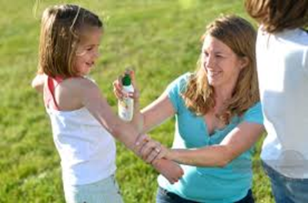
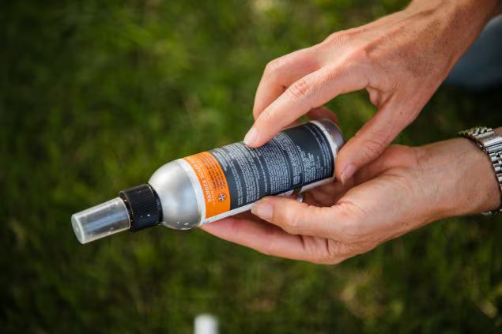



Protecting Yourself
Use repellents and follow the label
DEET
Picaridin
Oil of Lemon Eucalyptus
Permethrin (Great for Ticks too)

Slide 23

After You Come Indoors
Check your clothing for ticks. Ticks may be carried into the house on clothing. Tumble dry clothes in a dryer on high heat for 10 minutes to kill ticks on dry clothing after you come indoors. If the clothes are damp, additional time may be needed. If the clothes require washing first, hot water is recommended.
Examine gear and pets. Ticks can ride into the home on clothing and pets, then attach to a person later, so carefully examine pets, coats, & daypacks.
Shower soon after being outdoors. Showering within two hours of coming indoors has been shown to reduce your risk of getting Lyme disease and may be effective in reducing the risk of other tickborne diseases. Showering may help wash off unattached ticks.
Check your body for ticks after being outdoors

Slide 24


Slide 25

Contact Information
Address: Bristol County Mosquito Control Project
38R Forest Street
Attleboro, MA 02703
508-823-5253
Email: Priscilla Matton- Priscilla.Matton@mass.gov
Todd Duval- Todd.Duval@mass.gov
www.mass.gov\eea\bristolcountymosquitocontrol
Follow us @BCMCPmosq

