Slide 1
What are credentials What should I get and how can I get it
Larry Ramdin, MPH, MA, REHS/RS, CP-FS, HHS, CHO
Director of Training, Evaluation and Technical Services
Metro south Public Health Alliance Training Hub

Slide 2
Discussion points
Credential what is it
Requirements of SAPHE 2.0 and PHE program
CP-FS
CCFS
REHS/RS
CHO
CPH

Slide 3
Credential
Per National Environmental Health Association credential is way for practitioners to achieve a set of defined competencies, evidenced through testing and maintained through continuing education.
A credential is administered by an independent organization
Notes:
Credentials indicate that you have achieved expertise in a specific area or practice

Slide 4
Benefits
Benefits
Raises credibility with employers, community, and colleagues
Often leads to opportunities for promotion and increased pay
Shows dedication to the field and science of environmental health
Demonstrates commitment to staying up to date on environmental health policy, regulation, and practice
Provides an impartial, third-party endorsement of professional knowledge and experience
Distinguishes you from others in your field
Raises the visibility of the environmental health profession
Notes:
indicates that you have CP-FS holders are able to:
conduct facility plan reviews
evaluate hazard analysis and critical control points (HACCP) plans or other risk-based food safety programs
understand the causes and prevention of foodborne illnesses
analyze and implement sanitation standard operating procedures for safety and effectiveness

Slide 5
PHE Requirements for Management / Agent
Required at Hire | Required after Hire | Recommended after Hire
• Registered Sanitarian (RS) or equivalent eligible | • Foundations course within 18 months of hire • RS within 18 months of hire • Specific certifications for inspections performed, such as soil evaluator, system inspector, food inspector training, housing inspection training, certified pool operator/certified pool inspector, lead determinator within 1 year of hire | • Health Association membership • Local Public Health Institute Management Course*** • CHO within 3 years of hire
Notes:
The are specific requirements in PHE standards for Department Managers set out in th ePerformance standards developed for Local Public Health Practitioners

Slide 6
PHE Workforce Standards for Inspector / Environmental Health Specialist
Required at Hire | Required after Hire | Recommended after Hire
• High School Diploma or equivalent | • RS within 6 years of hire • Foundations course within 18 months of hire • Specific certifications for inspections performed, such as soil evaluator, system inspector, food inspector training, housing inspection training, certified pool operator/certified pool inspector, lead determinator within 1 year of hire | • Health Association membership • Associate's degree in science or public health, at hire
* https://www.mass.gov/info-details/workforce-standards#inspector-/-environmental-health-specialist
Notes:
RS requires a Bachelors degree, so th eInspector has 6 yeard to complete a degree after hire

Slide 7
Certified Professional Food safety
Credential Administered by the National environmental Health Association for persons engaged in retail Food Safety
Credential for personnel engaged in Retail Food inspection
Applications are valid for one year from the date it is received by NEHA. If the test has not been taken within one year of applying, new application and fees must be submitted

Slide 8
Eligibility
Individuals with the following education and training are eligible for the CP-FS exam:
Bachelor's degree in any subject
Or
Associate's degree
Valid, unexpired Certified Professional Food Manager (CPFM) certificate, International Certified Food Safety Manager (ICFSM), Food Safety Managers Certification Examination (FSMCE) certificate, StateFoodSafety Manager Certification, SuperSafe Mark certificate, OR a ServSafe Food Protection Manager certificate
Or
High School Diploma or GED
A valid, unexpired Certified Professional Food Manager (CPFM) certificate, International Certified Food Safety Manager (ICFSM), Food Safety Managers Certification Examination (FSMCE) certificate, StateFoodSafety Manager Certification, SuperSafe Mark certificate, or a ServSafe Food Protection Manager certificate
Notes:
Three tracks

Slide 9
Process
Submit an application to NEHA with Fee of $370.00 for Members
$515 for non- Members
Application reviewed and approved
Test is at a remote site
Schduele your exam

Slide 10
The Test
The CP-FS exam consists of:
seven content areas included in the exam and the percentage allotted to each area140 questions; 120 are scored and 20 are unscored pilot questions
Passing score is 650 weighted from 0-900
Multiple exams with different levels of difficulty hence weighting
Candidates have two hours and 30 minutes to complete the exam
.Content available at https://www.neha.org/PDFs/CPFS%20Blueprint_2025.pdf

Slide 11
Credential Maintenance
To maintain the CP-FS credential, individuals must:
Earn and submit a minimum of 24 hours of continuing education every two years
Pay renewal fee every two years ($130.00 members; $345.00 non-members)
Agree to and sign our Code of Ethics and Professional Conduct Policy

Slide 12
Certified in Comprehensive Food Safety - CCFS
The CCFS credential certifies that you have expertise in the manufacturing and processing areas of food safety in a regulatory/oversight, management, or compliance in the private sector
Applicability if you have oversight in the manufacturing or Food processing sectors working in the manufacturing sector

Slide 13
CCFS Eligibility
To be eligible for the CCFS credential, a candidate must meet the following criteria of a track below:
Bachelor's Degree Track
Bachelor's degree in food science or environmental health from a degree program accredited by the National Environmental Health Science and Protection Accreditation Council.
One full year of experience in food safety management, instruction, compliance, or enforcement.
Or
Bachelor's degree with 30-semester hours core science. Degree must be from an accredited institution of higher education or equivalent if an international institution.
At least two years full-time work experience in food safety management, instruction, compliance, or enforcement.
Associates Track
Associate degree from an accredited institution of higher education or equivalent if an international institution. Degree must be in science.
At least five years full-time work experience in food safety management, instruction, compliance, or enforcement.
Experience Track
Hold a Registered Environmental Health Sanitarian (REHS) or equivalent credential in good standing
One full year of experience in food safety management, instruction, compliance, or enforcement
Or
Hold a Certified Professional Food Safety (CP-FS) or equivalent credential in good standing
Two years full-time work experience in food safety management, instruction, compliance, or enforcement

Slide 14
Application
Applications must be completed and returned to NEHA for review at least four weeks prior to the exam date. A complete application must include:
Official college or high school transcripts or GED. To be considered an official transcript, it must be emailed from the school or transcript service to credentialing@neha.org.
Completed Work Experience Verification form.
Appropriate fees.
Third party review (applicable for international candidates).

Slide 15
Registered Environmental Health Specialist/Registered Sanitarian Credential
This Credential is often referred to as the Gold Standard for Environmental Health Practice
Professionals who hold this credential demonstrate competency in an impressive range of environmental health topics including vector control, water quality, hazardous materials, air quality, built environment, direct and train personnel to respond to routine or emergency environmental situations, and provide education to their communities. REHS/RS credential holders are also key to ensuring communities are in compliance with local, state, and federal environmental health regulations.
Notes:
Application process is similar to what I described earlier for the CP-FS and CCFS

Slide 16
Eligibility
Individuals can follow one of three tracks to be eligible for the REHS/RS credential exam:
Environmental Health Degree Track
Bachelor's Degree Track
"In Training" Track

Slide 17
Track 1
Environmental Health Degree
Candidates must meet the following criteria to apply for this track:
Hold a Bachelor's degree, Master's degree or PhD from a college or university accredited in the United States. Review the requirement for international degrees and diplomas on our Transcript Review page
Hold a degree in Environmental Health
Have attended a school and degree program that has been accredited by the Environmental Health Accreditation Council:
  EHAC-Accredited Environmental Health Bachelor's Degree Programs
  EHAC-Accredited Environmental Health Master's Degree or PhD

Slide 18
Track 2 – Bachelor's Degree
Candidates must meet the following criteria to apply for this track:
Hold a bachelor's degree, master's degree or PhD from a college or university accredited in the United States in any subject. Review the requirement for international degrees and diplomas on our Transcript Review page.
Have earned 30 semester hours (or 45 quarter hours) of college credit in basic science coursework. Basic sciences include life sciences, natural sciences, physical sciences, or health sciences. Social science courses such as Sociology or Psychology do not count toward the basic science requirement.
Have earned credit for a college level math or statistics class.
Have two or more years of full-time, paid experience working in environmental health.
Notes:
Eligible areas of environmental health include: general environmental health (including inspections, environmental microbiology, and contamination control), food protection, wastewater, solid and hazardous waste, potable water, inspections of facilities, vectors and pests, institutions and licensed establishments, swimming pool inspections, radiation, occupational safety and health, healthy housing, indoor air quality, disaster and emergency planning, and environmental health issues related to climate change.

Slide 19
Track 3– In Training
This track allows candidates with less than two years of qualifying work experience to take the exam.
Candidates must meet the following criteria to apply for this track:
Hold a bachelor's degree, master's degree or PhD from a college or university accredited in the United States in any subject. Review the requirement for international degrees and diplomas on our Transcript Review page.
Have earned 30 semester hours (or 45 quarter hours) of college credit in basic science coursework. Have earned credit for a college level math or statistics class.
Notes:
Basic sciences include life sciences, natural sciences, physical sciences, or health sciences. We do not count social science courses such as Sociology or Psychology toward the basic science requirement.

Slide 20
Qualification
Individuals cannot qualify for the REHS/RS Credential if they:
Do not hold a bachelor's degree, master's degree or PhD from a college or university accredited in the United States in any subject (and no international degree).
Have not earned 30 semester hours (or 45 quarter hours) of college credit in basic science coursework. Basic sciences include life sciences, natural sciences, physical sciences, or health sciences. We do not count social science courses such as Sociology or Psychology toward the basic science requirement.
Have not earned credit for a college level math or statistics class.

Slide 21
Scoring
The REHS/RS exam consists of two parts with a total of 225 multiple choice questions.
Part 1 asks 113 questions
Part 2 asks 112 questions
Candidates have three hours and 40 minutes to complete the entire exam or one hour and 50 minutes for each part with a 10 minute break in between
Of the 225 questions, 200 will be scored
25 questions will be unscored, pilot questions. Those items will not be called out within the exam.
Notes:
There are multiple test forms, so you may be taking the test on the same day and time with someone you know and they will have a completely different test

Slide 22
Scoring
The NEHA REHS/RS exam reports scores ranging from 0 to 900 with a scaled passing score of 650.
Scores are based on the number of questions answered correctly.
Notes:
You are not penalized for incorrect answers

Slide 23
Weighted Scoring
NEHA has provided an explanation on weighted scoring that explains what it is and how it works
https://www.neha.org/PDFs/ScaledScoresNEHA.pdf

Slide 24
Certified Health Officer - CHO Requirements
To become a Certified Health Officer (CHO) in Massachusetts, you must meet specific educational and experience requirements. The educational requirements vary depending on your degree level:
A medical degree and license in Massachusetts, plus one year of administrative public health experience.
A graduate degree (Master's or higher) in public health from an accredited school, plus one year of administrative public health experience.
A bachelor's degree from an accredited institution with at least 30 semester hours in public health-related disciplines (from a list including biological, environmental, public health, and related sciences), plus two years of administrative public health experience
.

Slide 25
Certified Health Officer
Completed Application form [105 CMR 803.210 (1)]
• Notarized Criminal Offender Record Information (CORI) Acknowledgement form [105 CMR 803.210 (2D)]
• Photo of Applicant uploaded to application [105 CMR 803.210 (2C)]
• Passing score on the Certified in Public Health exam administered by the National Board of Public Health Examiners (NBPHE)*. Exam date must be within 36 months of application date. Proof of active Certificate from the National Board of Public Health Examiners (NBPHE)* will be required for exam date over 36 months. [105 CMR 803.220]
•

Slide 26
Certified Health Officer - CHO
Public Health Law Course certificate uploaded to application ** [105 CMR 803.200 (3)] Available on MA TRAIN
• Official transcript(s) – emailed by endorser to RS.CHO@mass.gov [105 CMR 803.210 (2A)]
• Employer’s certification – letter(s) of reference certifying the duties and length of applicant work experience [105 CMR 803.210 (2B)] • Resume [105 CMR 803.210 (2D)]
• NON-Refundable application fee of $40.00 and certification fee of $78.00 paid with application submission [105 CMR 803.210 (2E)]

Slide 27
Certified in Public Health- CPH
The Certified in Public Health Exam is used to credential Massachusetts Certified Health Officers
The Examination is administered by The National Board of Public Health Examiners (NBPHE).
The NBPHE was established in September 2005 as an independent organization, to ensure that public health professionals have mastered the foundational knowledge and skills relevant to contemporary public health.

Slide 28
Certified in Public Health : Criteria
A bachelor’s degree in any concentration and at least five years of public health work experience
A relevant graduate-level degree and at least three years of public health work experience
At the graduate level, a certificate from a CEPH-accredited or applicant program and at least three years of public health work experience
Notes:
The Certified in Public Health credentials are similar to the CHO Credential requirements, passing this credential is required for the CHO Credential

Slide 29
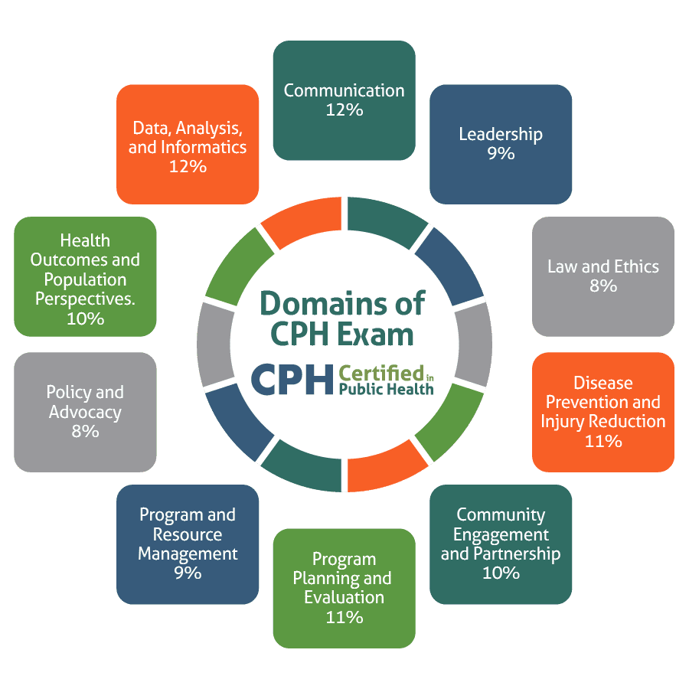
Certified in Public Health Test Domains

Slide 30
References
https://www.neha.org/credentials
https://www.mass.gov/orgs/certified-health-officers
https://www.nbphe.org/certified-in-public-health/cph-eligibility-requirements/

Slide 31
Questions
The only bad question is the one you are not sure about and did not ask!

Slide 32
Thank you
Thank you for your attention today and sharing your time with me
Thank you to Derek Macedo , Maggie Juneau and Joshua Montella at the Baystate Public Health Training Hub for inviting me to share this information with you

