Slide 1

Filing in Housing Court
Forms, Filing and General Procedural information
Notes:
The goal of today is to discuss a very general overview of the court process, and discuss some of the different forms available that you can use to file in Court in different scenarios
Lots of people in the room – varying experience levels – other goal is to establish a baseline of understanding about Court
As a note – much of this presentation is based on how the Northeast Housing Court operates.
All Housing Courts may do things slightly differently from one another, so I always recommend calling your Housing Court to touch base with them before filing for the first time.

Slide 2
Housing Court
Court with jurisdiction over residential housing
Specializes in housing law
Housing Courts have Housing Specialists
Experts on areas like 105 CMR 410.000
Mediate cases
Site inspections
Housing Court vs. District Court
District Court has jurisdiction over code enforcement as well, but does not specialize in housing law
No mediation is available in district court
Many more district courts vs. Housing Courts
Notes:
Jurisdiction and work of the Housing Court | Mass.gov
Mediate cases
Us and an Owner about an Order to Correct, or
Owner and occupant disputes about rent and evictions
Site inspections
If judge decides this is needed, they can do an inspection of the property to determine what issues remain
We will touch on meditation later in this presentation, but generally speaking it’s a way to meet with the person you're citing and the Housing Specialist to gain compliance

Slide 3
When to use Housing Court
Typically – last resort for compliance
Timelines have expired
Repairs were not done or not done properly
Access issues preventing repairs
Emergencies that are time sensitive
Think – Unfit for Human Habitation
Gaining access for Inspections
I.e. Hoarding or re-inspections
Notes:
Access issues – Our job is to INSPECT.
The owner can use housing court to gain access when unable to normally gain access.
If timeframes lapse due to access issues, we can file against the Owner and the Owner can discuss their issues with the court.
Timeframes – not all need to expire! 30 day violations but several CDEs are not repaired or in progress (egresses)
No heat – Write report for Occupant and they can obtain Court order to be put up in Alternative Housing by Owner
Encouraged that the Occupant files these if possible
ASWs and TROs
Reinspection being denied, or possible Hoarding cases you need to get entry on

Slide 4

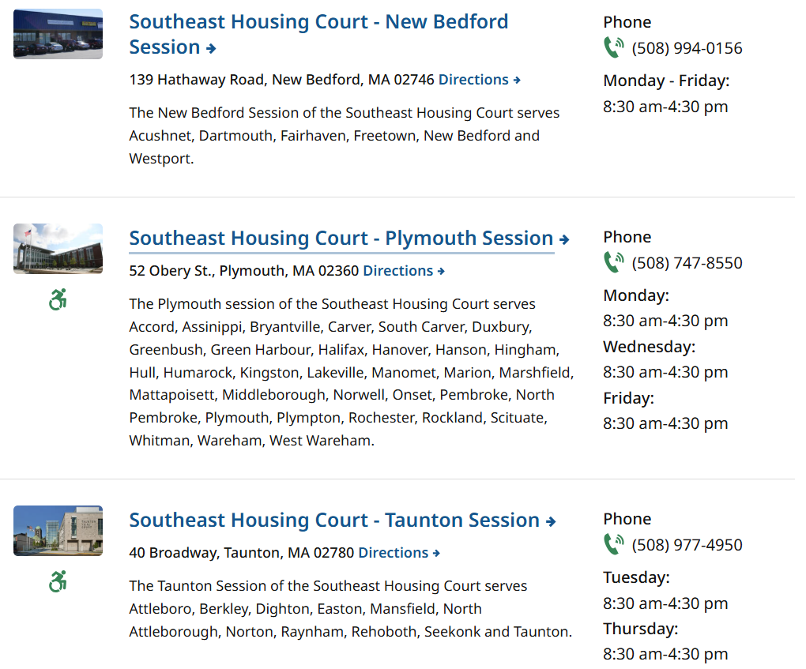
Know your Court
Locations | Mass.gov
Notes:
Housing Court website provides a page for you to Find your Housing Court location
Go to the page, plug in Municipality name and zip code --> pulls up relevant court locations. Check for your municipality under the name of the Court location
Good to keep an eye on court hours – some may be open multiple days a week, some may only hear cases on certain days (see Woburn Session)
May not have a clerk who can take filings at some spots, may only be open a day or two a week

Slide 5

Know your Court
Location AND Personnel
Where to file
Can YOU file?
Courts capacity
Bring the right paperwork – check with court
Notes:
Can you file as the Health Department, or do you need your City Solicitor?
I did this presentation last week in the Northshore – a small % of people could file themselves without Attorney
Capacity – Beverly example (1 assistant clerk magistrate – could be on vacation)
Some courts may not have the ability to take filings due to not having a Clerk or Assistant Clerk present. These may only hear the cases after being filed.
Some courts allow you to file electronically for civil complaints. Criminal complaints typically must be done In-person, as you must be sworn in while filing this.
Bring the right paperwork – if it's your first time filing, or first time filing a certain way its always useful to give the court a call to check that what you're doing is acceptable.
We'll cover ways to file later – these aren't necessarily the ONLY way to file. Courts differ sometimes

Slide 6
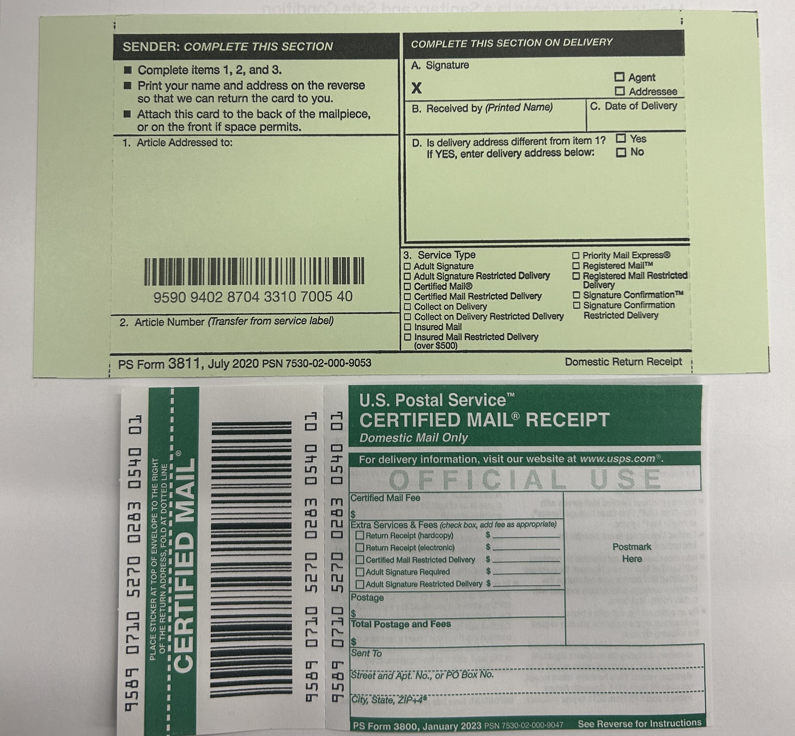
Before Filing
Was proper service given?
Certified Mail (have receipt)
Constable – return of service received
See 410.680
Ensure you've done a recent re-inspection
As close to the court filing as possible
Take Pictures
Notes:
Refresh on 410.680 Service of Orders
Recent Re-inspection – closer you can go re-inspect to the filing date and/or court appearance the better.
If you last went 2 weeks ago, that gives a lot of time for violations to be addressed.
Trying to go within a day or two before filing helps provide recent images and an up to date account on what remains.
Pictures
We're on the property for a limited amount of time. Court is likely never there – SHOW THEM
what's wrong!
Helps convey severity of issues!

Slide 7
Types of Filing
Civil Complaint
Criminal Complaint
Notes:
Two primary ways to file in Housing Court
You can file a Civil complaint, which can be done in a few different ways
Or you can file a Criminal Complaint

Slide 8
Civil Complaints
Court issues an order to make repairs
Within a certain timeframe
Receivership
Periodic inspections
If violations not met based on court order – can file contempt & request sanctions
Fines
Hold defendant in custody
Fire watch paid for by defendant
Notes:
Considered a non-punitive route to file.
Court may order these repairs to be made
Within a specified timeframe
If owner doesn't have funds or other issues arise - Receivership can be issued by court if violations not corrected
Can require periodic inspections of the property to ensure violations being corrected
I.e. deck that won't be fixed overnight
Sanctions – fancy term for penalties
Fines
Creative solutions --> Fire watch – maybe it’s a multiunit building with numerous smoke/co alarm issues

Slide 9
Civil Complaints
Typically move quicker
Useful for serious violations with short deadlines
Court provides you with paperwork and YOU notify parties
Constable/Sheriff
Once you have constable's proof of service, get it to the court before the hearing
Mediation possible & usually first step
Notes:
The court will provide you with paperwork when you file.
One packet is for you, other must be served on the responsible party BY YOU
Court date is usually soon – use a constable or sheriff
If you know you're filing – good idea to line up the constable for the date you go to court
Once you have proof of service for them, get it to the court!
Remember to serve each "defendant" separately (i.e. two separate owners at different addresses of the property in question --> serve each party separately)
We'll discuss mediation later on, but mediation is a great tool to gain compliance and show the court you're willing to work with the defendant to gain compliance

Slide 10
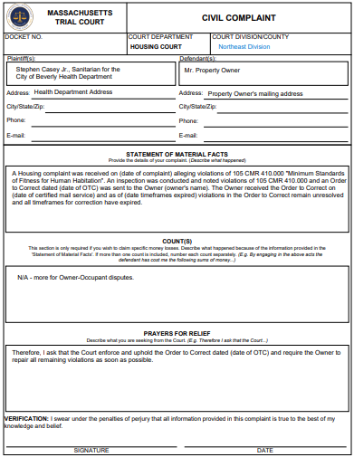
Civil Complaints
When filing a Civil Complaint you can use a Civil Complaint form and a Motion form
Motion form - "Cover sheet"
Civil Complaint Form
Case info
What we want
Notes:
This is a copy of the Civil Complaint form. You can fill in the open areas (outside of Docket Number at the top) and provide a description of why you are filing.
Motion form – cover sheet "appetizer" - motion to enforce order to correct dated XYZ
Civil Complaint form
Main course
Statement of material facts – details of the case (dates: Order to Correct date, when Owner received it, when timeframes expired)
Counts – skip; more for financial losses between parties
Prayers for relief – what we want the court to do! --> enforce the OTC
This may not be the only way to file these complaints!
I used to use a Motion Form & Statement of Material Facts form
Verify with your court on the preferred way to do so

Slide 11
Criminal Complaints
Punitive route
Outcomes – fines; does not matter if violations have been corrected
Criminal complaints involve the following
1st step: Show cause hearing – Clerk Magistrate
Demonstrate probable cause
2nd step: Arraignment – w/Clerk Magistrate or Judge
Generally a few questions asked during this
Guilty/not guilty? Bench trial or jury trial? Does the party you're filing vs want to hire a lawyer?
3rd step: Trial – bench trial or jury trial
Notes:
1st step
Demonstrate probable cause to proceed with case
2nd step
If Clerk Magistrate determines probable cause exists – can go to Arraignment with Clerk Magistrate or Judge
Usually a couple questions
Plead guilty or not guilty?
Bench trial (just the judge) or a jury trial (jury hears both cases and determines verdict)
3rd step
Bench or jury trial

Slide 12
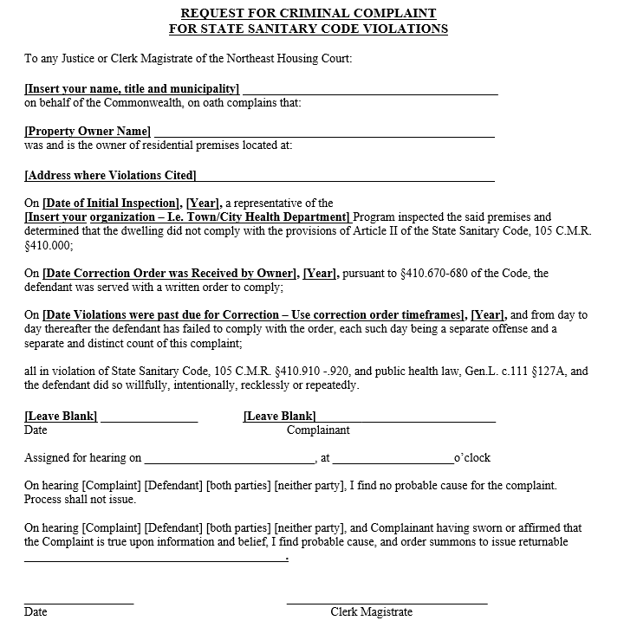
Criminal Complaints
Directly in front of Clerk Magistrate or Judge
Court notifies parties
Including you
Typically takes longer than Civil Complaint to get hearing date
Harsher penalties (fines, criminal record, jail)
Criminal complaints can be bumped down to Civil
Notes:
Court notifies parties – the court will send out via mail notice of the hearing date for Criminal Complaints.
Both us (Health Department) and responsible party (i.e. Owner) by mail
This takes time, which is why it can be more beneficial to use Civil Complaints for short timeframes
I believe in the Northeast Court there is about a 10 day period between receiving the complaint and sending the Service to both parties.
Paperwork
Some courts may have a Criminal Complaint form for you to use – if so, use their form
If the court you are filing at does not, you can use this form, copy & paste it into a word document and complete the applicable areas.

Slide 13
Civil vs Criminal
Civil Complaint
Move faster
"Non-punitive"
YOU serve notice of Court hearing on responsible party via Constable
YOU provide proof of service to court before hearing date
Mediation typically first step
Criminal Complaint
Can take longer for court date
Punitive route
Court serves notice to you and the responsible party of hearing date
Usually through mail
Appear in front of Clerk or Judge first
Notes:
Civil Complaint
We want to be heard quickly – these have a faster turnaround time
Non-punitive – Court orders repairs to be made
We must
Serve notice on Owner (by constable or sheriff)
Get proof of service and submit it to the Court BEFORE the hearing
Typically, Mediation is the first step
Criminal Complaint
Court serves notice of hearing to US and Responsible Party (Owner)
By mail – takes longer!
Punitive – outcomes are typically a punishment (fines, criminal record, jail)
Appear in-front of Clerk Magistrate or Judge first

Slide 14
Going to Court
What to bring?
Appearing in Court
After Court
Mediation

Slide 15

What to bring?
Court forms (wait to sign)
Civil – “Civil Complaint” & "Motion Form"
Criminal – “Request for Criminal Complaint for Sanitary Violations”
Copy of Correction Order and Proof of Service
CM receipt, constable receipt, etc.
IMAGES
Copy of other relevant documents
Municipal Dept. reports or docs (permits)
Licensed pest control reports, contractor receipts
Notes:
Filing paperwork – Court's I have been to, especially for criminal complaints, wanted us to sign the document in front of them.
BRING COPIES OF EVERYTHING – saves time when filing & can help gain rapport with your court. - Also, you know exactly what documents you provided them!
(email right after you left to file – did I submit this? What have I given them?)
Images show the court exactly what the violation is and can help convey the severity of the violation.
We're on site for a limited time – court is likely never going to be on site. Show them the issues!
Municipal Dept doc's – If they need to rebuild a deck and Building emails you no permit has been pulled, bring the email!
LPC Reports – include LPC reports if they're denied entry to show owner is attempting to do the repairs!

Slide 16
What to bring?
Summary of your Case Notes
Step-by-step summary to Court of why we are here
Start at Complaint – end at last re-inspection
Include correspondence with Owner and Occupant, re-inspection notes, etc.
Provides details of the case to the Court (and for you!)
Optional: Print out of your work Calendar
Scheduling next appearance
Notes:
- Case notes – timeline of events from receiving complaint through close of complaint
Step by step summary of the case
Lays out clearly why we're in court, and your efforts to gain compliance
Correspondence with owner and occupant, or with contractors
Also – if you go on vacation and a co-worker needs to re-inspect, they can pick this up and know where the case is at
Calendar
Used to not be able to bring phone into court
You want to know your availability if they schedule the next hearing while you're there

Slide 17
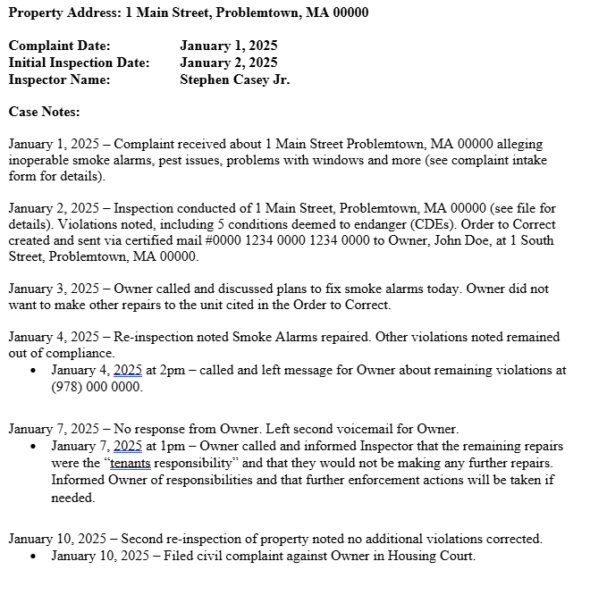
Example of Case Notes
Notes:
Start with complaint, then inspection, then touch on relevant dates or dates involving correspondence
Clear, concise summary for the court of why we are here

Slide 18
After Filing
Court will provide you with a date for hearing
If you filed a civil complaint – typically in the packet you receive
If you filed a criminal complaint – letter with this info mailed to you
When you know the Court date - block off the day
You won't feel rushed
Can review the case details before going to Court
Gives you a chance to check the property on the way to court (if needed)
Notes:
Can review case notes and info submitted to the Court before appearing
Check the property on the way to court
What's better than being able to say "I was there 2 hours ago, here's pictures showing XYZ isn't repaired"

Slide 19
Appearing in Court
Documentation
Bring all doc’s from filing AND anything relevant from filing date to court date
Know what you want to get out of the court date
“I want the Court to order the Owner to do XYZ”
If numerous violations remain – focus on most pressing ones
Know your schedule (3-4 weeks out)
Notes:
This is also where having a Copy of what you submitted helps
Also where Case Notes comes in handy
You have a summary of the details to review (versus digging through emails and notes on various documents)
AND you can add to this between court dates!
Know what you want out of the Court appearance
In Court, WE take the lead (not the clerk or judge) – what do we want done? What violations need to be prioritized?
If they offer a follow up date 3 weeks out – is that too much time? Maybe we want to return in 1-2 weeks!

Slide 20
After Initial Court Date
Depending on how you filed, process moving forward varies
Follow up Hearing for status update
Make sure to update Case Notes and gather additional documents
Hearing in front of a Judge
Continued or get referred to Mediation
Continue your case notes
Maintain written documentation
Notes:
Written documentation
Includes emails
Permits pulled or proof of work being done (contractor receipts)
Pest control reports received

Slide 21
Mediation
Step after filing paperwork but before appearing in Court
Parties meet with Housing Specialist
Quicker solution to correct violations
Less formal conversation
Can create a signed agreement enforceable through court
Can voice new violations
Can refer parties to services
Mediation is more commonly used in Civil Process
Notes:
Signed Agreement – Owner will have XYZ repaired within 1 week.
Also can be used in Hoarding cases – create an agreed upon timeline
Services
Tenancy Preservation Program (TPP) or Rental Assistance for Families in Transition (RAFT) - may be able to help fund repairs or assist occupant.
Get the lead out! - help with cost of de-leading property
Voice new violations
Infront of a Judge – can only reference the Order to Correct you filed for
Would need new OTC and filing for new violations
If a leak starts before your mediation, you can mention this with the mediator

Slide 22
Paperwork
Motion Forms
Temporary Restraining Orders (TROs)
Statement of Material Facts
Civil Agreement

Slide 23
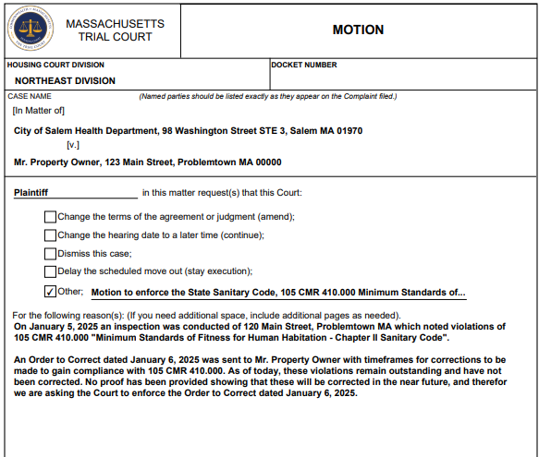
Motion Forms
Notes:
Example of the form

Slide 24
Motion Forms
Versatile
Can be filed with Civil Complaints
Postpone scheduled court date
Dismiss cases if repairs completed
Motion to Enforce Sanitary Code with Injunctive Relief for emergency cases
I.e. Roof caving in – can file to have Owner put up Occupant in Alternative Housing
Accompanied by a TRO*
Notes:
Postpone court date – if an Owner gets you confirmation that a repair is to be made on your upcoming court date, can use a motion form to request the court date be pushed off for 1 week to allow for this repair to be made
Dismissing Cases – personally, if it is extremely close to the court date (i.e. within 2-3 days) and you have had issues with the party you are dealing with (or if its Owner Occupant issues related to access, etc) I have kept my appearance dates in the past. See if court has input on this.
*encourage occupants to utilize TROs where possible!!
We may need our legal counsel to file this – Occupant's can file "pro-se" or on their own behalf and the court can walk them through the process

Slide 25
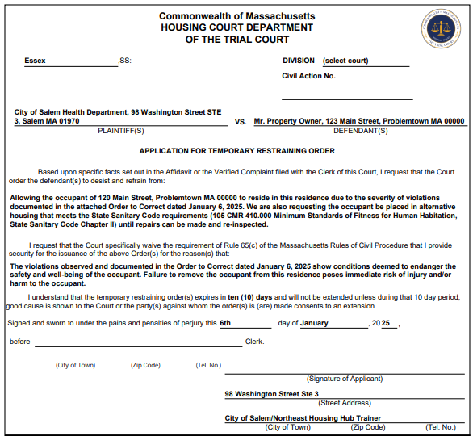
Temporary Restraining Orders (TROs)

Slide 26
Temporary Restraining Orders (TROs)
Typically more for Emergency scenarios
I.e. – Definition of Unfit for Human Habitation
I.e. a roof collapse – can file TRO with a Motion Form to relocate occupant
Can also provide Occupant with your written report for them to get a TRO (encouraged)
Filing TROs & Using Injunctive Relief
Injunctive Relief – court-ordered remedy which restrains a party from certain acts or requires party to act in a certain way
Judge can order Owner to make repairs or rehome the occupant to prevent immediate or imminent harm
Preliminary Injunctive Relief – temporary relief that preserves the "status quo" until court decides merit of case
Permanent Injunctive Relief – decided by judge
Notes:
- Civil Procedure Rule 65: Injunctions | Mass.gov
Unfit for Human Habitation - "a violation which poses such immediate harm or threat of harm to an occupant or to the public..."
Filing TROs with Injunctive Relief – court orders defendant to stop a specific act or behavior
Recommended the occupant get this
They can use the Lawyer for a day program or the online housing court virtual counter for guidance
If we file, we'd likely need an attorney to do this (may be seen as "practicing law") whereas occupants can represent themselves (pro-se) and the court can walk them through this in person or virtually

Slide 27
Temporary Restraining Orders (TROs)
When filing a form with Injunctive Relief - Can note this on the Motion Form, TRO or both
Submit the TRO WITH a Motion form
Additional use of TROs
Can use when the Occupant is not allowing access for a re-inspection
Notes:
Submit this with motion form – As far as needing a Motion Form, this may vary depending on the clerk you are filing with's preference. Some may want a Motion Form with the TRO, some may be fine with just the TRO and a Statement of Material Facts. Either call your court before going down, or fill out the motion form in addition and bring it with you.
In emergencies, court typically wants to see the Owner notified of the issue
What is acceptable by this - may vary
Some courts may be OK with us showing we called the Owner
If the occupant files, the court may determine its an emergency and do a "courtesy call" to the Owner, then issue their Order
I.e. call owner, get their email, and serve the order electronically to relocate the occupant
Other TRO information
Serve on party with constable/sheriff
Don’t need to return this to the court (using an ASW you would) - get order to inspect and then inspect unit
Housing court prefers TROs (district court prefers ASWs)
Can have Constable accompany you to the inspection and serve owner/occupant then

Slide 28
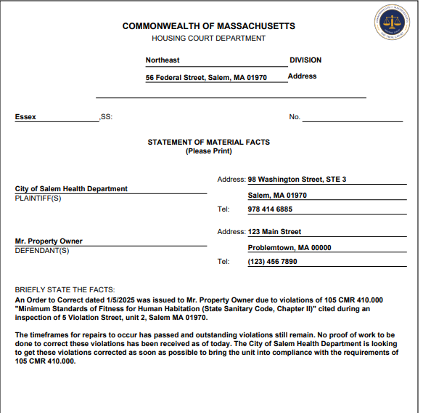
Statement of Material Facts
Notes:
Civil complaint form incorporates this, but there is a separate form available to use

Slide 29
Statement of Material Facts
Used to inform the court of important facts of your case
5 W's
Paraphrase key areas of Case Notes
This is used in unison with a Motion form
Motion form = Action item
Motion – Enforce sanitary code/OTC
Statement of Material Facts = Why action is required
Statement – Timeframes have expired and repairs have not been made
Notes:
Name (Statement of Material Facts) describes exactly what its used for
Who – is the Owner? Who is filing (us)?
What – What are the violations?
When – was the OTC issued? When did timeframes expire?
DATES
Where – where is this issue occurring?
Why – Why is this case coming before the court? Why are you requesting the action to be taken?
DATES

Slide 30
Civil Agreement
We don't "File" this to start a Case
More often used between parties
Owner & Occupant
Can also be used in Mediation for Hoarding scenarios
Develop timeline for areas to be addressed
By March 30th, 2025 the living room window will be accessible and items will be removed
Notes:
Useful in mediation - Agreement between Owner & Occupant
Agreement on a date/time for Access for repairs to be made
Agreement to repay withheld rent after repairs are completed
Hoarding Scenarios
In mediation, can use this to develop an agreed upon timeline for correction enforceable by court

Slide 31
SCENARIO
Order to Correct where timeframes have all lapsed and no BOH hearing occurred
Motion Form + Civil Complaint Form
Motion Form: Motion to Enforce the State Sanitary Code...
Or "See Civil Complaint form"
Civil Complaint - Information about the case
Facts of the Case
Dates: Of the Order Letter, Date received, and timeframes for correction expired
"See attached Case Notes for additional details"

Slide 32
SCENARIO
Owner has shut off electricity to the unit with no timeframe for it to be restored
TRO + Motion Form with Preliminary Injunctive Relief
TRO Form: I request that the Court order the defendant(s) to desist and refrain from "Curtailing utilities (electricity) to address of unit and to restore this utility immediately."
Provide security for issuance of the above Order(s) for reason(s) that "violations observed and documented in OTC dated X show CDEs and endanger the well-being and safety of the occupant."
Motion Form: To enforce State Sanitary Code and restore utilities required by 105 CMR 410.000. This motion is filed with preliminary injunctive relief.
Notes:
Underlined portions – Language from the TRO form
Emergency TROs – encourage the Occupant to file these.

Slide 33
SCENARIO
Pipes burst and flooded the unit - unit is now uninhabitable
TRO + Motion Form with Preliminary Injunctive Relief
TRO Form: desist and refrain from "Allowing Occupant of address to reside in this residence, due to severity of violations documented on date of inspection, until repairs and re-inspection(s) can be completed."
Motion Form: To relocate the Occupant until repairs can be completed and unit is reinspected. This motion is filed with Preliminary Injunctive Relief.
Occupant filing – provide them written copy of Inspection Report or OTC
They can take this to the Courthouse and file in your place
Notes:
Injunctive relief – asking the Court to take action --> relocate the occupant.

Slide 34
General Advice
If you're unsure about what paperwork to use – call your housing court!
Can't give legal advice, but can provide clarity or explanation of paperwork use
If you do file – loop in your supervisor and municipal attorney in case they are needed later on
Bring copies of documents you are filing (i.e. OTC, Proof of Service, etc.)
Maintain your Case Notes!
Appearing in Court – dress professional and arrive early
Notes:
Housing Courts can typically provide explanations on what paperwork is needed or required by the court.
The Northeast housing court helped clarify most of the information needed in this presentation
Case Notes – keeps you up to date on your case details (i.e. after a vacation), and keeps colleagues informed if they need to reinspect for you
Maintaining this helps show the Court your efforts to gain compliance before coming to the Court.

Slide 35
Additional Information
Tier 2 Housing
Judge is present and speaks more about Court
Can ask your questions about Court!
Filing in Housing Court SOPs
How to file
Use of forms
General Court info
Being updated as we speak!
Notes:
Chief Justice Diana Horan of the Housing Court presents on Housing Court and can take questions you may have
Finish your Tier 1 coursework!!
SOPs – being updated; walks you through the process of filing

Slide 36

Questions?
Stephen Casey Jr., Regional Housing Trainer
Scasey@salem.com
(978) 414-6885
Notes:
List of questions for Court Staff
Is there a reason or way to know, outside of contacting the court, whether a municipal health department can file? For example, is it a "City with a Population of X" cutoff?
Best ways to prepare for mediation? Or things we can do to make it go smoothly?
Preparing for appearing in front of a Judge – best practices? OR – what have you seen that has caused issues for BOHs in court?
THIS MAY VARY COURT TO COURT - Ask Tom's opinion on Certified Mail return receipt that isn't signed or doesn't come back – is printed USPS tracking info showing "delivered" acceptable?

