Slide 1
Bay State Training Series: Tobacco
Megan daCosta, Tobacco & Marijuana Compliance Program Manager
Bay State Training Hub Tobacco Presentation
April 29, 2025
Notes:
Thank you very much for the introduction and for the opportunity to present to you all today!

Slide 2
Agenda
Overview of 105 CMR 665
Basics of Permitting, Inspections, & Compliance Checks
Model Local Regulations
Correction/Cease & Desist vs Civil Ticket
New & Evolving Products
Questions?
Notes:
Here is a quick overview of the agenda that we will be discussing today.

Slide 3
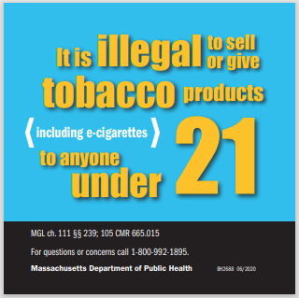
Minimum Legal Sales Age
In 2005, Needham was the first town in the US to enact a law raising the minimum legal sales age to 21
Gov. Charlie Baker signed Tobacco 21 legislation that prohibited the sale of tobacco products to anyone under the age of 21 effective December 31, 2018
Tobacco 21 or T21 was signed into law under President Trump on December 20, 2019 raising the federal minimum age for the sale of tobacco products to 21.
Notes:
To start us off on some key information from the recent state law changes. The legal age for the sale of tobacco products is now 21. Needham was the first town in the nation to up the age from 18. MA changed the age as we headed into 2019 and it was signed into federal law almost a year later.

Slide 4
105 CMR 665
On June 1, 2020, An Act Modernizing Tobacco Control took full effect in Massachusetts (MA). This law contains the following provisions:
  Restricts the sale of all menthol and other flavored tobacco products (including vape products) to adult-only smoking bars for on-site consumption only
  Restricts the sale of all vape products with a nicotine concentration of more than 35 mg/ml to adult-only retailers and smoking bars
  Imposes a 75% excise tax on all vape products
  Requires that health care insurers cover at least one FDA-approved cessation product at no out-of-pocket cost
Notes:
Gov. Charlie Baker signed into law “An Act Modernizing Tobacco Control” which went into effect on June 1st 2020. This has been the “big” state law change that essentially removed all flavored tobacco products including menthol from the retail market. The only establishments that can still sell flavored products are adult-only smoking bars for on site consumption only. There are currently 24 licensed smoking bars in MA, half are in Worcester (12).
The law also restricted the nicotine content on vape devices to no more than 35 mg/ml or 3% in all stores other than adult-only smoke shops and smoking bars; who are able to sell higher nicotine amounts.

Slide 5
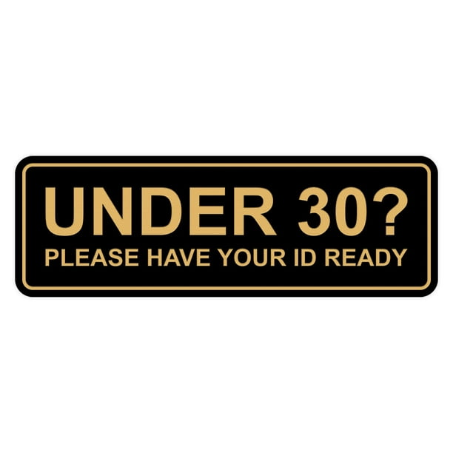
ID Everyone Regardless of Age
“each person selling or providing tobacco products shall verify the age of the purchaser by means of a valid government-issued photographic identification containing the bearer's date of birth that the purchaser is 21 years of age or older, as verified by said person's proof of identification”
“Fenway Rule”
Notes:
When the state law changed there is no longer a clause of “if you look under 27 or you look under 40 we need to see your ID”. Some large chain stores still have these internal policies, but it is important to let them know that they must ID everyone according to state and federal law. This Leaves nothing up to individual perception or facial judgement. We often refer to this section of the law as the “Fenway rule”, no matter who you are or how old you may appear at the ballpark you must show your ID to get a beer. This is the same process.

Slide 6
Acceptable IDs Unacceptable IDs
MA or Out-of-State Driver’s License
MA Liquor ID/State ID
Military ID
Passport
US Immigration/Permanent Resident Card
College ID
Work-Issued ID badge
Non-Photo ID
Credit Card ID
Permanent Residency Card from Foreign Country
Informational Sheet with Photos of IDs available on MA Clearinghouse!
Notes:
Must be Valid/non-expired, physical IDs must be shown/No Photos
Aka “Green Card”
Non-Photo IDs include social security cards
massclearinghouse.ehs.state.ma.us/PROG-TOB/BH2649.html

Slide 7
Permitting
Local Permitting through BOH
Yearly, could be Fiscal or Calendar Year
MA Department of Revenue (DOR)
3 licenses for Tobacco Products (Cigarette, Cigar & Smoking Tobacco, Electronic Nicotine Delivery Systems)
Required in order to acquire a local permit
If retailers are tax delinquent with the state; ex. income tax, excise tax, etc. it may impact their ability to renew their state tobacco licenses
Vincent Piccolo-Miscellaneous Excise Unit (Point of Contact for Retailers)
piccolo@dor.state.ma.us (617)887-5626
Notes:
For local permitting in addition to a general permit application, you should collect workers comp affidavit & policy if applicable, state licenses, employee sign off/agreements, etc.

Slide 8
Tobacco Inspections
Conducted by multiple agencies (inc. FDA, MHOA, LBOH)
Typically conducted 1-2x yearly (not including complaint-based or violation follow up)
Can be conducted whenever a retailer is open for business incl. weekends and evenings
Consenting to unannounced, periodic inspections are a requirement for retail establishments per 105 CMR 665.040

Slide 9
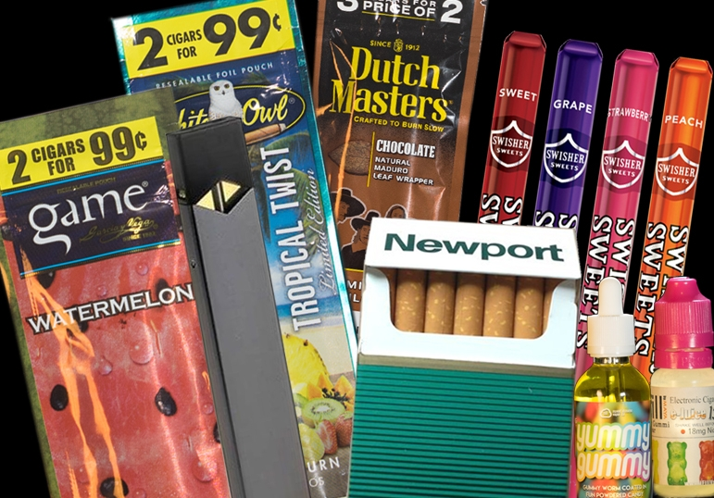
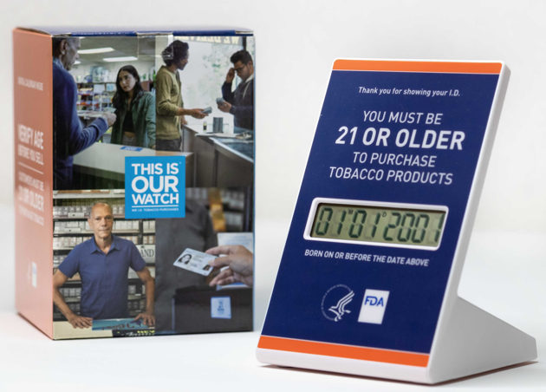
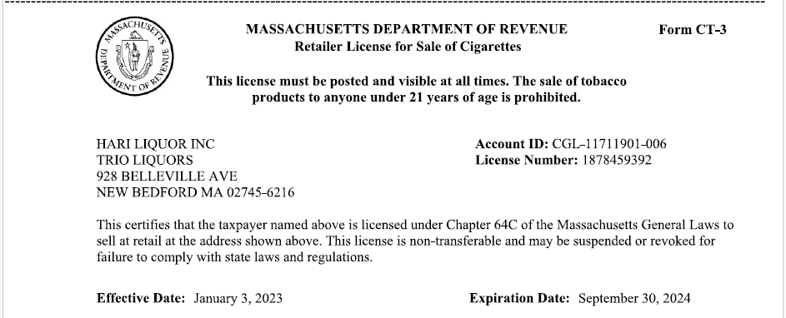
Things to look for on Inspections
Local & State Permits Posted
Signage
FDA Age Calculators FDA Tobacco Education & Prevention Resources: Posters, Flyers, & More | Digital Calendar
Flavored Tobacco Products
Local regulation adherence
Manufacturer’s Letters
Notes:
FDA Age calculators also available in Spanish FREE & includes batteries
(menthol cigarettes, flavored vapes, flavored cigarillos, etc.)
Local policies including blunt wrap bans, cigar minimum pricing, nicotine pouch restriction, etc.

Slide 10
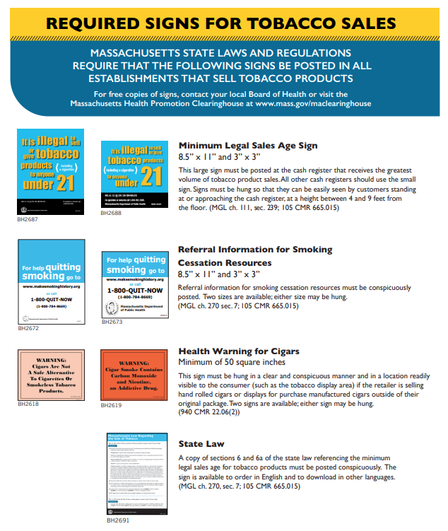
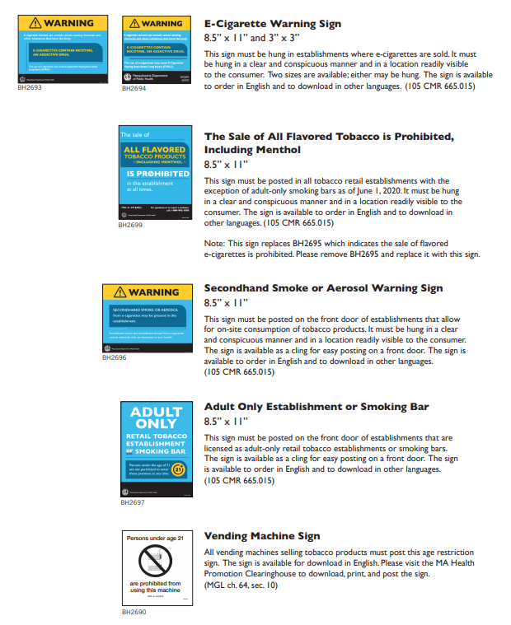
Required Signage
Notes:
Found on the MA Clearinghouse
massclearinghouse.ehs.state.ma.us/PROG-TOB/BH2648.html

Slide 11
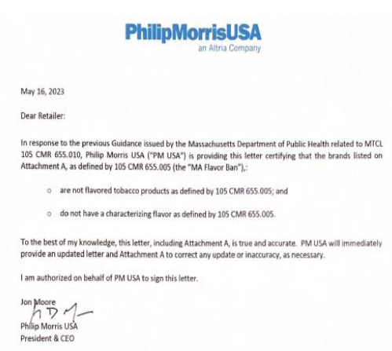
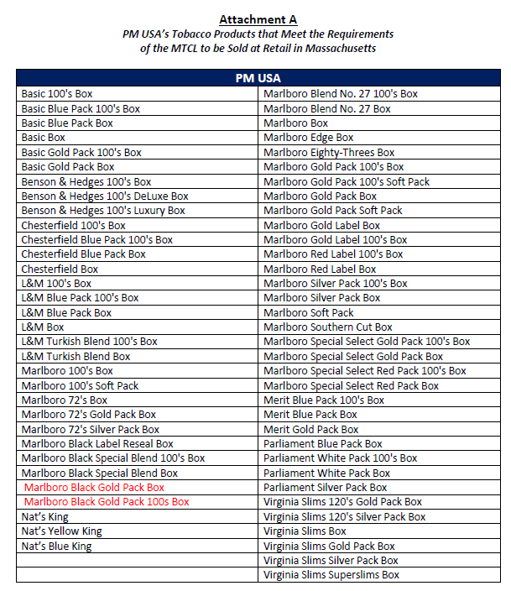
Manufacturer’s Letters
The letter must be from the product manufacturer
The letter must certify that the product(s) listed within the letter or attached to the letter are neither flavored nor have a characterizing flavor as defined by 105 CMR 665.005;
The letter must contain an attestation clause indicating that the “letter is true and accurate”; “manufacturer will immediately provide an updated letter to correct any inaccuracy”;
The letter must state that the person signing the letter “is authorized on behalf of the manufacturer to sign the letter”; and include the signature of the manufacturer’s corporate officer or an owner.
For all ENDS (vapes), retailers must have a manufacturer’s letter certifying that the product does not have a nicotine content greater than 35 milligrams per milliliter.
Notes:
Letters can be obtained from the distributor but must be from the manufacturer.

Slide 12
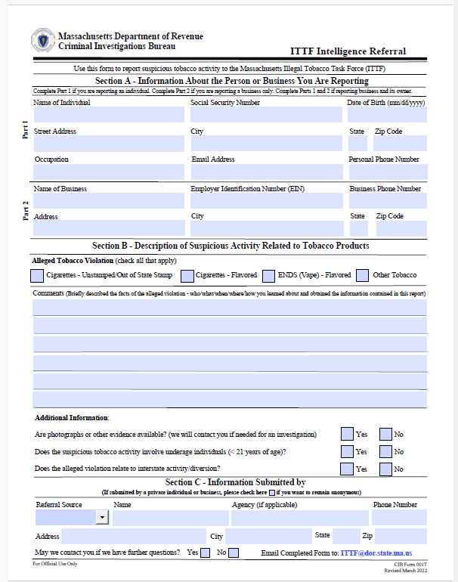
Found Large Amounts of Flavored Tobacco?
You may contact the DOR’s Criminal Investigations Bureau at (617)626-3210 or complete this form and email to DOR’s Illegal Tobacco Task Force at ITTF@dor.state.ma.us
Notes:
If you find large quantities of flavored tobacco/vaping products or cigarettes without MA tax stamps

Slide 13
Youth Compliance Checks
Conducted by multiple agencies (inc. FDA, MHOA, LBOH)
Utilizing youth between the ages of 16 and 20
- local 84 chapters can be a great place to recruit youth
Typically conducted 1-2x yearly (not including complaint-based or violation follow up)
Can be conducted whenever a retailer is open for business incl. weekends and evenings
Notes:
These visits confirm compliance with checking IDs for all tobacco sales transactions
Ultimate Goal of 100% compliance with checking IDs!

Slide 14
Local BOH Regulations: Retail Sales
At minimum, must reflect state regulations (105 CMR 665)
Could also include local policy options such as:
Cigar Minimum Pricing
Nicotine Pouch Restriction to Adult-Only Establishments
Nicotine Pouch Nicotine Content Restriction
Retail Density buffers near schools & other retailers
Permit Capping/Descending
Nicotine Free Generation

Slide 15

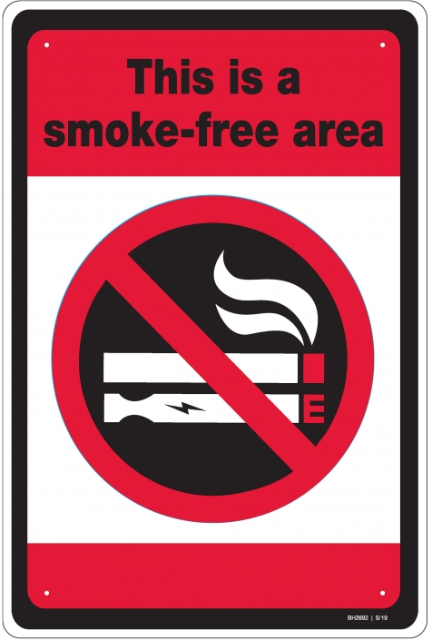
Smokefree Public Spaces & Workplace
At minimum, reflect state regulations (MGL Ch. 270 Sec.22)
Smoke cannot migrate into a workspace
Smoking in a prohibited place may result in a civil fine ($100-$300) to the smoker as well as to the employer/business owner for permitting smoking
Notes:
Transit stations are included! “Enclosed platforms/terminal”
Metal signs available on MA clearinghouse, FREE
massclearinghouse.ehs.state.ma.us/PROG-TOB/BH2692.html

Slide 16
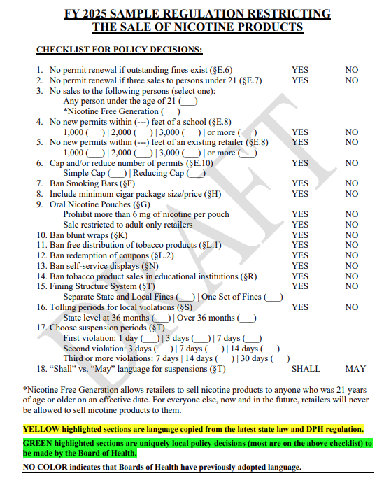
Model Local Regulations
Most up to date copy can be found on www.mahb.org/resources
Atty. Cheryl Sbarra (MAHB) sbarra@mahb.org and Atty. Lisa Stevens-Goodnight (MMA) lstevensgoodnight@mma.org are both technical assistance providers who can support BOHs through the regulation adoption process

Slide 17
Local Regulation Options Include…
Restriction on Nicotine Pouches
  Limiting the sale of nicotine pouches to adult-only retail establishments
  Limiting the nicotine content in nicotine pouches (maximum 6mg per pouch)
Minimum Cigar Package Size/Price
  No single cigars may be sold
  Single cigars must be priced for retail sale at $2.90 or more, pack of 2 or more cigars must be priced for retail sale at $5.80
Nicotine Free Generation
  No Tobacco/Nicotine Sales to a person born on or after January 1, 2005
Cap/reduce number of permits
  “There shall be no more than ____ of tobacco retailer within the City/Town of_____”
  “There are currently ____ permits within the City/Town of ____, any permit not renewed or revoked shall be returned to the BOH and permanently retired thus reducing the number of tobacco permits available”
Retail Density
  No new permits within ____ft of a K-12 school
  No new permits within ____ft of a currently permitted retailer

Slide 18
BOH Regulation Process
Health Agent may reach out to regional tobacco control coordinator to assist, if part of MTCP-funded collaborative
→ Review current local tobacco regulations & model regulations
→ Present proposed local tobacco regulation changes to BOH at meeting
At second meeting, complete draft regulations and present to BOH for their approval, loop in legal counsel if necessary
Schedule public hearing date

Slide 19
Public Hearing & Regulation Adoption
→ Post public hearing notice at city/town clerk’s office, notify all retailers (affected parties), good practice to post in newspaper once in each of two successive weeks
→ Host public hearing, have sign in sheet for attendees & proposed regulations available
→ If BOH chooses to adopt following public hearing, they will choose an implementation date that allows for proper public notice (legal notice in newspaper, notifying retailers, posting on BOH website)
Notes:
(first newspaper posting being not less than two weeks before hearing date)

Slide 20
When to issue a Correction/Cease & Desist Order
Violations of 105 CMR 665 including:
- Sales to a minor
- Sale/offering for sale flavored tobacco products
- Self-Service displays in a non-adult-only establishment
Anytime you are issuing a fine >$300
ex. If your municipality sets regulations deeming the sale of tobacco without a permit to be a local violation of $1000
Appeal process through BOH hearing then, if necessary, a court of competent jurisdiction
Notes:
State fine structure is $1000 on first violation, if it is a sale to a minor then there is also a permit suspension associated with the violation of up to 30 days. On average 1-3 business days is the most common suspension that I am seeing BOHs adopt. On a second violation within 36 months of the first violation, the fine is $2000 and at least a 1-day suspension and up to 7 days. On a third or subsequent within 36 months, the fine is $5000 and the suspension is at least 7-days and up to 30 days. Thus, any violation of 105 CMR 665 would need to be a Correction/Cease & Desist Order.

Slide 21
When to Issue a Civil 21D Ticket
If a violation is <$300
Examples include:
- Smokefree Workplace/Public Spaces
- Ban on Smoking Bars
- Nicotine Free Generation
-Cigar Packaging/Pricing
Appeal through non-criminal hearing at District Court
Notes:
Unless BOH adopts local penalty structure greater than $300

Slide 22

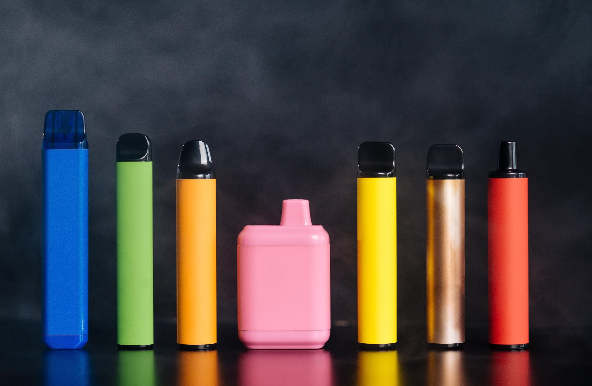
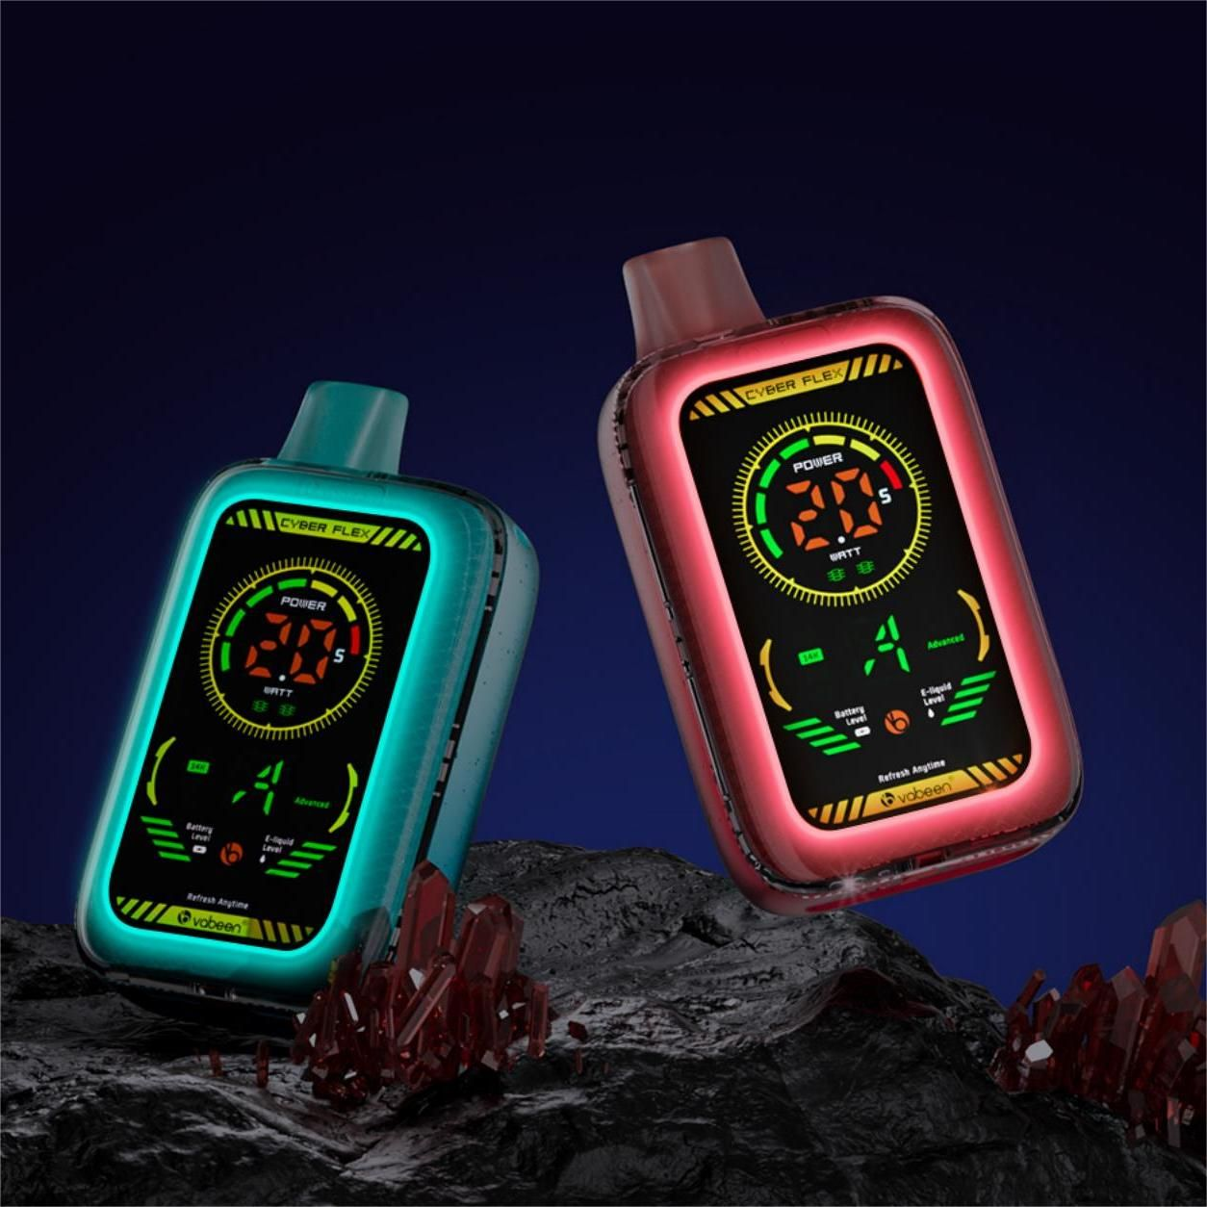
New & Evolving Products
Nicotine Pouches
Common brands inc. Zyn, On, Crave, Velo, etc.
Nicotine count ranges from 3mg/pouch to >16/mg pouch depending on brand
Not taxed by DOR, thus incredibly low prices
Disposable Vape Devices
New devices & brands are coming out weekly
Some include LED screens, zodiac signs, adjustable features, etc.
Most do not have FDA PMTA
Disposal concern
Notes:
Premarket tobacco product application= marketing approval NOT SAYING IT’S A SAFE/HEALTHY PRODUCT
Sniff Test to determine compliance with flavor ban. If you are in a store and unsure if a product is flavored, ask for their manufacturer’s letter (if they cannot produce one, they cannot sell the product) if they produce one but you are unsure if it is truly compliant. You/BOH may conduct a sniff test.

Slide 23
Sniff/Smell Test
The MA Appeals court stated a municipal BOH is “entitled to credit the perception of odor by its own members in concluding” the decision of a smell test (2018).
Conduct at a regularly scheduled BOH meeting
  Limit strong odors, drinking anything other than water, eating, chewing gum during and a short while before testing
Provide BOH members with the product in question as well as a known unflavored control product
Open & Smell the product
  The BOH only needs to determine whether the product in question smells like tobacco or something else. If it smells like anything other than tobacco it is not compliant with the state law.
Notes:
2018 Cumberland Farms vs Yarmouth BOH
Typically I see BOHs utilize Marlboro Reds as a control.

Slide 24

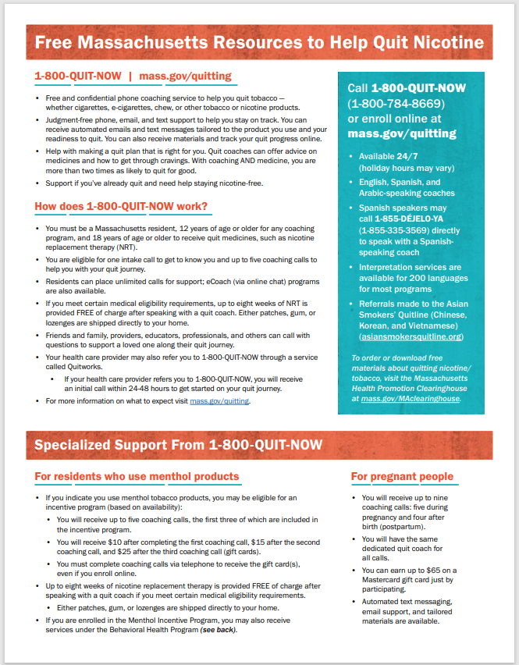
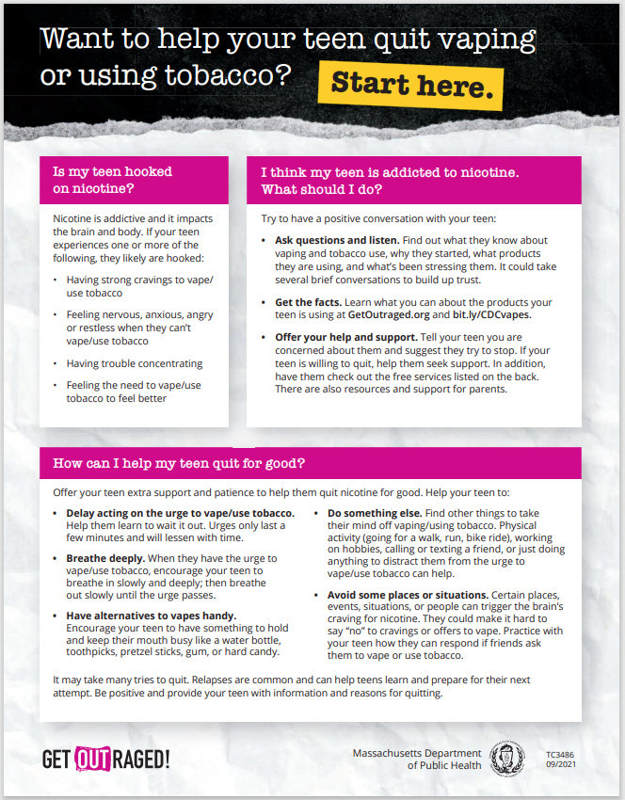
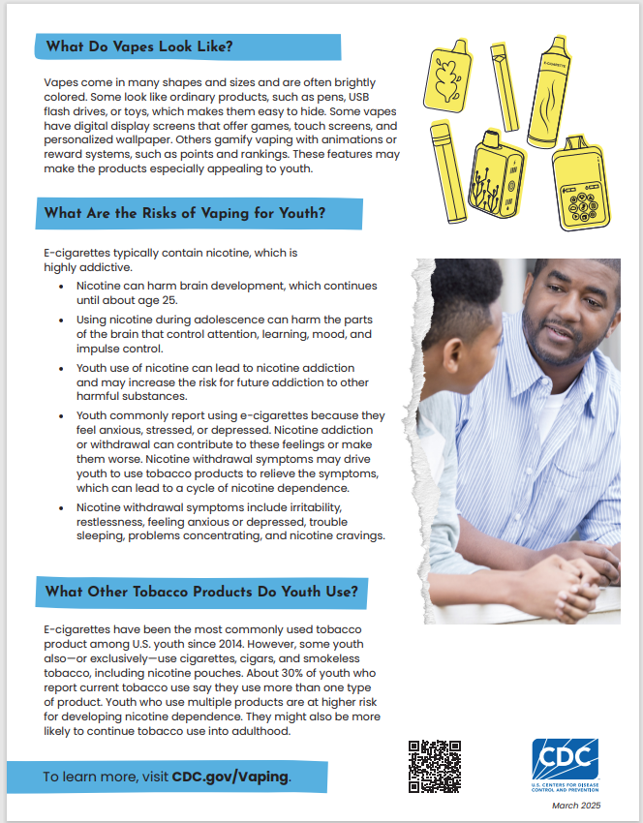
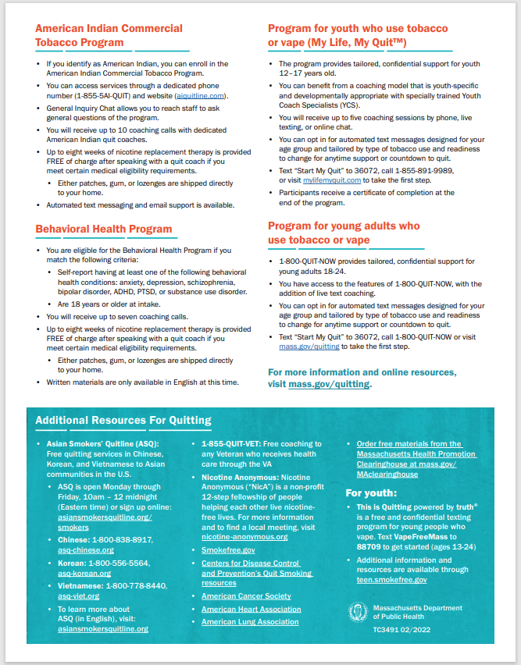
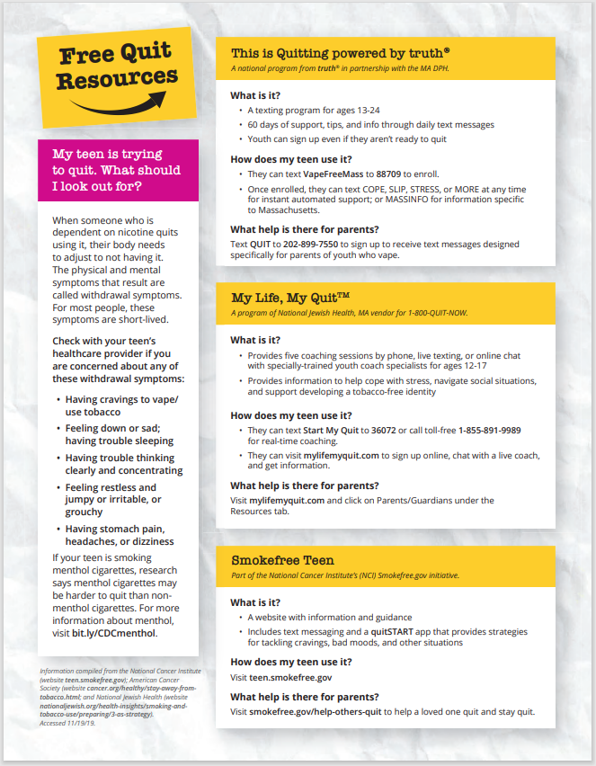
Info Sheets & Cessation Resources
Free Resources from CDC & MA Clearinghouse
If local schools/organizations are looking for staff presentations, please contact your local Tobacco Free Community Partnership Coordinator
Notes:
Free resources, most available in Spanish
tobaccocontrolnetwork.org/wp-content/uploads/2025/03/Vaping-and-Youth-What-Parents-and-Caregivers-Need-to-Know.pdf
massclearinghouse.ehs.state.ma.us/PROG-TOB/TC3491kit.html
massclearinghouse.ehs.state.ma.us/PROG-TOB/TC3486kit.html
Resource sheets geared towards the general public, healthcare providers, and parents/caregivers
Presentations can be geared to parents, guidance counselors, nurses, administration, etc. NOT STUDENTS
Most towns in region covered by Colleen Kennedy-Mello (Seven Hills) other than Easton & Sharon who would be covered by Kathryn Im. Happy to make the connection!

Slide 25
Questions?

Slide 26
Megan daCosta, Tobacco & Marijuana Compliance Program Manager
megan.dacosta@newbedford-ma.gov

