Slide 1
How to Conduct a Retail Vibrio Investigation
August 28, 2025
Jessica Ferreira, CP-FS
Environmental Analyst III, Food Safety Trainer
Department of Public Health - Division of Food Protection

Slide 2
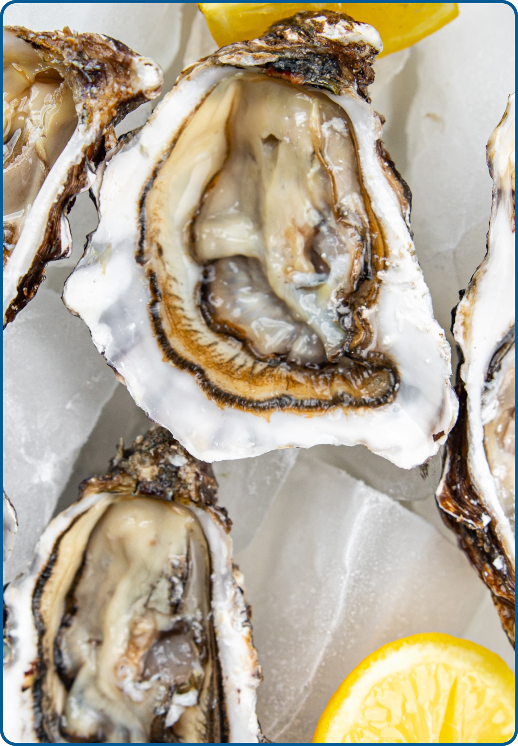
Introduction
Vibrio is a bacteria that occurs naturally in the United States and Canada's coastal waters and causes serious illnesses.
The Massachusetts Department of Public Health (DPH) and the Massachusetts Department of Fish and Game's Division of Marine Fisheries (DMF) have successfully partnered with the industry to develop controls to mitigate the risk of Vibrio associated with Massachusetts-harvested oysters.
The statewide Vibrio Control Plan is part of The National Shellfish Sanitation Program (NSSP), recognized by the FDA, and has been in effect since 2013.
The Massachusetts 2025 control season for Vibrio parahaemolyticus will begin on Sunday, May 19, 2025, and end on Saturday, October 19, 2025.
Notes:
READ SLIDE.
*Note: Vibrio investigations can occur even after the month of October as people who consume these during the season can get illness thereafter.

Slide 3
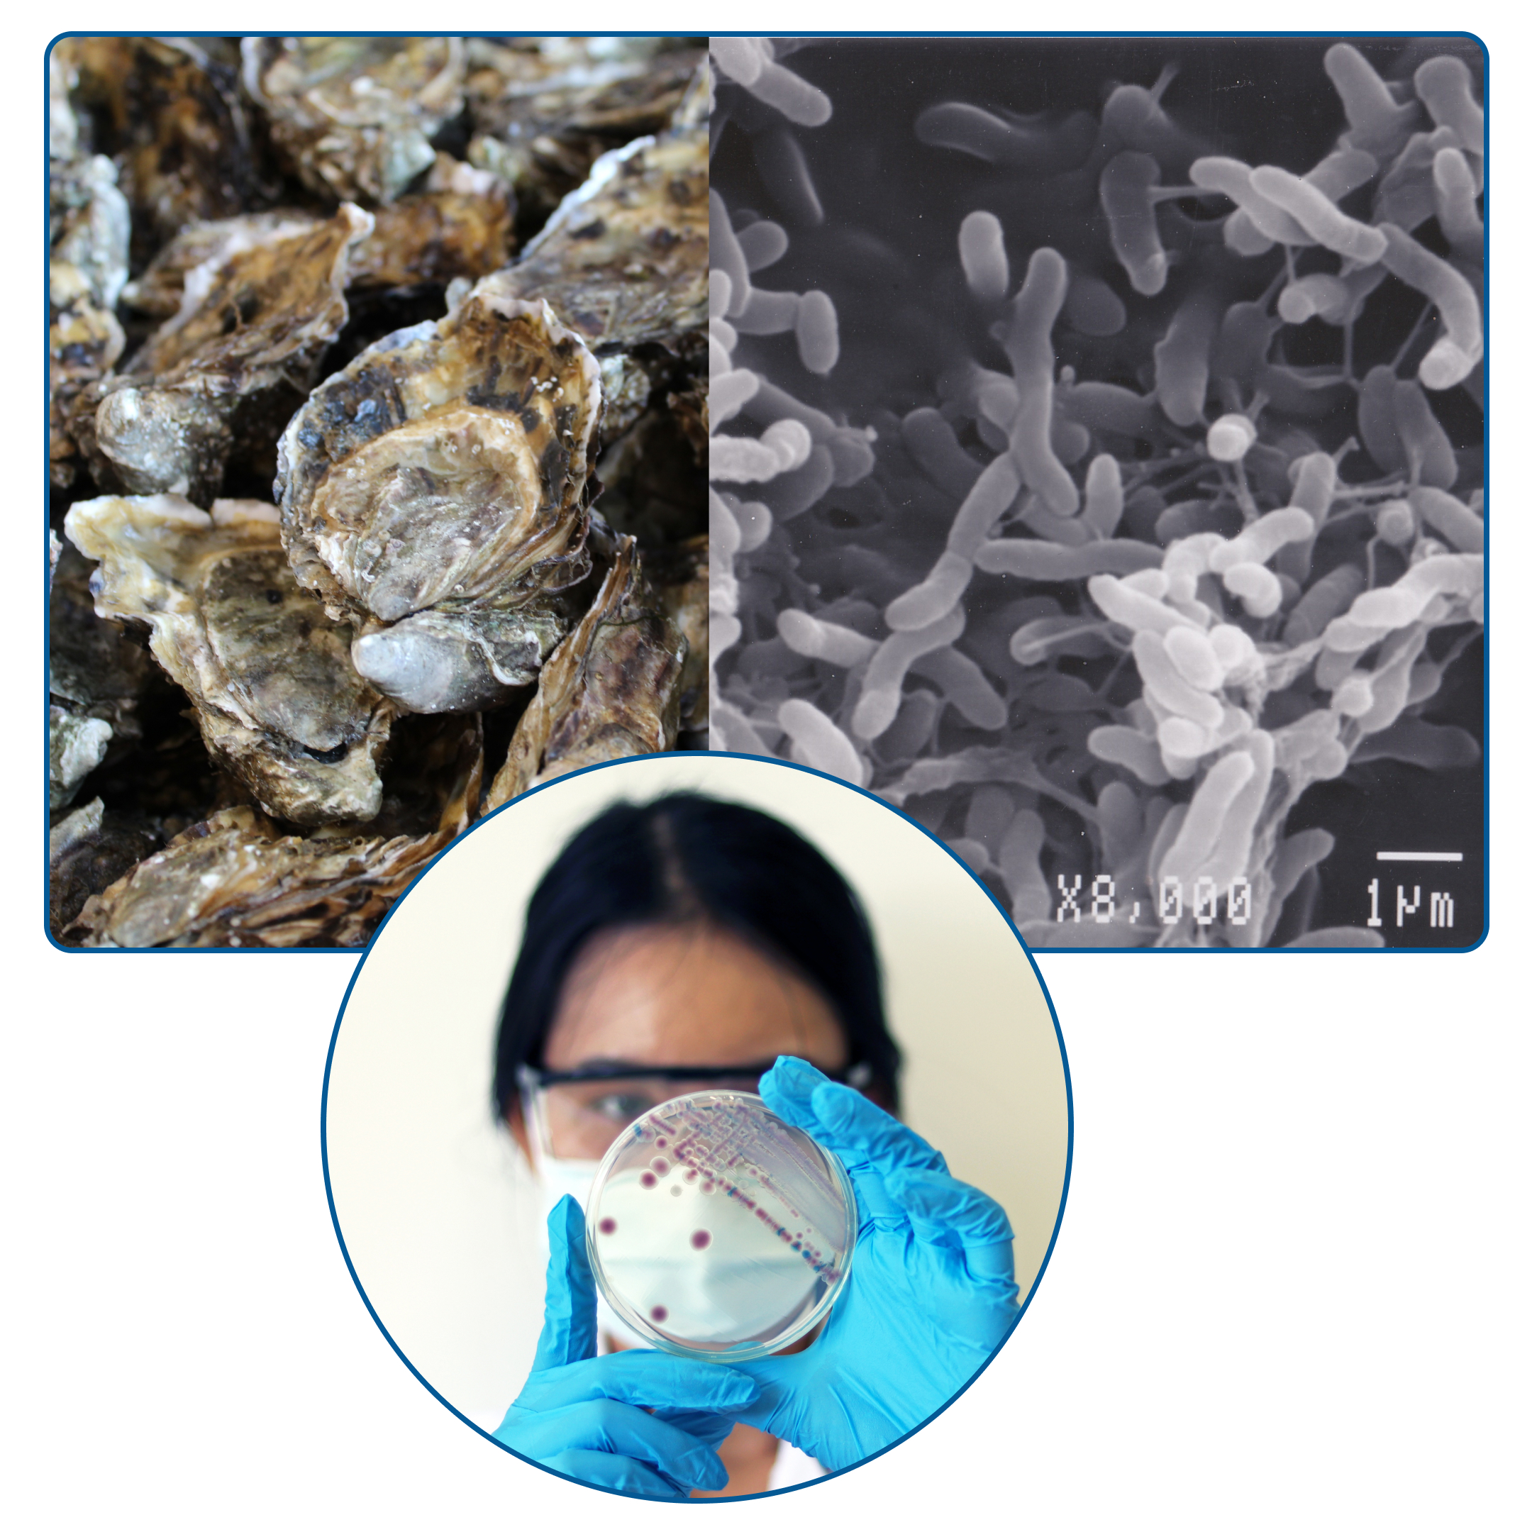
What is Vibrio?
Vibrio is a form of bacteria that naturally live in certain coastal waters and are present in higher concentrations between May and October when water temperatures are warmer.
Source of infection in humans:
eating raw or undercooked shellfish, particularly oysters
open wound is exposed to salt water or brackish water
When illnesses are identified, a detailed investigation at retail and wholesale is required to determine the source of the illness and to prevent further illnesses.
Vibriosis cannot be passed from one person to another.
Notes:
Vibrio is a form of bacteria that naturally live in certain coastal waters and are present in higher concentrations between May and October when water temperatures are warmer.
Source of infection in humans:
eating raw or undercooked shellfish, particularly oysters
open wound is exposed to salt water or brackish water
This bacteria can cause stomach pain or even be lethal. When illnesses are identified, a detailed investigation at retail and wholesale is required to determine the source of the illness and to prevent further illnesses.
Vibriosis cannot be passed from one person to another.

Slide 4
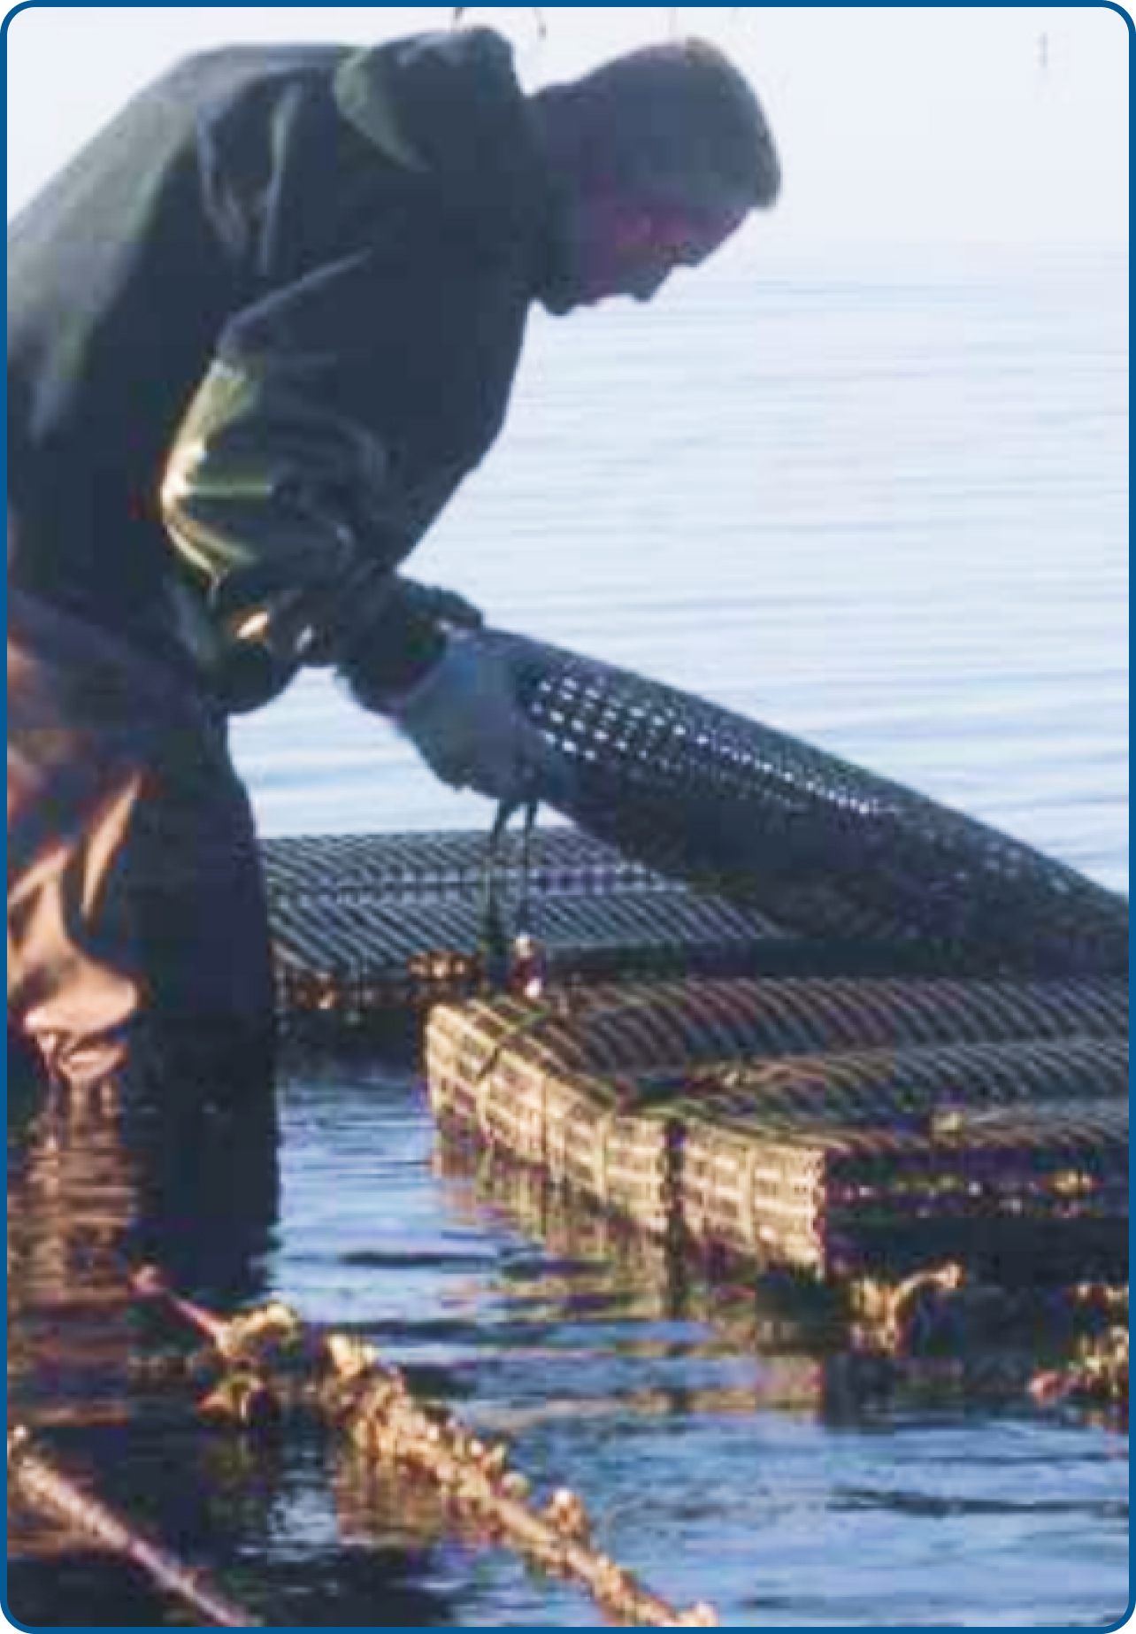
Why is Vibrio Control work so important?
A Vibrio Control Plan is a program to protect the public health of consumers by assuring the sale or distribution of shellfish from safe sources and that shellfish have not been adulterated during cultivating, harvesting, processing, shipping, or handling.
This program includes a collaborative effort by state, local, and federal officials as well as businesses and advocacy groups, and creates multiple layers of oversight to prevent injury and death because of Vibrio infection.
Due to climate change and overall warmer water temperatures, the reach of Vibrio bacteria is expanding; therefore, the need to protect public health and strictly monitor harvesting systems is greater than ever.
Notes:
A Vibrio Control Plan is a program to protect the public health of consumers by assuring the sale or distribution of shellfish from safe sources and that shellfish have not been adulterated during cultivating, harvesting, processing, shipping, or handling. This plan mainly falls on the harvesters and dealers.
The vibrio control plan tracks the conditions of the oyster harvests in MA. It also limits post-harvest growth of Vibrio in oysters.
This program includes a collaborative effort by state, local, and federal officials as well as businesses and advocacy groups, and creates multiple layers of oversight to prevent injury and death because of Vibrio infection. The Division of Marie Fisheries regulates the shellfish harvesters, while Public Health regulates the dealers that buy from the harvesters.
Due to climate change and overall warmer water temperatures especially during the summer months, the reach of Vibrio bacteria is expanding; therefore, the need to protect public health and strictly monitor harvesting systems is greater than ever.

Slide 5
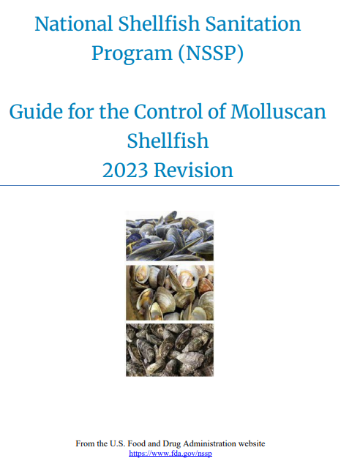
Notification of Affected Shellfish / Growing Areas
Growing area closures are conducted in accordance with the CH II requirements of the MO.
For parahaemolyticus, the area is closed when 2 or more illnesses are confirmed from the same harvest area and are harvested on the same day, or there are 5 or more illnesses in the same harvest area over a 30-day period.
However, DMF and DPH have continued to use a preventative 7-day closures when 4 illnesses are confirmed in a 30-day period.
Notes:
For some background information….
Growing area closures are conducted in accordance with the CH II requirements of the MO.
For parahaemolyticus, the area is closed when two or more illnesses are confirmed from the same harvest area and are harvested on the same day OR, more commonly, we have five or more illnesses in the same harvest area over a 30-day period. However, DMF and DPH have continued to employ preventative seven-day closures when four illnesses are confirmed in a 30-day period. This used to be required by the MO but was changed back in 2017ish. We continue to use it because it creates a potential pause in illnesses as five confirmed cases will close an area for a minimum of 14 days.

Slide 6
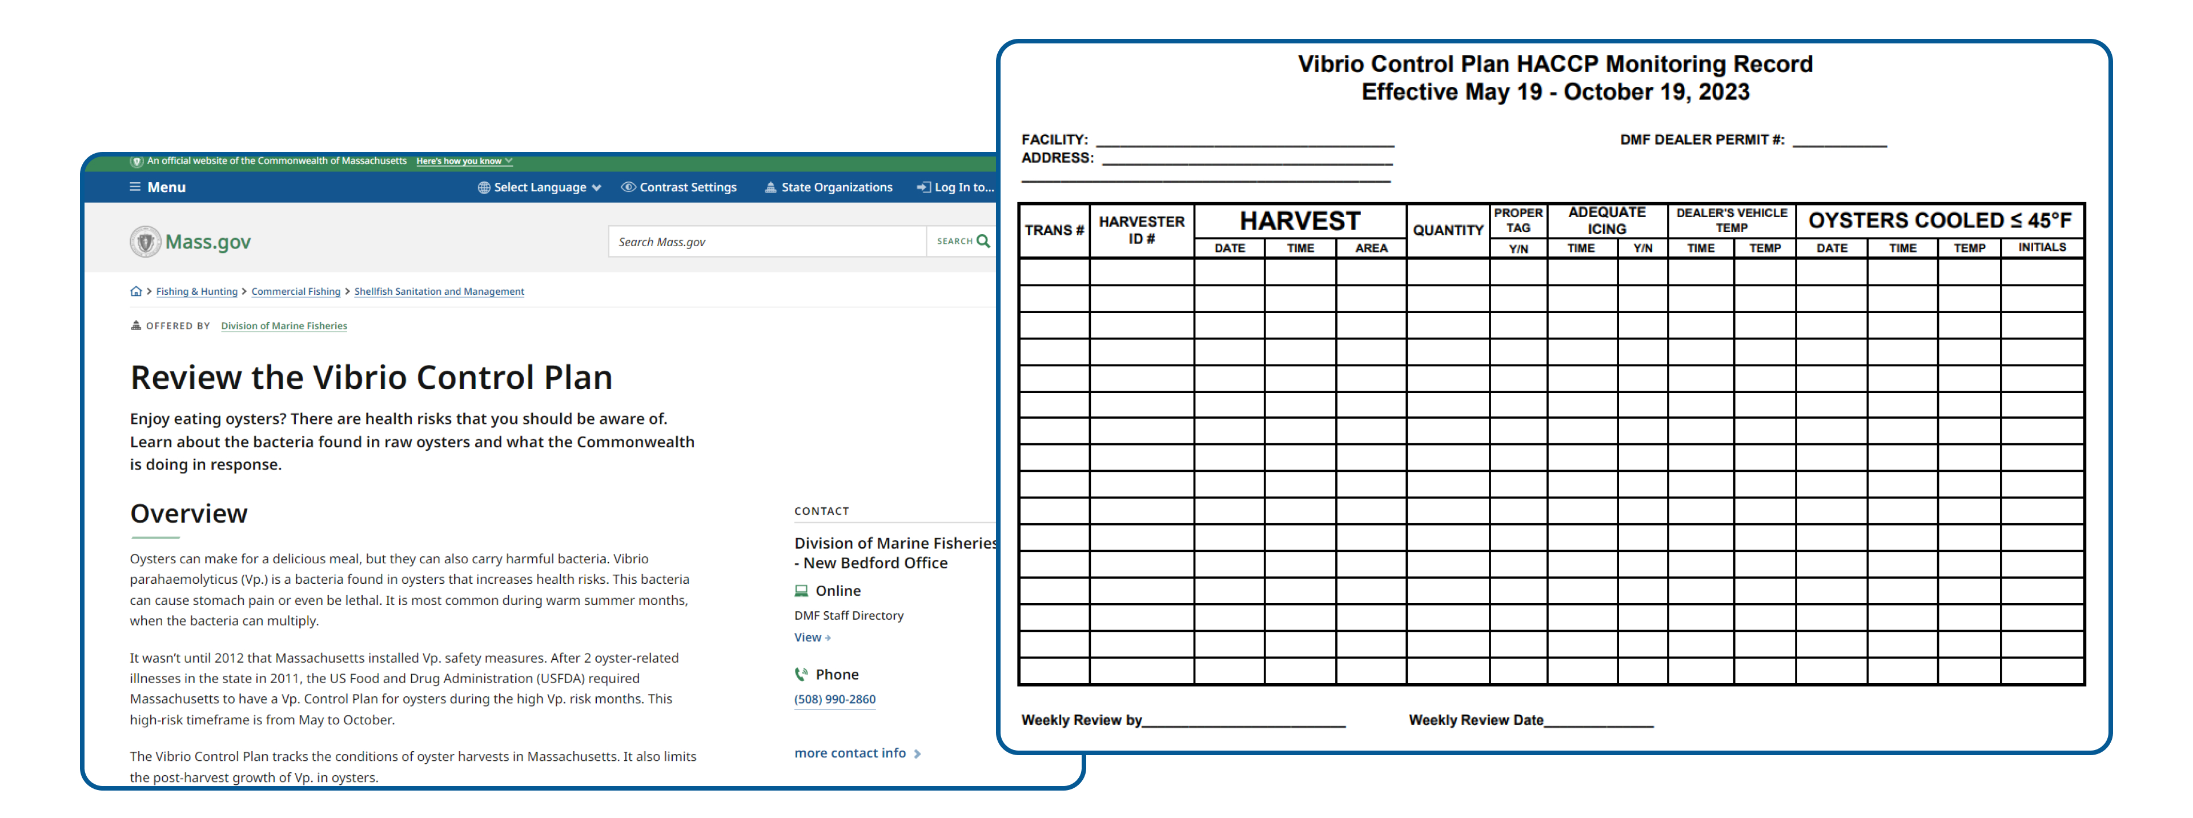
MA Vibrio Control Plan
A Vibrio Control Plan is a requirement for wholesale only. It requires specific icing times and logs to ensure the oysters were held at 45*F or below after harvesting. For more information, including training videos you can go to the MA Division of Marine Fisheries website.
Notes:
A Vibrio Control Plan is a requirement for wholesale only. It requires specific icing times and logs to ensure the oysters were held at 45*F or below after harvesting. You may be requested to get copies of these documents if the Division of Food Protection needs copies for their traceback investigation. For more information on vibrio control plans, including training videos you can go to the mass.gov website and put in the search bar “Vibrio Control Plans” website. You can also review this information at the Division of Food Protection and Division of Marine Fisheries websites.
https://www.mass.gov/info-details/review-the-vibrio-control-plan

Slide 7
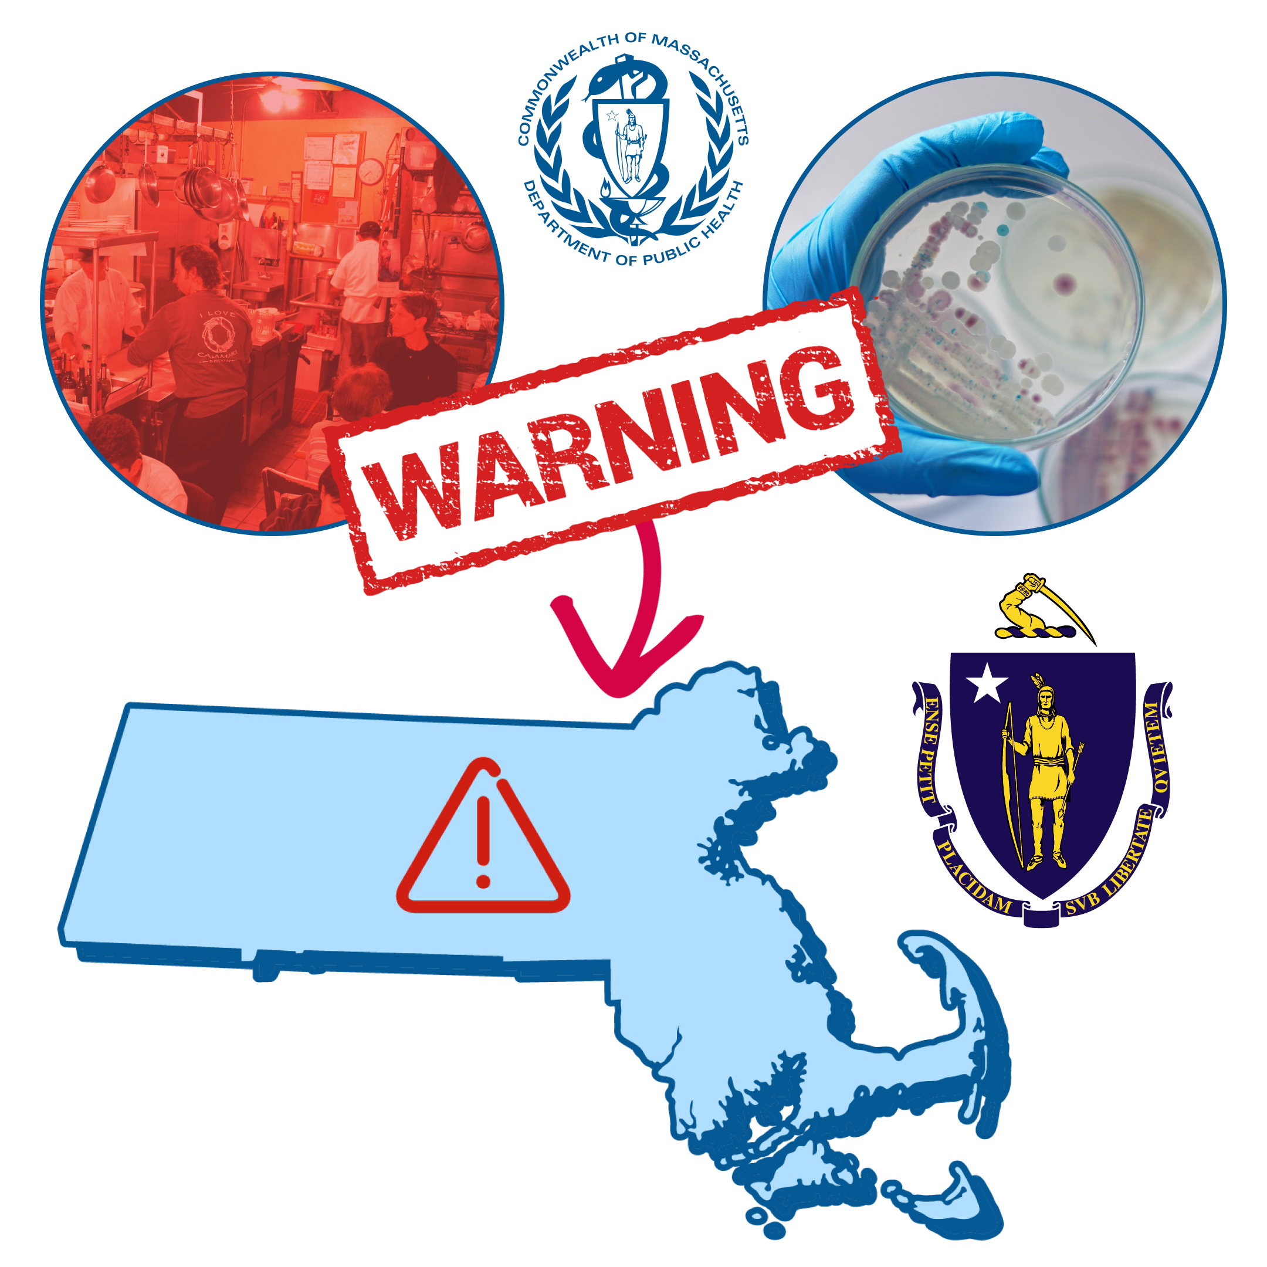
Initiating a Vibrio Illness Investigation
When a retail food establishment is identified in the food history of a Vibrio case:
The Division of Food Protection (DFP) will contact the LBOH and communicate objectives and a time frame for completion. Food histories are collected by an epidemiologist or a public health nurse.
Local Boards of Health (LBOH) overall goal is to identify any evidence of cross-contamination, mishandling, or temperature abuse.
DFP provides a guidance document to the local inspector(s) and encourages local inspector to contact DFP inspector with questions.
DFP will request for assistance from the LBOH to contact the retail site to collect tags, invoices, and other documents, and conduct a HACCP Assessment which then allows for a timely initiation of wholesale traceback by DFP.
Notes:
Initiating a Vibrio illness investigation starts…..READ SLIDE

Slide 8
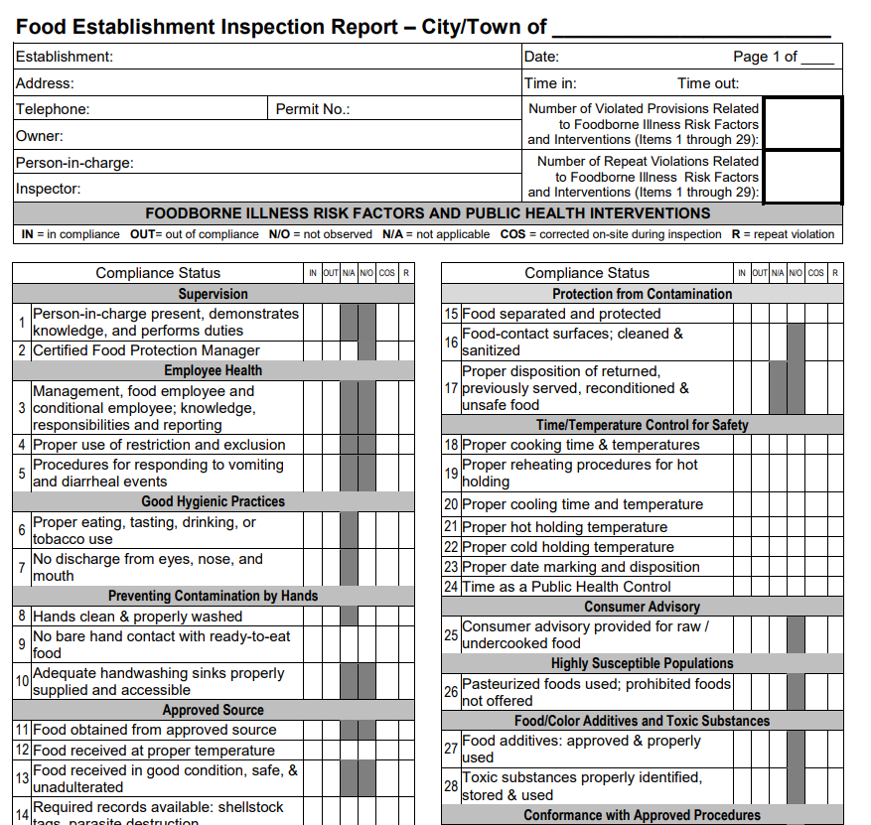
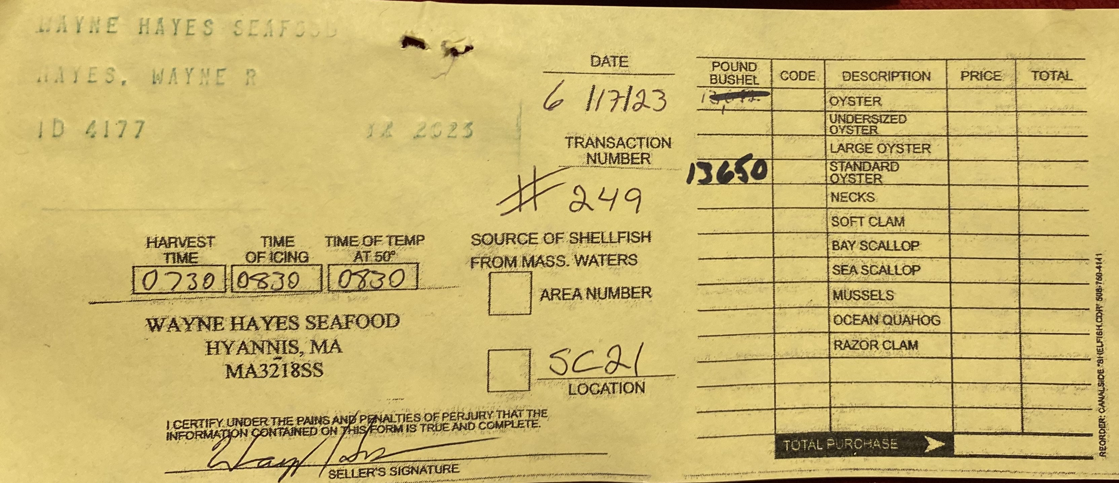
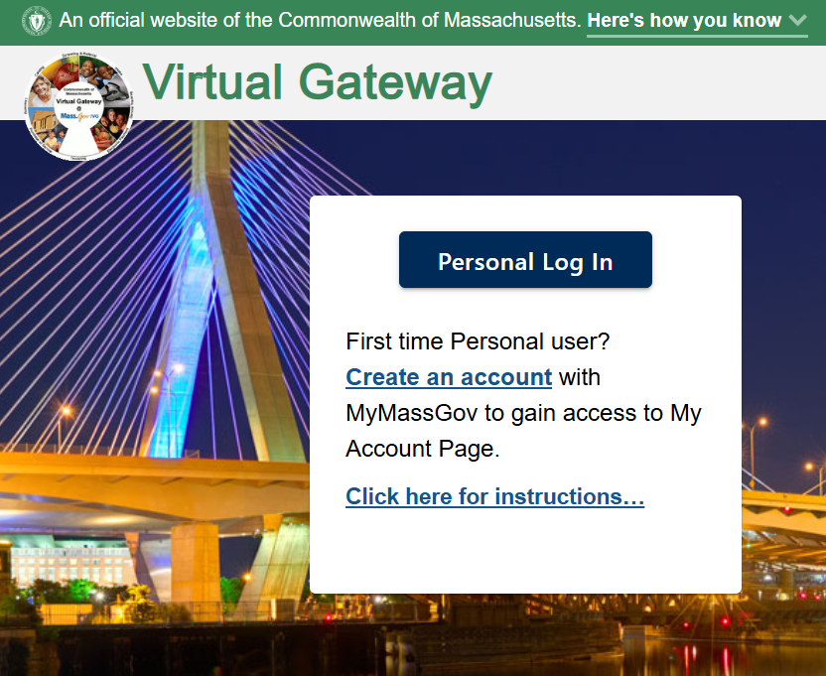


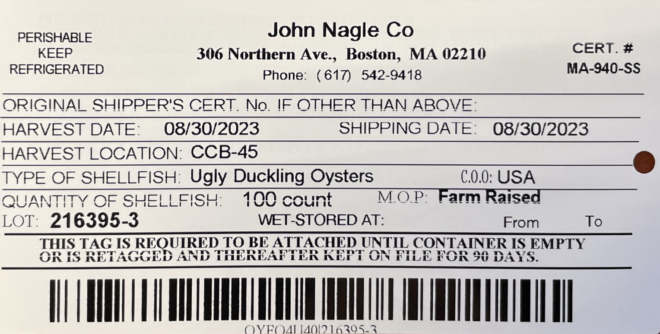
Notification and Request to the LBOH
Case entered in Maven
DFP Contacts LBOH
LBOH conducts Retail Investigation
LBOH Sends Inspection Report and Requested Docs to DFP
DFP Conducts Traceback Investigation
Notes:
Once a case is a confirmed case, either a MA resident or case reported from another state, it is then is reported through MAVEN. Then the Outbreak and Response Coordinator Supervisor at DFP will contact the LBOH to notify, provide all the information on the case and provide resources if needed. The MA resident would be interviewed by Epi or the LBOH public health nurse to gather all needed information which includes exposure information. If the case reports food exposures outside the home or any high-risk foods within their incubation period, a foodborne illness complaint event is created. If the case consumed raw bivalve molluscan shellfish (typically oysters, but occasionally may be clams or other products), a traceback would need initiated by the Outbreak and Response Coordinator Supervisor at DFP.
Then the Outbreak and Response Coordinator Supervisor will reach out to the LBOH and request that they conduct an inspection with a focus on raw oysters (or whatever the suspect shellfish may be); identify any time/temp abuse, cross contamination, or mishandling either by observing in real time and/or by reviewing log books and documentation; and collect copies of invoices and tags for product served to the consumer or otherwise available for service on the day in question if they are unable to narrow down. I request that they provide me the information within 2 business days. It is most important to only get records / tags of the exact date / and or dates DFP requests only.
Many times, particularly later in the season as illnesses begin to add up or the LBOH cannot investigate immediately, the assigned DFP inspector will contact the retail establishment directly, ahead of the LBOH’s visit, to get tag information to identify the harvest area(s) and original shipper(s).
DFP then reviews the findings and collects the documents requested, mainly Bill of Ladings / Invoices and Shellfish tags and uses that information to conduct traceback investigation.

Slide 9
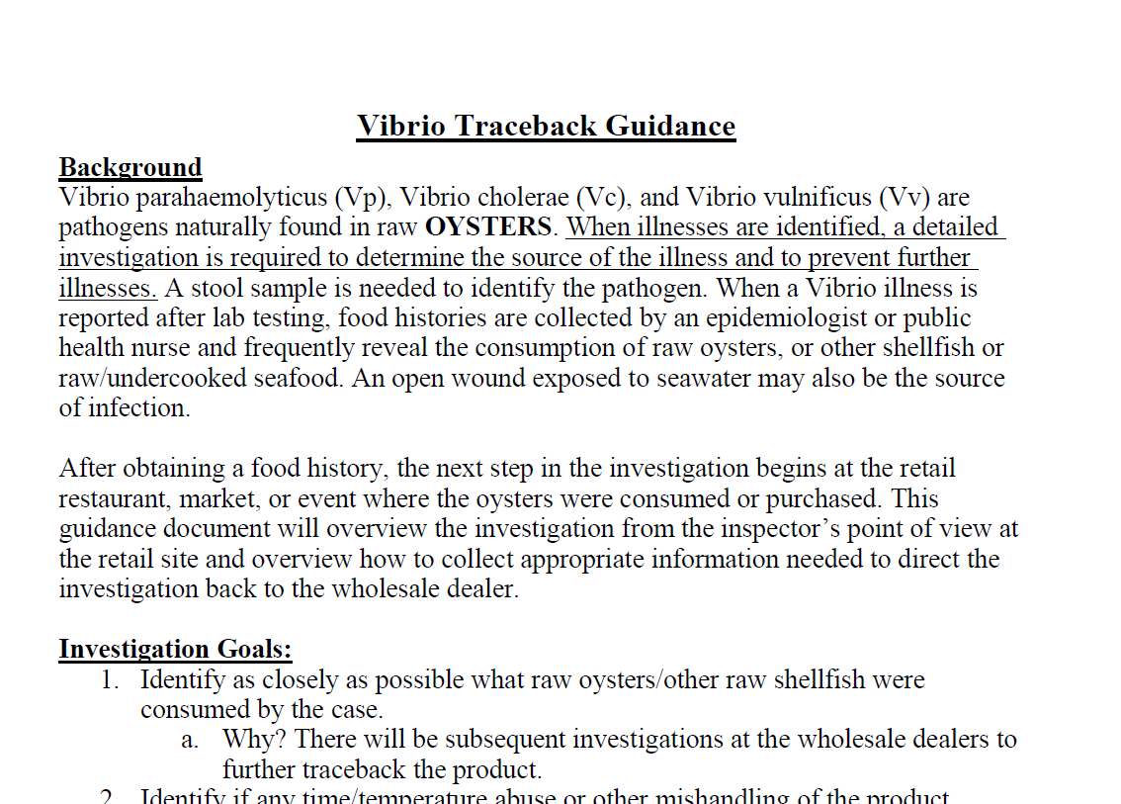
DFP Guidelines
Notes:
DFP will provide a guidance and technical support to the local inspector(s) on how to conduct the investigation and what to look for specifically. This is a resource DFP has to provide to LBOH inspectors.

Slide 10
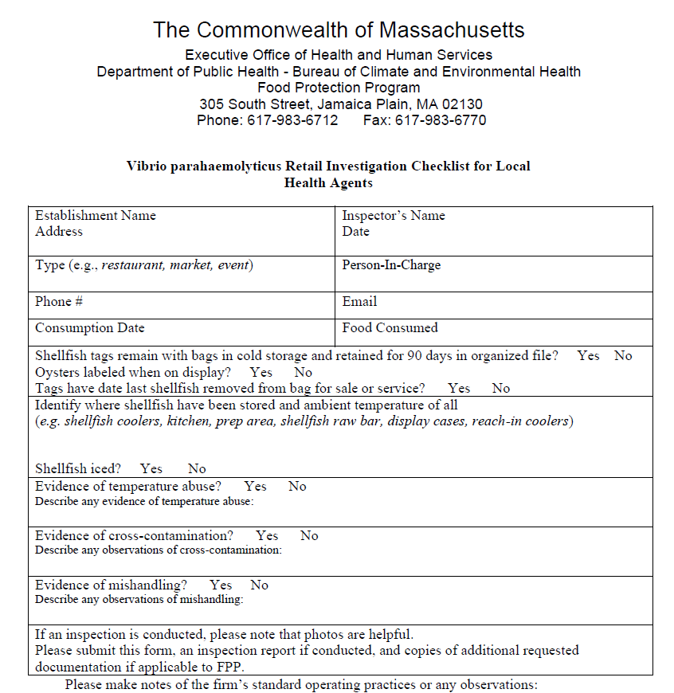
Vibrio Checklist for LBOH
Notes:
DFP also has a retail investigation checklist for LBOH to assist during their investigation.

Slide 11
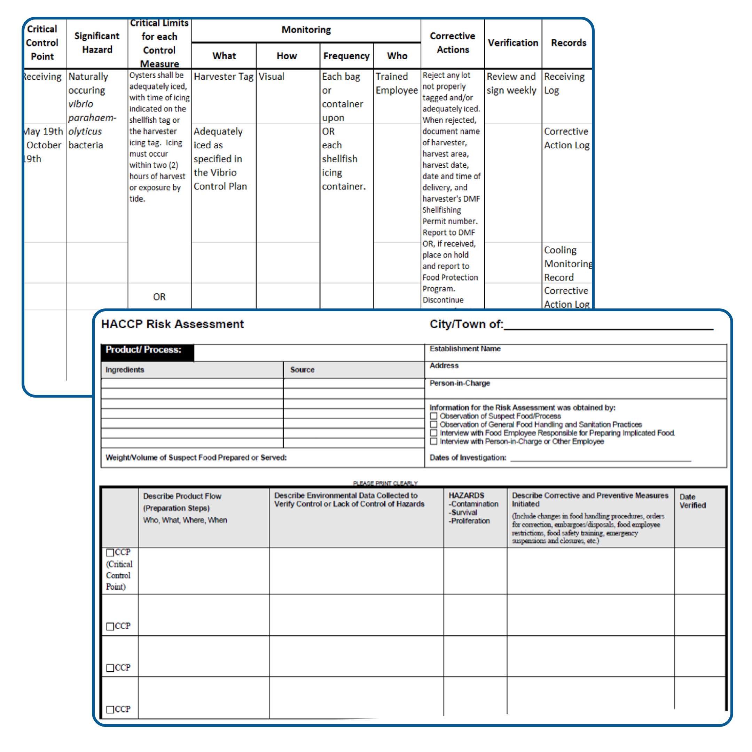
Conduct a HACCP Risk Assessment
The LBOH will then conduct a HACCP risk assessment of the raw oysters at the retail food establishment.
Request a copy of the retail food establishments HACCP Plan as well to help you fill out the assessment form and collect information needed for your onsite visit.
Follow the flow of food by reviewing the HACCP Plan.
Get copies of the records noted in the Records column.
While doing a walk-though it is important to identify any evidence of cross-contamination, mishandling, or temperature abuse.
Other areas to focus on are outlined in the guidance document and overviewed briefly in the next slides.
Notes:
READ SLIDE
Conducting a HACCP Risk Assessment is highly recommended and or will be requested by DPH if needed.

Slide 12
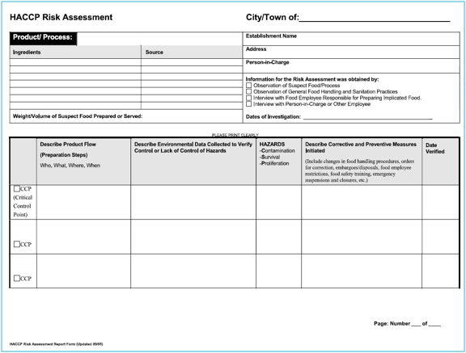
Summary of a HACCP Risk Assessment (HRA)
Notes:
This is a HACCP Risk Assessment Form. This is the form a LBOH staff member will be filling out if requested by DPH.
A HACCP Risk Assessment Form is used to facilitate risk assessment of the suspect food. The form is structured to assist with identifying the procedures used in the establishment in preparing the suspect food, as well as to identify corrective actions initiated because of the investigation.​

Slide 13
Steps in a HACCP Risk Assessment:
1. Identify ingredients, weight/volume, and steps involved in the preparation of suspect food(s).
2. Identify food handling procedures at each step in the preparation of suspect food(s).
3. Based on observation or interview, identify potential hazards and critical control points (CCP).
4. Identify violations and initiate corrective actions.
5. Verify corrective actions undertaken by the food establishment.
Notes:
There are 5 steps to the HACCP Risk Assessment.
1.) Identify ingredients, weight/volume, and steps involved in the preparation of suspect food(s).
2.) Identify food handling procedures at each step in the preparation of suspect food(s).
3.) Based on observation or interview, identify potential hazards and critical control points (CCP).
4.) Identify violations and initiate corrective actions.
5.) Verify corrective actions undertaken by the food establishment.
For more information on how to conduct a HACCP Risk Assessment, training and resources can be provided by the DFP Retail Food Team. We can discuss how you can get these resources after the presentation.

Slide 14
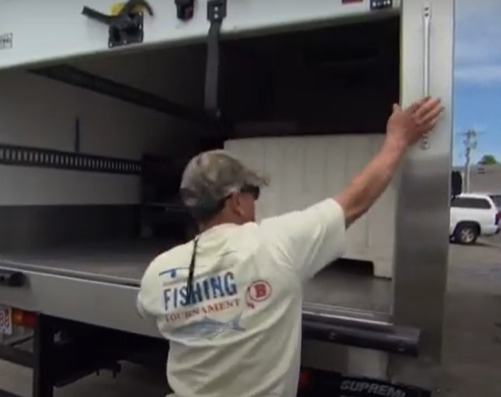
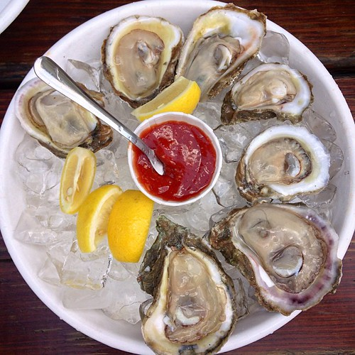
Follow the Flow of Food
Flow of Food: Start at receiving all the way through how it is served to the consumer
Notes:
The walkthrough part of the investigation should start by using the flow of the food. This means starting at receiving and going through the process until it is served to the consumer. If an employee is seen shucking the oysters or seen conducting improper food handling practices in the moment, then immediately stop and observe and document your findings.

Slide 15
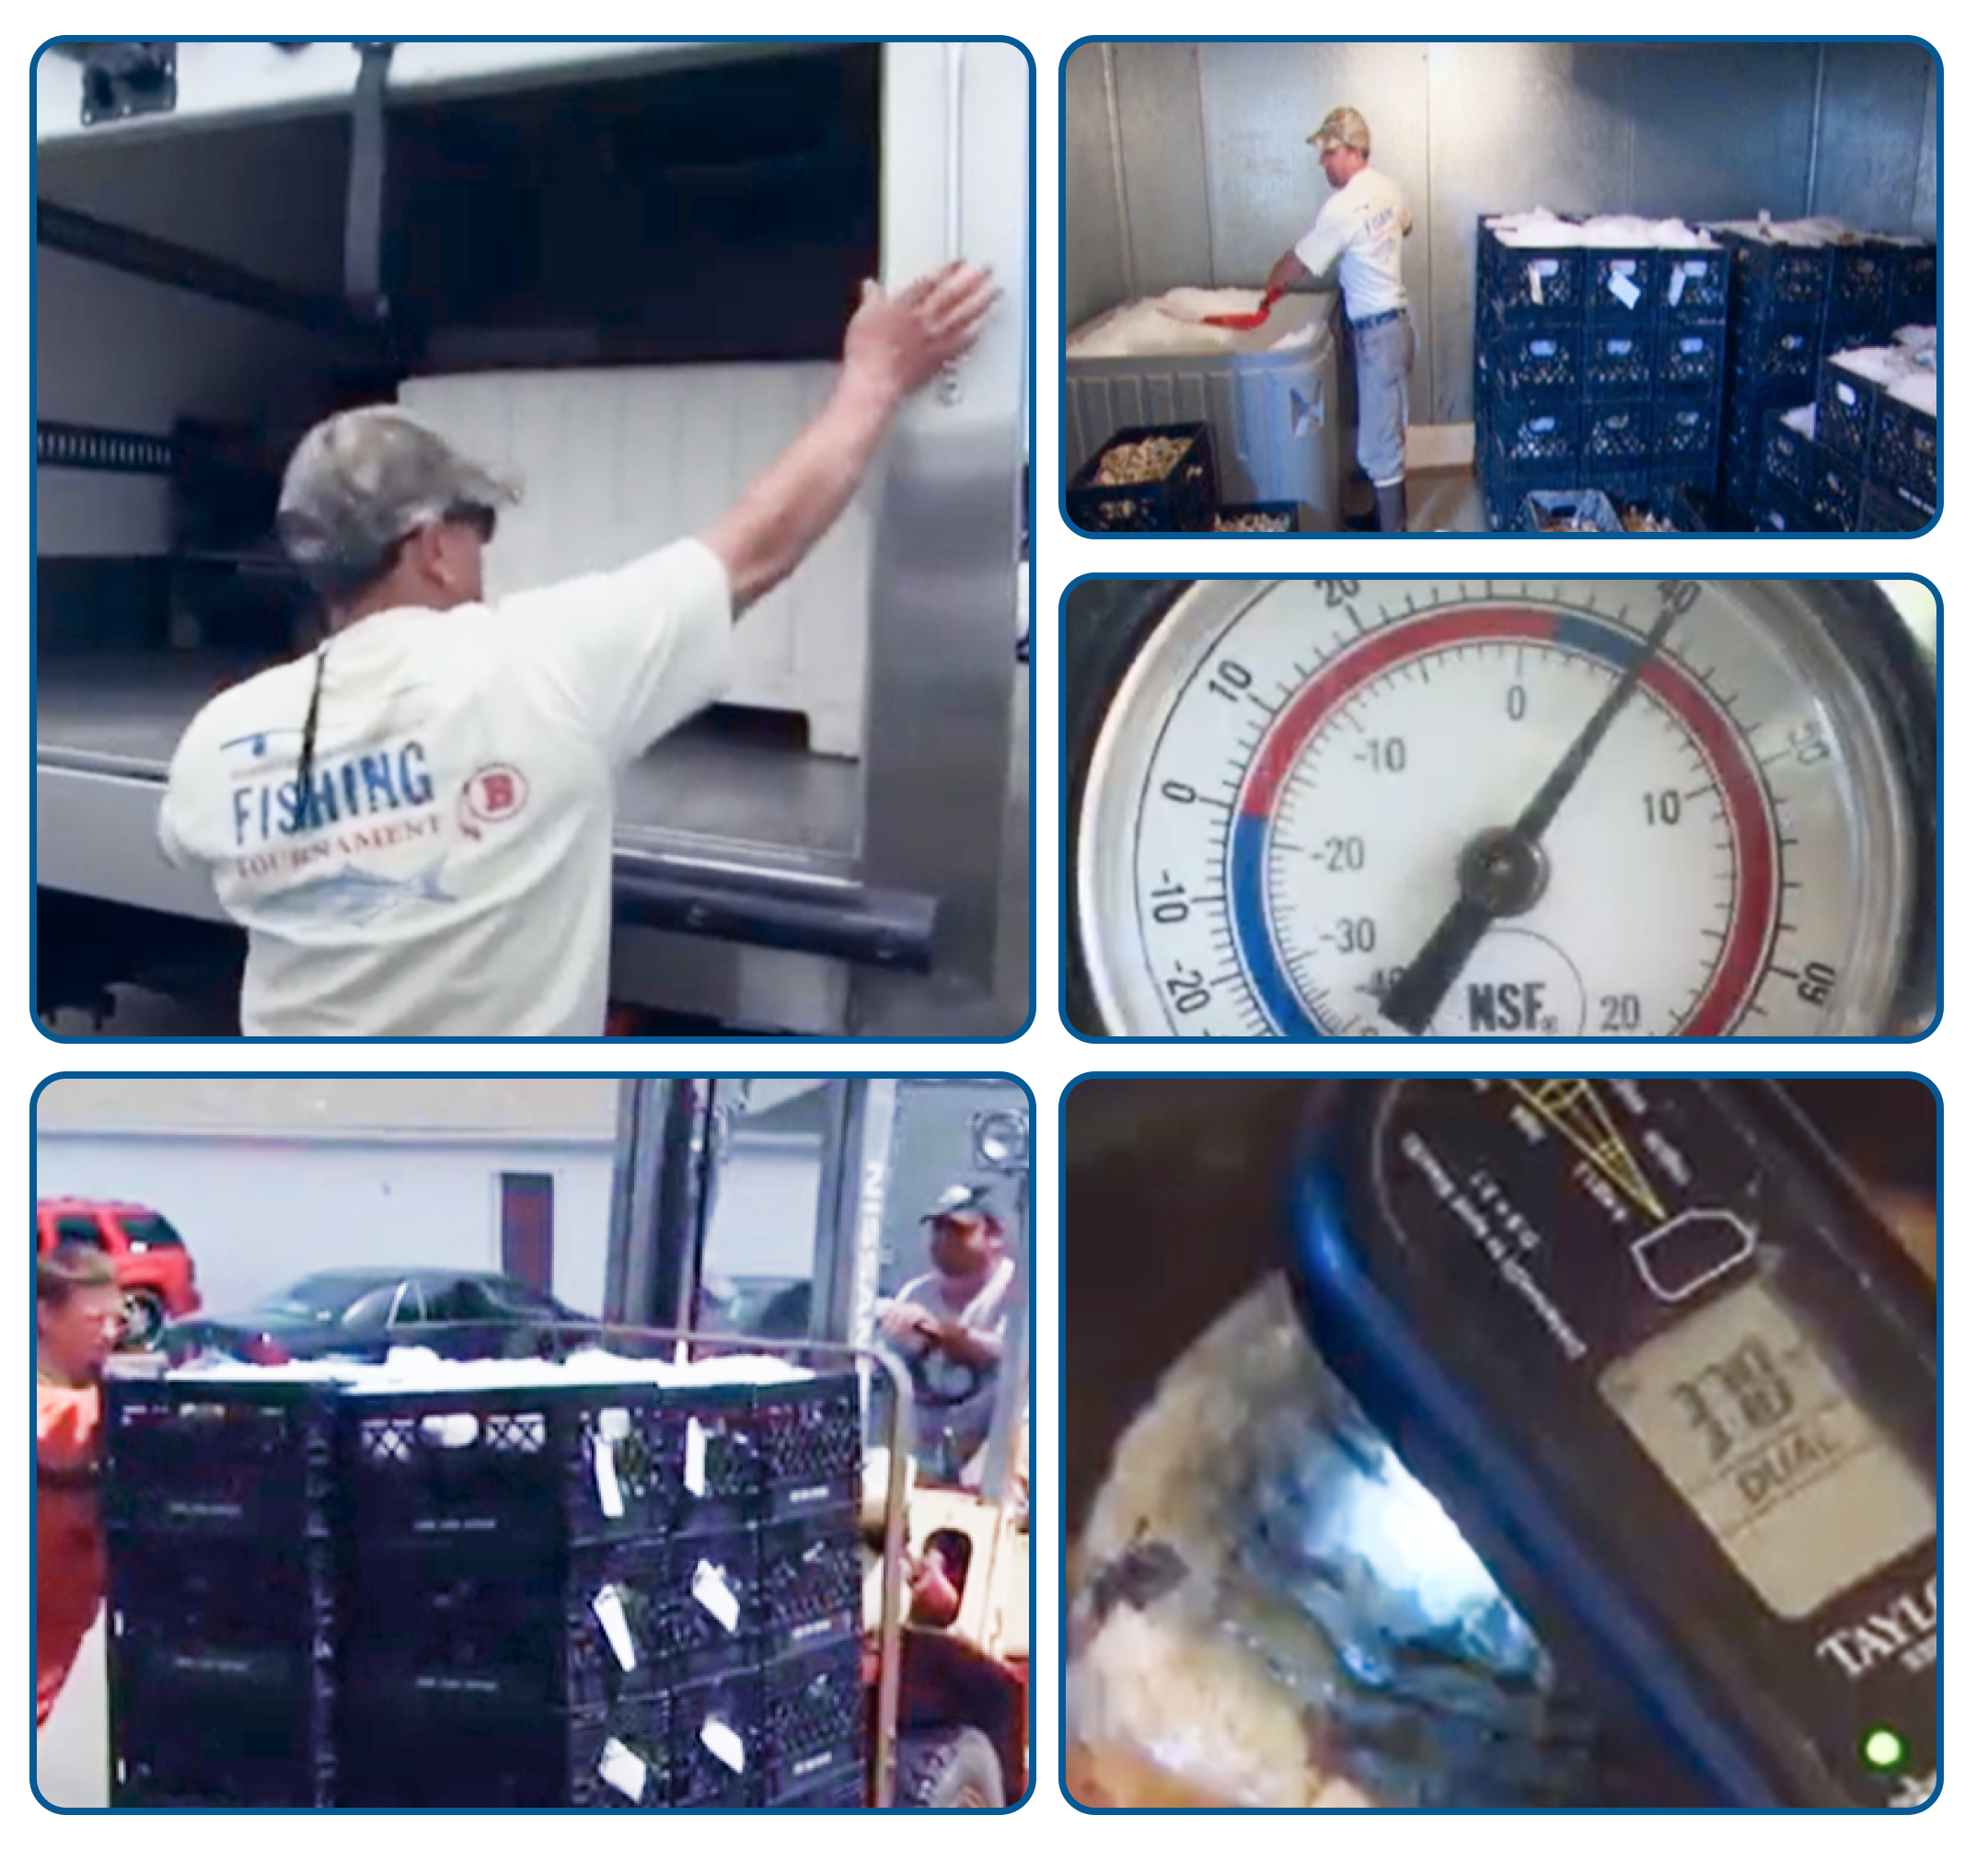
Observe Receiving
Observe how the oysters are received from the wholesale dealer
Consider:
Are they picked up by the food establishment or delivered?
Are they refrigerated during transport?
Are they put away immediately or left out in the kitchen?
Who is responsible for putting them in the walk-in cooler?
When stored in the cooler, at what temperatures are the coolers set? Take a temperature of oysters in the food establishments cooler. Overcrowded coolers may have trouble maintaining temperatures <41℉.
Is there a cooler log with recorded temperatures?
Notes:
If you are able to observe how the oysters are received from the wholesale dealer
Consider and or ask the following
Are they picked up by the food establishment or delivered?
Are they refrigerated during transport?
Are they put away immediately or left out in the kitchen?
Who is responsible for putting them in the walk-in cooler?
When stored in the cooler, at what temperatures are the coolers set? Take a temperature of oysters in the food establishments cooler. Overcrowded coolers may have trouble maintaining temperatures <41℉.
Is there a cooler log with recorded temperatures? Ask if they use electronic monitoring and if so, can you review the logs for the days in question?

Slide 16
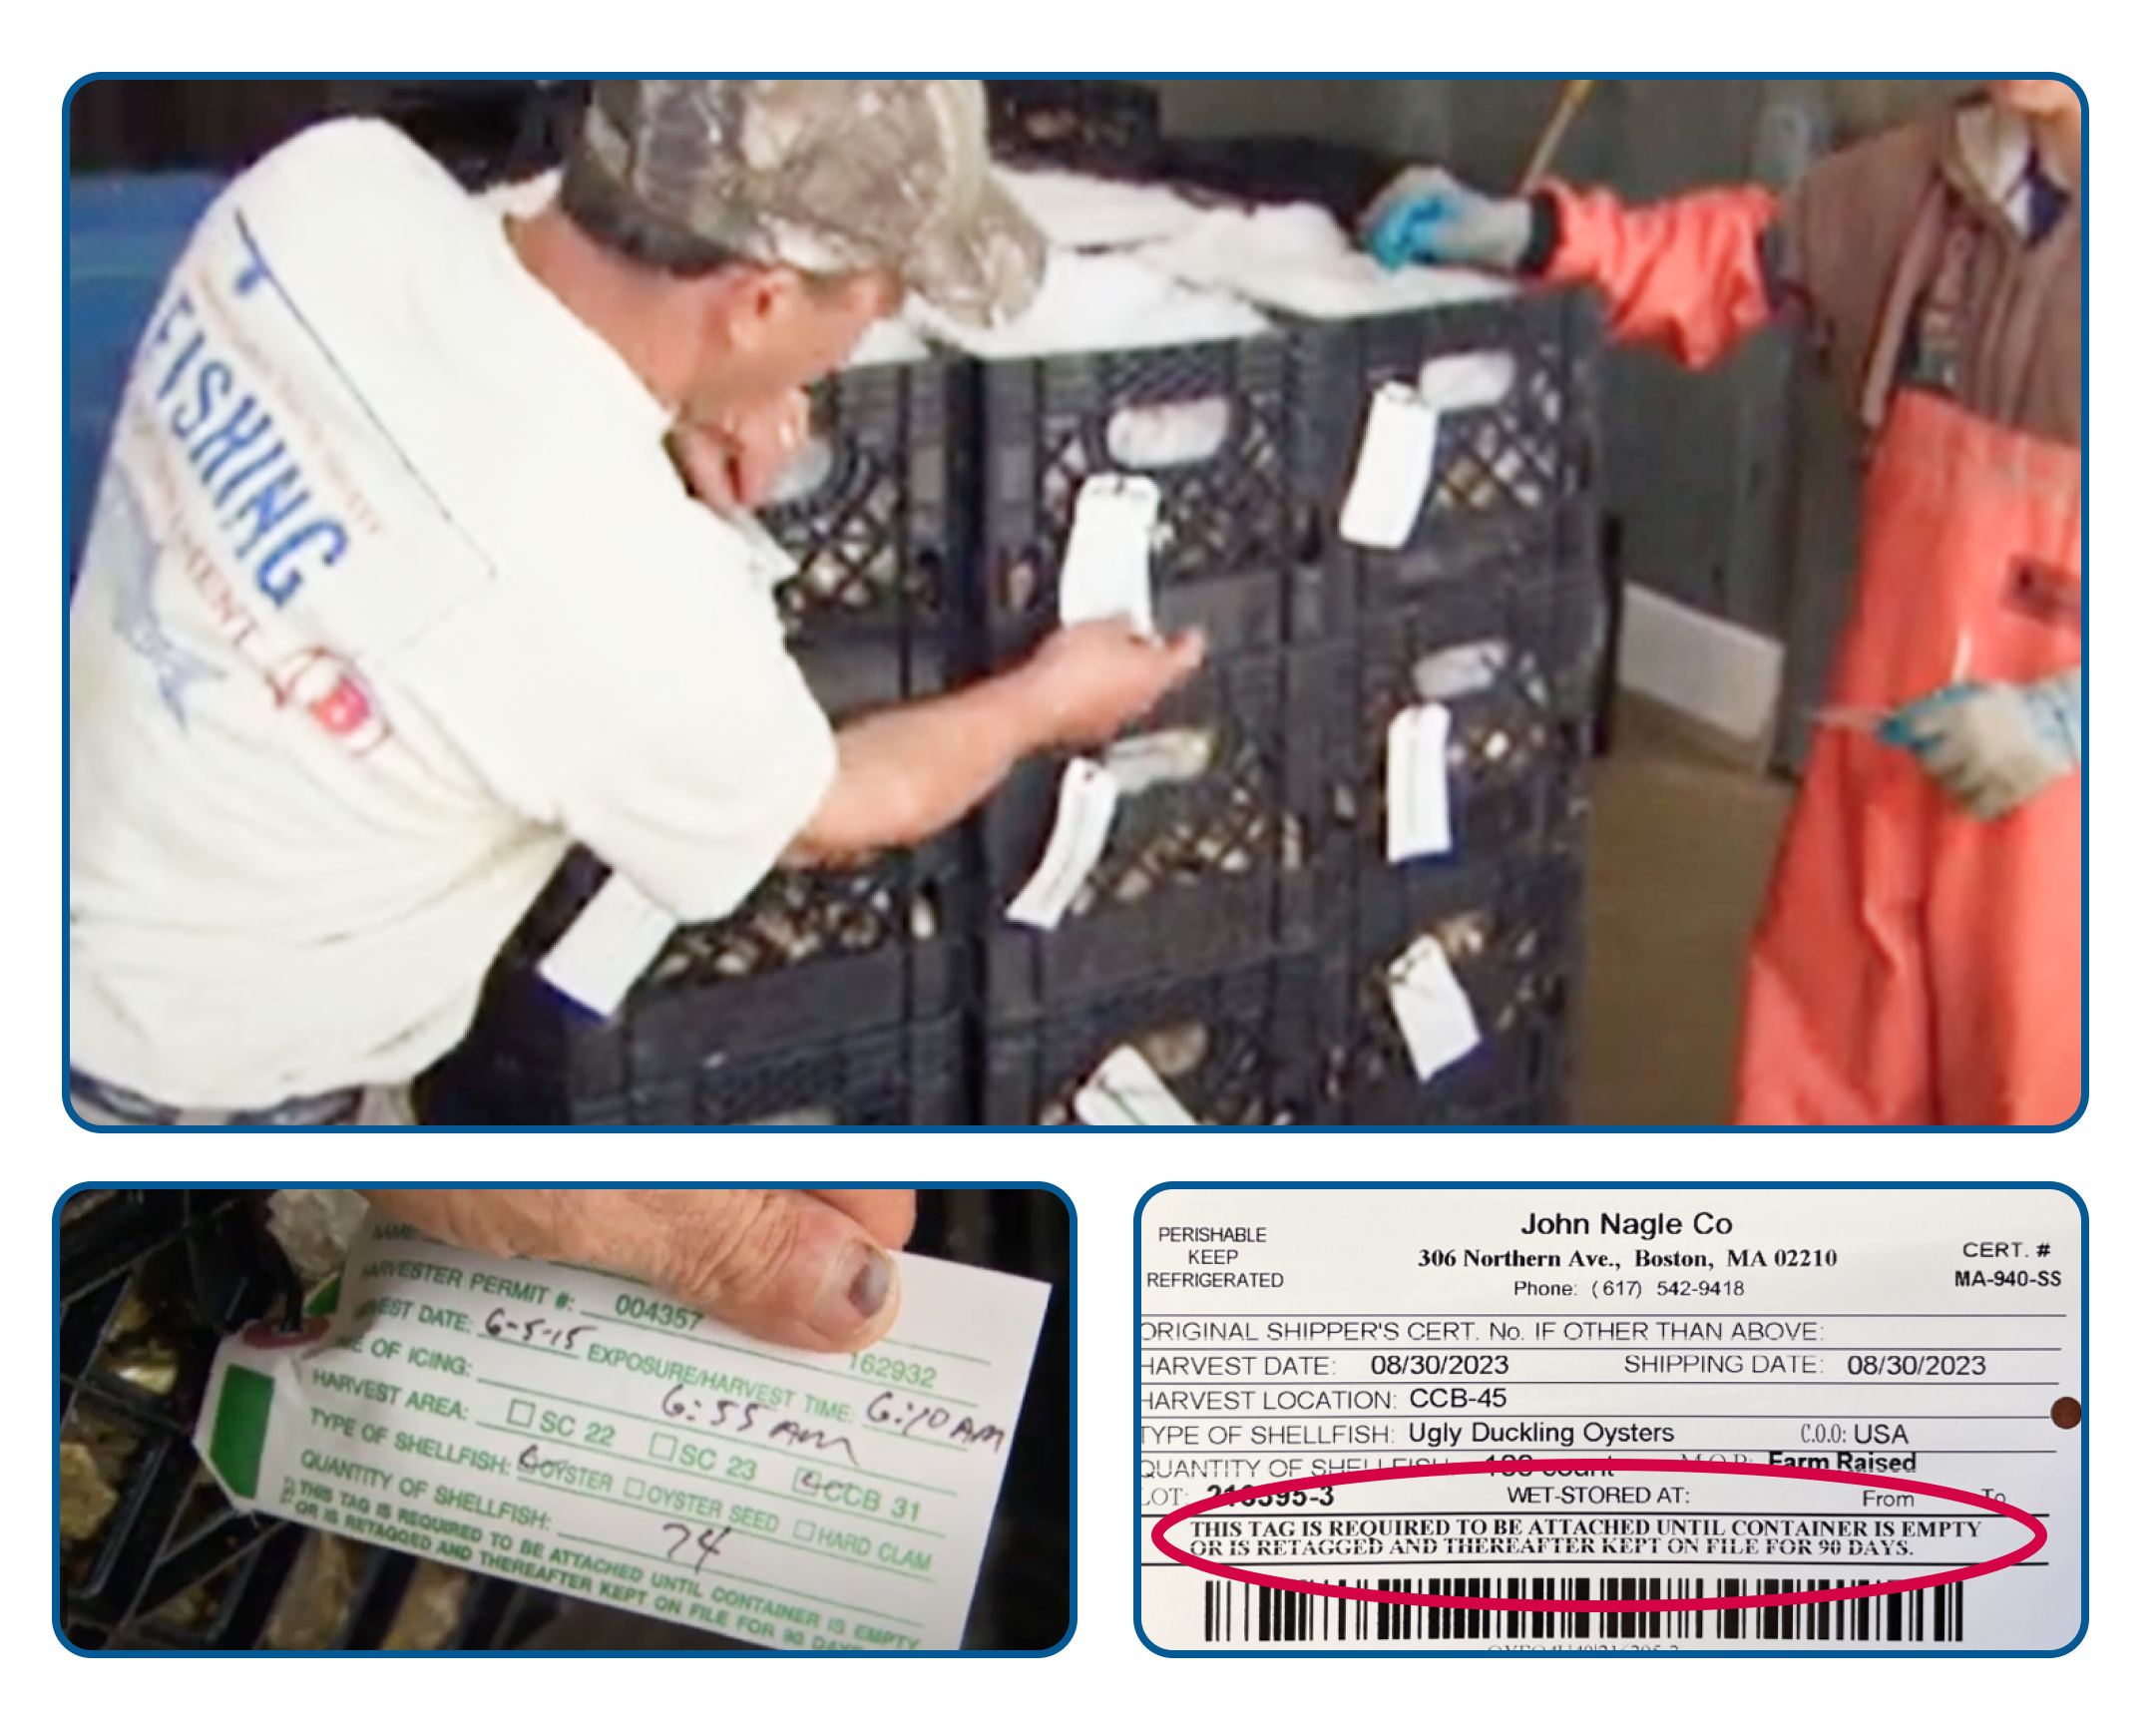
Review Tags
Consider:
Are all bags or containers properly identified with tags?
Does the firm maintain the tags for 90 days following the consumption of the last oyster?
Are the tags held in an organized manner?
Has the firm recorded the date on the tag that the last oyster was served from a bag?
Notes:
When reviewing shellfish tags:
Consider:
Are all bags or containers properly identified with tags?
Does the firm maintain the tags for 90 days following the consumption of the last oyster? Remember this is a requirement of the code under 3-203.12 (C)
Are the tags held in an organized manner? By keeping the tags in chronological order correlated to the date that is recorded on the tag or label.
Has the firm recorded the date on the tag that the last oyster was served from a bag? This is something food establishments do not do or forget to do. Remind them this requirement per 3-203.12 (B).

Slide 17
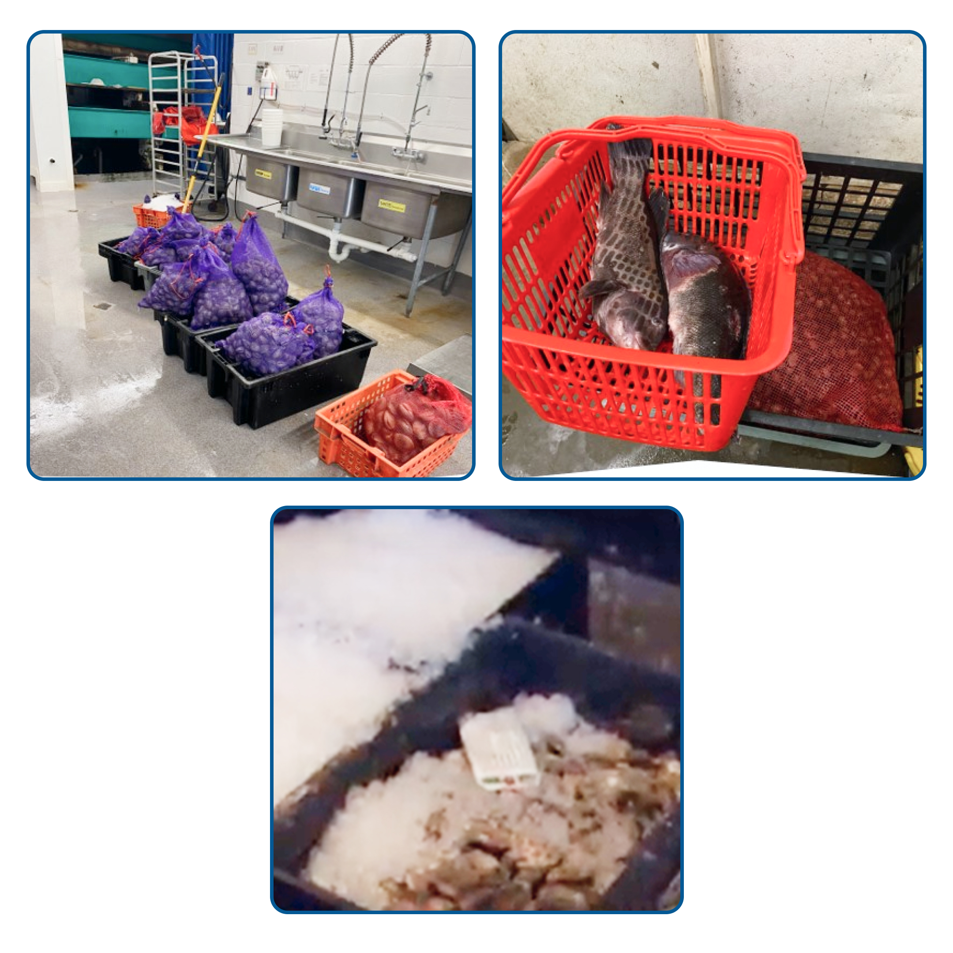
Review Storage
Consider:
How is shellfish stored?
e.g., Are they held separately, or do they set one lot on top of one another (nesting)?
Does the firm segregate the shellfish from other hazardous foods?
Is the shellfish iced?
Is there a FIFO rotation of inventory?
What sanitation practices are in place for the areas of storage, preparation, holding, and service?
Notes:
Review Storage
Consider:
How is shellfish stored?
e.g., Are they held separately, or do they set one lot on top of one another (nesting)? Ensure that they are no commingling with shellshock from other containers with different certification numbers, different harvest dates or different growing areas as identified on the tag or label.
Does the firm segregate the shellfish from other hazardous foods? Such as fin fish.
Is the shellfish adequately iced? Meaning the amount of ice and application of it is sufficient.
Is there a FIFO rotation of inventory?
What sanitation practices are in place for the areas of storage, preparation, holding, and service?

Slide 18
Review Service
Consider:
When readied for service, how are the oysters (or other shellfish) prepared and held prior to service?
Are the oysters shucked in advance or shucked to order?
What are the practices of the person who shucks the oysters?
How many people typically shuck shellfish?
Are the oysters exposed to warm temperatures for any extended periods of time?
How are oysters handled when ordered from the menu vs. when ordered from the raw bar?
How are varieties of oysters displayed at the raw bar?
How are oysters identified in the oyster display?
Is there a “specials” board for branded oysters served?
Does the firm keep track of what oysters were served on each date?
What does the firm do when they run out of a particular oyster?
What does the firm do with oysters prepped for service, but not sold on a particular evening?
Are there adequate hand washing facilities for those at the raw bar?
Have any illnesses been reported by staff to management?
Notes:
When observing service ask the following questions:
READ SLIDE.

Slide 19
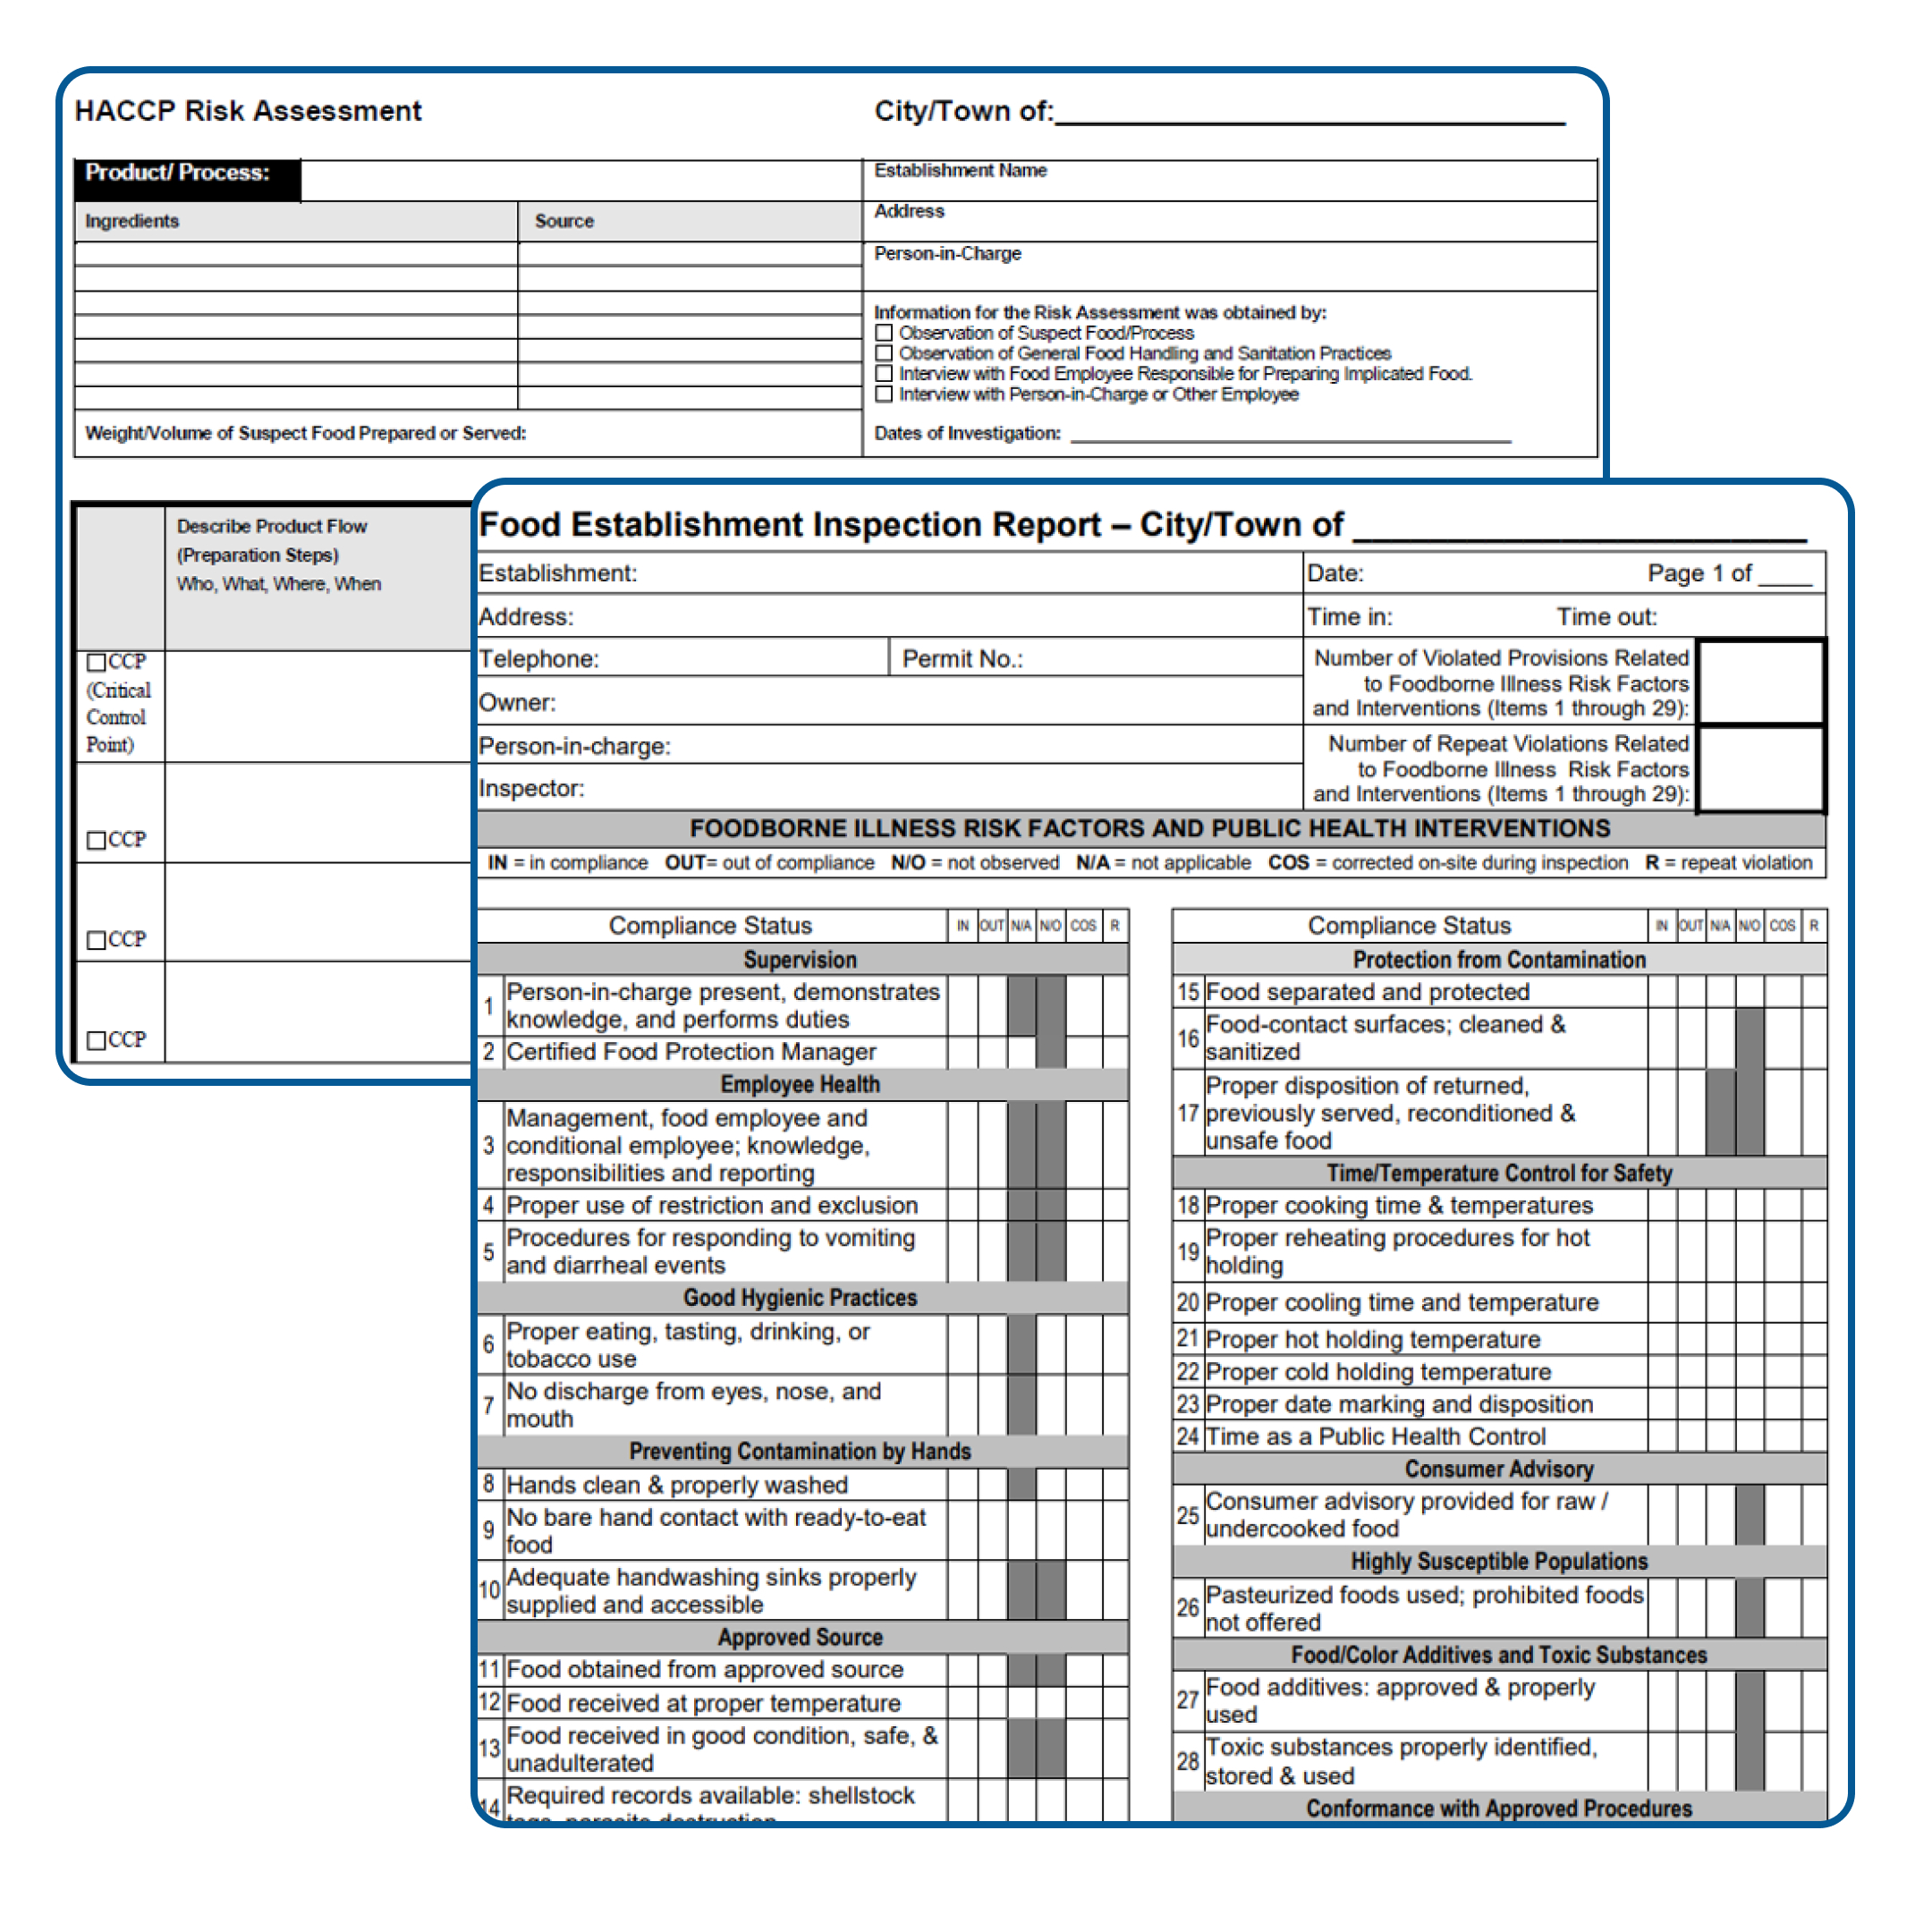
Post on Site Investigation
For Vibrio investigations inspection reports, write ups, tags, pictures, etc., are not typically confidential or sensitive. Those can be emailed back to the requestor or attached directly to an applicable MAVEN event.
Return inspection report, HACCP risk assessment, and any other notes from the investigation to DFP ASAP or within 2 business days.
DFP will then conduct a wholesale traceback with the documents obtained from the LBOH from the retail food establishment.
DFP will incorporate LBOH findings into overall traceback report.
Notes:
Read Slide.
It is important to highlight bullet #2. Its important you get this information asap or within 2 business days. The state needs this information to then start their traceback investigation.

Slide 20
DFP Traceback Investigation Summary
LBOH provides information to DFP
DFP Contacts Purveyors / Dealers
DFP collects all information and completes a traceback/ timeline
DFP stores records and monitor trends
Notes:
Once DFP gets the information from the LBOH they take the information, such as bill of ladings and Shellfish tags to conduct their traceback investigation.
The state inspectors will ensure the traceback from retail back to harvester is complete and narrowed down as specifically as possible. They use this information to see where the retail food establishment received product from and then reach out to that purveyor to gather more information; such as vibrio control plans, time/temp logs, shellfish tags, and Harvester transaction slip.
It takes a lot of time and reach out to conduct these tracebacks that is why it is very important to conduct your investigation in a timely manner within 2 business days of notification, so the wholesale investigation can be completed.
Once the retail and wholesale investigations are complete and inspectors generate their reports, the DFP Outbreak and Response Coordinator Supervisor ensures the documents are stored where they need to be, information is completed in MAVEN as applicable and monitor for trends and any potential issues.

Slide 21
Special Thank You
Steven Rice | Steven.Rice@mass.gov
Retired Supervisory Food Inspector III, Seafood Unit
Division of Food Protection
Bureau of Climate and Environmental Health
Nichol Smith, MS | Nichol.L.Smith@mass.gov
Outbreak and Response Coordinator Supervisor
Division of Food Protection
Bureau of Climate and Environmental Health
Notes:
Special thank you to these two individuals from the MA Division of Food Protection for providing information.

Slide 22
My Contact Information
Jessica L. Ferreira, CP-FS
Environmental Analyst III / Food Safety Trainer
Email: Jessica.l.ferreira@mass.gov
For access to these and other Retail Food resources please email me to set up a Food shield account!

Slide 23

QUESTIONS ???
Notes:
Any questions? I just wanted to note that if I am not able to answer your question, please come see me after the presentation so I can capture your question and get your email to follow up with.

