Slide 1
Hoarding Behaviors
February 17, 2026

Slide 2
Disclosures
This presentation is for informational purposes only and is not meant to be used for diagnostic purposes.
The opinions expressed in this presentation are solely those of the presenter and do not represent the opinions of DPH or the host.

Slide 3
Learning Objectives
Understand the working definition of hoarding
Recognize the signs and symptoms of hoarding disorder
Understand basic housing codes and regulations re:hoarding
Consider how TO support others in a nonjudgemental way
Identify community resources that can help

Slide 4
What is Hoarding?
The main feature of hoarding disorder is a persistent difficulty with discarding or parting with possessions, regardless of their actual value
Commonly saved items:
    Newspapers
    Old clothing
    Bags
    Books/paperwork

Slide 5
What is Hoarding?
Discarding difficulties are motivated by:
    Perceived utility
    Fear of losing important information
The prospect of discarding can be marked by profound distress
Squalor: The state of being extremely dirty and unpleasant, especially as a result of poverty or neglect.

Slide 6
Hoarding Behaviors
Have difficulty with acquisition
Experience persistent difficulty with discarding or parting with possessions
    Regardless of value
    Due to a perceived need to save these items
    Associated distress with discarding items
Results in rooms or the entire house becoming unable to be utilized for the intended purpose(s)

Slide 7
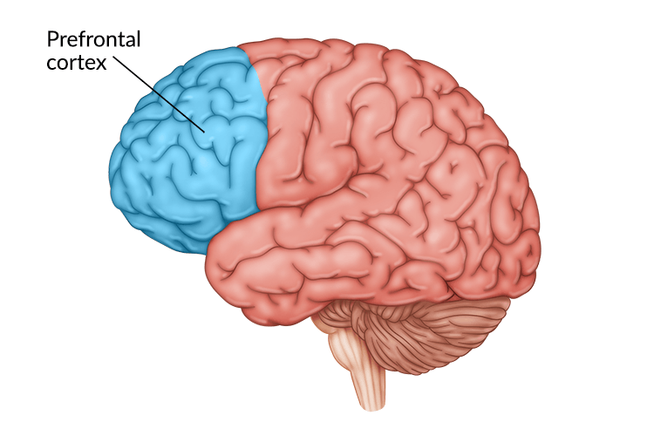
Hoarding and Brain Function
Executive function
Controlled largely by the frontal cortex
  working memory
  cognitive flexibility
  inhibition control
Often decreases as we age
  MRI studies show abnormal activity when people with a hoarding disorder attempt and discard an item

Slide 8
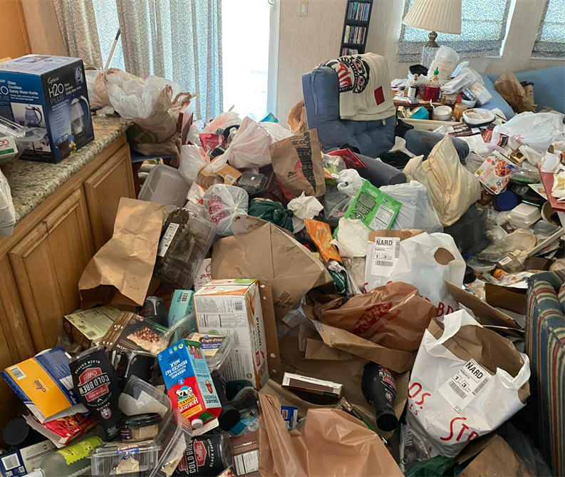
Hoarding
DSM IV describes “extreme” hoarding as a manifestation of OCD; new guidelines differ
Relatively new diagnosis
Research is lacking on presentation, causes, and best treatment options
Differs from collecting or clutter

Slide 9
A. Persistent difficulty discarding or parting with possessions, regardless of their actual value.
B. This difficulty is due to a perceived need to save the items and to distress associated with discarding them.
C. The difficulty discarding possessions results in the accumulation of possessions that congest and clutter active living areas and substantially compromises their intended use. If living areas are uncluttered, it is only because of the interventions of third parties (eg, family members, cleaners, authorities).
D. The hoarding causes clinically significant distress or impairment in social, occupational, or other important areas of functioning (including maintaining a safe environment for self and others).
E. The hoarding is not attributable to another medical condition (eg, brain injury, cerebrovascular disease).
F. The hoarding is not better explained by the symptoms of another mental disorder (eg, obsessions in obsessive-compulsive disorder [OCD], decreased energy in major depressive disorder, delusions in schizophrenia or another psychotic disorder, cognitive deficits in major neurocognitive disorder, restricted interests in autism spectrum disorder).
DSM-5 Diagnostic Criteria

Slide 10
Hoarding Rating Scale
0 = no problem
2 = mild problem, occasionally (less than weekly) acquires items not needed, or acquires a few unneeded items
4 = moderate, regularly (once or twice weekly) acquires items not needed, or acquires some unneeded items
6 = severe, frequently (several times per week) acquires items not needed, or acquires many unneeded items
8 = extreme, very often (daily) acquires items not needed, or acquires large numbers of unneeded items
1. Because of the clutter or number of possessions, how difficult is it for you to use the rooms in your home?
2. To what extent do you have difficulty discarding (or recycling, selling, giving away) ordinary things that other people would get rid of?
3. To what extent do you currently have a problem with collecting free things or buying more things than you need or can use or can afford?

Slide 11
Hoarding Rating Scale
0 = no problem
2 = mild problem, occasionally (less than weekly) acquires items not needed, or acquires a few unneeded items
4 = moderate, regularly (once or twice weekly) acquires items not needed, or acquires some unneeded items
6 = severe, frequently (several times per week) acquires items not needed, or acquires many unneeded items
8 = extreme, very often (daily) acquires items not needed, or acquires large numbers of unneeded items
4. To what extent do you experience emotional distress because of clutter, difficulty discarding or problems with buying or acquiring things?
5. To what extent do you experience impairment in your life (daily routine, job / school, social activities, family activities, financial difficulties) because of clutter, difficulty discarding, or problems with buying or acquiring things?

Slide 12
Epidemiology
Estimated 2.5% of the population suffers from hoarding behaviors
Mostly older adults
Hoarding behaviors can have an onset as early as 16 years old
Hoarding behaviors frequently have comorbidities
    Depression/anxiety
    Obsessive-compulsive disorder
    Panic disorder

Slide 13

Causes of Hoarding Behaviors
Specific cause(s) largely misunderstood
Genetics may play a role
Unique environmental events (e.g., trauma)

Slide 14
Hoarding and Boards of Health
Boards of Health are complaint driven.
The Board of Health enforces codes to keep the public safe and healthy.
Who can bring a complaint to the Board of Health?
  First responders
  Family and friends
  Neighbors
  Utility companies
What happens when the Board of Health receives a complaint?
  An investigation is conducted to determine if the complaint has merit.

Slide 15
The Investigation
The first step is a gather information.
A visual evaluation to see if the complaint has merit.
The Health Inspector knocks on the door and attempts to contact the occupants.
The Health Inspector explains why they are there and asks for permission to inspect the house and property.
Does the occupant understand why you are there, the possible heath concerns, can they take care of themselves, and are there children or animals living there? The answers to these questions can indicate the type(s) of agencies that may need to be contacted.

Slide 16
The Inspection
Plain View – You are denied entry and are basing your violation off what you can plainly see in the yard or as you approach the main entrance.
Limited – You are given permission to enter and conduct your inspection but either denied access to the entire dwelling or can not access the area due to physically being able to access it.
Comprehensive – You are given permission to conduct you experiment and can access all areas in the dwelling.

Slide 17
The Inspection
The housing code does not specify “Clean” it only states that a dwelling must be kept in a sanitary manner.
Commonly sited violations:
  Blocked egress
  Pests
  Harborage
  Refuse

Slide 18
Clutter Image Rating Scale: Living Room

Slide 19
What Happens Next?
Enforcement
Citation and Order to Correct
Condemnation
Housing Court
  Mediation
  Guardian ad litem
  Intervention
Receivership

Slide 20
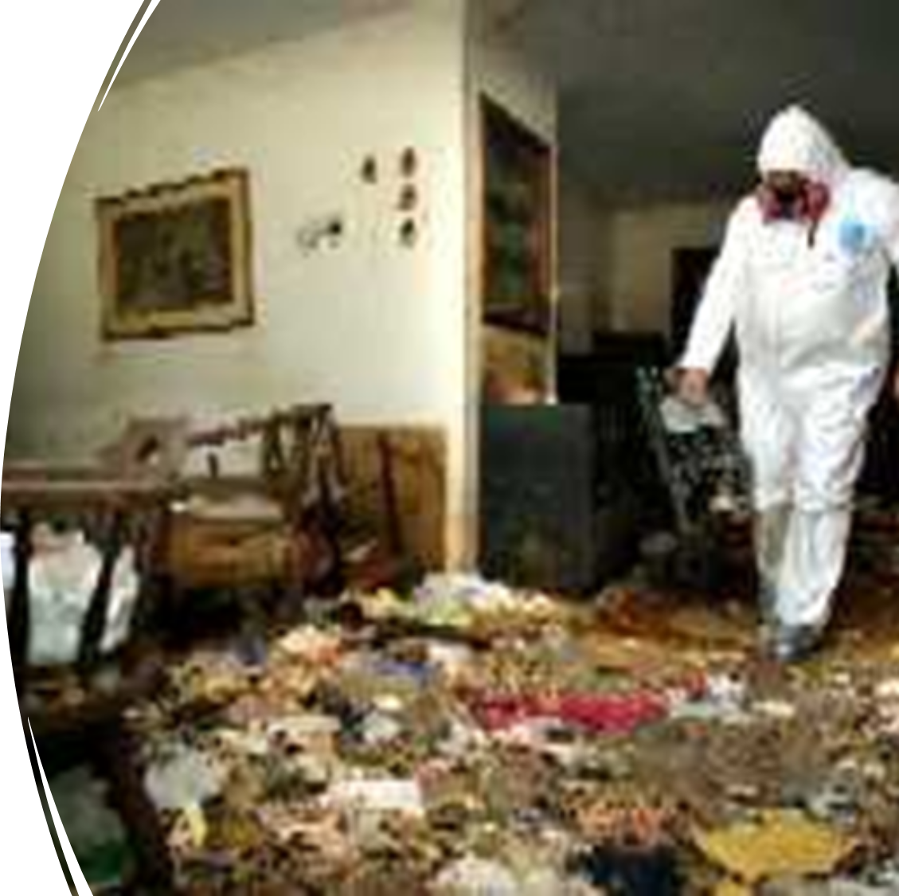
Health Effects of Hoarding
Air in some homes is so irritating to the respiratory tract that a non-acclimated person cannot enter without protective breathing equipment.
Even brief exposures (<5 minutes) can cause nasal irritation and dryness in people.

Slide 21
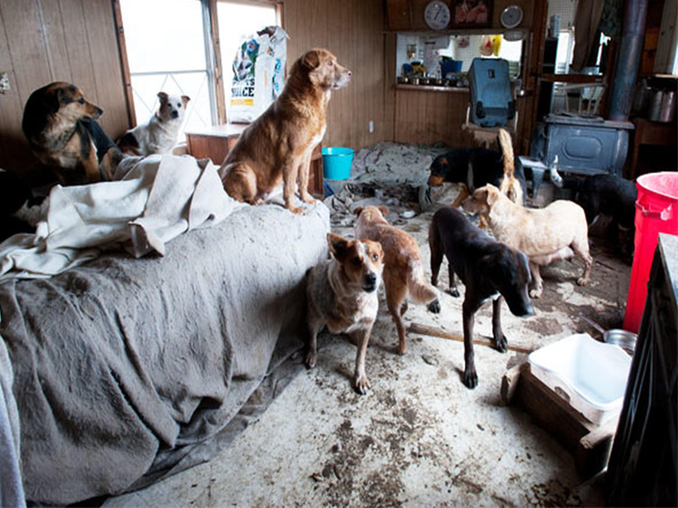
Animal Hoarding
The accumulation of many animals with a failure to:
  provide minimal standards of nutrition
  Have a sanitary environment
  veterinary care
  act on the deteriorating condition of the animals and the environment

Slide 22
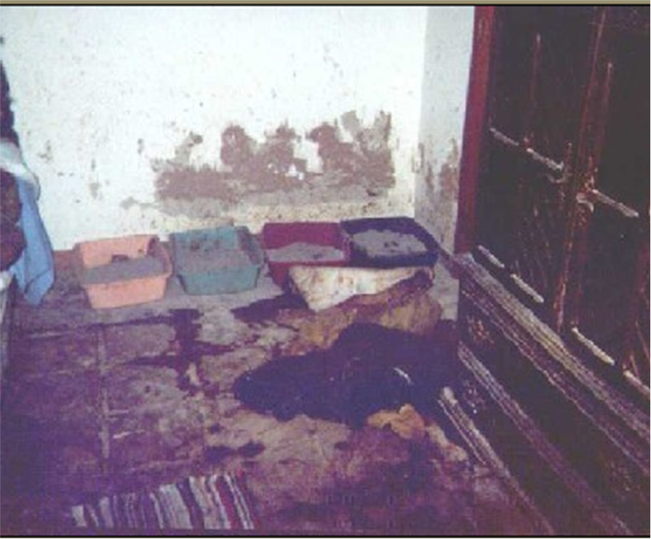
Spreading Zoonoses: A Risk in Animal Haording
Diseases which might be of particular concern include but are not limited to:
Toxoplasmosis (cats)
Salmonellosis (reptiles, birds, farm animals)
Psittacosis (birds)
Campylobacter (dogs and cats)
Ringworm (cats)
Cryptosporidium (cats, dogs, farm animals)

Slide 23
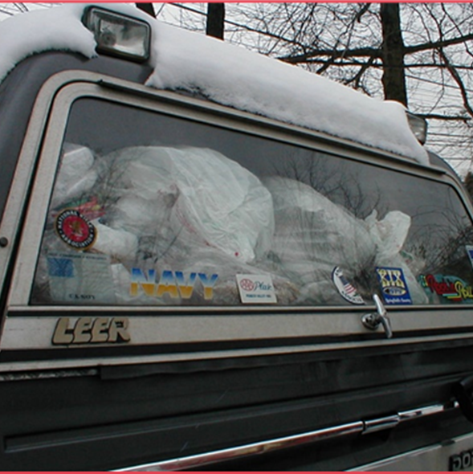
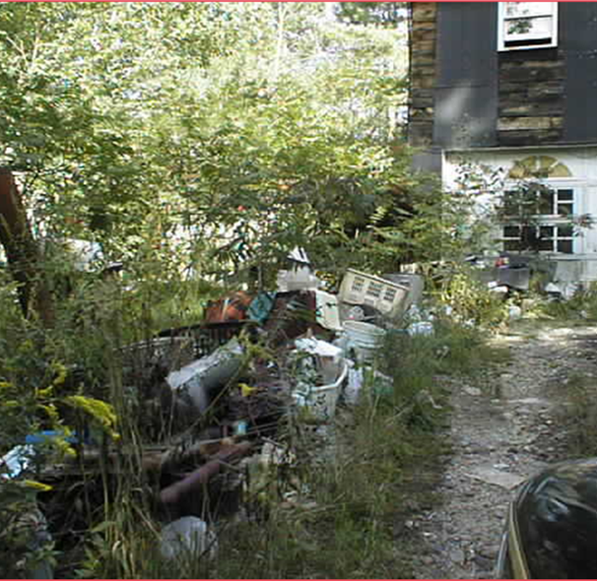
Examples of Hoarding

Slide 24
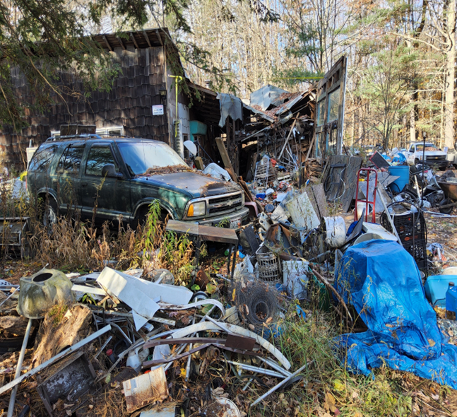
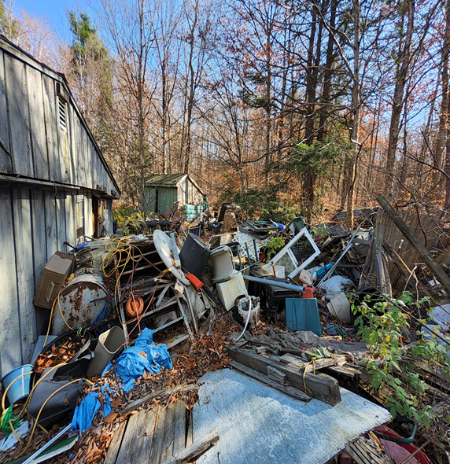
Examples of Hoarding

Slide 25
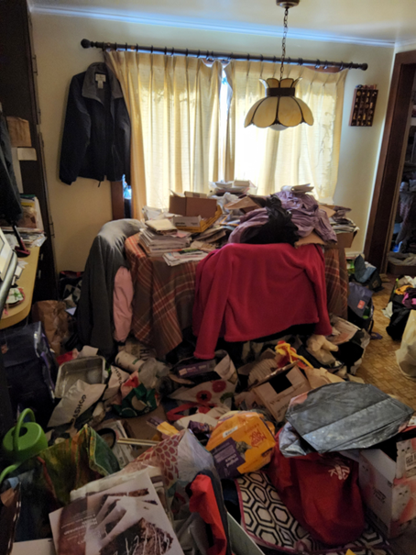
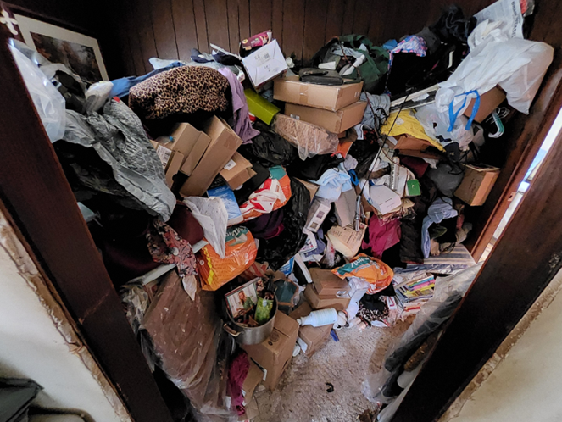
Examples of Hoarding

Slide 26
What can you do to help?
Try to be neutral/objective and nonjudgmental
Be empathetic
Highlight the consequences of hoarding
Harm reduction is a great first step
Ask open ended questions about their understanding of the situation
Emphasize concern for this person’s safety and well-being
Helping with the removal of items may not be helpful

Slide 27
Community Resources
Primary care provider
Therapist (CBT)
Peer Support Groups
Visiting Nurses
Elder Services
Veterans Affairs
Social Services
Community Legal Aid

Slide 28
Community Resources
Tenancy Preservation Program
Housing Authority
Local councils on aging
Local SSA or Planning Commission
Local TRIAD Groups
Massachusetts Hoarding Resource Network
DPH
Child Protective Services
Local Humane Society/MSPCA

Slide 29


Additional Resources
International OCD Foundation
Buried in Treasures

Slide 30
Any questions?

Slide 31
Thank You!!!
Daniel Hassett, REHS/RS
dhassett@berkshireplanning.org
(413) 442-1521 x 59

