Slide 1


Recreational Camps
Regulation Review
2026
Central Massachusetts Regional Planning Commission
Central Massachusetts Public Health Training Hub
March 2026
This Photo by Unknown Author is licensed under CC BY-ND

Slide 2
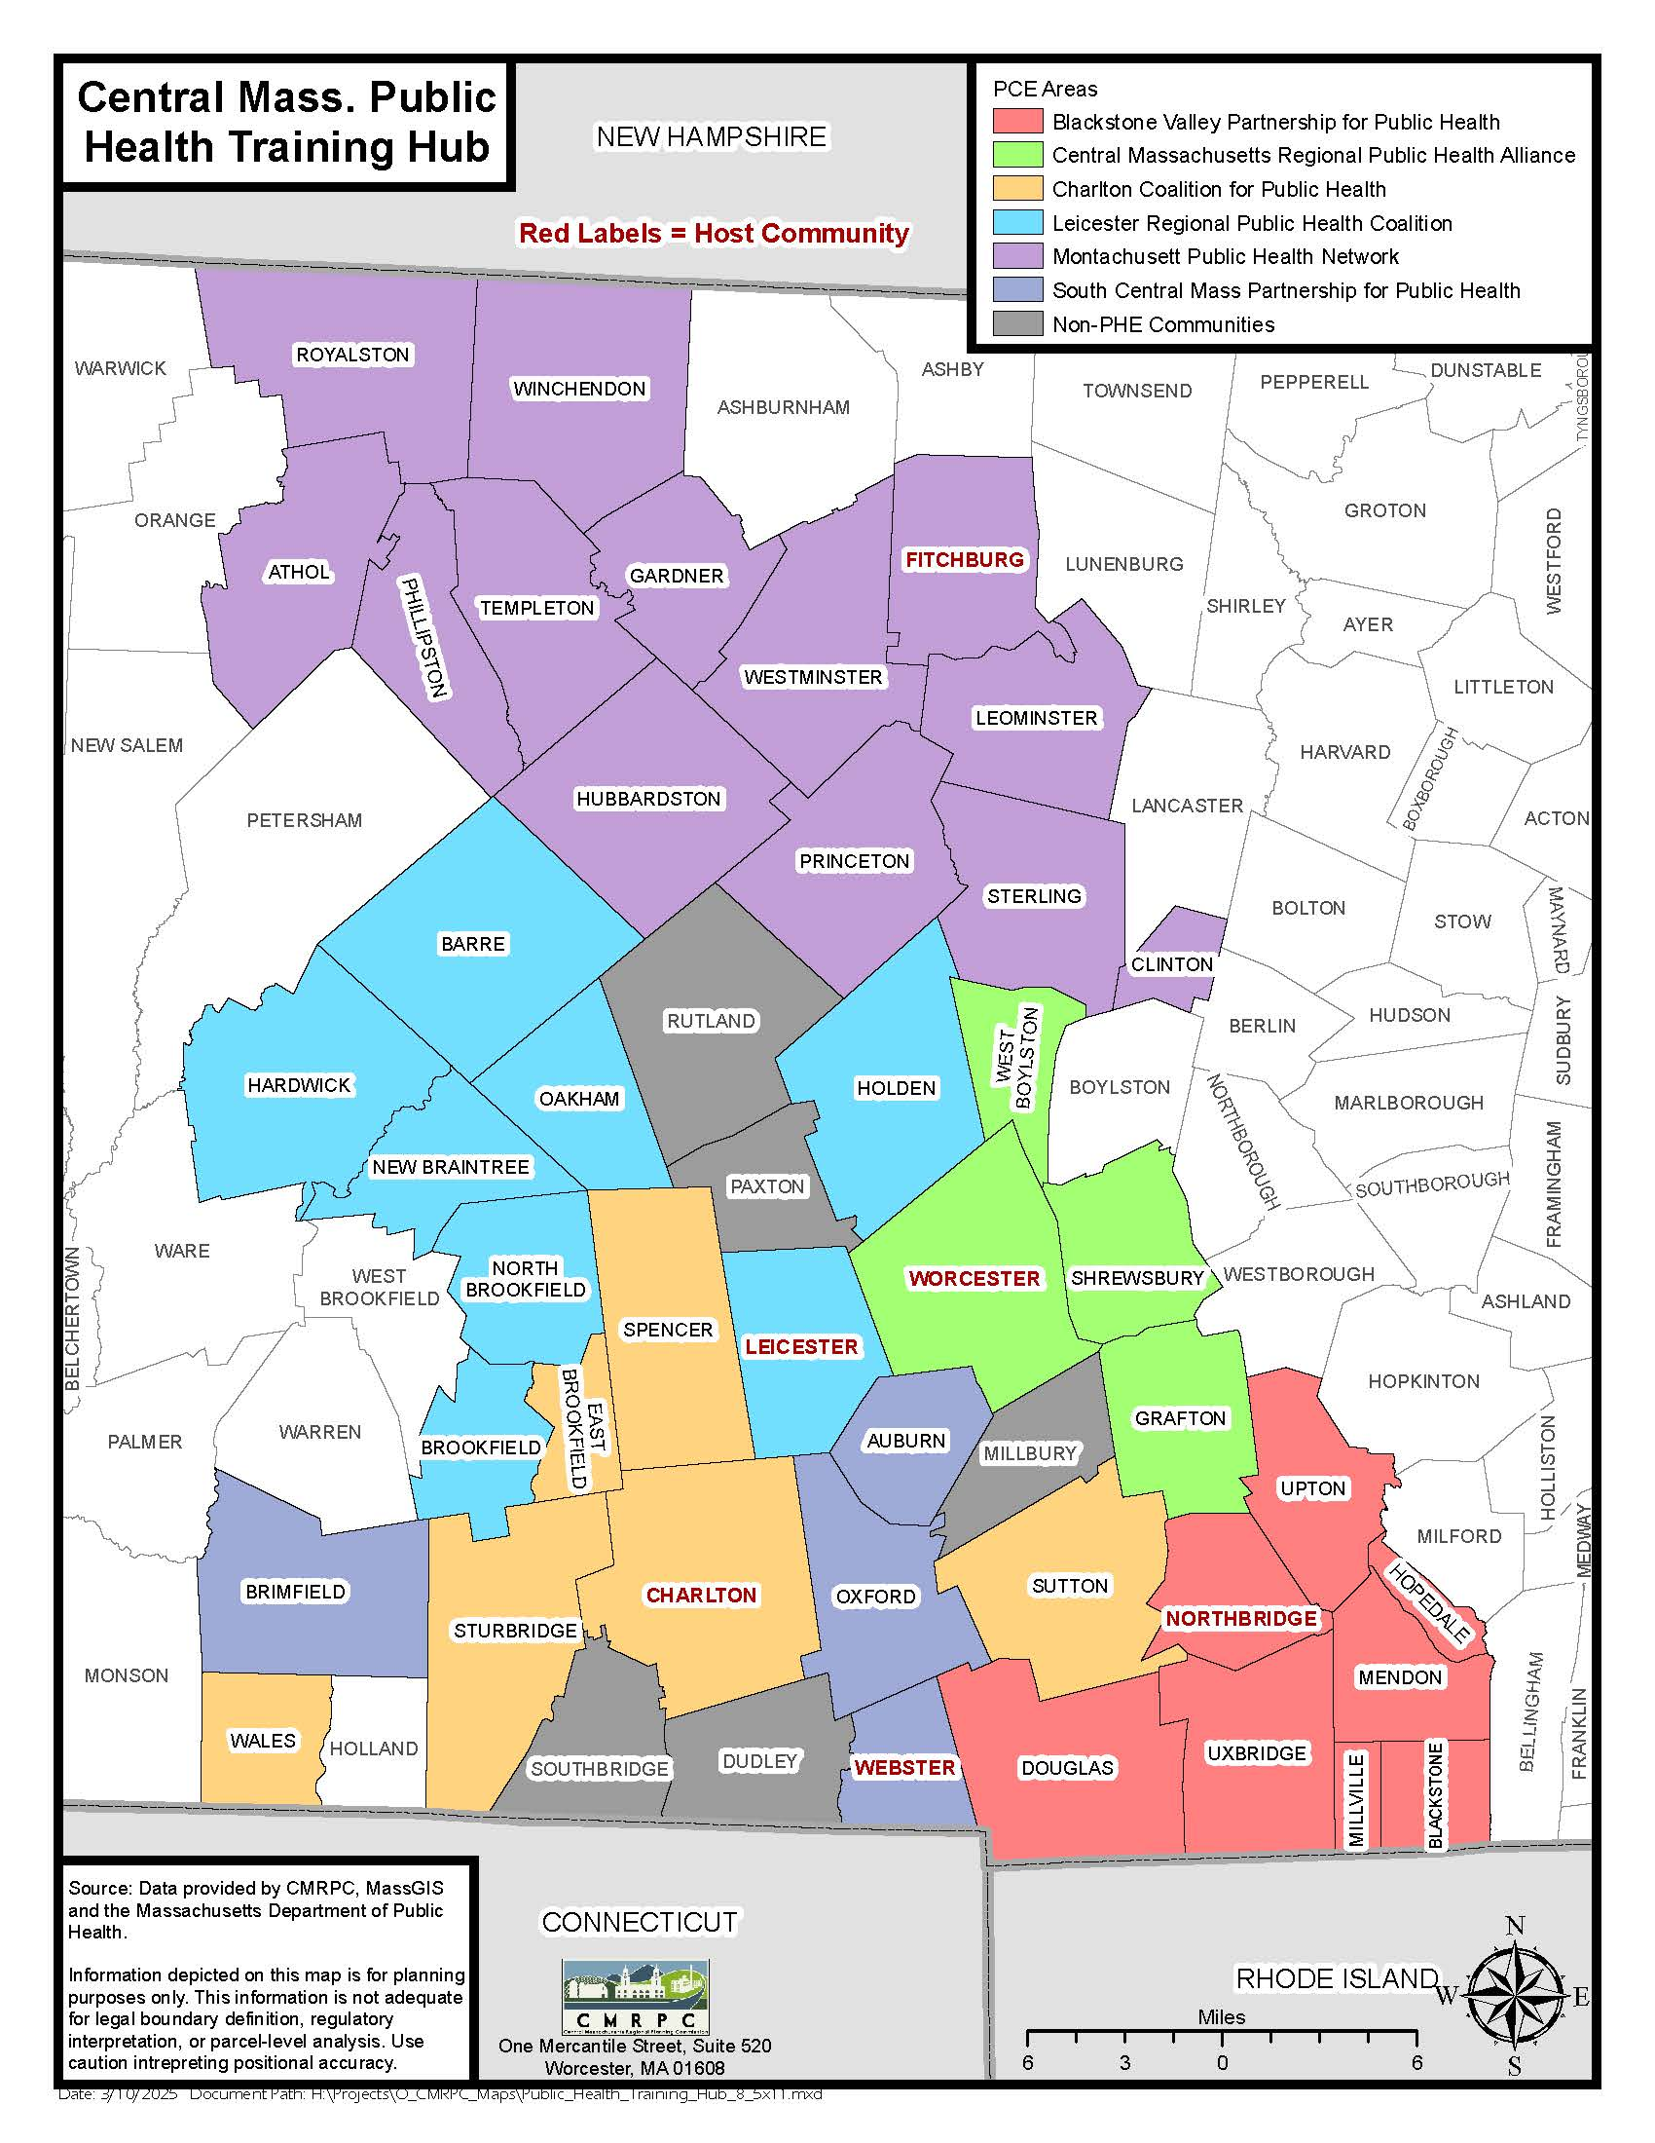
CMPH Training Hub
Notes:
Giving a little overview of the towns I cover ☺

Slide 3

105 CMR 430.000 Minimum Standards for Recreational Camps for Children
These are the minimum requirements to ensure a safe and healthy space for children to enjoy summer camp
Recommend storing all camp information on site
  Binder(s)
  Online file

Slide 4
Staff Information
Day Camp Directors must be 21+ years with at least two seasons of previous experience as part of administration staff
  Residential camp directors must be 25+ years with at least two seasons of previous experience as part of administration staff
Health Care Consultant name and MA license numbers need to be clearly written
  MA licensed physician, certified nurse practitioner or physician assistant
    WITH PEDIATRIC EXPERIENCE
Health Care Supervisors must be 18+ years
  MA licensed physician, physician assistant, certified nurse practitioner, registered nurse, licensed practical nurse, or another person specially trained in first aid
    Online First Aid /CPR certification not accepted
    Hybrid options are acceptable, providing that CPR component is evaluated in-person by a certified instructor

Slide 5
Staff Background Information
105 CMR 430.090
Documentation of background review of staff
  Identify what information is collected and who is authorized to view results on background checks
  Ensure records are stored securely, at all times
  Operators are responsible for the destruction of records in accordance with 803 CMR 2.15 Destruction of CORI and SORI Acknowledgment Forms [.145(B)]
STAFF + VOLUNTEERS must minimally have:
    Up to 5 years previous work history, contacts + phone numbers
    3 Positive Reference Checks
    Expanded CORI and SORI ; If out-of-state, an equivalent criminal background check required
    Any break in employment service (gap in camp seasons), new references + CORI + SORI required
    If no gap in employment (year-round), CORI + SORI required every 3 years minimum
  Hiring records kept for 3 years

Slide 6
Summer Camp Policy
Camp Counselor and Junior Counselor Requirements
105 CMR 430.100
Camp Counselor and Junior Counselor Requirements
  MUST have had at least 4 weeks experience supervising children/junior counselor
  MUST complete camp counselor orientation and training
  MUST be at least 3 years older than the campers they supervise
Day Camp
  Counselors >16 years old
  Junior Counselors > 15 years old
Sports camp, residential camp, medical specialty camps
  Counselors > 18 years old, or high school graduate
  Junior Counselors > 16 years old

Slide 7

Camp Counselor Ratios
105 CMR 430.100 / 430.101
7 YEARS OLD is the threshold
Day/Residential/Sports Camp:
  1 Counselor per 10 campers > 7 years old
  1 Counselor per 5 campers < 7 years old
Tips:
  When creating staffing, exclude camp directors and health care supervisors to ensure your ratios always meet standards
  Surplus staffing in case of illness, emergency, etc.

Slide 8
Summer Camp Policy
Staff Orientation Plan
105 CMR 430.091
Describe, in writing, the necessary trainings for all camp activities [.091(A)]
Specialized trainings to meet the requirements of campers with unique physical/behavioral needs [.091(A)]
Online Head Injury Safety Awareness Training – completed annually [.091(B)]
Health Care Policy and infection control procedures
Physical copy provided to all staff and volunteers [.091(A)]
Fire Drills [.210]
Disaster/Emergency Plans [.210]
Lost Camper/Swimmer Plan [.210]
Traffic Control Plan [.210]
Disease Outbreak Response Plans [.210]
Notes:
Describe in detail the camp’s orientation/training plan
Must cover:
Camp’s organization, policies and procedures
E.g.: Disaster/emergency plans, health care policies, etc.
Specific training overseeing campers with unique physical or behavioral needs
Complete ANNUAL online head injury safety/concussion program (CDC Heads-Up certificate)
Attendance record of this orientation with the date and time of training must be kept on file
No staff shall be assigned to be responsible for a group of children nor utilize any staff to supervise others until they have undergone the orientation described

Slide 9
Camp Site Requirements
Safety Requirements
Immediate access to a reliable phone with emergency contact numbers posted/readily accessible [.209]
An emergency communication system [.213]
Fire/CO alarms [.216]
A current certificate of inspection from the local building inspector for all structures used for sleeping or assembly purposes [.451]
Egresses unobstructed and maintained in accordance with 780 MA State Building Code requirements [.456]
Additional Requirements
Sufficient shelter space large enough to house all campers and staff at Day Camps [.457]
Adequate lighting in all infirmaries and stairways [.453]
Structural and interior maintenance [.454]
Elements maintained in good repair and
Interior of the facility maintained in a safe, clean, and sanitary condition
Potable water that is always available [.300]
Drinking facilities must be centrally located

Slide 10
Camp Site Requirements (Cont.)
Sleeping Area and Spacing Requirements
Provide adequate square footage per person in the cabin/sleeping areas [.458]:
  40 ft2 for single beds
  35 ft2 for bunk beds
  50 ft2 for individuals with special equipment
Maintain appropriate bed arrangements [.470]:
6 ft of distance between the heads of sleepers
Head to toe sleeping is a common practice
  3 ft between single beds
  4.5 ft between bunk beds
Tents under 400 ft2 must be labeled as fire resistant [.217]
Screens must be in place for all windows [.452]
Self-closing doors that open in the direction of the flow of traffic out of the building [.452]

Slide 11

Camp Site Requirements (Cont.)
Food Services at Camp
Camps that prepare and/or serve meals must comply with 105 CMR 590.000 Minimum Sanitation Standards for Food Establishments
  Prominently display a Food Service permit
  Obtain written compliance with 105 CMR 590 for the USDA Summer Food Service Program (if applicable) [.320]
  Ensure proper storage methods for meals brought from home [.335]
  Provide lunches if a camper arrives without one [.335]
  Install screens in all windows and self-closing exterior doors [.452]
  Ensure adequate lighting in all kitchens and dining areas [.453]

Slide 12

Summer Camp Policy
Special Contingency Plans
105 CMR 430.211
Must cover the following scenarios:
  Camper who is registered for camp but does not show up for the day/does not show up at designated pick-up location
    Who are you going to call? What steps are you going to take?
  Unregistered camper arrives at camp
    Immunization records must be reviewed by Health Care Supervisor on-site prior to engaging in any activities

Slide 13
Summer Camp Policy
Disaster Plans or Other Emergencies
105 CMR 430.210
Must cover:
Fire Evacuation Plan
  Fire Drills – held within 24 hours of the beginning of each camp session (1st day)
  Submit written fire evacuation plan to respective Fire Department for approval
  Must indicate the frequency of fire drills to be held during camp season
Disaster/Emergency Plans
  Describe shelter locations/facilities, include maps as an overview
    Large enough to accommodate al staff/volunteers present at camp
  E.g.: lightning storms, non-natural emergencies (active shooter)
Lost Camper and Swimmer Plan
  Describe what your procedures are for a lost camper/swimmer
    Don’t delay contacting emergency services!
Disease Outbreak Response Plan
  Develop written procedures on how to prepare for and respond to disease outbreaks at camp
  Plans must include but are not limited to:
    Alternative staffing plans
    Isolation and quarantine spaces
    Disease reporting requirements
Notes:
Lost camper and swimmer plan
Include the search of the entire campground
Detail shallow water and deep water searches
Clearly outline staff/volunteer responsibilities
Identify when and who calls 911

Slide 14

Summer Camp Policy
Shelter Plans
105 CMR 430.457
Develop a shelter plan for on-going camp activities during inclement weather
Shelter structure shall be sufficiently large to house and provide for camp activities
Include map for location

Slide 15

Summer Camp Policy
Traffic Control Plan
105 CMR 430.210 (D)
Describe how you manage traffic for camp
  Camper arrival and camper dismissal
  Include a map with arrows indicating traffic flow and designate camper drop-off/pick-up locations are

Slide 16
Summer Camp Policy
Discipline Policy
105 CMR 430.191
Describe appropriate de-escalation policies for bad behavior, etc.
Must include, verbatim, the following list of specific prohibitions:
  1) Corporal punishment, including spanking, is prohibited;
  2) No camper shall be subjected to cruel or severe punishment, humiliation, or verbal abuse;
  3) No camper shall be denied food, water or shelter;
  4) No child shall be punished for soiling, wetting or not using the toilet.
Notes:
Goal: To maximize camper’s growth and development while protecting campers and staff.

Slide 17
Summer Camp Policy
Suspect Child Abuse and Neglect
105 CMR 430.093
Written procedures for suspected incidents of child abuse/neglect
Must include:
  How staff reports suspected abuse or neglect to camp director
  All staff shall immediately report suspected incidents of abuse or neglect that occur at camp to Massachusetts Department of Children and Families
    https://www.mass.gov/how-to/report-child-abuse-or-neglect
  Camp Director shall notify the respective Local Board of Health and DPH that a 51A report was filed
    Do not send the actual report to LBOH and DPH
    Use the Recreational Camp Injury and Incident Report and Notification Form
Find your Local DCF
  https://www.mass.gov/orgs/massachusetts-department-of-children-families/locations
    Immediate assistance available at: Child-At-Risk Hotline 800-792-5200

Slide 18

Summer Camp Policy
Protocol for Unrecognized Persons at Camp
105 CMR 430.190(D)
Describe your stranger danger policy
Must include:
  Effective protocol for identifying unrecognized persons
    E.g.: non-campers, staff, volunteers, contractors, parents

Slide 19

Summer Camp Policy
Campers Released only to Designated Individuals
105 CMR 430.190(B)
Procedures must state how campers are only released to designated individuals
  Parents/legal guardians or
  Other individuals designated by the parents/guardians
    List of designated individuals can be written and provided in electronic or hard copy form

Slide 20

Summer Camp Policy
Sun Protection Policy
105 CMR 430.163
Describe what your policies are to encourage campers AND staff to reduce UV exposure from the sun
Written procedures for topical application of sunscreen, including parent/legal guardian authorization
Minimum SPF 25

Slide 21
Summer Camp Policy
Field Trip Policy
105 CMR 430.212
Copies of travel/trip itineraries shall be available to parents/guardians before departure
Sources of Emergency Care
  All field trips away from camp shall include at least one designated Health Care Supervisor
  The Health Care Supervisor is identified on the itinerary
Health Records, Medications and First Aid Kits
  All health records and medications for campers in attendance on the trip is readily accessible
  First aid kit is available
Contingency Plan
  Written contingency plans for natural disasters, lost campers, illnesses and injuries shall be established and accompany all field trips
  Staff must be able to carry out these plans
At least one staff person shall accompany and monitor campers during any transport
Notes:
Do a headcount to make sure you don’t leave anyone behind!

Slide 22

Aquatics Director & Lifeguard Requirements
105 CMR 430.020 Definitions / 103(A)
Aquatics Director
  Lifeguard certification
  > 21 years old
  6+ weeks experience in a supervisory position
Lifeguard
  Lifeguard Certification
  > 16 years old
  CPR and First Aid Certification
    NO ONLINE-ONLY certificates
Notes:
One of the following lifeguard training programs:
(a) An American Red Cross Lifeguard Training Certificate; or
(b) Lifesaving Society of Canada National Lifeguard Service; or
(c) Boy Scouts of America Lifeguard Certificate; or
(d) National YMCA Lifeguard Certificate; or
(e) Ellis and Associates International Lifeguard Training Program; and

Slide 23

Summer Camp Policy
Swimming Safety Plan
105 CMR 430.430 - 432
Ensure that your camp swimming pool is PERMITTED and INSPECTED before camp season
  Swimming pools must comply with 105 CMR 435.000 Minimum Standards for Swimming Pools
  Copies of Swimming Pool Permits kept on file at camp
Swim Test required to determine camper’s swimming ability at camper’s first swimming session
  Describe your swim testing policy
  Campers confined to swimming areas consistent with the limits of their swimming ability
1 Lifeguard required per 25 Campers
1 counselor per 10 campers (high-risk activity)
Include written plan for “buddy system”
Must include “lost swimmer plan”
Swimming areas must be clean and safe
Notes:
Compliance with 105 CMR 435.000 Minimum Standards for Swimming Pools (State Sanitary Code, Chapter V) & 105 CMR 445.000 Minimum Standards Bathing Beaches (State Sanitary Code, Chapter VII).
105 CMR 432.000 Minimum Requirements for Personal Flotation Devices for Minor Children at Municipal and Recreational Programs and Camps.
Protects all minor campers, staff, and volunteers who swim at fresh or saltwater beaches while attending recreational camps or programs

Slide 24
105 CMR 432.000 Minimum Requirements for Personal Flotation Devices for Minor Children at Municipal and Recreational Programs and Camps
Protects all minor campers, staff, and volunteers who swim at fresh or saltwater beaches while attending recreational camps or programs
  These regulations set the minimum requirements for swim tests of all minors and the use of personal floatation devices (PFDs)
All minors must be swim tested at their first swimming session [432.100(C)]
A swimming ability determination must be conducted at a minimum once per summer for every minor at each program or camp by a certified swim instructor or a swim assessor
Identification of Swimmers and Non-Swimmers/At-Risk Swimmers [432.010]
Swim test location [432.100(D)]
An operator shall not refuse a PFD provided by a parent/guardian [432.130(A)]

Slide 25
105 CMR 432.000 Minimum Requirements for Personal Flotation Devices for Minor Children at Municipal and Recreational Programs and Camps
Polices and Record Keeping
An operator must develop and implement written policies and procedures to ensure compliance with 105 CMR 432.000, which include but are not limited to [432.400]:
  An orientation plan for all staff and volunteers
  Procedures for identifying non-swimmers and at-risk swimmers
  A daily check-in routine for reviewing and confirming proper swimming level identification
  A plan to ensure an adequate inventory of serviceable PFD’s and their proper storage
  Procedures for PFD distribution to minors
  Appropriate training for staff and
  Compliance with required record keeping

Slide 26


Specialized High-Risk Activities
Means those activities posing an inherent risk of serious injury or death due to the nature of the activity regardless of reasonable precautions and supervision
Such activities present an increased risk to health and safety beyond the routine risk of exercising and being active in various weather conditions
Any recreational camp for children that operates specialized high risk activities outside of Massachusetts shall comply with all state and local laws or regulations for such activities in the state or local jurisdiction where the activity is held
Activities include:
  Aquatics [.103]
    Supervision of Aquatics Activities
      Swimming [.103]
      Paddle Sport [.103(B1 and 2)]
      Sailing or Motor-Powered Watercraft [.103(B1 and 3)]
  Beaches [430.432], [.204(E)], [.103]
  Challenge Courses, Climbing Walls, and Inflatables [.103(G)], [520 CMR 5.00 Amusement Devices]
  Firearms/Riflery Programs [.103(D)], [.201], [.203]
  Archery Programs [.202(A and B)], [.203]
Notes:
One of the following lifeguard training programs:
(a) An American Red Cross Lifeguard Training Certificate; or
(b) Lifesaving Society of Canada National Lifeguard Service; or
(c) Boy Scouts of America Lifeguard Certificate; or
(d) National YMCA Lifeguard Certificate; or
(e) Ellis and Associates International Lifeguard Training Program; and

Slide 27

Promotional Materials
105 CMR 430.190(C)
Regulatory compliance and licensing statement on promotional materials (website, brochure, etc.) MUST STATE:
  “This camp must comply with regulations of the Massachusetts Department of Public Health and be licensed by the local board of health.”

Slide 28
General Requirements
At time of application (welcome email, registration, etc.)
  MUST Inform parents of right to review background check, health care, discipline policies and grievance procedures upon request
  MUST annually give information regarding meningococcal disease
  MUST mention policies regarding Care of Mildly Ill Campers, Administration of Meds and Emergency Health Care Provision
    Complete policies must be made available to parents/guardians upon request

Slide 29
Health Care Policy
105 CMR 430.159
Identify Health Care Consultant
  MA licensed physician, certified nurse practitioner or physician assistant
  Reviews and approves the camp health care policy annually
  Review and approves first aid training of staff
  Be available for consultation at all times
  Develop and sign written orders including for medication administration followed by the on-site camp health care supervisor
  Provide trainings to Health Care Supervisor and camp staff
    Includes training and evidence of competency for unlicensed individuals designated to assume the responsibility for medication administration
    Training of authorized individuals to administer epi-pens
Health Care Consultant Agreement
  This document must include HCC signature and signature of those who have received training to be a Health Care Supervisor

Slide 30

Health Care Policy (Cont’d)
105 CMR 430.159
All staff must have a copy of the health care policy and be trained in infection control procedures during staff orientation
Prior to admitting a child to camp, parents and guardians shall be provided a copy of the following policies:
  Care of mildly ill campers
  Administration of medication
  Procedures for providing emergency care

Slide 31

Health Care Policy (Cont’d)
105 CMR 430.159
At least one health care supervisor on-site at all times and are responsible for day-to-day operation of the camp’s health program
  Must be at least first aid + CPR certified
    NO ONLINE-ONLY COURSES
Health Care Supervisor responsibilities:
  Administering First Aid
  Administering medication if properly trained/if part of your health care policy
  Documenting injuries in medical log, maintaining medical log
  Filling out any injury reports that get filed to respective Health Department

Slide 32
Health Care Policy (Cont’d)
105 CMR 430.159(B)
Health Care Policy shall include, but not limited to:
  Daily health supervision;
  Infection control;
  Medication storage and administration, including self-administration when appropriate, pursuant to the requirements of 105 CMR 430.160;
  Procedures for using insect repellant and conducting tick checks;
  Promoting allergy awareness;
  Handling health emergencies and accidents, including parental/guardian notifications;
  Available ambulance services;
  Provision for medical, nursing and first aid services;
  The name of the designated on-site camp health care supervisor;
  The name, address, and phone number of the camp health care consultant required by 105 CMR 430.159(A);
  The name of the health care supervisor(s) required by 105 CMR 430.159(E), if applicable.
Notes:
Goal: is to prevent kids from getting their hands on them, and keep the medications clearly identified to each camper. If you don’t have the infrastructure for infirmary, make it your policy that parents are responsible for that.

Slide 33
Health Care Policy
Storage and Administration of Medicine
105 CMR 430.160
Medication prescribed for campers must be kept in original containers with pharmacy label and date of filling
All medication shall be kept in a secure manner
  Where? Identify who’s control? – HCS?
  Medications requiring refrigeration stored 36°F to 46°F
Medication shall only be administered by Health Care Supervisor or licensed health care professional authorized to do so
  Must have written permission from parent/guardian to administer medication
Health Care Consultant shall acknowledge in writing a list of all medications administered at camp

Slide 34
Health Care Policy
Storage and Administration of Medicine (Cont’d)
105 CMR 430.160
Written policy for administration of medications at camp
  List individuals at the camp who are:
    Health care consultants or designated health care supervisors authorized by scope of practice to administer medications;
    Qualified health care supervisors who are properly trained and designated to administer oral or topical medications by the health care consultant;
    Authorized to administer epinephrine auto-injectors by the health care consultant;
    Authorized to administer medications for diabetes care at a medical specialty camp pursuant to 105 CMR 430.159(F).
  Require health care supervisors designated to administer prescription medications to be trained by the health care consultant to administer oral or topical medications in accordance with 105 CMR 430.160(I).
  Require individuals who are authorized to administer epinephrine auto-injectors under 105 CMR 430.160(F) to be specifically trained to administer epinephrine auto-injectors under the direction of the health care consultant in accordance with 105 CMR 430.160(I).
  Require individuals who are authorized to administer medications for diabetes care at a medical specialty camp under 105 CMR 430.159(F) to be specifically trained by the health care consultant to administer medications for diabetes care and shall only be administered under the direct supervision of a health care provider listed in 105 CMR 430.159(E).

Slide 35
Staff + Camper
Health and Immunization Records
105 CMR 430.151
Required Immunizations for Children and Staff attending recreational camp
Immunization records must be reviewed if an unregistered camper shows up
  Immunization records must be cleared before unregistered camper is allowed to participate
Reminder: All Staff are required to have CDC “Heads Up” or similar concussion/head injury safety training before camp is permitted (annually)
  Good to have due with immunization records
Notes:
Recommend 2 week in advance due date

Slide 36

Medical Log
105 CMR 430.155
This is a legal document.
Shall always be readily available and signed by authorized staff person
Formatted correctly:
  Date, time, name of patient, issue, treatment for each incident
    Signed off by authorized staff
  No spaces/no skipping lines in between entries
  Pages numbered (front and back)
  Bound book
Notes:
Composition notebook!!!

Slide 37

Injury and Incident Reports
10105 CMR 430.154
Shall be completed for each fatality or serious injury as a result of which a camper/staff/volunteer is sent home or brought to the hospital
Copy shall be sent out to the respective Board of Health and Massachusetts Department of Public Health as soon as possible after injury
  No later than 7 calendar days after the occurrence of the injury or incident
Form can be accessed at this link: https://redcap.link/campinjuryreporting
Notes:
Such injuries or incidents shall include, but not be limited to: (1) cuts or lacerations for which suturing is required (2) when resuscitation or other life saving measures are required (3) fracture or dislocation (4) concussion (5) administration of an epinephrine auto-injector or (6) those resulting from errors in the administration of medications including diabetes care.

Slide 38
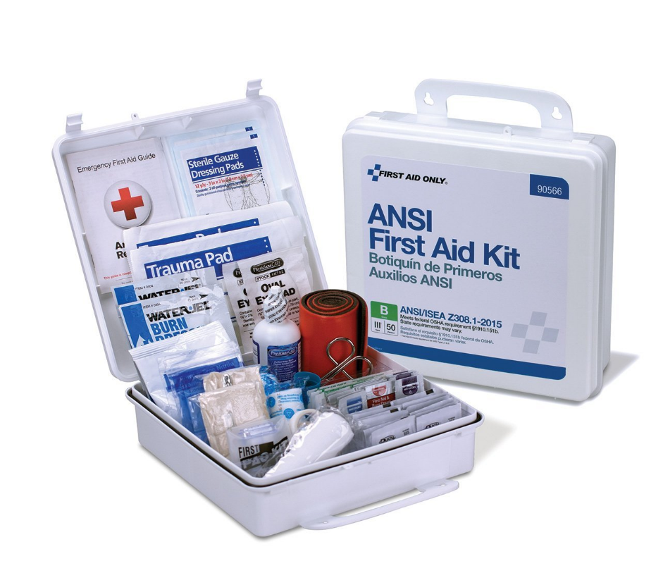
First Aid Kit Requirements
105 CMR 430.161(C)
Buy the kits.
Minimum:
  1 Class A Kit AND
  1 Class B Kit
Keep kits stocked and available at all times.
Notes:
Make sure to check expiration dates as well (especially liquids).

Slide 39

Medical Specialty Camps
Amendments in March 2024 to allow certain unlicensed individuals at medical specialty camps to administer diabetes medications.
Note: Additional amendments were also made to help clarify or better organize health and safety standards.
Notes:
The additional amendments fall into 4 categories:
1.Administration of Medications for Diabetes Care
2.Training and Parental Consent Requirements for Diabetes Care
3.Aquatics and Specialized High Risk Activities
4.Other Changes to Re-Organize, Clarify, or Align with Existing State Codes

Slide 40
Medical Specialty Camps
A camp with a primary purpose to provide programs for campers with special medical or health needs.
Direct Supervision means oversight of an individual authorized under 105 CMR 430.159(F) in a medical specialty camp by a licensed healthcare provider listed in 105 CMR 430.159(E) who is present on the camp property and readily available to furnish assistance and direction throughout the course of administration of medications. These individuals must be properly trained and include [.159(F) and .160(D)(1)]:
  A student nurse or a nursing school graduate who is not yet licensed
  A staff person trained by the Health Care Consultant to administer medications for diabetes care or
  A Certified Diabetes Care and Education Specialist in good standing with the Certification Board for Diabetes Care and Education
Medical specialty camps authorized to administer medications for diabetes care, pursuant to M.G.L. c. 94C, must comply with all registration requirements set forth in regulation 105 CMR 700.000 [.160(D)(2)]

Slide 41
Common Violations
First aid kits missing supplies, items past expiration dates
Medical logbooks not formatted correctly, or absent altogether
Camper ratios!
  1 Counselor per 10 campers >7 years old (7 and over)
  1 Counselor per 5 campers < 7 years old (6 and under)
Counselors shall be within the line of sight or in close proximity to campers at all times
  MUST BE SUPERVISING CAMPERS
Proper training of staff
Notes:
Past expiration, lot of the time is eye wash

Slide 42
Annual Recreational Camp Reporting Requirements
In accordance with M.G.L. c. 111, §§ 3 and 127A and 105 CMR 430.000: Minimum Standards for Recreational Camps for Children (State Sanitary Code, Chapter IV), all recreational camps operating in Massachusetts must be inspected and licensed by the local Board of Health or Health Department. The Massachusetts Department of Public Health (Department) shall be notified annually of all recreational camps licensed within each community on a form provided by the Department pursuant to 105 CMR 430.632.
As of 2024, new web-based reporting form
This form must be used to annually report:
  All recreational camps licensed in each city/town; and
  No licensed recreational camps in a city/town.
The new reporting form can be found here:
  https://redcap.link/campreporting

Slide 43
LPH Three-Tiered Program
Information being finalized for recreational camp training! More to come…
Tier 1: Essential Knowledge
  Self-paced online courses, facilitated by TRAIN MA, FDA, and other organizations to develop baseline knowledge on local public health topics on LPH professionals own time and free of charge.
    Must complete to advance to Tier 2
Tier 2: Instructor Guided Learning
  Hybrid instructor-led classroom courses Building upon the knowledge gained in Tier 1 to be applied to real public health scenarios in Tier 3.
Tier 3: Applied Practice
  On-site training with Hub Trainers conducting a variety of inspections based on public health topic.
    After completion of all three tiers, individual will receive a Certificate of Completion.
Notes:
Aiming for end of 2025 launch!

Slide 44

Questions?
CONTACT US!
Central Massachusetts Public Health (CMPH) Training Hub – CMRPC
Emily Whittaker-Smith, Public Health Training Manager
ewhittakersmith@cmrpc.org
(508) 459-3346

