Slide 1

Advocacy 101 for
Local Public Health
Kate Forrest, MA Public Health Alliance
Bay State Public Health Training Hub webinar - 5/14/26
Notes:
1 min

Slide 2
Icebreaker
Share a time you used your voice to get something that felt important to you (personally or professionally)
Notes:
3 mins

Slide 3

Learning
Objectives
Develop an understanding of how the local public health workforce can harness collective power to influence state policy;
Demystify how MA’s legislative and budget cycles work, and who holds the most power;
Define the differences between lobbying versus advocacy (and when/how you can do both);
Walk away feeling confident to apply what you’ve learned to raise visibility for local public health!
Notes:
2 mins

Slide 4
Legislative Structure
Who controls the levers of change?
Notes:
1 min

Slide 5

Which statements describe
the MA legislature? (Continued)
People can ask their legislator for help with things in the community.
TRUE!
The MA legislature determines how we spend state tax dollars every year.
TRUE!
Your Congressperson and your state legislator are one in the same.
FALSE: One works at the federal level and the other at the state level.
The MA legislature is made up of 40 senators and 160 house reps.
TRUE!
Notes:
4 mins

Slide 6

Who holds the power?
House Leadership
  Speaker of the House
  Majority Leader
Senate Leadership
  Senate President
  Majority Leader
Committee Chairs
YOU
Notes:
3 mins

Slide 7

Committees + Power
Joint Committee on Public Health
Joint Committee on Municipalities and Regional Government
Joint Committee on Emergency Preparedness and Management
Joint Committee on Mental Health, Substance Use and Recovery
Joint Committee on Housing
Joint Committee on Transportation
Joint Committee on Racial Equity, Civil Rights, and Inclusion
Joint Committee on Ways and Means
…and more!
Notes:
4 mins - Explain how committees work, and share an example of how committees might become relevant to this group. Share what “joint” committee means versus House or Senate Committees. https://malegislature.gov/Committees

Slide 8
Learn about your legislators
Let’s get to know your legislators a little better.
Notes:
1 min

Slide 9

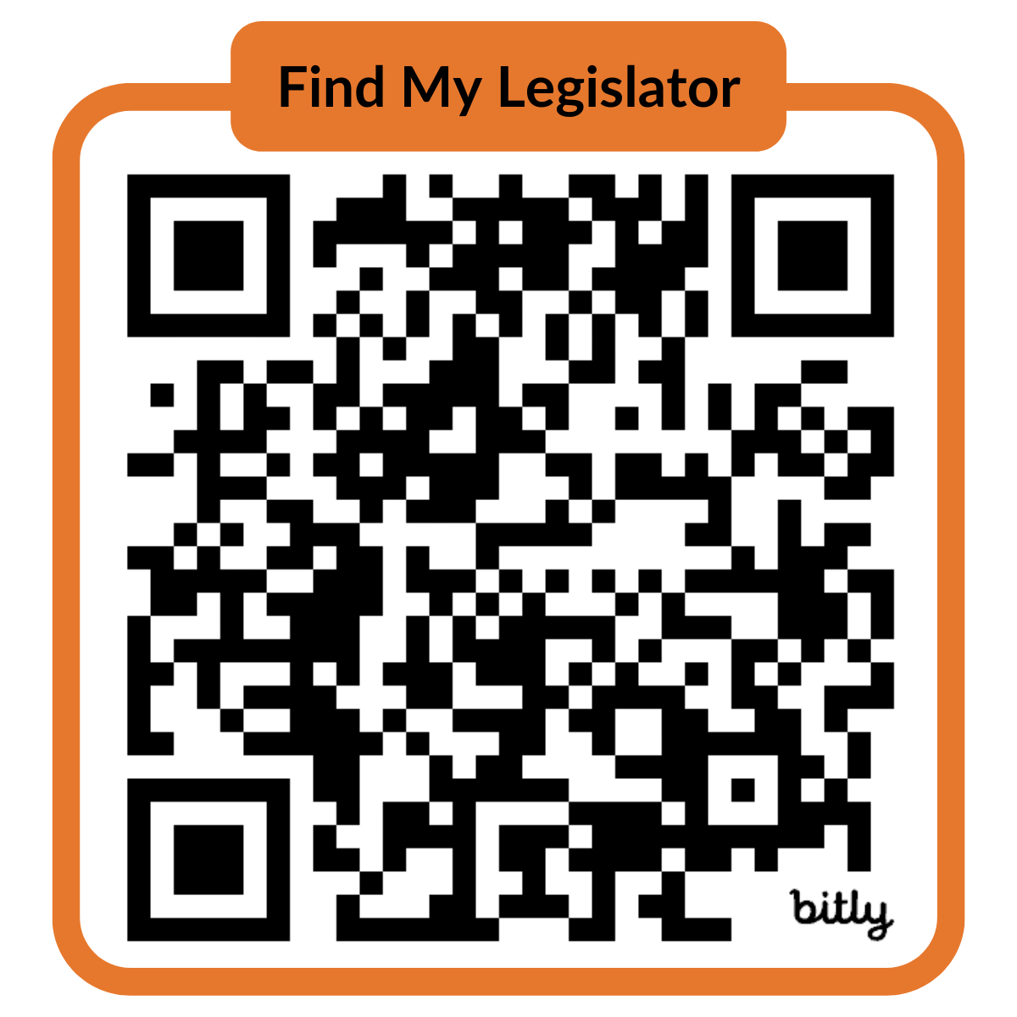
If you don’t know, that’s okay! You can identify both your MA House Representative and State Senator by scanning the QR code:
Enter your:
Street address
City/town
Zip code
Breakout Activity:
Who are your legislators?
Notes:
3 mins
Ask people to follow-along with the exercise, but tell them you will provide an example and slides will be shared afterwards.
https://malegislature.gov/Search/FindMyLegislator

Slide 10

Answer these questions about your legislators!
What is their career background?
What are two bills that they’ve recently sponsored?
How long have they been in office?
Are they chair or vice chair of a committee?
Notes:
3 minutes
Put questions in chat for reference

Slide 11
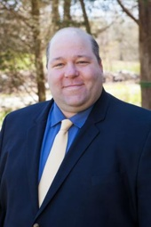

Kate’s legislators (Attleboro, MA)
Let’s look at an example…
Senator
Paul Feeney
Representative
James Hawkins
Notes:
4 minutes
Paul’s campaign site: https://www.votefeeney.com/meet_paul
Malegislature: https://malegislature.gov/Search/FindMyLegislator
What is their career background?
What are two bills that they’ve recently sponsored?
How long have they been in office?
Are they chair or vice chair of a committee?

Slide 12
MA State Budget Process
Notes:
1 min

Slide 13

When should advocates engage legislators?
Notes:
2 mins

Slide 14
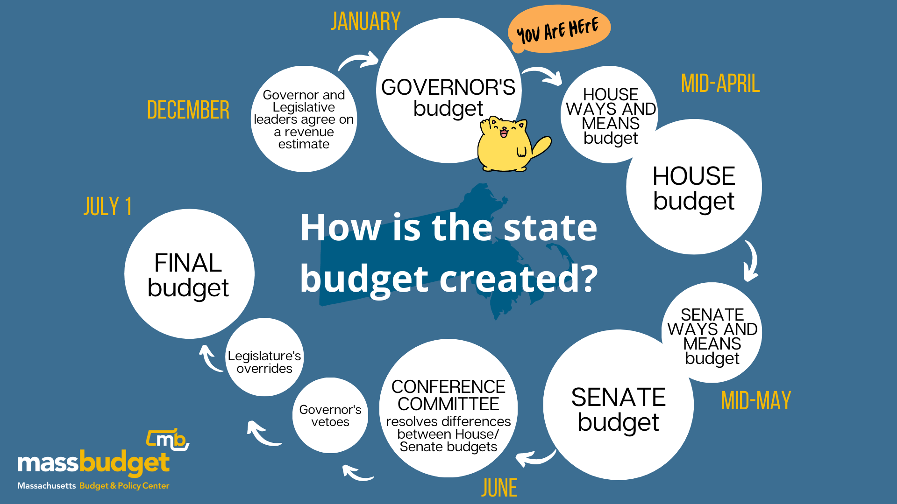
You are HERE
Notes:
5 mins

Slide 15
What is lobbying?
…and can I do it?
Notes:
1 minute

Slide 16
Elected officials need our eyes and ears​
It impacts who gets what, when and how​
It creates dialogue
Positive impacts on public health (the squeaky wheel gets the grease!)
Why advocate & lobby?
Notes:
1 min

Slide 17

What is lobbying?
Direct Lobbying
Grassroots Lobbying
Communication to an elected official or staffer
Specific legislation​ +
An opinion and/or clear ask on that legislation
Communication to people​ +
Expressing a view on specific legislation​ +
A call to action
Notes:
3 mins

Slide 18
When & how can you lobby?
We all have a responsibility to lobby!
Most of you will never hit the threshold that would jeopardize your non-profit’s 501(c) 3 status or require you to register as lobbyist
If your work is 100% state or federally funded, you can lobby on your own personal time
If you work for government, you are legally able to lobby, but may want to check with your organization to understand your own organizational policies
Notes:
3 mins
The question is not “can I lobby?” It’s “when and how can I lobby?”

Slide 19
Advocacy or Lobbying?
GL = grassroots lobbying, DL = direct lobbying, A = advocacy
Sending a mass email to a listserv asking subscribers to contact their legislators about co-sponsoring a bill that protects low-income folks from evictions
GRASSROOTS LOBBYING
Organizing an educational public forum for local politicians to debate and share
their views on transportation issues
ADVOCACY
Calling or writing members of the legislature asking them to vote
against the current version of a climate bill
DIRECT LOBBYING
Notes:
4 mins
Put in the chat the code letters for each type of legislative engagement as you make your guesses.

Slide 20
Legislative Engagement
You know the basics. Now, how do you get involved?
Notes:
1 min

Slide 21
What have you contacted your legislators about?
Notes:
2 mins

Slide 22
Advocacy Pro Tips
Do
Don’t
Remember legislators are just people
Mention that you are a constituent
Lead with your experience/expertise
Be polite, friendly, and patient
Be concise and to the point
Make the issue personal (remember: stories are stickier than data)
Be prepared to talk with staff who work with your elected official
Thank them and follow-up
Assume someone else is contacting your legislators about this issue
Be intimidated
Be dishonest or exaggerate
Be afraid to say you don’t know
Forget your power
Notes:
3 mins

Slide 23

Here are your secret ingredients!
When talking with others, it is important that we use plain language to communicate the what, the why and the how.
Here is a simple ‘recipe’ for effective advocacy:
Step one. Share what the problem is, and emphasize the policy solution.
Step two. Share why your audience should care, using stories and data.
Step three. Share a clear ask regarding how they can support.
Notes:
4 minutes (provide an example)
Link to current Senate email/phone scripts

Slide 24
You are not alone! There are a number of orgs that work full time on campaigns that matter to you. They analyze policy, build coalitions, and know when and how to take action to influence legislators. Stay connected:
Homes for All MA - housing justice
T4MA - transportation access
Healthy Incentive Program Funding Campaign - healthy food access
Raise up MA - economic justice
Shameless plug - MPHA!
I feel prepared.
So, what comes next?
Notes:
2 mins
Encourage them to write down these names, and remind them you will follow up with slides.

Slide 25

Stay Connected
Stay connected with MPHA! Scan the QR to stay up to date on public health policies and receive action alerts.
Notes:
1 min

Slide 26

Kate Forrest, MA Public Health Alliance
kforrest@mapublichealth.org
Questions?
Notes:
15 mins
Mention that we only covered the budget process today, but we can also talk about how laws are passed in MA and how to get involved there. (Shameless plug for MPHA’s trainings)

