Slide 1
Understanding the Presence of Pests: Tips and Tools for Local Public Health Inspectors
Sasha Clapp MS, REHS/RS
Public Health Training Specialist
Berkshire-Hampden Public Health Training Hub
September 22, 2026

Slide 2
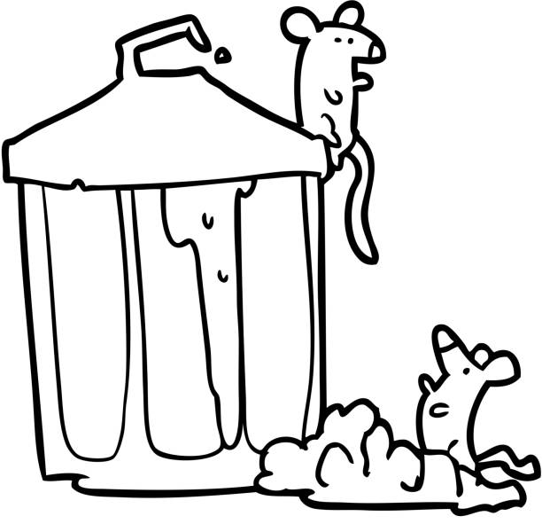
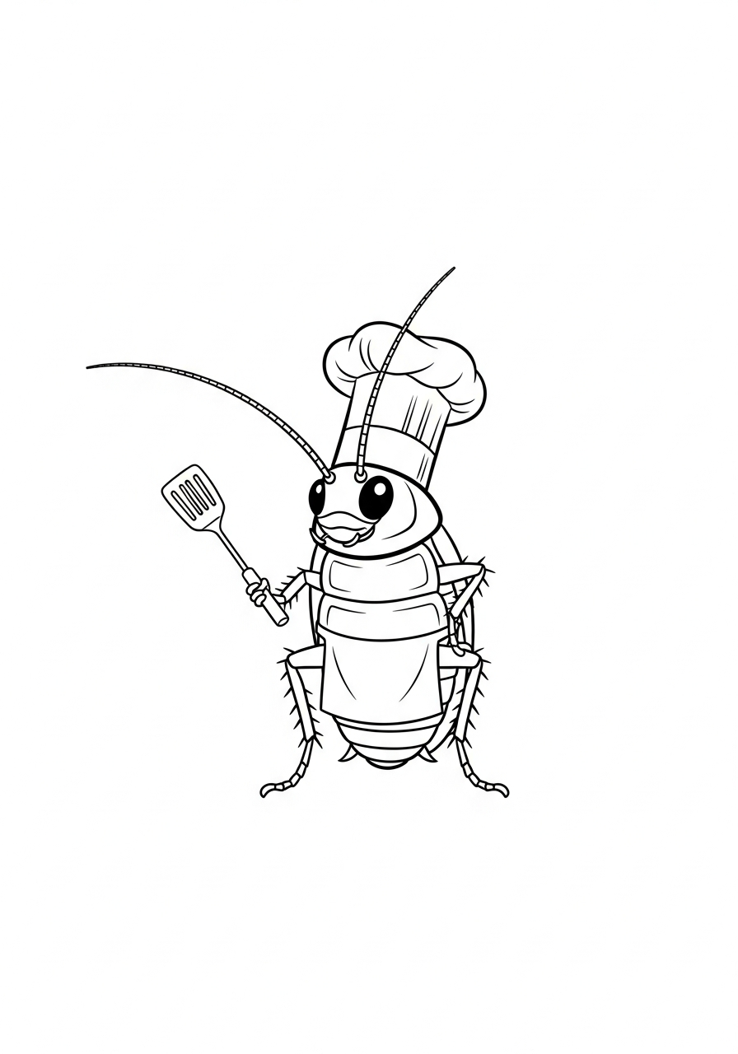
Agenda
1. Brief overview of a few common pests encountered during food and housing inspections
2. Making sense of pest management reports
3. Focusing on root causes: pests as a symptom rather than a source of problems
4. Strategies for collaboration:
  Addressing pests in food inspections
  Addressing pests in housing inspections
6. Destigmatizing pests as a local health agent: how our reactions can impact response

Slide 3
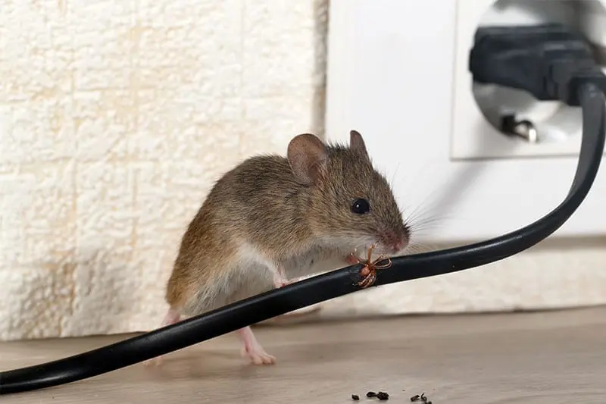
Definitions of Pests
“Pest means any of the following that may cause disease, injury or other health risk to humans or pets, or act as a disease vector, or cause damage to property:
(1) Insects including, but not limited to, mosquitoes, bees, flies, ants,
termites, cockroaches and bed bugs ;
(2) Arachnids including, but not limited to, spiders, daddy long legs,
scorpions, and ticks;
(3) Rodents; or
(4) Other unwanted animal life.” (105 CMR 410.010)
Generally speaking, a pest is a living thing growing or living where unwanted and with the real or perceived potential to cause destruction or harm

Slide 4
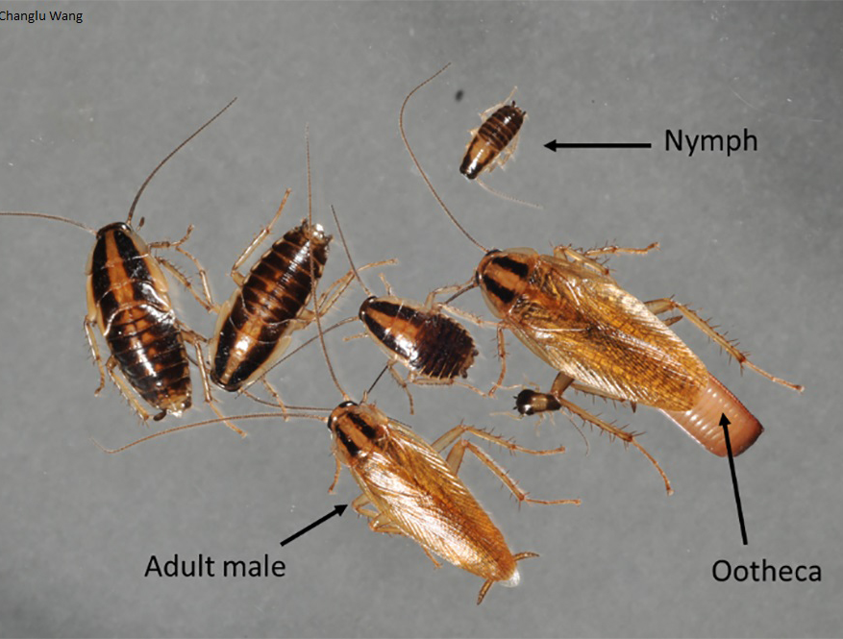
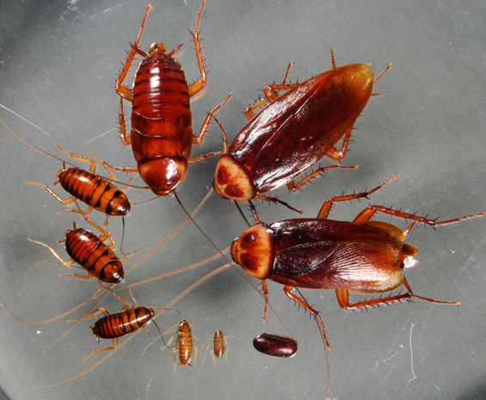
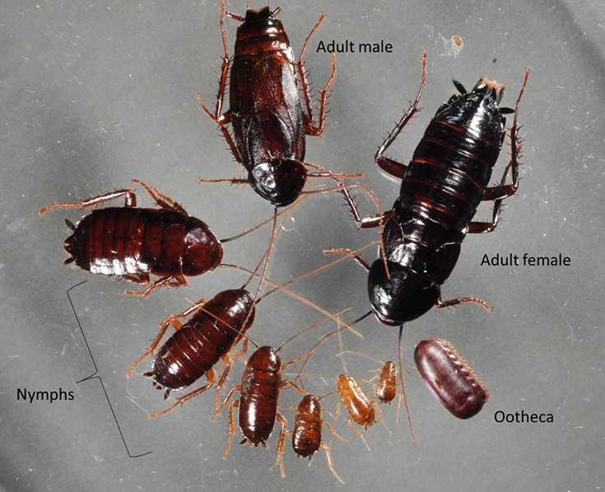
Common Pests: Cockroaches
German Cockroaches (Blattella germanica)
American Cockroaches (Periplaneta americana)
Oriental Cockroaches (Blatta orientalis)
Most common in food establishments and homes
Smallest pest cockroach
Look for dark stripes
Prefers dampness and moisture
Regularly found in sewers
Largest of common pest species
Look for red-brown color and tan/ yellow border
Midsized cockroach (about 1 in)
Dark brown, almost black
Prefer dampness and decaying organics
Slowest moving
Notes:
Photograph sources:
https://njaes.rutgers.edu/fs1322/
https://extension.entm.purdue.edu/radicalbugs/default.php?page=pests/american_cockroach
https://njaes.rutgers.edu/fs1327/

Slide 5
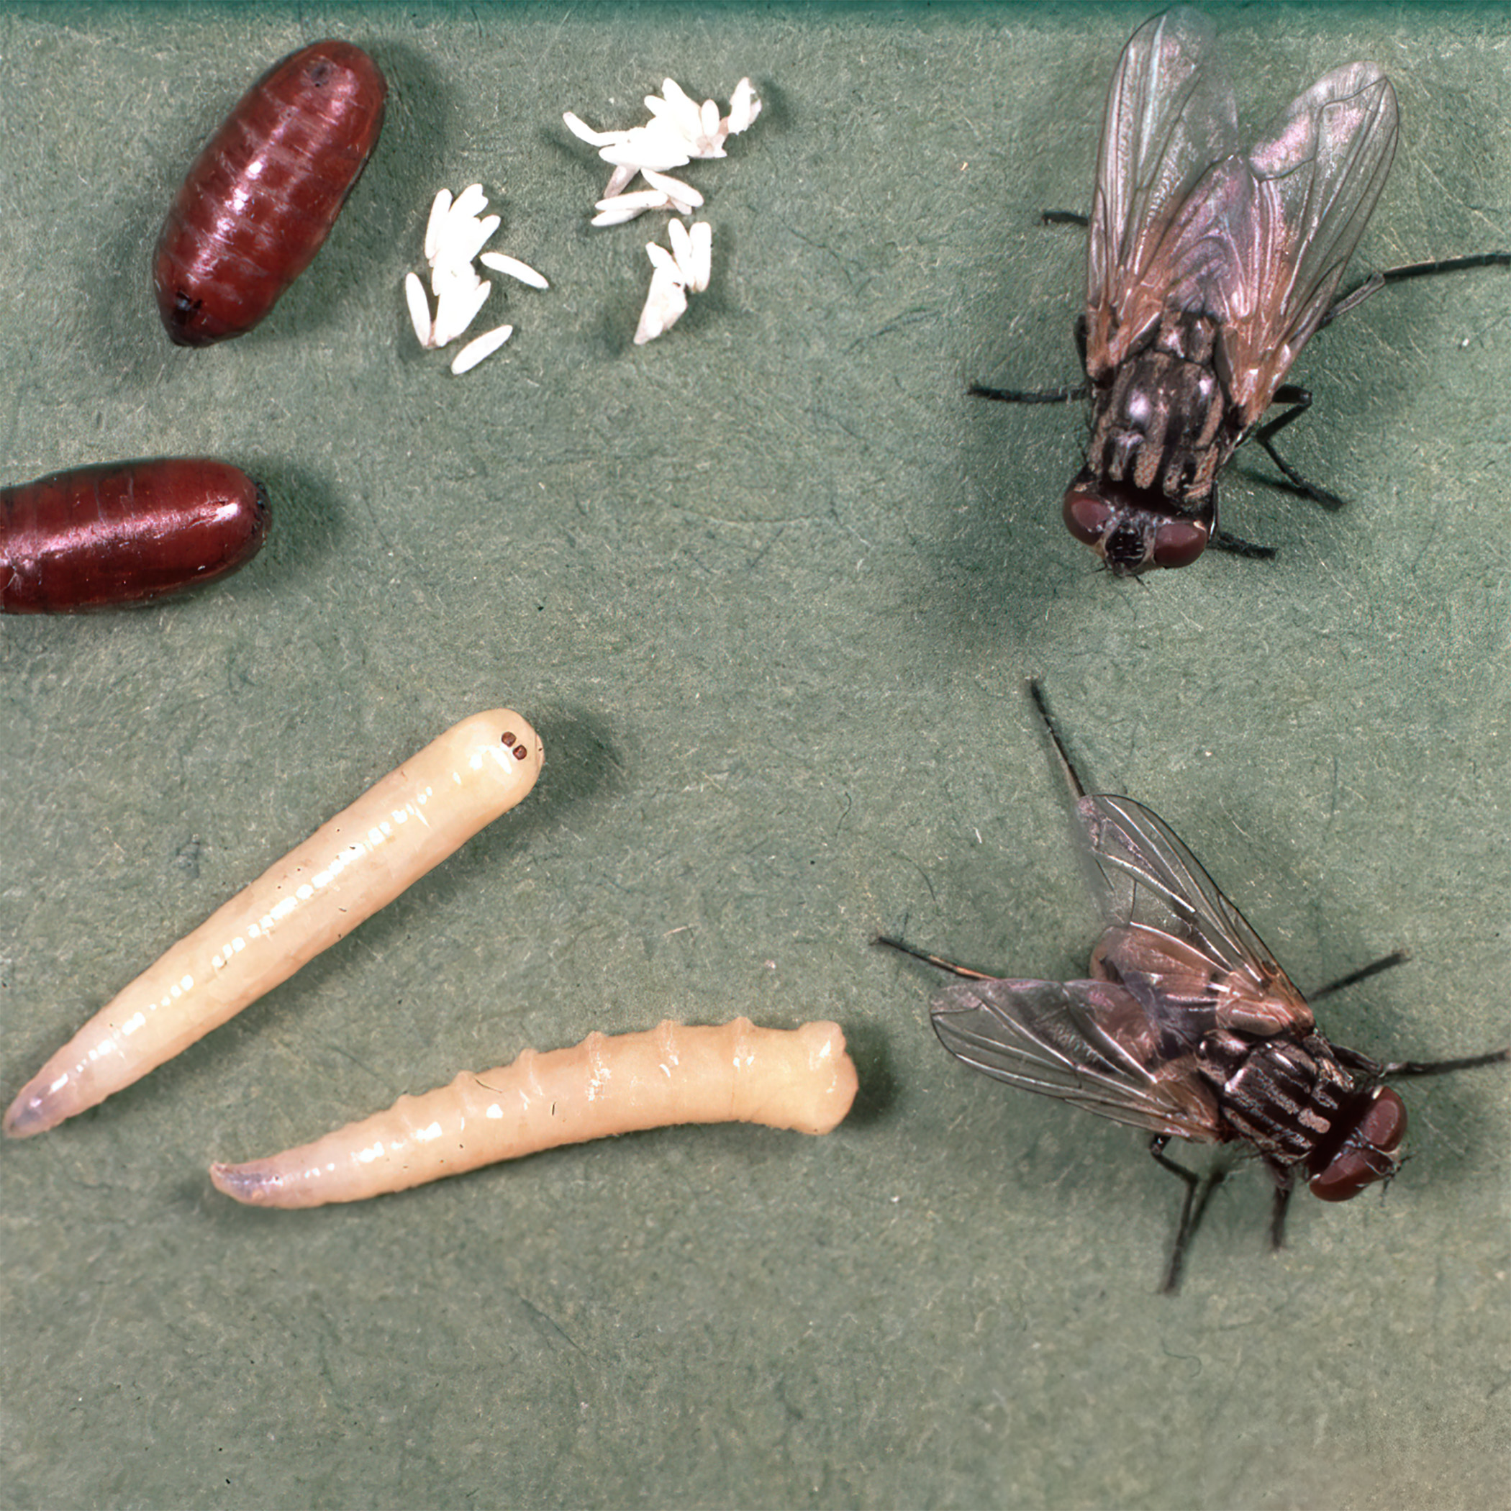
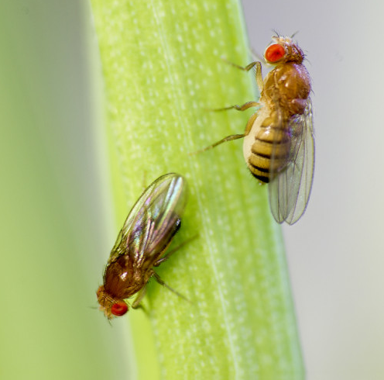
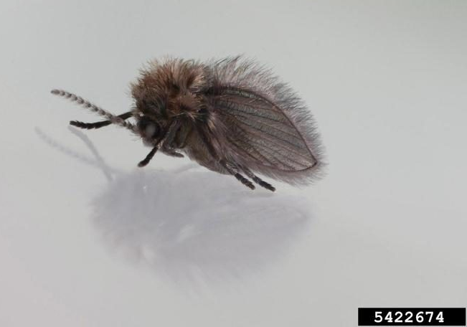
Common Pests: Flies
House Flies (Musca domestica)
Fruit Flies(Drosophilidae)
Drain Flies (Psychodidae)

Slide 6
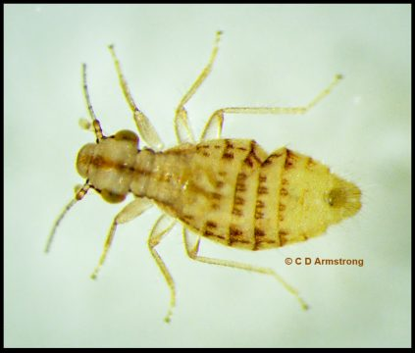
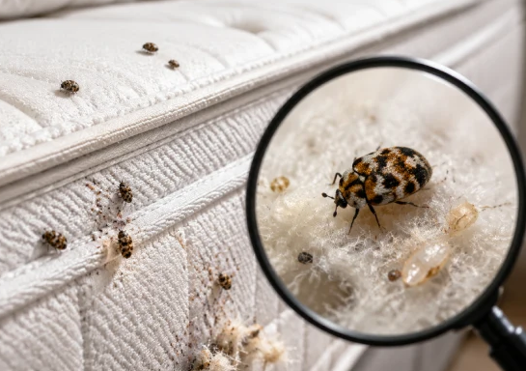
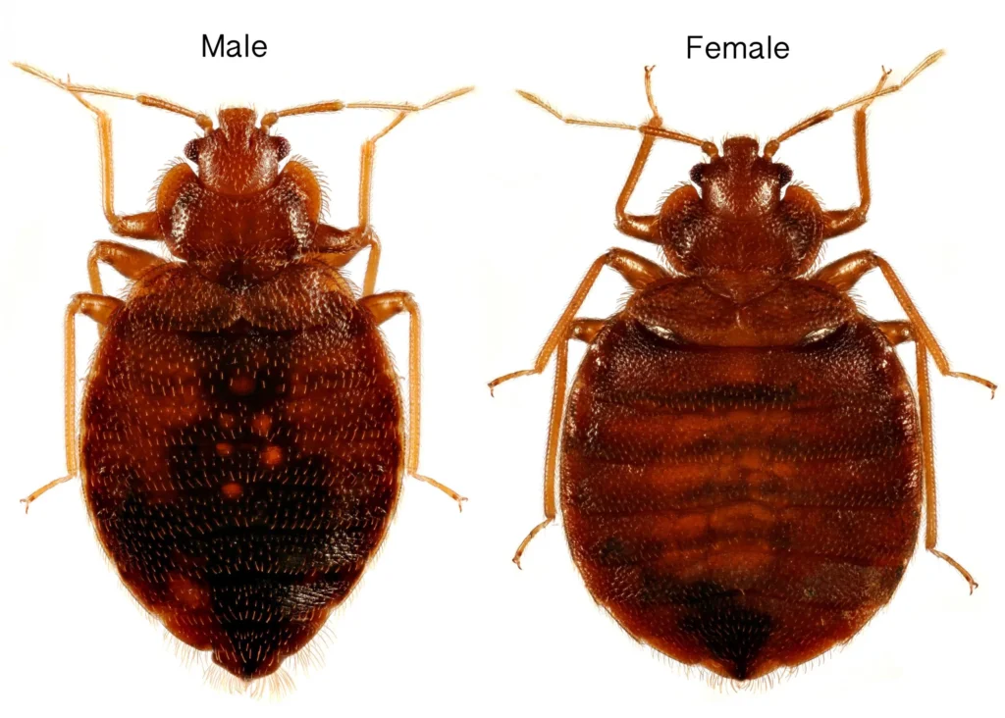
Common Pests: Bedbugs

Slide 7
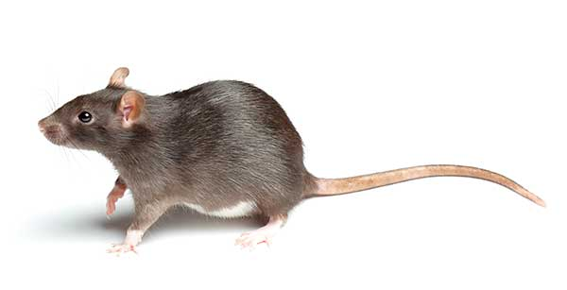
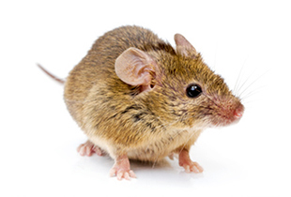
Common Pests: Rodents

Slide 8
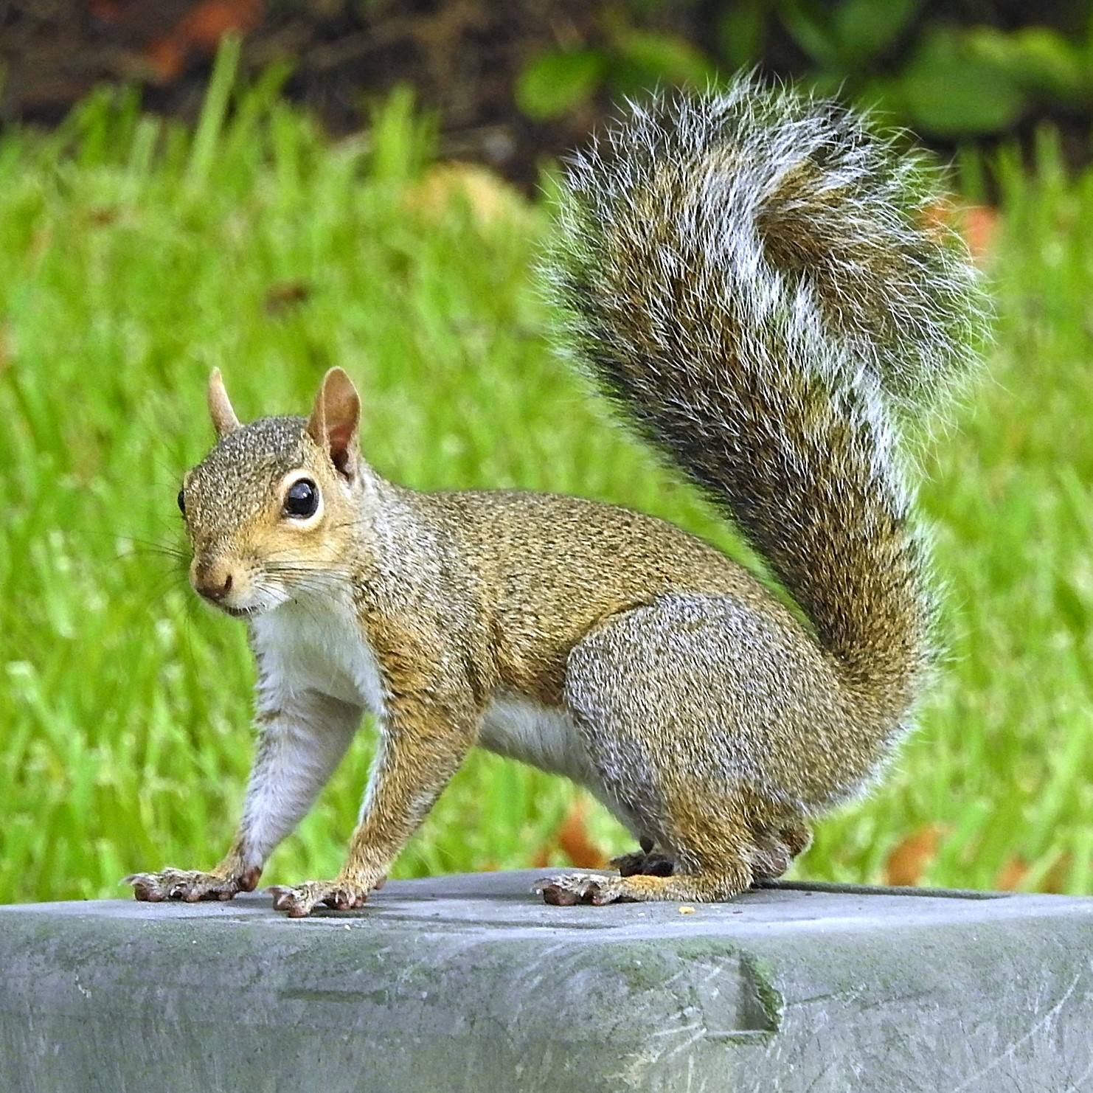
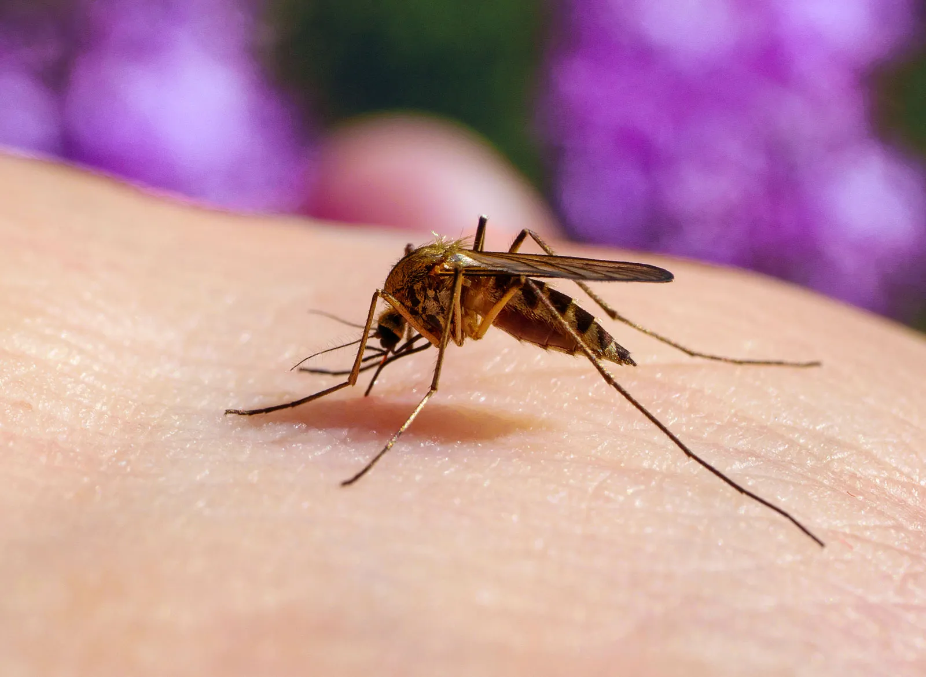
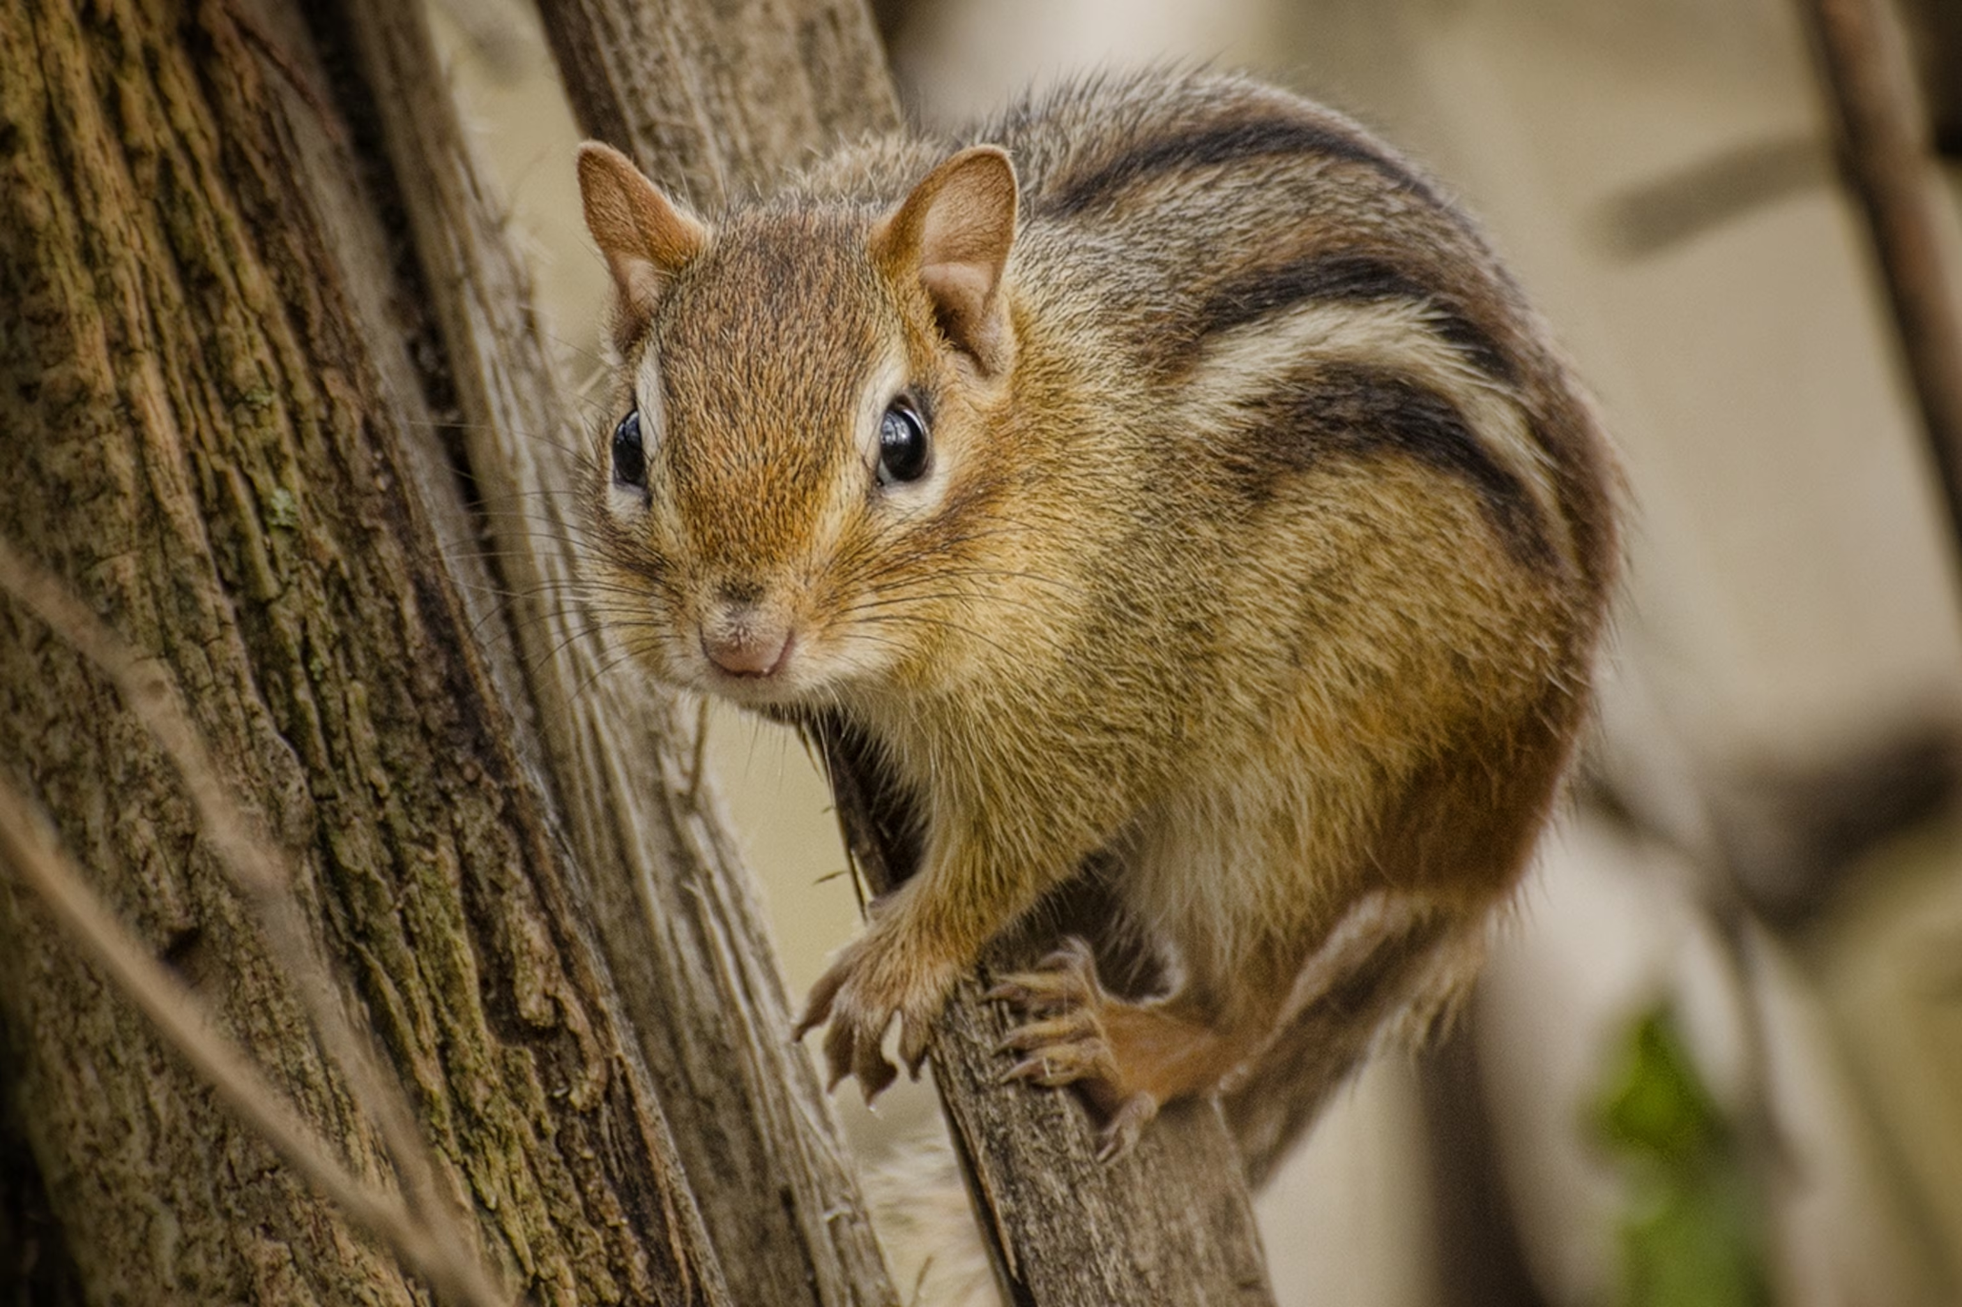
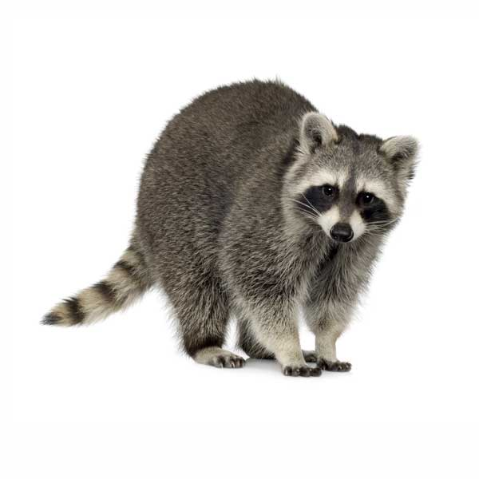
Other Pests You Have Encountered?

Slide 9
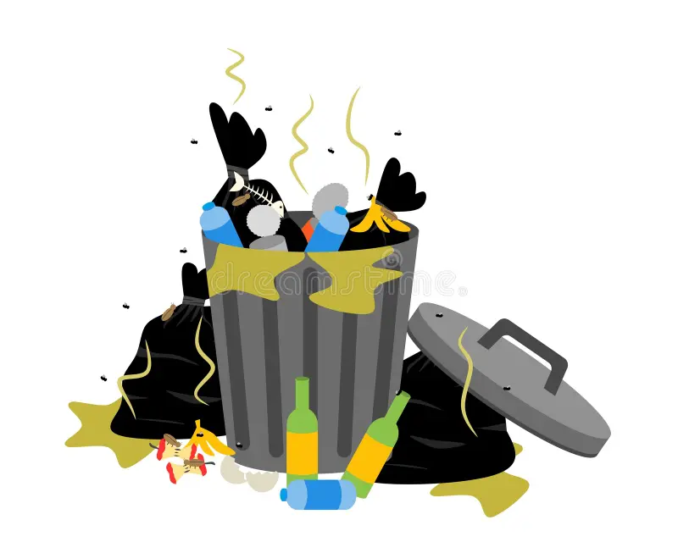
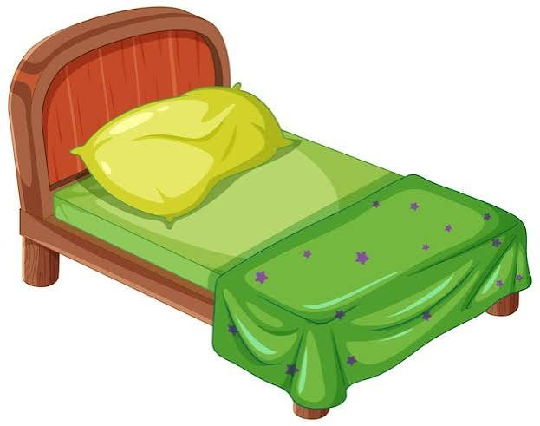
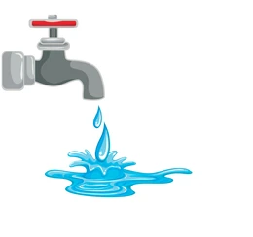
Pests need:
1. Food
2.Water
3.Habitation

Slide 10
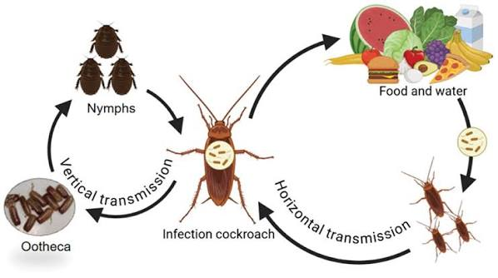
Pests as vectors
  Salmonella
  E. coli
  Hantavirus
  Leptospirosis
  Plague
  Murine typhus
  Pests can also be vectors of shame, fear, and isolation…

Slide 11
Pests: Starting to Destigmatize
Pests are famous for “hitchhiking” – shipment packaging (think: cardboard), luggage, clothing, used furniture, shared spaces, etc.
Pests move through densely populated areas more readily
“Pests” also exist in nature, and are only “pests” because of how they affect humans
Pests enter through structural deficiencies – even really small ones
  Diameter of a dime = mouse
  Diameter of a quarter = rat

Slide 12
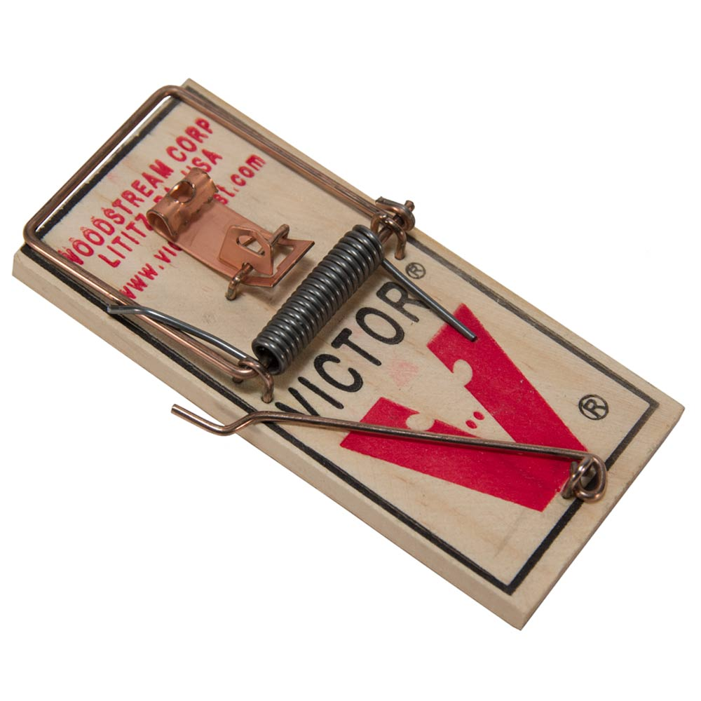
Pest infestations are eliminated by:
Taking away their basic needs
Treating the existing individuals (consider life stages)
Excluding additional pests by preventing re-entry
Continued monitoring for activity and intervention as necessary
Can we use these in food preparation areas in licensed food establishments?

Slide 13
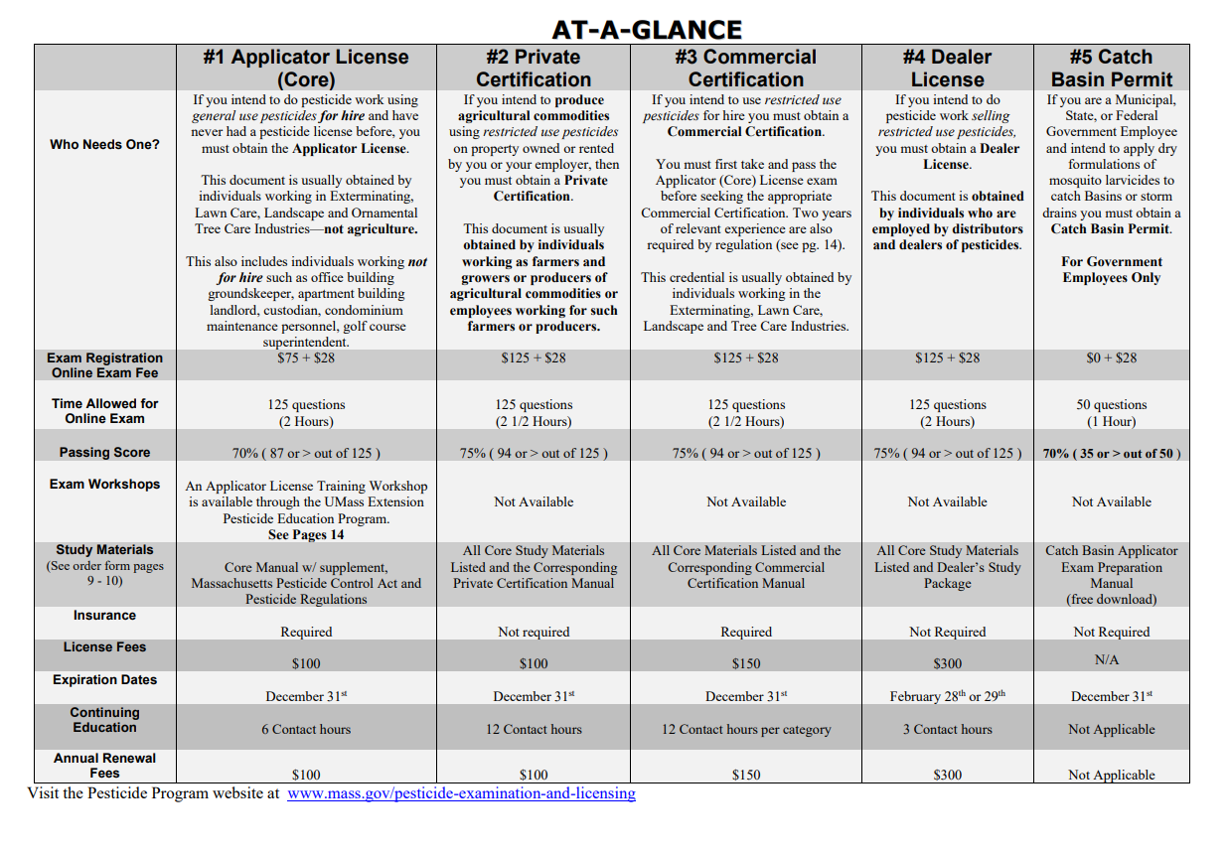

Collaboration with Licensed Pest Applicators
Might be necessary
Massachusetts Department of Agricultural Resources sets requirements for those wishing to apply pesticides
Notes:
https://www.mass.gov/doc/pesticide-examination-and-license-information-bulletin/download

Slide 14
Always come back to scope
BOH agents function to educate the public – occupants, owners, persons in charge, etc. – about pests
BOH agents function to enforce the Sanitary Code
To effectively do both, we must:
  have a basic understanding of different kinds of pests and their associated health risks as vectors
  generally perceive what other sanitary conditions may be leading to the infestation
  Communicate openly and effectively with those affected to determine their understanding of the infestation and what steps they will take to resolve it
  Know where the limits of our knowledge end – and accept that it is okay to delegate to another professional!
***It is outside of our scope to instruct owners/ occupants/ persons in charge HOW to remedy the situation…

Slide 15
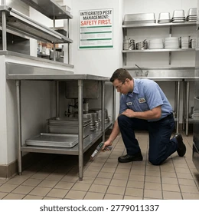
Pest Management Reports
Third-party assessment of pest infestations:
  What kind?***
  What life stages?
  What extent? How severe?
  Where located ?
  Observed signs
  Other conditions***
  Professional recommendations to aid in exclusion and treatment***

Slide 16
When you observe pests or signs of pests during an inspection, what other concerns do you typically also notice?

Slide 17
Pests are a symptom of other problems:
Improper food storage
Excessive refuse and waste
Squalor conditions
Poor sanitation
Failure to exclude (holes to the exterior)
Structural deficits
Excessive moisture

Slide 18
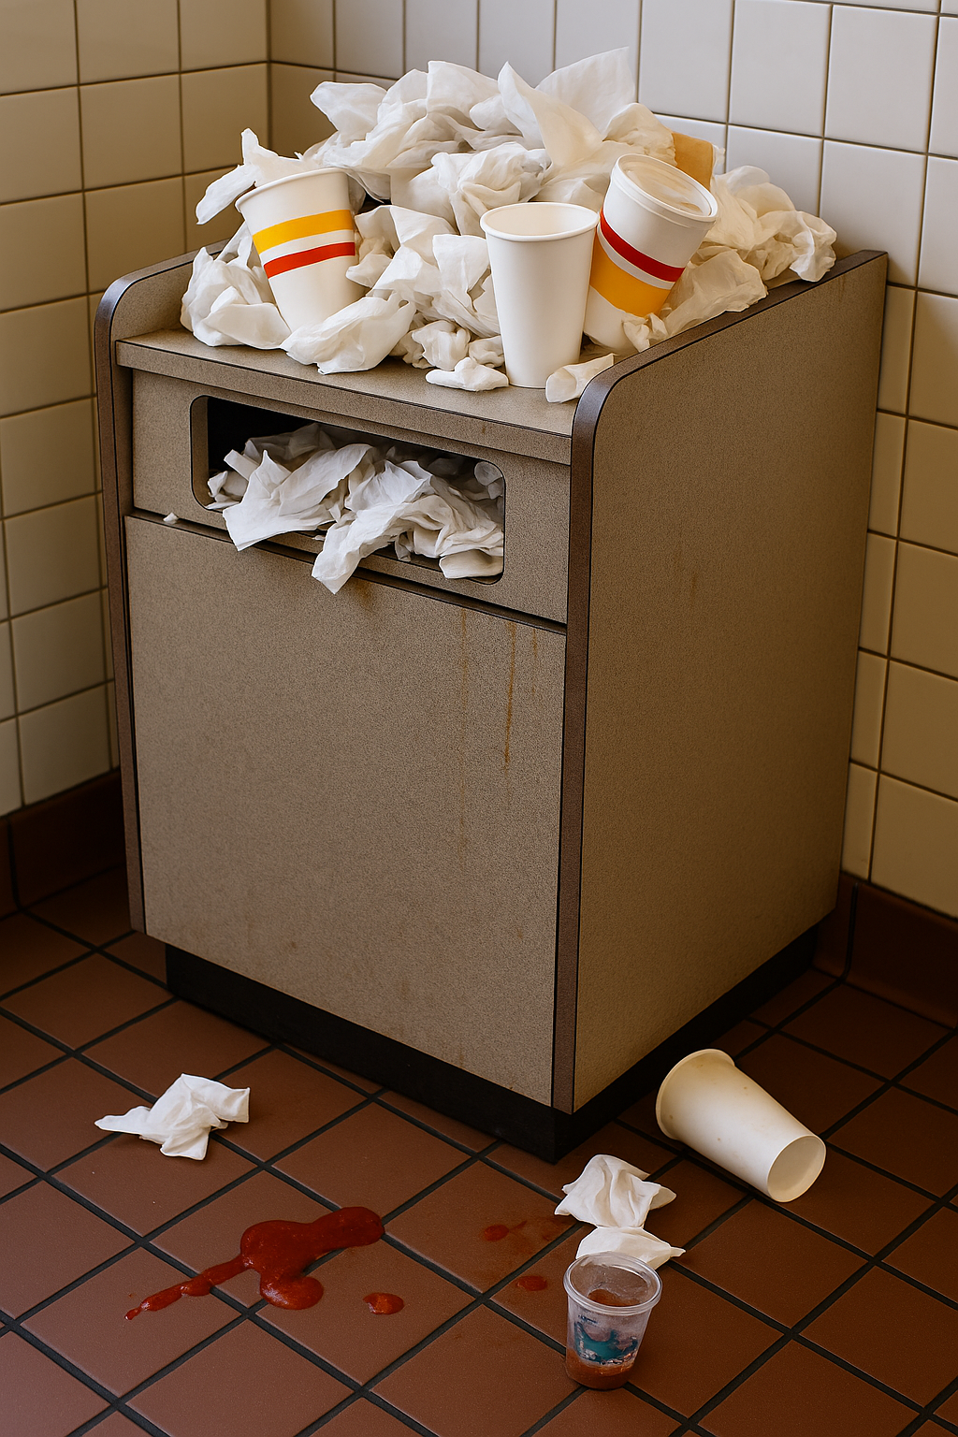
A Food Scenario: The Great Place
You receive a complaint about a local food establishment. The anonymous caller states that they tried to eat at That Great Place this afternoon, but as they were sitting down, the biggest rat they had ever seen ran across their table. They tell you how horrified they were and ask if you will inspect.
The Person in Charge, Mr. Joseph, allows you in and says he has been having some trouble with mice. He has set up a few traps, but claims they are not working.
As you are walking through the kitchen with Mr. Joseph, you see open garbage cans overfilling with food waste, bags of flour sitting on the floor with gnaw marks, trails of grease low down on the coving, and a hole the size of half dollar leading straight out the back door. You agree with Mr. Joseph’s assessment that the traps are not working – and watch five large rats devour the remnants of some kind of pie left out on a cooling rack. You see the floors are covered in flattened cardboard boxes, which are covered in large, shiny rodent dropping… so many that you simply cannot count them.
Mr. Jospeh shares that he has recently lost a few staff members and that they are short staffed. He says the garbage gets taken out once every three days or so, and says “the new hire hasn’t been great about putting food away at closing time.”

Slide 19
Where do you even begin?

Slide 20
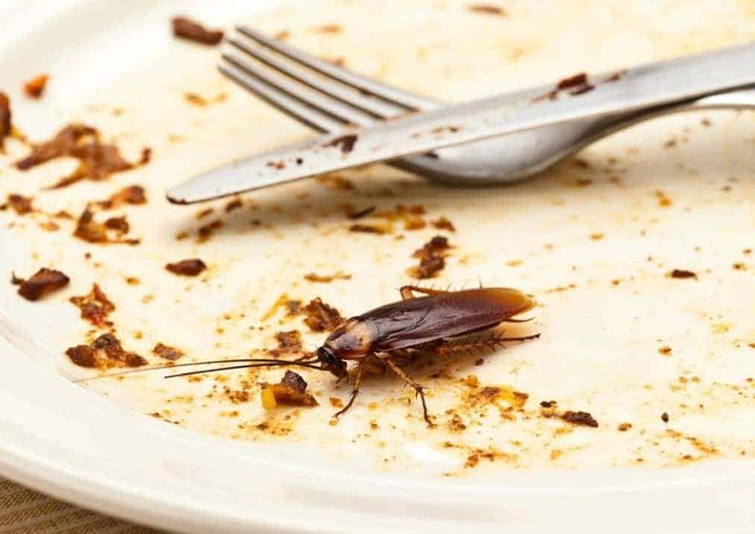
Pests During Food Inspections
“The PREMISES shall be maintained free of insects, rodents, and other pests. The presence of insects, rodents, and other pests shall be controlled to eliminate their presence on the PREMISES by:
(A) Routinely inspecting incoming shipments of FOOD
and supplies;
(B) Routinely inspecting the PREMISES for evidence
of pests;
(C) Using methods, if pests are found, such as
trapping devices or other means of pest control as
specified under §§ 7 -202.12, 7-206.12, and 7- 206.13;
(D) Eliminating harborage conditions.”
(105 CMR 590.006; FC 6-501.111)

Slide 21

The Great Place: Resolution
Come back to scope: education, then enforcement
Assess:
  are there pests present?
  To what extent, generally?
  What other violations do you notice?
Evaluate:
  Which of these violations pose the biggest risk to public health?
  Use 105 CMR 590 to support your decisions
Educate:
  Clearly communicate your observations
  Explain why pest mitigation is needed
  Share information about general requirements:
    Rodent bait stations must be covered (105 CMR 590.007; FC 7-206.12)
    Tracking powder pesticides may not be used (590.007; FC 7-206.13(A)), unless nontoxic – such as flour – and if so, must not contaminate food/ equipment/ utensils (590.007; FC 7-206.13(B))
  If collaboration with an IPM technician is needed, be sure to review reports and compare to your findings at the reinspection
Other approaches?

Slide 22
Pests in Housing: Cockroaches
An occupant, Ellie Jacobson, calls to report that she has been finding cockroaches in her apartment kitchen at 10 Main Street Anytown, MA 00000. Ellie lives in Apartment C of a 6-family complex owned by Becky Smith.
You arrive and Ellie allows you entry for a comprehensive inspection at 0900. You conduct a thorough inspection of every room, noting that Ellie’s apartment is particularly sanitary – no food left out, no trash, seemingly not a speck of dust. You search high and low for signs of cockroaches – but you find no frass, no musty odor, no shed skins.
You do notice a small gap around the water pipe under her sink and you see some water accumulating underneath the sink cabinet. You find one, singular small adult cockroach in a dark corner under the sink.
As you leave Ellie’s apartment and turn down the hall toward the exit, a strong, musty odor hits your nose. You prepare to leave, but notice a glue trap in the shared corridor. Stuck to it are at least a dozen cockroaches, adults and nymphs.

Slide 23
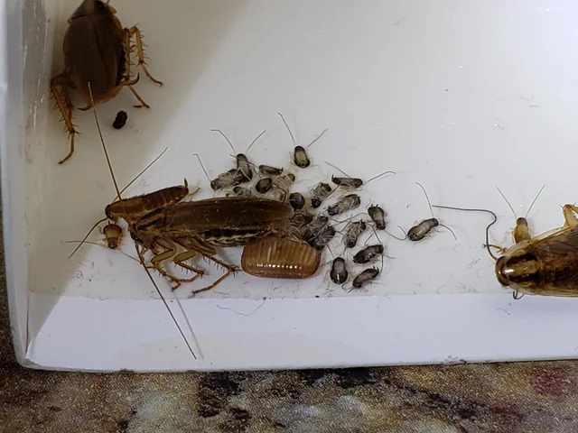
Now what?

Slide 24

Who is responsible?
How many would cite the owner only?
How about the occupant only?
How about both owner and occupant?
Who is responsible for the control and elimination of pests in a multifamily? (105 CMR 410.550(B))
Who is responsible for maintaining common areas in a sanitary condition? (410. 570(C)(1))

Slide 25
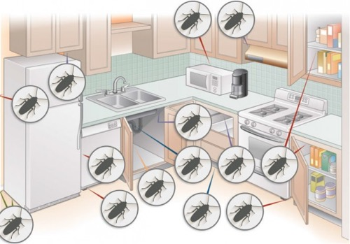
How to we begin to assess the situation?
What are your obligations for inspection:
  Remember, “a violation found in a common area shall be considered a violation which exists in each dwelling or rooming unit in which occupants have access to that area” (410.620(B)(2))
Perhaps most importantly, does one cockroach mean that Ellie’s apartment has cockroaches?
  How would you document that?
What about the glue traps?
  How did they get there?
  Who monitors them?

Slide 26
Cockroaches in a Multifamily: Continued
You conduct a thorough inspection of the common areas and document frass (cockroach droppings), adults and nymphs, and a musty odor throughout. You notice a large water leak in the shared corridor and an abundance of adult cockroaches huddled in a dark corner by this puddle of water. They slowly scatter when you shine your flashlight.
Becky Smith, the owner of the building, says she has been work with Pest Destroyers – a local, licensed pest management company, to try to eradicate the cockroaches. She says they leave a paper every time, but she doesn’t look at it. They come twice a month and have been coming for about a year. Becky says she has a few occupants who don’t “keep a tidy home”
You ask Becky if you can review those reports, and notice that Pest Destroyers has determined these are Oriental cockroaches. Pest Destroyers keeps noting their suggestion to repair the leak and to remove exposed compost bins from the property – the same sentence on every report.
What would you do next?

Slide 27
Cockroaches in a multifamily: resolved?
Pests are a condition deemed to endanger (410.630(A)(17))
The owner already has a contract… but is this a “good faith effort”?
Keep in mind that most pest interventions take time: exclusion can be more immediate, but treatment of an ongoing infestation requires cooperation between owner, occupant(s), and the pest management company
Pest treatments need to target specific life stages – and there may be individuals at various stages
Document what you observe and only cite what you directly observed (with your senses)
You may note (in your case notes) what was stated to you by occupants, owners, pest management techs, etc.
Education is paramount here!
Be sure to follow up at reinspection – and refer to BOH if the infestation appears to progress or if resolution stalls

Slide 28

Destigmatizing Pests as a LPH Inspector
Emotional responses to pests: fear, anxiety, shame, anger, disgust
Yes, there are actions we can all take to exclude pests: exclusion is the best pest management
Yes, there are actions we can and should take to treat pests that we do encounter
Yes, we must prioritize pest management because pest infestations pose both imminent and long-term risks to local public health
However, we must do so with the ultimate goal of protecting the public, promoting wellness and health, and preventing illness that we know to be spread by pests
To accomplish this, we must work to understand that pest infestations can happen to anyone – even those that are the most cautious
By intentionally or inadvertently shaming those affected by pests, we sabotage our ultimate goal: protect, prevent, promote.

Slide 29
But what do I do, then?
If pests get under your skin, admit this. We all have fears, and it’s okay if this is one of yours
Prepare yourself by reading a bit about some of the pests you may encounter - and looking at photographs
Know that you are not expected to taxonomically identify insects (or rodents)
Select appropriate PPE
Do not place your inspection bag down on upholstered surfaces during housing inspections
Politely decline offers to be seated during housing inspections
Practice good hygiene when returning to the office or to your home after inspections: removing shoes and soiled clothes
Get to know your local pest management technicians and IPM professionals. They are a wealth of information and a great resource
Familiarize yourself with state and local resources for pest mitigation tips
Prepare to be empathetic, not sympathetic
Avoid words like “dirty”
Avoid placing blame: focus on having the person responsible (for fixing the issue) describe back how they can remedy it

Slide 30
Questions?
Sasha Clapp, MS, REHS/RS
Public Health Training Specialist
Berkshire Hampden Public Health Training Hub
sclapp@berkshireplanning.org
(413)442-1521 x 53

