Slide 1
Intro slide
Environmental Sampling at Retail
October 22, 2026
Created by:
Jessica L. Ferreira, CP-FS
Environmental Analyst III, Food Safety Trainer
Division of Food Protection - Retail Food
Bureau of Climate and Environmental Health
Notes:
To start off this presentation it is rare an inspector is asked in their career to do this activity.
As more foodborne illness outbreaks occur and the state wanting LBOH to assist with this activity; The Retail Team, at the Division of Food Protection wanted to create a training and resource guidebook to assist in doing so.

Slide 2
Introduction
Environmental Sampling is:
A public health intervention to support prompt response to foodborne illness investigations.
A collaboration between the state and local health officials to conduct thorough investigations around foodborne illnesses.
This presentation will cover a comprehensive training on how to conduct environmental sampling in food establishments.
Notes:
Environmental sampling is more than a technical exercise—it is a practical public health intervention used to identify contamination, reduce ongoing risk, and support rapid response during foodborne illness investigations.
This work is a collaboration across state and local public health. The Bureau of Climate and Environmental Health, within the Massachusetts Department of Public Health, includes the Division of Food Protection, which works with local boards of health, the State Public Health Laboratory, and the Bureau of Infectious Disease and Laboratory Sciences during foodborne illness investigations and outbreak response. Together, these partners support environmental assessments, sample collection, laboratory analysis, and follow-up actions to protect the public.
This presentation provides training on environmental swabbing in retail food settings, with a focus on its public health purpose, proper sample collection techniques, and coordination with state laboratory and outbreak response partners.

Slide 3
Objectives
  Environmental Sampling in Outbreak Response.
  Why do sample collection?
  What is needed to conduct this activity?
  Environmental Sample Submission Form.
  Preventing contamination of swabs and samples.
  Step by step on how to do Environmental Sampling.
  Video: How to conduct an Environmental Assessment.
  Important Contacts.
  Resources.
  Wrap Up – Q & A.
Notes:
These are the objectives for today's presentation. A reminder this is just an overview of environmental sample collection procedures and how to conduct them.
We will discuss what is environmental sampling, the reasons why we conduct these types of activities, the supplies and forms you will need, go through the step-by-step process, and provide important reminders, contact information, and resources. We will then wrap it up with a Q & A session if time allows.

Slide 4
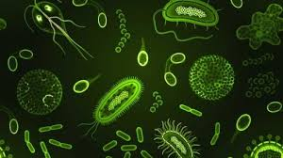
Environmental Sampling in Outbreak Response
Why it matters!
Identifies the source of illness.
Confirms environmental contamination
Supports outbreak investigations
Guides control measures
Stops ongoing transmission
Verifies effectiveness of interventions
Goal = Prevent Microbial Contamination of Food!
Notes:
Environmental Sampling in Outbreak Response: Why it matters!
It identifies the source of illness by pinpointing where contamination is occurring for example on equipment, non-food contact and food contact surfaces.
It confirms environmental contamination is present by detecting pathogens that may not be found in food samples alone.
It supports outbreak investigations by providing evidence linking the environment to reported cases.
It guides control measures helping target cleaning, disinfection, and operational corrections.
It stops ongoing transmission by identifying contamination pathways to prevent additional cases from occurring.
And it verifies effectiveness of interventions by confirming that corrective actions and sanitation efforts are working.

Slide 5

Why - Environmental Sampling? (part 1)
To initiate corrective actions to eliminate contaminated foods or poor food handling practices which may result in contaminated food.
With the assistance of DPH’s WGFIC, it will be determined if environmental sampling is needed during an outbreak, and the LBOH will lead the sampling investigation.
Notes:
Why do we conduct environmental sampling?
The goal of the investigation is to identify the reason for, and / or the source of contamination. Additionally, to initiate corrective actions to eliminate contaminated foods or poor food handling practices which may result in contaminated food.
During a foodborne illness outbreak, environmental sample collection will be requested and coordinated in advance with DPH’s Working Group for Foodborne Illness Control team which includes members of Epidemiology and The Division of Food Protection.

Slide 6
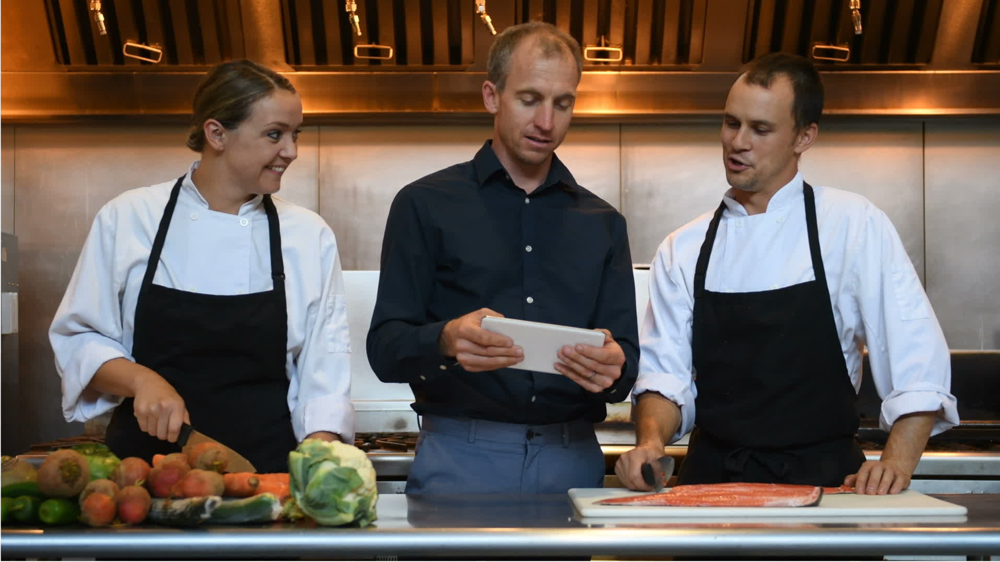
Why - Environmental Sampling? (part 2)
Educate On:
Proper Cleaning and Sanitization
Recognizing Employee Illness
Preventing Cross Contamination
Not to Use Bare Hand Contact
Proper Handwashing
Notes:
Environmental Sampling also creates an opportunity to re-educate and provide resources on incorrect poor handling practices, cleaning and sanitizing, or other observations made while conducting a foodborne illness outbreak investigation on site. Such as…READ BULLET POINTS ON SLIDE.

Slide 7
Preparation is Key
Coordination with the State Public Health Lab!
Receives samples weekly on Mondays, Tuesdays, or Wednesdays Only
DPH can assist with supplies, training, and sample logistics if needed by the LBOH.
Having the right supplies to collect aseptic samples is essential! ​
Sample integrity can be questioned and can be of no legal use for further enforcement action if needed.
Notes:
Preparation is key:
Coordination with the State Public Health Lab is very important! The lab can only receive samples on Monday’s, Tuesday’s, and Wednesday’s! (NOTE: *It can take a day and up to a few days to get the results depending on the number of samples taken.)
There will be coordination with DPH and the state lab for supplies, training and logistics prior to your sampling if needed!
Having the right supplies to collect aseptic environmental samples of equipment, nonfood contact and food contact surfaces is essential. It also makes the collection streamlined and efficient.
Without the proper supplies and handling, sample integrity can be questioned, possibly rejected by the state lab and the sample will be of no legal use if needed for further enforcement action.

Slide 8
What You Will Need (part 1)
Clothing
Field Equipment
ID/Credentials
Calibrated Thermometer
Alcohol Swabs
Sanitizer Test Kits
Camera/Batteries
Black Pen/Black Permanent Marker
Lab Coat (Laundered or disposable)
Hair/Beard Restraint
Rubber Soled Non-Slip Shoes
Bootie Covers
Documents
Environmental Sample Submission Form (COC)
Inspection Forms
Labels
Notes:
These are some of the supplies and forms you will need when conducting environmental sampling activities.

Slide 9
What You Will Need (part 2)
Required Items:
Sterile Bags (aka Whirl-Pak Bags)
Sterile Swabs and Dacron Swabs / Sponges
Appropriate Media (if applicable – will need to coordinate with the lab.)
Sterile Disposable Gloves
Cooler with Ice Packs / Bagged Ice
Trash Bags
Clipboard
Laptop / Tablet (if applicable)
Notes:
Required Items are….. READ SLIDE
It is important to note that the swabs or sponges, and the appropriate media, such as broth, have expiration dates on them. So, it is not recommended to buy ahead or have a large supply on hand.

Slide 10
How To Get Supplies – If getting from the SPHL
MDPH will coordinate availability and receipt of sampling supplies with the LBOH if needed.
If LBOH is picking up supplies at the SPHL: Coordination with the State Public Health Lab is very important!
Call to coordinate pick up of supplies with the SPHL prior to sampling.
State Public Health Laboratory: 617-983-6616.
The address to the SPHL is 305 South Street, Jamaicia Plain, MA.
Notes:
If you are getting supplies from the state public health lab, if they have them, MA DPH will coordinate with the LBOH.
If the state public health lab has supplies and the LBOH is picking them up at the lab it is key to coordinate this ahead of time with the state public health lab prior to sampling! Do not just show up.
For those of you who do not know where the state public health lab is it is located at 305 South Street in Jamacia Plain.

Slide 11
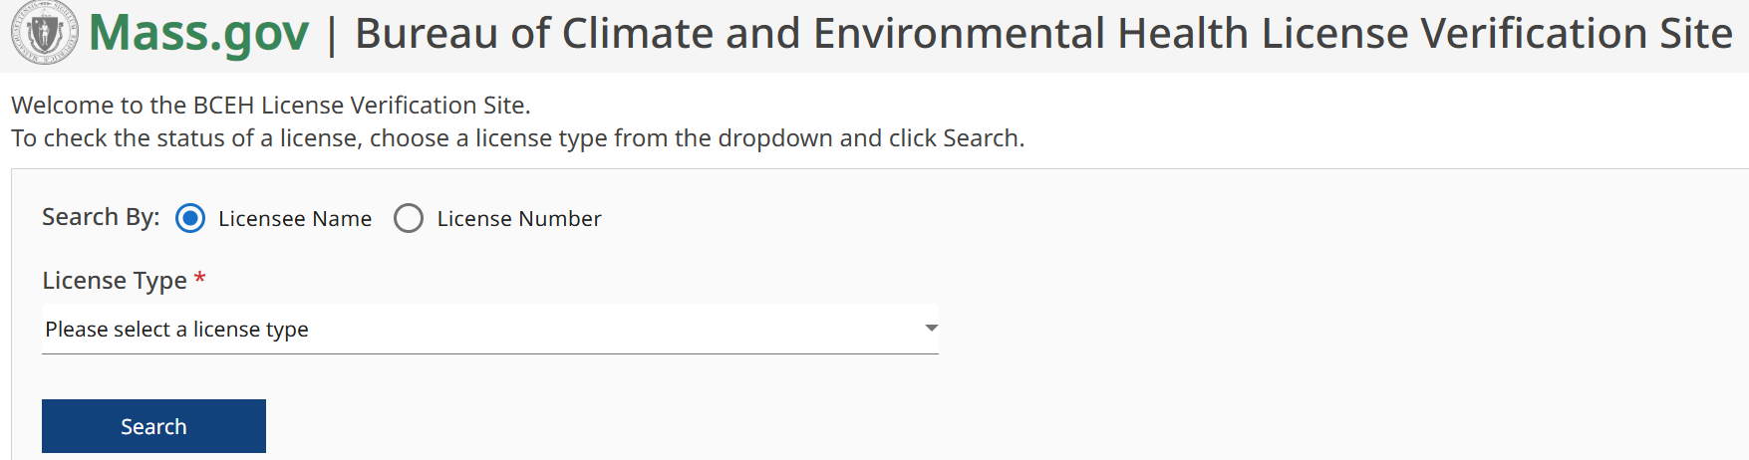
How To Get Supplies (part 1)
Option 1: If LBOH Do Not Have Supplies On Hand…….
LBOH could seek a 3rd party environmental testing accredited lab to do the sample testing for them. *DFP is unable to recommend a lab
Do an online search for environmental testing by accredited lab in MA.
You can check the public licensing website to ensure they are accredited:
BCEH Check a License:
http://checkanenvironmentallicense.mass.gov
Notes:
There are 2 options in getting supplies if the state lab does not have them.
The first option is the LBOH could seek a 3rd party environmental sampling accredited lab to do the sample testing. DPH is not able to recommend a particular lab, but you can do an online search and or check the state public licensing website.

Slide 12
How To Get Supplies – If LBOH must get supplies (part 2)
Option 2:
LBOH could purchase rapid test kits to conduct the environmental sampling.
Do an online search for rapid test kits specific to the pathogen in question. *DFP is unable to recommend a particular brand.
*Please note that these testing kits require an incubator (heating block) and/or a refrigerator that the LBOH or the food establishment must keep onsite. Keep in mind when purchasing these kits have an expiration date!
Notes:
The second option is the LBOH could purchase their own rapid response kits on their own to conduct the environmental sampling. Again, DPH is unable to recommend a particular brand for these kits.
LBOH can do an online search for the rapid response kits just ensure to get the right kit for the specific pathogen you are swabbing for. (For example, Salmonella, Listeria.)
*NOTE: An incubator or refrigerator may be required depending on what kind of test kit / swabs the LBOH get and for the specific pathogen. Ensure to read the manufacturers instructions prior to using.
Again, it is important to note that kits have an expiration date!

Slide 13
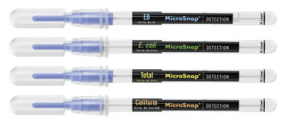
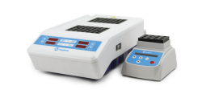

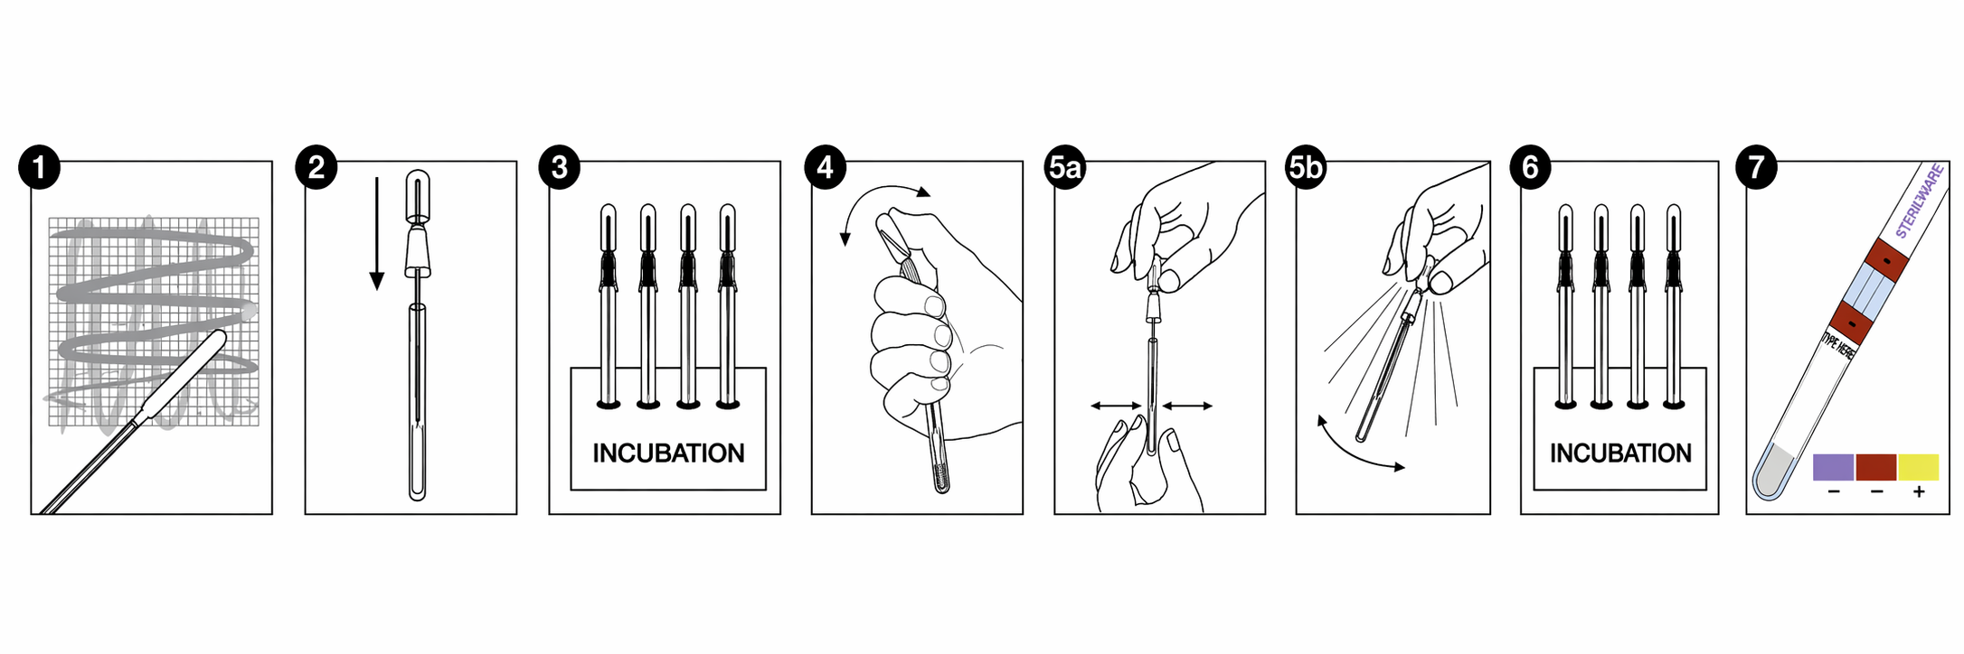
Rapid Response Kits
Incubator (Heating Block)
Different Types of Test Swabs
Process on how to conduct the test
Notes:
This is an example of what a rapid test looks like. This test uses an incubator (heating block). This brand has different swabs for different types of pathogens. Ensure you purchase the correct swabs for the type of environmental test and pathogen you will be conducting.

Slide 14
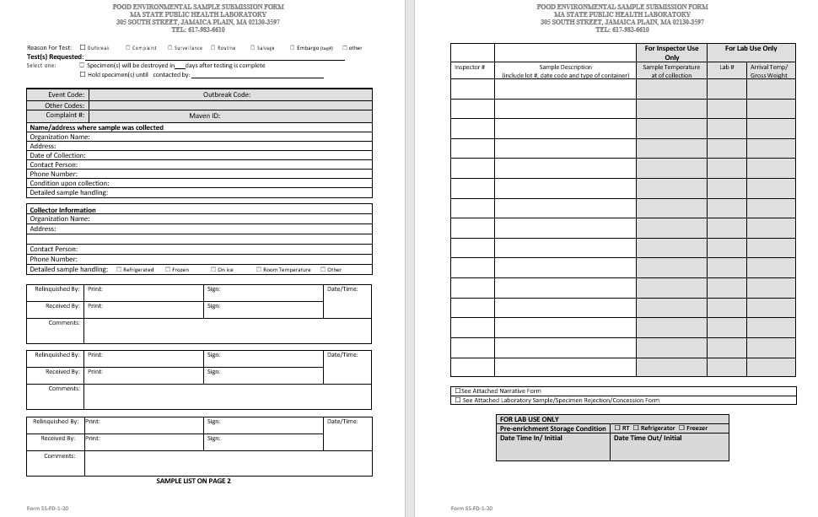
Environmental Sample Submission Form
Notes:
This is what the DPH Environmental Sample Submission form looks like. Also know as the chain of custody form. It can be found on the mass.gov website by simply putting in Environmental Sample Submission form in the search bar.

Slide 15
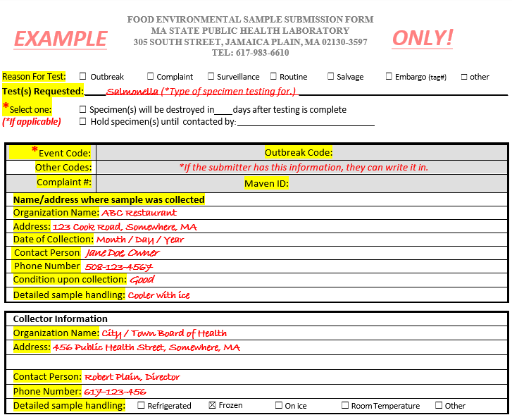
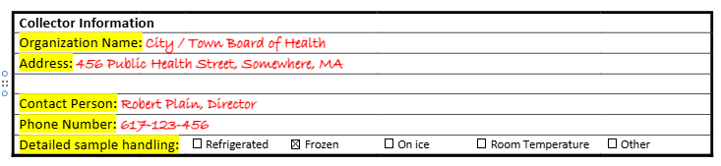
Environmental Sample Submission Form – Page 1
Notes:
This is what the DPH looks like up close.
The first page of the Environmental Sample Submission form includes a check box section for the reason the test.
The next section is to fill out is the name of the food establishment and contact information, as well as the date, the condition of the samples collected, and how they will be handled after collection. (i.e. Cooler with ice.)
The next section after that is the collector information. This is where you as the person collecting the swab samples puts their contact information and how the samples will be handled after collection. Again i.e. cooler with ice. It is very important to note in the collector information section to check off one of the boxes under the “Detailed Sample Handling” area. Which has the option of the samples being refrigerated, frozen, on ice, room temperture and other.) Ship all samples on ice / ice packs unless the state lab requests otherwise. The lab will reject the samples if you do not check one off.

Slide 16
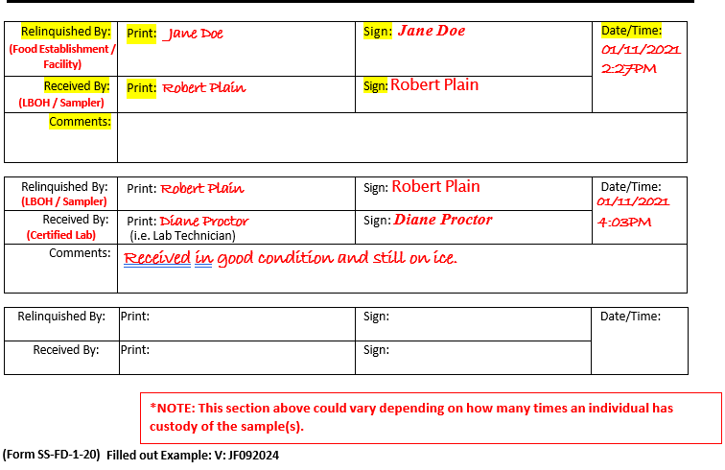
Environmental Sample Submission Form – Page 1 (part 1)
Notes:
The first relinquished by section is where you put the PIC or owners name and have them sign it. Next box underneath that PIC or owners name is where you put your name and signature. It is important to not forget the time and date.
The second relinquished by section is where you put your name and your signature. The next box underneath that is where the State Lab technicians name goes and their signature. Again, do not forget the time and date. There is also a comment section if you wish to put any information that you want to include.
*NOTE: The number of relinquished sections could vary depending on how many times an individual has custody of the sample(s). Another form could be used to capture this information if space on this form runs out.

Slide 17
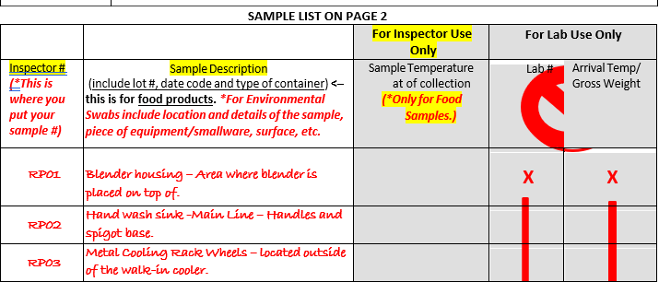
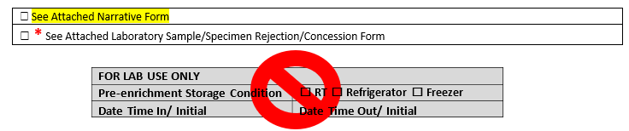
Environmental Sample Submission Form – Page 2 (part 2)
Notes:
This is the second page or back side to the environmental submission page.
The first column is where you put the Inspector #. The inspector # is the Sample number you will designate for each sample. Any numbering system can be used if the number never repeats for a different sample. For example, you can use the initials of the person who is conducting the swabbing / sampling and use a number right after. For example: I, Jessica Ferreira, is conducting the sampling and must collect 100 samples. I decided I would start the sample number with JF, and start with JF01, then JF02, then JF03….all the way to the last sample using JF100. Always double check the environmental sampling form with the labeled sampling bag to ensure they match and have the same number and the same sample description.
Sample Description is the next column. *For Environmental Swabs include the location and details of the sample, including the piece of equipment or smallware, the surface you swabbed, and in what location etc. For example, Hand wash sink -Main Line – Handles and spigot base. The description tells you what was swabbed, where the hand wash sink was located, and what specific areas of the hand wash sink were swabbed.
If you write a narrative on your environmental sampling, which is highly recommended, there is a section below to check off that you are going to attach it to the form. As shown on the screen this is for lab use only is only for the state lab to fill out.

Slide 18
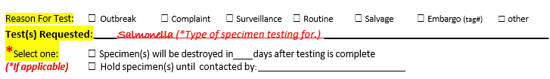
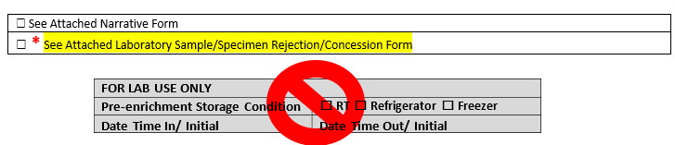
Environmental Sample Submission Form – Lab Only
Notes:
Two areas to take note of is…
The top area shown on the screen is located on the top section of page 1. It has a check box for specimen(s) will be destroyed in blank days after testing is complete. This area is really if there are any special instructions given by the state lab. With environmental swabs, the entire sample is consumed in testing so the state lab cannot save the sample. The second option noted on the form is "hold specimens until contacted by X" this is for the state lab to hold specimens until the submitter (BOH, DFP, or a Federal agency) gives permission for the state lab to destroy them.
The bottom section of the screen is located on the bottom of the second page of the form. There is a check box for “See Attached Laboratory Sample / Specimen Rejection / Concession Form. This is for the state lab only. This gets checked off when samples are rejected, and the submitter states recollection is impossible, and the sample must be tested to avoid adverse effects. In this situation, the state lab initiates a concession form which details why the sample was rejected and the reason for sample concession request. It then requires the Division Director, QA, and Laboratory Director approval to perform the testing.

Slide 19
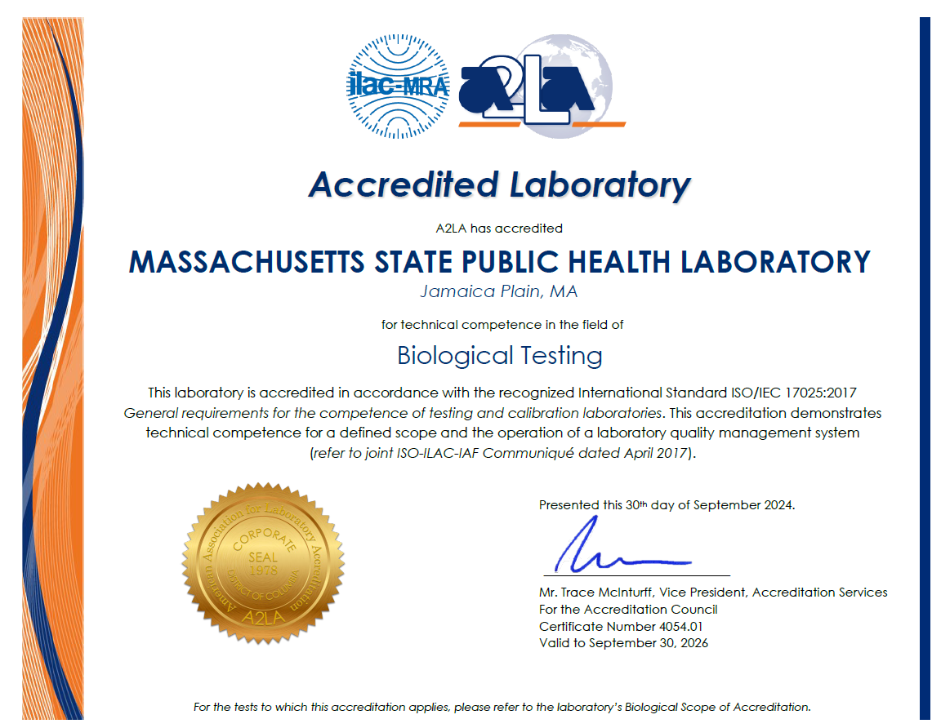
What the SPHL Tests For
Escherichia coli O157:H7 – Confirmation
E. coli O157:H7 – Screen
Listeria monocytogenes – Confirmation
L. monocytogenes – Screen
Salmonella spp. – Confirmation
Salmonella spp. - Screen
State Public Health Laboratory Services | Mass.gov
Notes:
This is a list valid until September 2026 for the type of tests the state lab can conduct for dairy and food samples. (*It gets updated annually.)This information is available on the State Public Health Lab services website. Go to mass.gov and type in state public health laboratory services in the search bar.
L mono, E.coli and Salmonella are the most common pathogens tested at the state lab.

Slide 20

Sample Criteria for Acceptance / Rejection
Transport Temperature: Keep all swab samples under refrigeration 36*F – 46*F (2*C – 8*C).
Shipping Requirements: Transport samples on ice
or on pre-frozen cold packs in appropriate packages.
If it is not done correctly the samples will be rejected!
Notes:
*It is very important to note that the samples must be delivered per the State Lab requirements.
During transit you must keep all samples under refrigeration. Shipping Requirements include the transport of samples on ice or on pre-frozen cold packs in appropriate packages.
This information is also available on the State Public Health Lab services website.
Remember if sampling is not done correctly the samples will be rejected by the state lab!
(*NOTE: This information is listed on the Manual of Laboratory tests and services (MLTS). It is listed under “Enteric Pathogens, Food.” This is available on the State Public health Lab services website (https://www.mass.gov/state-public-health-laboratory-services).

Slide 21
Aseptic Samples
Aseptic - to avoid contamination by your actions during the collection process itself.
Sampling method = the use of sterile containers and swabs + the use of recommended collection procedures.
Proper aseptic sample collection = effective enforcement action.
Notes:
The term “aseptic” means to avoid contamination by your actions during the collection process itself. For example, preventing bare hand contact with the sample or packaging during sampling.
This sampling method requires the use of sterile containers and swabs, and the use of recommended collection procedures per the state recommendations.
And again….proper aseptic sample collection is the standard of the state lab accepting the samples and an effective for enforcement action.

Slide 22

Important Reminders with Aseptic Samples:
Do nothing to contaminate the sample.
Maintain sterile sample equipment and aseptic sampling techniques.
Frequently wash and sanitize your hands between collection of samples when changing zone areas.
Notes:
Important reminders when handling aseptic samples:
The most important rule when collecting samples: Do nothing to contaminate the sample.
Maintain sterile sample equipment and aseptic sampling techniques throughout the collection.
And wash and sanitize your hands between collecting samples and when changing zone areas.

Slide 23
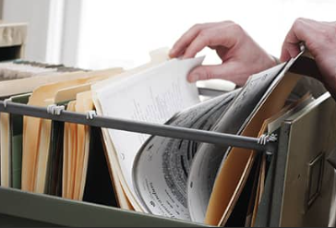


How to Prepare for the Investigation
Review the food history collected during the foodborne illness complaint interview.
Review previous inspection reports.
Prepare forms and get supplies ready.
Identify yourself to the PIC.
Explain the purpose of the foodborne illness investigation.
Notes:
When preparing for a foodborne illness investigation and prior to sampling:
1.) A complete a food history form must be completed with the complainant (s) over the phone using report my meal or in MAVEN. This will help in narrowing down a list of suspect foods to start the coordination of the environmental investigation.
2.) Review previous inspection reports of the food establishment. Note down any trends or repeat violations that have been noted. See if a HACCP Plan is on file and if needed take a copy with you.
3.) Identify yourself / show your credentials to the PIC prior to entering the establishment.
4.) Explain the purpose of the foodborne investigation, keep it short and sweet and be prepared for reactions. Stay calm, respectful and professional. Maintain unbiased. Encourage cooperation by explaining its is the LBOH responsibility to ensure practices and procedures are adequate to prevent foodborne illnesses and to investigate every complaint. In some cases, the investigation may prove the establishment is not involved or is responsible for the outbreak. Review the flow chart, preparation steps, equipment used, storage, etc. on site.

Slide 24

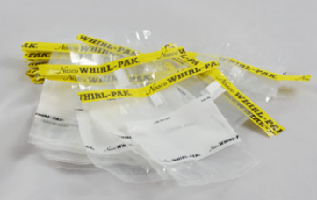
Conducting the Environmental Swabbing
Timing of Exercise – Min. 4 hours
Timing depends on the following criteria:
1.) How many samples can the lab process?
2.) If the person who is collecting the samples comfortable with conducting the exercise?
Notes:
Sampling activities may vary depending on how many samples need to be taken and if the lab can process the amount. It also may depend on if someone will be conducting the sampling activity by themselves or with a team of people who can help. It is best to have a team of 2 to 4 people to assist with the activity to streamline and make it go quicker. You can at least expect a minimum of 4 hours to conduct a sampling activity with 2 people.

Slide 25

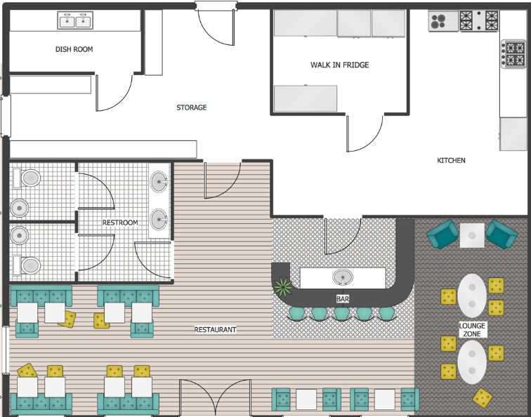
Other Important Factors
Conduct a facility assessment.
Understand the pathogen you will be sampling for and the niches in which they thrive.
Observe food establishment behaviors.
Notes:
Other important factors to include are:
Facility assessment – the flow of food, kitchen layout, equipment layout, and foot traffic of employees.
Request a map of the layout of the kitchen prior to conducting your sampling.
Write down areas and equipment you want to swab in connection with the investigation while you are conducting your walk-thru.
Understand the pathogen you will be sampling for and the niches in which they thrive.
- Zones / Areas where the pathogen is known to be. (We will discuss this further in the presentation.)
Food Establishment Behaviors.
- Write down notes on employee practices and other observations you observe while on site.

Slide 26
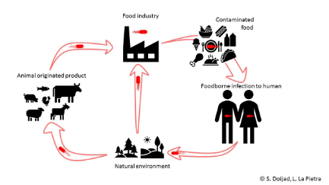
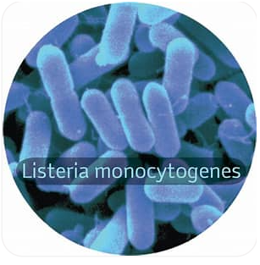
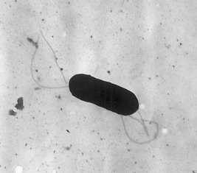
Type of Pathogens - Listeria monocytogenes
Notes:
Types of Pathogens at that are tested is L Mono:
This pathogen is associated with such foods as raw milk, allegedly pasteurized fluid milk, cheeses (particularly soft-ripened varieties), ice cream, raw vegetables, fermented raw-meat sausages, raw and cooked poultry, raw meats (all types), and raw and smoked fish.
It has the ability to grow at temperatures as low as 32*F (0°C) and permits multiplication in refrigerated foods.
Listeria is a foodborne illness of major public health concern because of the severity of the disease (meningitis, septicemia, and pregnancy complications such as miscarriage or stillbirth), has a high case-fatality rate, and a long incubation period.
Listeria monocytogenes differs from most other food-borne pathogens because it is widely distributed, resistant to diverse environmental conditions, including low pH and high sodium chloride concentrations, and is micro-aerobic.
The multiple ways it can easily enter food processing areas and its ability to grow and survive for long periods of time (whether in the environment, and in or on foods) under adverse conditions have made it a major concern for many manufacturing industries and food establishments in recent decades.

Slide 27
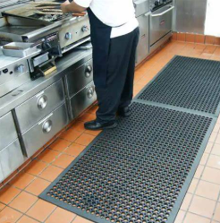
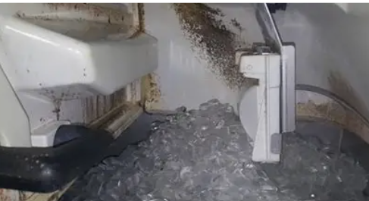
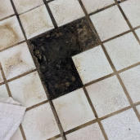
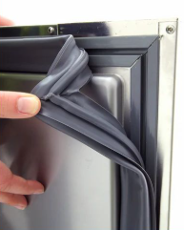
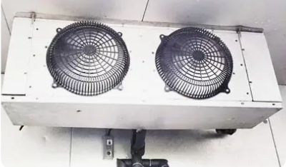
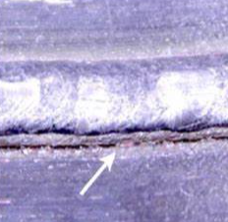
Areas Listeria monocytogenes Can Be Found
Zone 3
Zone 2
Zone 3
Zone 2
Zone 2
Zone 2
Notes:
Areas L. Mono can be found are:
Moist/wet areas with standing water.
Floors and related areas – Under floor mounted equipment, scales (floor and table mounted).
Air conveying equipment – pressurized air lines, air hoses, condensate from pressurized air lines, HVAC evaporators and evaporator condensate pans
Product conveyors – cables, belts, joints, where product residue accumulates, exposed bearings and rollers, sponge or felt rollers used to remove moisture from product.
Cracked equipment – boots (shock absorbing equipment), metal joints, etc.
Under sinks / safety stations – Under hand wash or eyewash stations if appearance of leaks, cracks, etc. are present.
Equipment – areas that are difficult to reach and clean, non- food contact surfaces, think nooks and crannies.
Doorways - floor area leading directly into production and food preparation areas.
Drains – Not during production.
Ice Makers – inside areas, scoops, underside of the top of the ice chamber.
Ceilings and Walls – in production / food prep areas and in coolers and freezers.
Door gaskets to coolers and freezers; damp insulation around pipes.

Slide 28
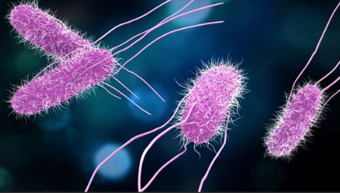
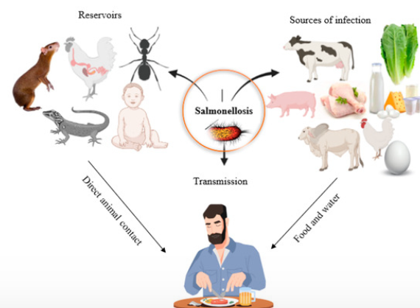
Type of Pathogens - Salmonella
Notes:
Salmonella:
Remains a major food safety concern throughout the world, is the major cause of bacterial foodborne illness in the U.S and is a pathogen of significant interest to FDA.
This pathogen is associated with such foods as raw meats, poultry, and eggs; the organism is also isolated from aquaculture products and fruits, vegetable, and nut meats. Salmonella outbreaks have been associated with a variety of foods, including raw seafood, fresh produce, egg products, cake mixes, unpasteurized milk, peanut butter, chocolate, and salad dressings.
Salmonella are known to survive and grow in the natural environment, including water sources.
It is universal and has been recovered from some insects and nearly all vertebrates and invertebrates. This makes the recovery and identification of Salmonella critical as an environmental contaminant.

Slide 29
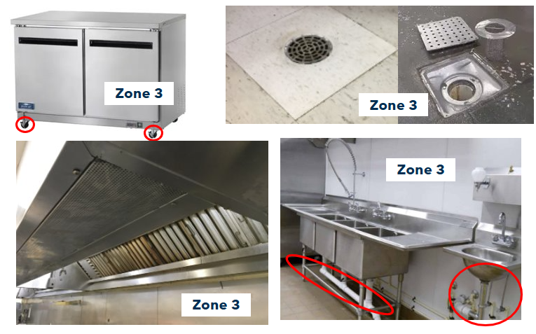
Areas Salmonella Can Be Found
Notes:
Areas you can find Salmonella are:
Floors and related areas – Under floor mounted equipment, scales (floor and table mounted).
Cleaning Equipment – central vacuum systems, automated floor cleaning equipment (e.g., Walk-behind or riding sweepers, brooms, mops, etc.)
Air conveying equipment – air filters; air ducts and intake and exhaust vents; food residue on equipment and floors if old and dry.
Product conveyors – cables, belts, joints, where product residue accumulates, if the residue is old and dry.
Unsealed control and drive chambers; electrical/ mechanical service boxes that are not cleaned and/ or sanitized. Look for dry dust and residue in these boxes.
Cracked equipment – boots (shock absorbing equipment), metal joints, etc.
Under sinks / safety stations – Under hand wash or eyewash stations if appearance of leaks, cracks etc. are present.
Equipment – areas that are difficult to reach and clean, non-food contact surfaces, nooks and crannies if dry.
Doorways - floor area in doorways leading into or out of the production facility / food prep areas.
Pallets – Floor under wooden or plastic pallets and pallets themselves.
Floor drains - use a sponge to scrub dry residue from floor drain grids and walls.

Slide 30
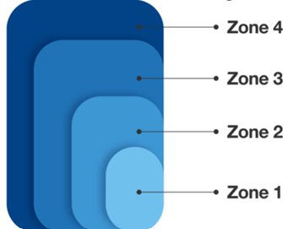
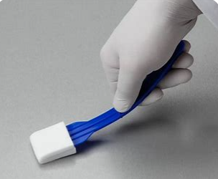
Zoning Considerations
ZONE 4:
Exterior of the Production Room
Break Room
Maintenance Room
Sanitation Cage / Chemical Storage
ZONE 3: Area immediately surrounding Zone 2:
Within the Production Room
Floors
Walls
Wheels on equipment (i.e. carts)
ZONE 2: Areas directly adjacent to Zone 1:
Adjacent to Product Contact
Non-Food Contact Surfaces
Table Legs, Conveyor Belts, Gear Boxes, Buttons on Equipment.
ZONE 1: Direct Food Contact Surfaces:
Utensils / Equipment
Production / Prep Table
Notes:
Zone consideration identifies and prioritizes from highest risk to closest to the product, to lowest risk and farthest from the product.
Zone 1 – Refers to all direct food contact surfaces.
Zone 2 – Encompasses the areas directly adjacent to food contact surfaces (Zone 1).
Zone 3 – The area immediately surrounding Zone 2. Zone 3 is an area which, if contaminated with a pathogen, could lead to contamination of Zone 2 via actions of people or the movement of machinery.
Zone 4 - The area immediately surrounding Zone 3, generally considered a remote area. Zone 4 is an area which, if contaminated with a pathogen, could lead to contamination of Zone 3 via the actions of people or machinery.
A zone chart is provided in the resource guidebook we will discuss at the end of the presentation.

Slide 31

Preparing for The Sample Collection
Review your facility assessment.
Environmental Sample Submission Form (COC).
Then do the same on the sample Whirl-Pak bags.
Helps the swabbing to go a little more quickly and efficiently!
Remember to check the bags as you fill and seal and make sure the same information is on the Environmental Submission Form (COC).
Notes:
Preparing for the sample collection. Start by:
Reviewing your facility assessment and write down final areas and equipment you want to swab.
Write these on the Environmental Sample Submission Form (COC) and write down the Inspector# (Sample#.) Then do the same on the sample bags.***This helps with the swabbing to go a little more quickly and efficiently.
Remember to check the bags and make sure the same information is on the Environmental Submission Form (COC). Ensure they match!!!

Slide 32
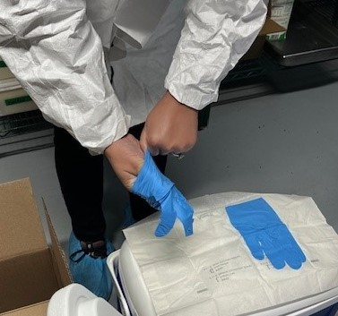
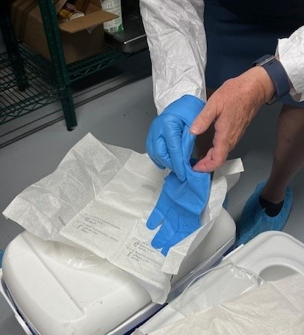
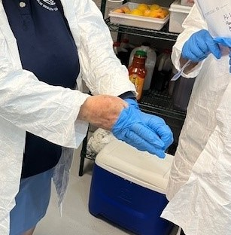
Step by Step – Swabbing Exercise
Notes:
To start the process of environmental sampling you must start by…Putting on personal protective equipment (known as PPE) Including as a Hairnet, Disposable Suit / Covering, and Booties.
Wash your hands, and then you can don the sterile gloves. The next slide will show a video on how to properly to this.
It is important to note that you can use the same gloves in between swabbing areas as long as the swabbing is in the same area, but not the same 'zone'. For example, the handle of a deli slicer would be one swab and /or sponge, and the under-arm of the blade would be another swab and/or sponge, but no need to change gloves.
However, a drain near a stove and a drain near the 3-bay are the same zone, but a change of gloves would be required as they are the same zone…but different areas.
You can use hand sanitizer between glove changes to make it easier but must wash your hands when you first start the sampling activity.

Slide 33

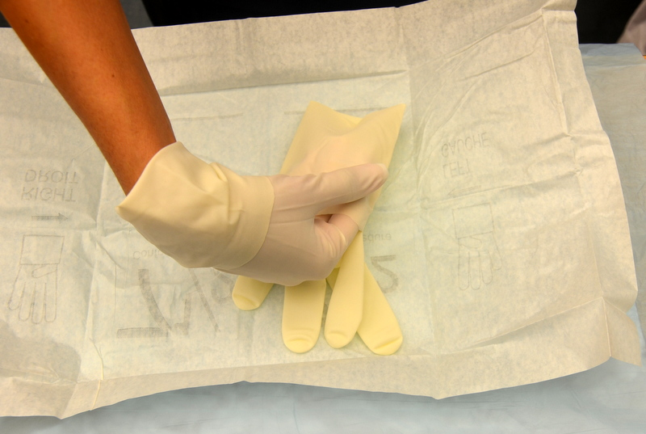
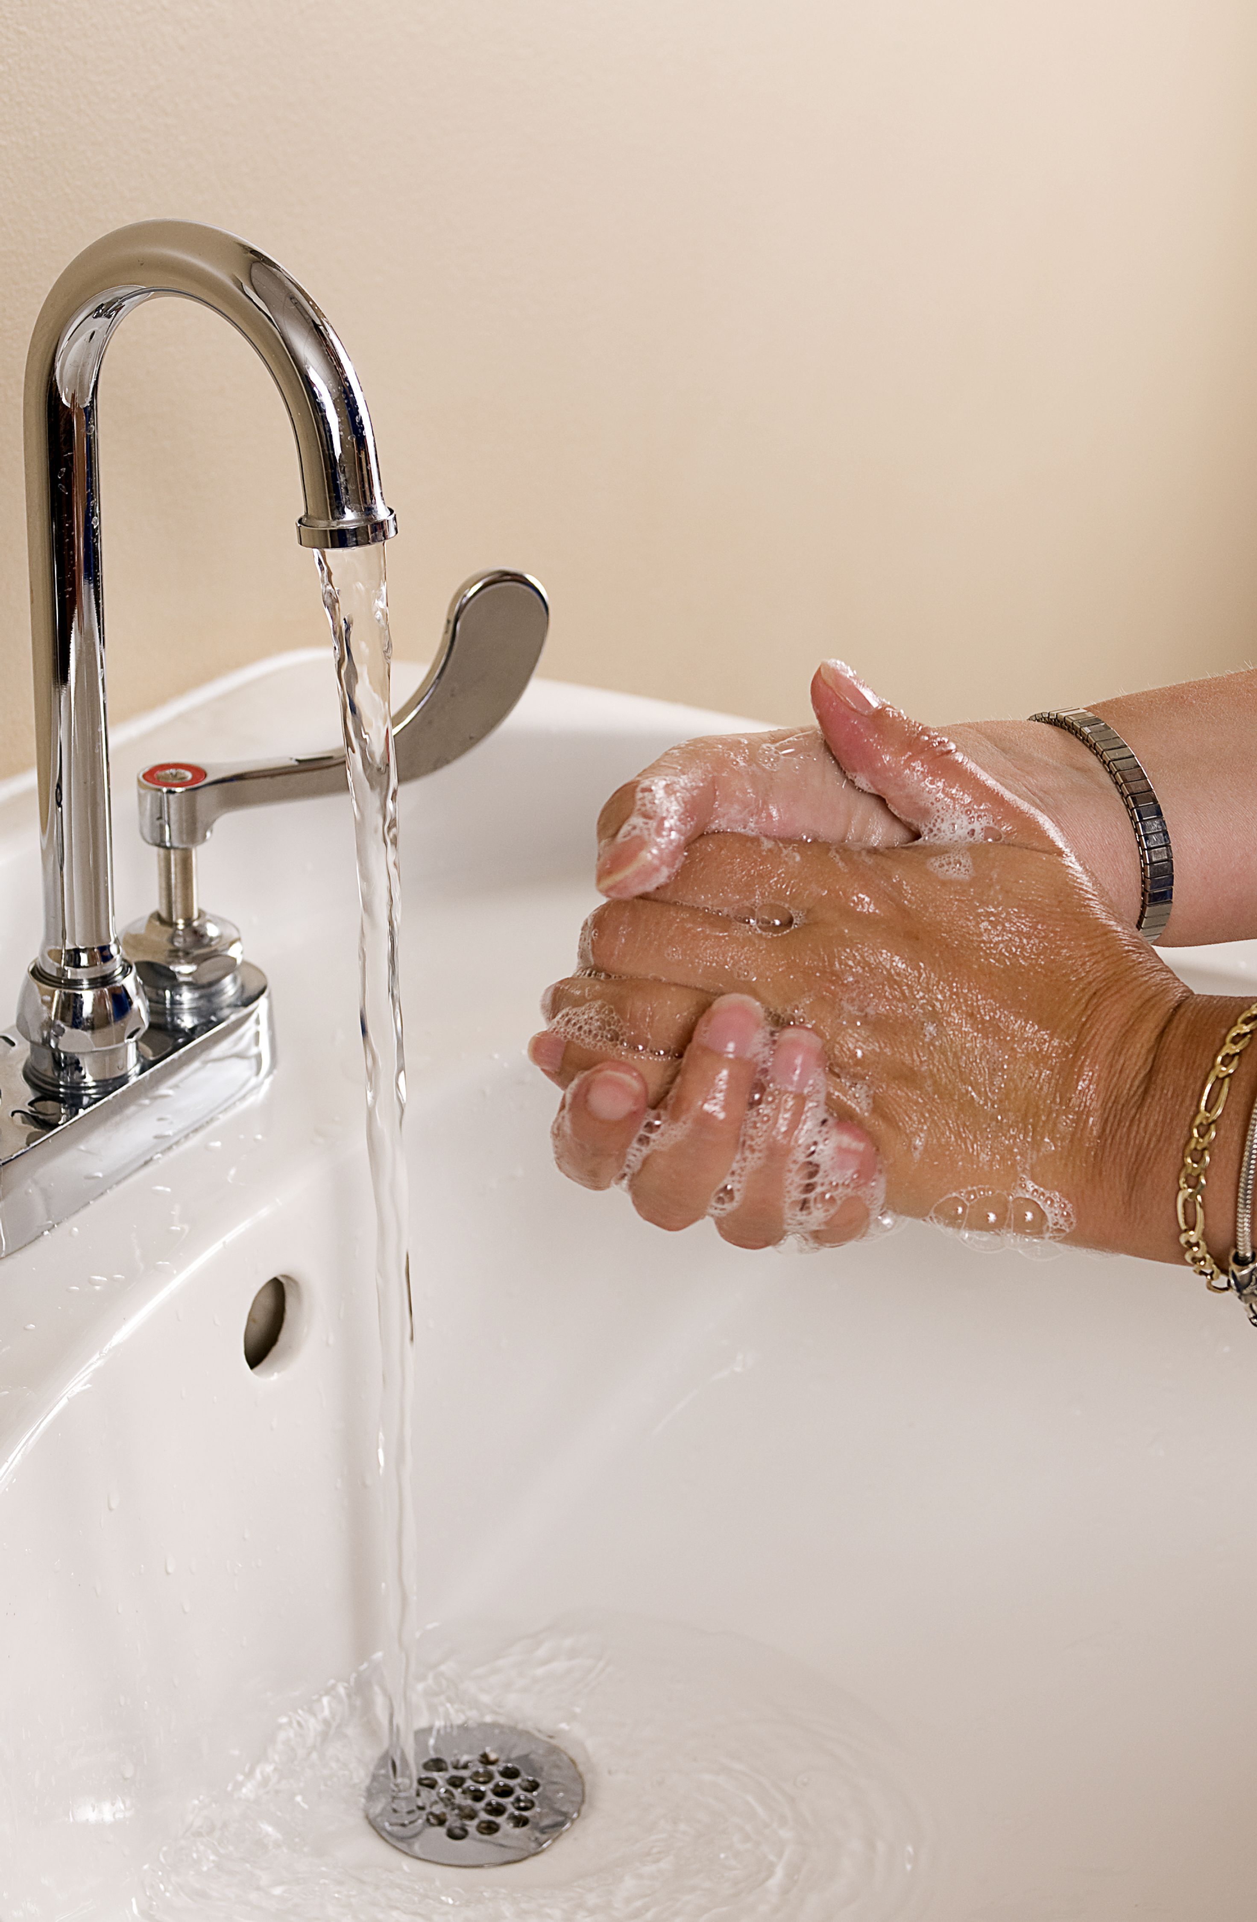
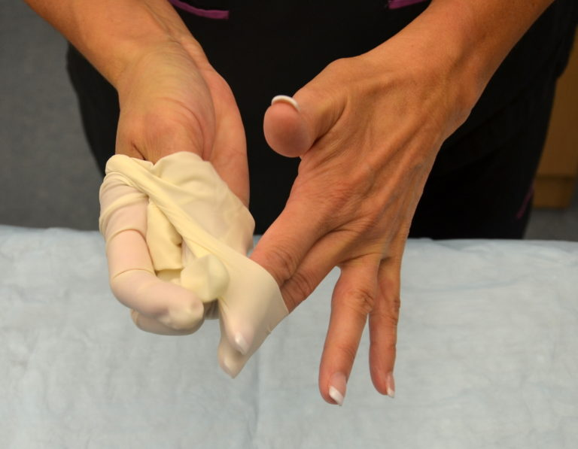
Prevent Contamination of Swabs Samples
Wash and Watch
where you put
your hands.
Notes:
Prior to donning gloves, you must wash your hands appropriately! It is also important to remember after donning the gloves to not touch anything to contaminate them!

Slide 34
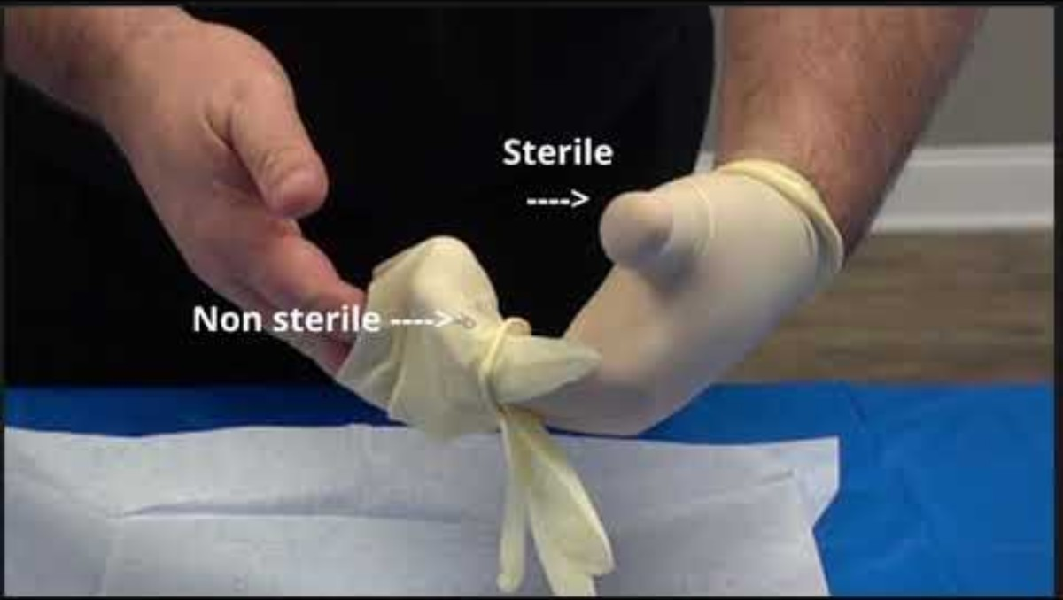
Donning and Doffing Gloves
How To Get Supplies
Notes:
This video will show you how to properly don and doff gloves to avoid contamination of samples.
Video Time: 2:37 minutes
You tube:*NOTE: Press Ctrl and then click on the link
Donning and Doffing Sterile Gloves
https://youtu.be/oiPXywMNqFw?si=ad5wpzd54k2EFbrz

Slide 35
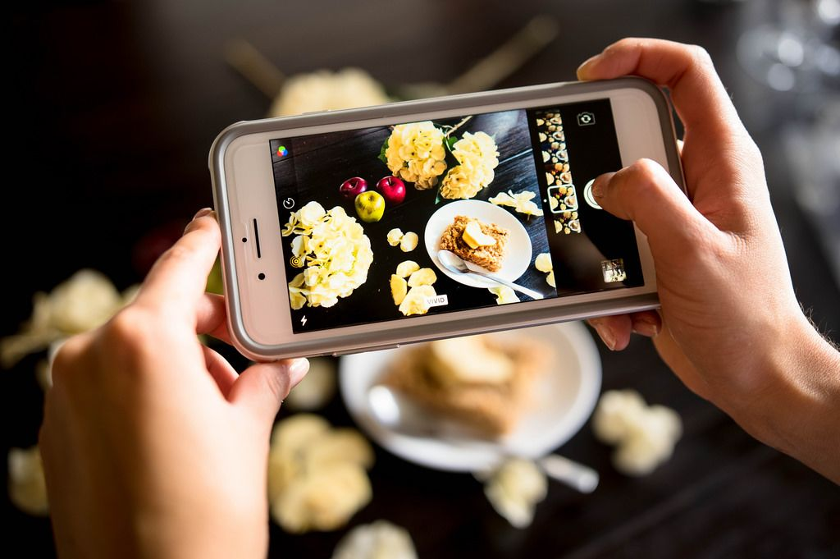

Step by Step - Sample Sites
Take detailed notes and pictures of sample locations.
  Write details on the possible source of contamination of the food product or piece of equipment that was used.
  Describe the location of the sample to where the food was exposed.
  Take notes on the proximity of the sample location to the food preparation areas and the likelihood of cross-contamination between the swabbed surface and food or food contact surfaces.
  Take pictures of where exactly the samples were taken.
  Show the whole picture. (Far way and up close)
Notes:
It is important to take detailed notes of sample sites and take pictures to help show the bigger picture and to reference in the future. Especially if there is a positive hit.
It helps to document the possible link between the source of an environmental sample and contamination of the food product using both written descriptions and photographs.
On the environmental sample form make sure to describe the location of the sample in relation to areas where food is exposed and any mechanical or human activities you observe that might cause a pathogen to be spread beyond this area.
The division’s response to a positive swab will depend on the proximity of the sample location to the food preparation areas and the likelihood of cross-contamination between the swabbed surface and food or food contact surfaces.

Slide 36
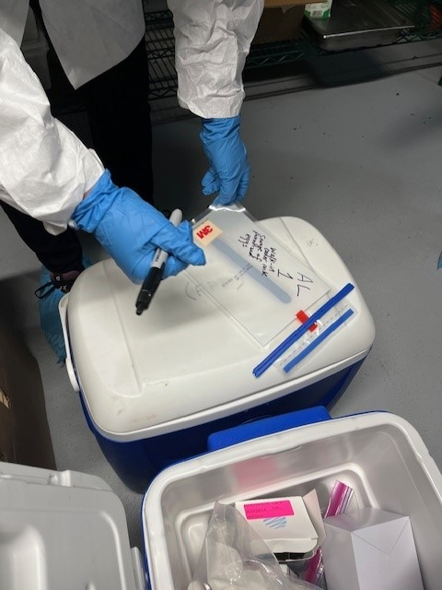
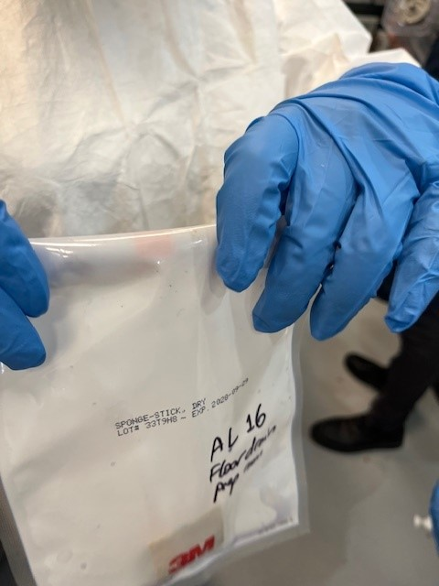
Step by Step – Swabbing Exercise (part 1)
Notes:
After you wash your hands and don gloves… you will….
If not already done, you will prepare the sample bags by labeling the bag with the name of the sampling site and the designated Inspector # (aka Sample #). *It is best to have this written towards the bottom of the bag, as you will have to roll the top down after you collect the sample!
Remember this is the same information you put on the Environmental Sample Submission Form (COC)!

Slide 37
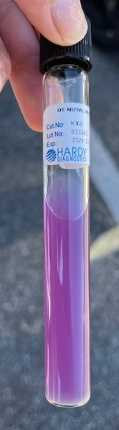
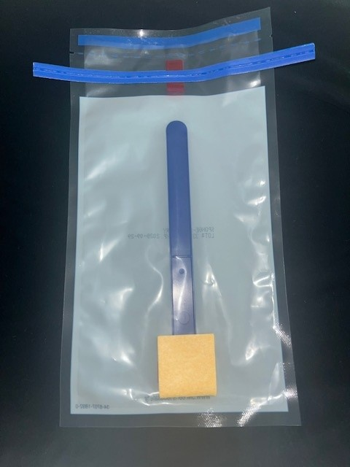
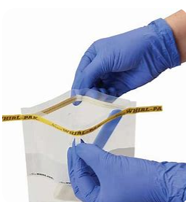
Step by Step – Swabbing Exercise (part 2)
Whirl Pak with Sponge Stick
DE Broth
Notes:
This is one media type used called DE broth and a whirl pak with a sponge stick.
If using DE broth you would start the process by taking the whirl pak bag and manipulating the handle of the sponge stick toward one side of the bag. Do not put your hands inside the bag to move the stick. Pull off the top of the whirl-pak bag holding the Sponge-stick along the perforation. Using the tabs on both sides of the wired band, pull gently to open the bag. Do not remove the Sponge-stick.
Pour 9-10 ml or sufficient volume of the DE neutralizing broth into the bag on the side away from the handle to hydrate the sponge (do not get broth on the handle). Be careful not to touch the opening of the broth container to any non-sterile surface before or during this transfer to the bag.
***There is also an option to get pre-moistoned sponges with broth already within a whirlpak bag. You would just have to manipulate the handle is the same manner.

Slide 38
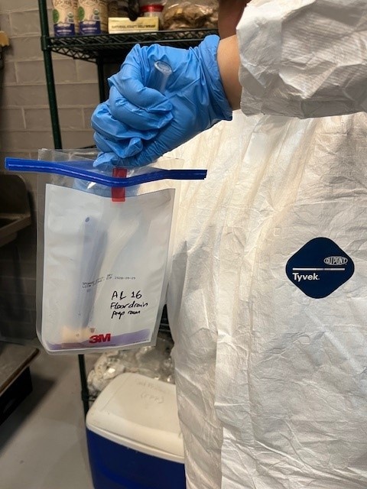
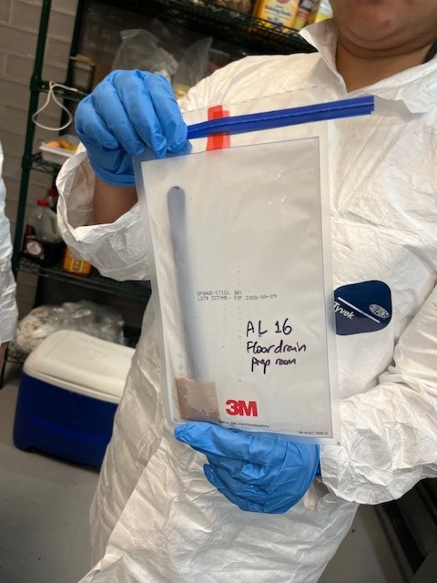
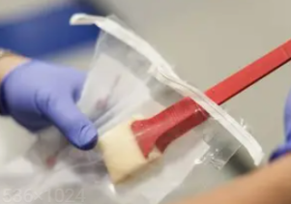
Step by Step – Swabbing Exercise (part 3)
Notes:
Massage the sponge through the outside of the bag to facilitate absorption. From the outside of the bag, push the Sponge-stick to the upper portion of the bag.
While pushing the sponge-stick up from the bottom of the bag, squeeze excess D/E broth from the sponge back into the bag. By pushing the sponge stick up it will expose the handle out from the bag. Allowing to grab the handle without contaminating inside the bag with your hands.
Note the sponge should be moist but not dripping wet.

Slide 39
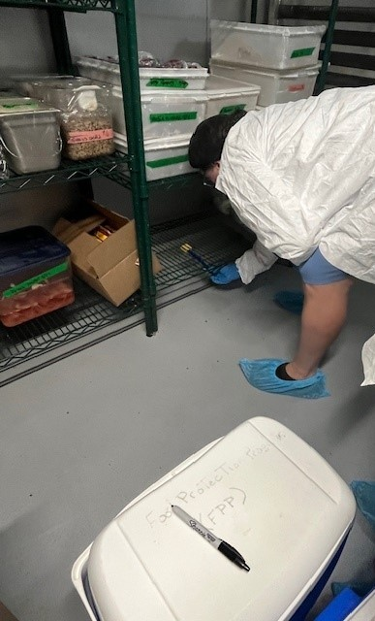
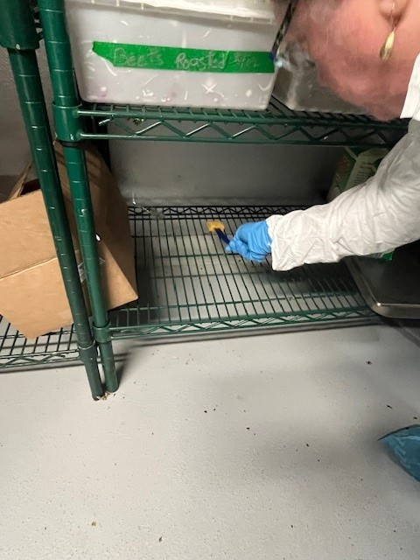

Step by Step – Swabbing Exercise (part 4)
Notes:
Remove the Sponge-stick from the bag using your gloved hand.
Using even and firm pressure, push the sponge in one direction across the desired area of the environmental surface 10 times vertically, then 10 times horizontally.
If visible soil or residue is present, sample the surface by vigorously rubbing the sponge over the designated area until the soil or residue is removed. (*for example, residue / build up in a drain.)

Slide 40



Step by Step – Swabbing Exercise (part 5)
Notes:
After sampling, return the sponge to the original Whirl-Pak bag with any excess buffer. Do not put the handle in the bag.
Snap off the handle in accordance with the product instructions that accompany the Sponge-stick. Here the sponge was snapped off by moving the handle back and forth until the sponge was broken off and fell into the bag. The handle was then discarded.
Only the sponge should remain in the bag.

Slide 41


Step by Step – Swabbing Exercise (part 6)
Notes:
Roll the top of the bag over several times until it is folded all the way down to the sponge.
Fold in the tabs to lock the fold in place. The bag must be tight enough to provide both a leak proof seal and minimal airspace during shipment of the moistened sponge.
Ensure the inspector sample number is showing and not covered up.

Slide 42


Step by Step – Swabbing Exercise (part 7)
Notes:
Place the bagged sponge inside an insulated cooler, with bagged ice or pre-frozen gel packs to keep the samples cold, but not frozen.
Call the state lab right away to provide them with an estimated timeframe in which you will arrive at the lab.
Transport/ship the samples to the servicing lab for analysis and it is received by the lab within 24 hours of collection.

Slide 43


Step by Step – Swabbing Exercise (part 8)
***Important to Note—Ensure the food establishment / LBOH staff cleans and sanitizes any surfaces after you have sampled.***
Notes:
Lastly but most importantly…
Ensure to discard any trash and used gloves while conducting the sampling activity as you go.
It is very very very important to ensure the food establishment or LBOH staff who are assisting cleans and sanitizes any surfaces that are touched with the swab right after you have finished sampling! This ensures the broth does not activate anything if it is present and does not spread the pathogen!

Slide 44

Conducting an Environmental Assessment
Notes:
This is a video DPH Division of Food Protection did some time back and will show you how an environmental assessment is conducted and how a sample collection activity is done within a manufacturing facility. This will at least give you an idea of how this activity is done if you have never done it before.
Video Time: 21 minutes
*NOTE: Press Ctrl and then click on the link
https://youtu.be/yt_g-mAmhcs?si=3pRjvbR8wCi_Q7J3

Slide 45
Reminder—coordinate with SPHL
It’s essential to coordinate with the state public health laboratory (SPHL) prior to conducting sampling and only IF you are sending samples to them.
Once sampling has been completed you must call the state lab and give them an estimated time of arrival.
State Public Health Laboratory: 617-983-6616
For technical assistance with the collection protocol for food and enteric specimens.
Notes:
Again, coordination is key with the state lab before and after the sample collection has been conducted. Once the activity has been completed you must call the state lab and give them an estimated time of arrival.

Slide 46
Other Important Contacts
Division of Food Protection: 617-983-6712
For policy and technical assistance with the environmental investigation such as conducting a HACCP risk assessment, initiating enforcement actions and collecting food samples. On-site investigation assistance is available through the Division for larger outbreaks.
Division of Epidemiology: 617-983-6800
For assistance with the epidemiologic investigation including conducting case interviews, developing questionnaires, and performing analytic studies. Epidemiologists can also assist with coordinating food handler stool testing at the State Public Health Laboratory.
Notes:
Here are two other departments who are involved with environmental sample collection. The Division of Food Protection and the Division of Epidemiology.
The Division of Food Protection assists with training and technical assistance if needed.
The Division of Epidemiology helps narrow down and identifies food products and or areas of concern where to test.

Slide 47

Helpful resources
MA DPH - Foodborne Illness Investigation and Control Reference Manual (Feb 2019)
  Foodborne Illness Investigation and Control Manual | Mass.gov
MA DPH - Environmental Sample Submission Form
FDA 2024 Operations Manual – Chapter 4 - Sampling
Notes:
Here are some helpful resources. The DPH foodborne illness manual can be found on the mass.gov website as well as the environmental sample submission form. Some other helpful information can be found in the FDA Operations Manual which can be found on the FDA website and putting it into the search bar.
On the right side of the screen, I have created an environmental sampling resource guide to help if you ever get requested to perform this activity by the state. We don’t expect you to remember everything from the presentation and wanted a resource guide to provide you with all the information and pictures on all the steps from preparation to doing the actual activity, to showing you how to fill the form out appropriately and provide you with a zone chart and how to properly don and doff gloves. You can gain access to this document either by reaching out to me or Mark Carleo or signing up for a MA Resource Page on Foodshield. I have a sign-up sheet at my table outside of this room, come see me after the presentation and I can set you up.
There will also be an opportunity to get this training through your training as as well.

Slide 48

Special Thank You!
Sudbury BOH
&
Kristie Ferreira,
Deputy Director DFP
Notes:
Big Shout out to the Sudbury Board of Health, especially Vivian Zeng and her Regional Health Agent, Ann Loree. Specifically with their assistance on this project in conducting this activity while we captured every moment of it and providing feedback to help make this training better for LBOH.
Also, to Kristie Ferreira, now deputy Director for the Division of Food Protection, whose subject matter expertise with lab background information helped me get this project up and running and into fruition.

Slide 49

Q&A
Jessica L. Ferreira, CP-FS
Environmental Analyst III, Food Safety Trainer
Division of Food Protection - Retail Food
Email: Jessica.l.ferreira@mass.gov
Notes:
Questions?

Slide 50



Connect with DPH
@MassDPH
Massachusetts Department of Public Health
mass.gov/dph

